Slide 1
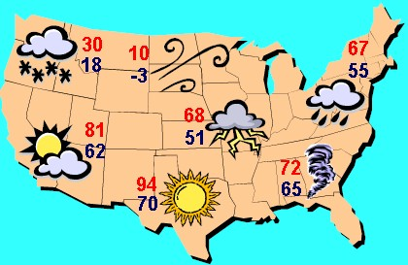
Weather

Slide 2
Weather Variables
Create a page in your SNB labeled WEATHER
Make a list of variables that contribute to weather

Slide 3
Weather Variables
Weather
Atmospheric conditions of a certain place at a certain time

Slide 4
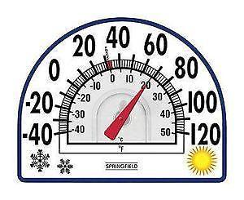
Weather Variables
Air Temperature
Measure of average kinetic energy of molecules in air
High kinetic energy = high temperature

Slide 5
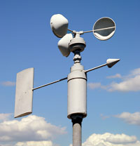
Weather Variables
Wind
Created when air moves from areas of high pressure to areas of low pressure
Direction=where wind is blowing from
Measured with anemometer

Slide 6
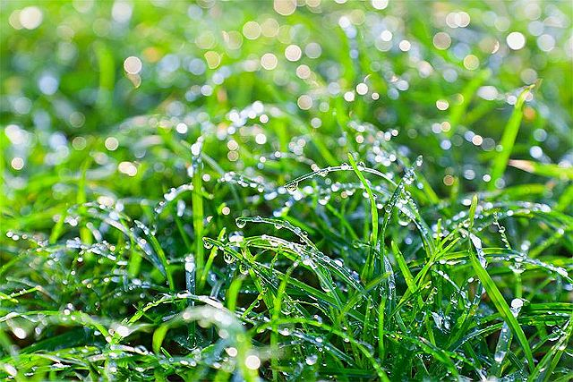
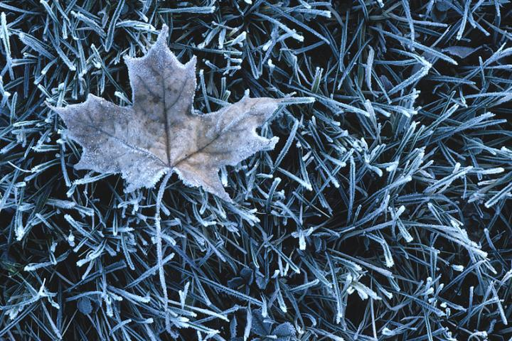
Weather Variables
Dew Point
Temperature at which air is fully saturated because of decreasing temperatures while holding the same amount of moisture constant
Water vapor condenses and forms dew droplets or frost

Slide 7
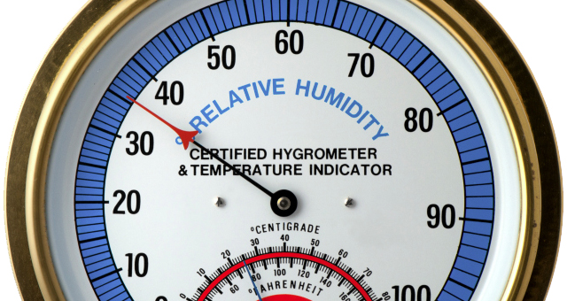
Weather Variables
Humidity
Amount of water vapor in air
High humidity=more water vapor
Relative Humidity
Amount of water vapor in air compared to maximum amount air could contain at that temperature
Measured in percent

Slide 8
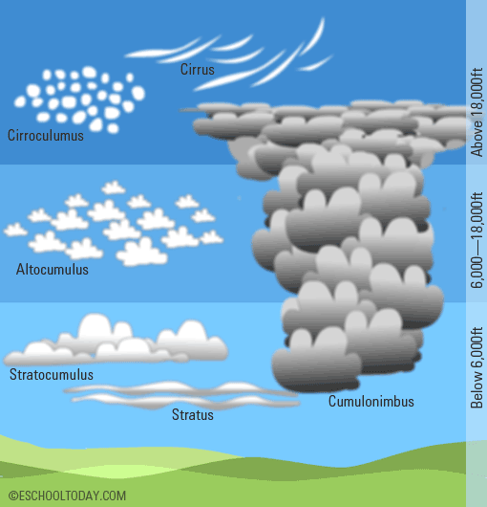
Weather Variables
Clouds
Water droplets or ice crystals suspended in the air
Fog
A cloud that forms near earth’s surface

Slide 9
Weather Variables
Precipitation
Water, in liquid or solid form, that falls from the atmosphere
Rain
Droplets of water
Snow
Solid, frozen crystals of water
Sleet
Snow melts and refreezes
Hail
Large pellets of ice formed by being up drafted into a cloud several times

Slide 10
Weather Variables
The Water Cycle

Slide 11
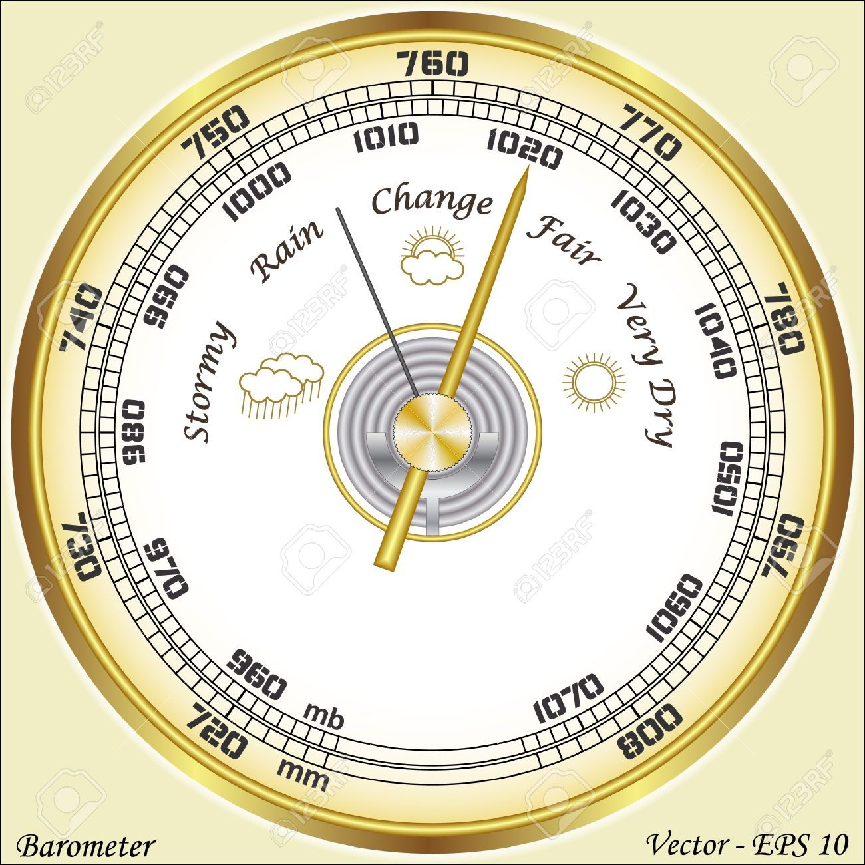
Weather Variables
Air Pressure
Force that a column of air applies on the air or the surface below
Altitude increases - air pressure decreases
Barometric pressure=air pressure
Measured mb by a barometer

Slide 12
Pressure Systems
High Pressure
A large body of circulating air with high pressure at its center and lower pressure outside the system
Air moves away from center
Air sinks
Clear skies and fair weather

Slide 13
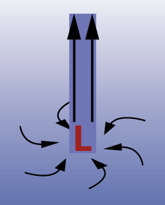
Pressure Systems
Low Pressure
A large body of circulating air with low pressure at its center and higher pressure outside the system
Air rises
Air cools and water vapor condenses
Forms clouds and sometimes precipitation

Slide 14
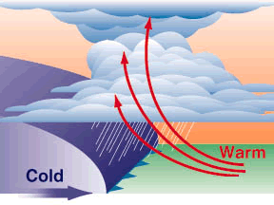
Fronts
Weather Front—boundary between two air masses
Cold Front
A colder air mass moves toward a warmer air mass
Cold air pushes under the warm air
Warm air rises and cools
Water vapor condenses, clouds form
Showers and thunderstorms form

Slide 15
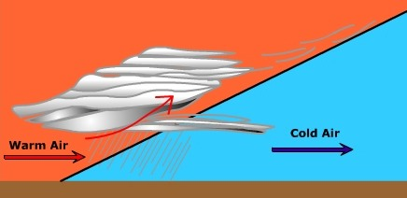
Fronts
Weather Front—boundary between two air masses
Warm Front
Less dense warmer air moves toward colder, denser air
Warm air rises above cold air mass
Water vapor in warm air condenses, Blanket of clouds form
Steady rain or snow

Slide 16
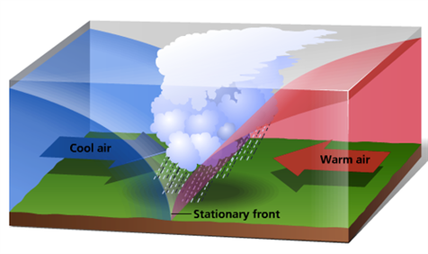
Fronts
Weather Front—boundary between two air masses
Stationary Front
Approaching front stands still for days
Warm air on one side and cold air on the other
Cloudy skies, light rain

Slide 17
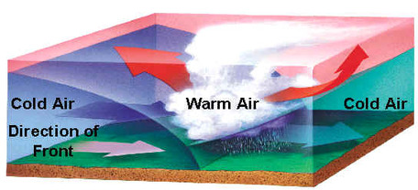
Fronts
Weather Front—boundary between two air masses
Occluded Front
Flow-moving fast-moving cold front catches a slow-moving warm front
Brings precipitation

Slide 18
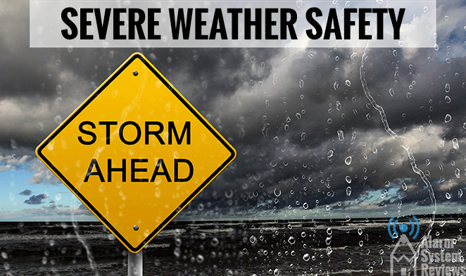
Severe Weather Safety
Watch
Severe weather is possible
Warning
Severe weather is already occurring

Slide 19
Weather Forecasting
Surface Reports
Weather measurements made on the Earth’s surface
Measured by weather stations
Report wind direction and speed, temperature, air pressure, humidity, and precipitation

Slide 20
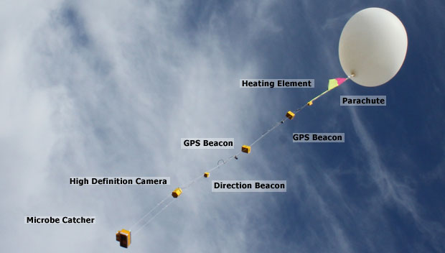
Weather Forecasting
Upper-Air Reports
Describes wind, temperature, and humidity conditions above Earth’s surface
Measured by radiosonde and carried by weather balloons

Slide 21
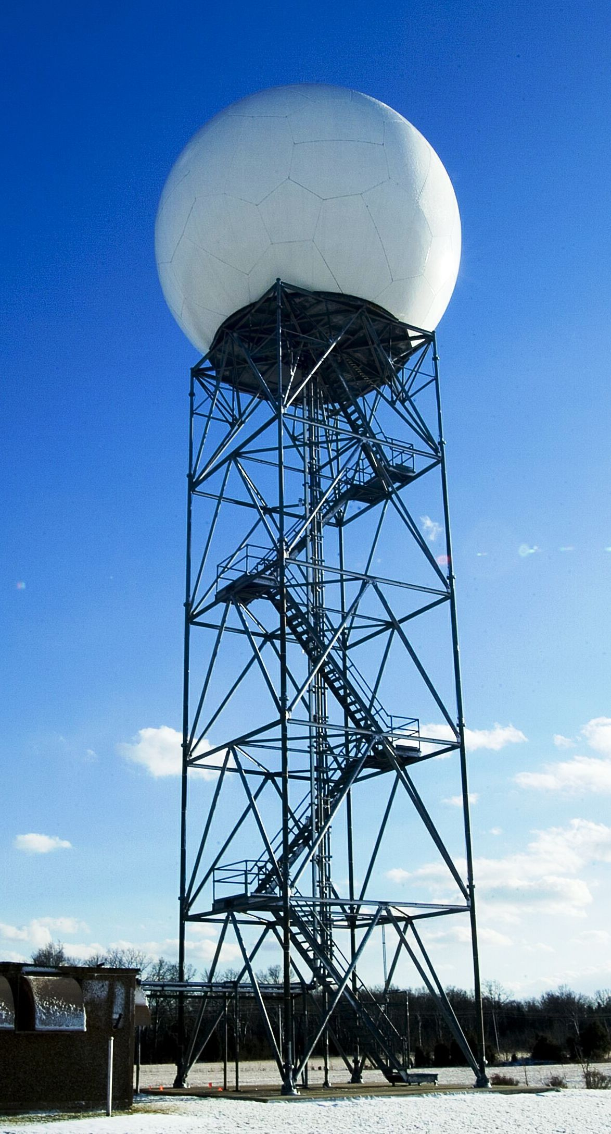
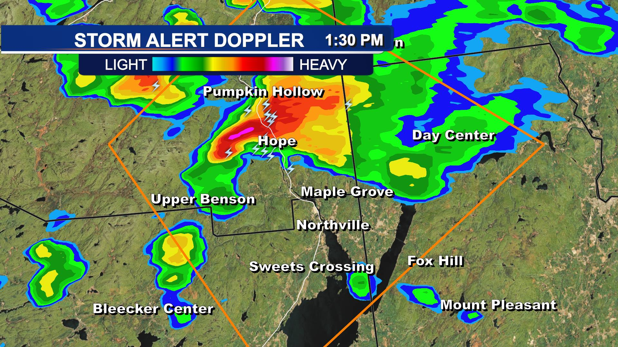
Weather Forecasting
Doppler Radar
Specialized type of radar that can detect precipitation as well as the movement of small particles (used to measure wind speed)

Slide 22
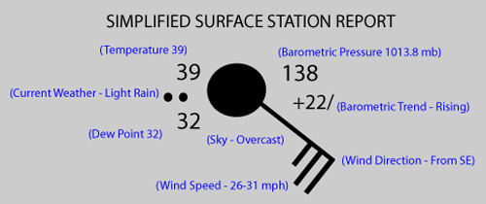
Weather Forecasting
Station Model
Contains information about weather variables
Uses numbers and symbols

Slide 23
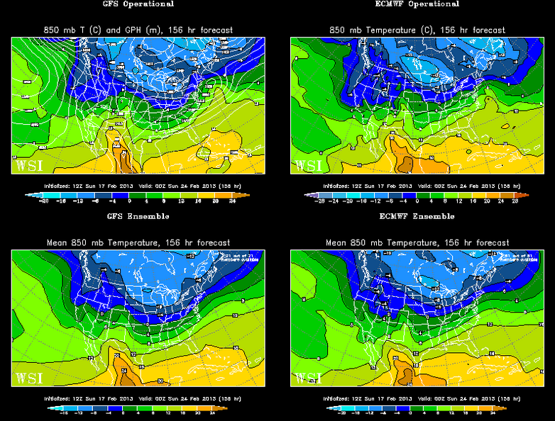
Weather Forecasting
Computer Model
Detailed computer programs that solve a set of complex mathematical formulas
Predict temperature, wind, clouds, rain, snow

