Slide 1
Newton’s Laws of Motion

Slide 2
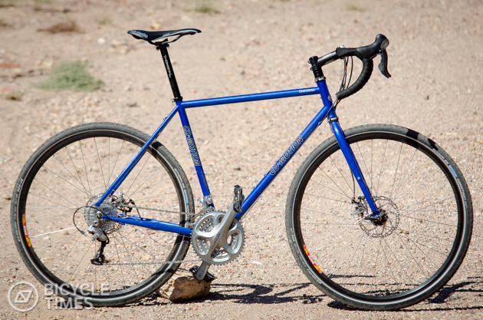
Newton’s 1st Law
If the force on an object is zero, the motion of the object does NOT change!

Slide 4
Newton’s 1st Law
Balanced
Forces
NO change in velocity
(speed or direction)
Unbalanced
Forces
Change in velocity
(speed or direction)

Slide 5
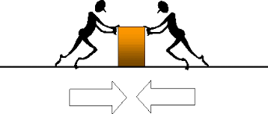
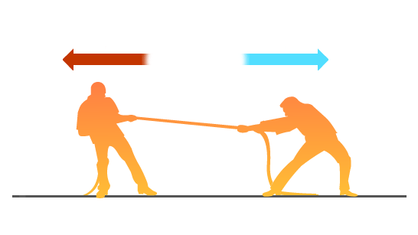
Newton’s 1st Law
Balanced
Forces
Unbalanced
Forces

Slide 6
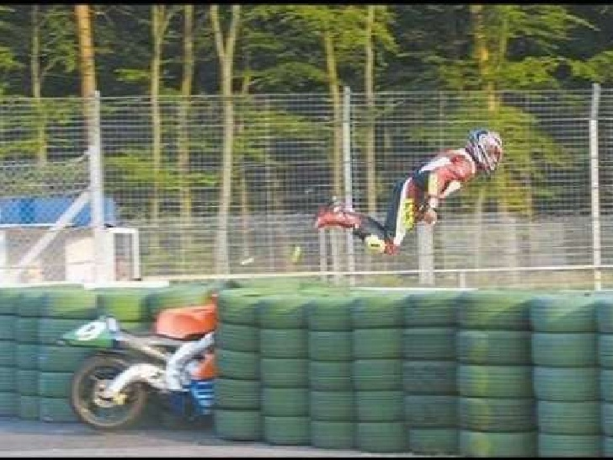
Newton’s 1st Law
Inertia
Tendency of an object in motion to resist a change in its motion

Slide 7
Newton’s 1st Law
Movement
Start Moving=force greater than static friction
Keep moving=force as strong as friction
Stop moving=friction or another force acts on an object

Slide 8
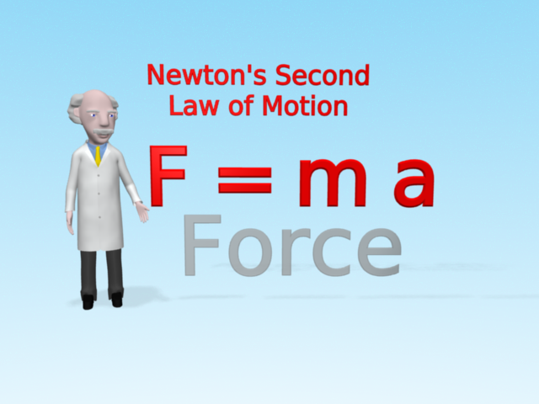
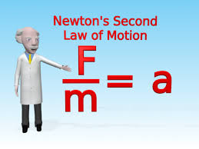
Newton’s 2nd Law
The acceleration of an object is equal to the net force acting on an object divided by the object’s mass.
F=force m=mass a=acceleration

Slide 10
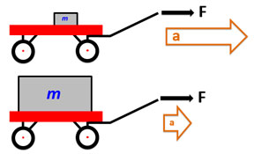
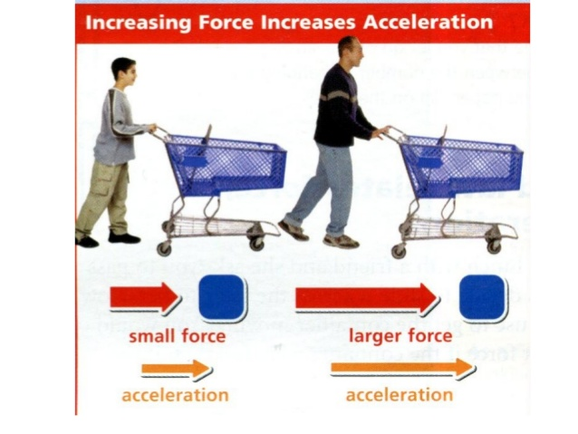
Two ways to increase acceleration:
Newton’s 2nd Law
1. Increase mass
2. Increase force

Slide 11
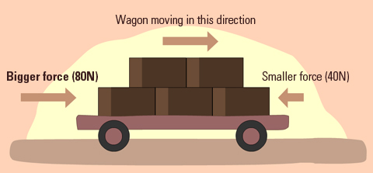
Newton’s 2nd Law
Unbalanced Forces on an object at rest =
object begins moving in direction of net (bigger) force

Slide 12
Newton’s 2nd Law
Unbalanced Forces on a moving object =
change in acceleration
Speed Up = Positive Acceleration
Increasing speed
Increasing velocity
Slow Down = Negative Acceleration
Decreasing speed
Decreasing velocity
Change direction

Slide 13
Circular Motion
Newton’s 2nd Law
Any motion in which an object is moving along a curved path

Slide 14
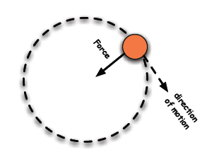
Centripetal Force
Newton’s 2nd Law
In circular motion, a force that acts perpendicular to the direction of the motion (towards the center of the curve)

Slide 16
Newton’s 3rd Law
When one object exerts a force on a second object, the second object exerts an equal force in the opposite direction on the first object.

Slide 18
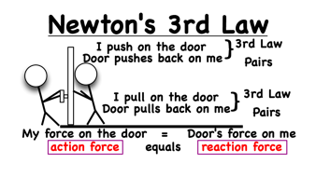
Newton’s 3rd Law
Force Pair
The force two objects apply to each other
Action Force: force you apply
Reaction Force: force applied by the object

Slide 19
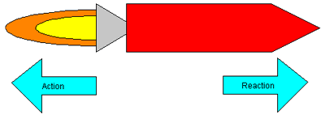
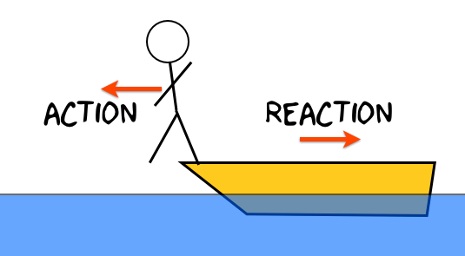
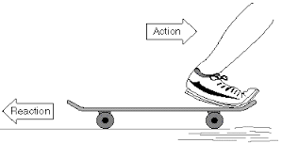
Newton’s 3rd Law

Slide 20
Newton’s 3rd Law
Momentum
A measure of how hard it is to stop a moving object
Momentum = mass x velocity (p = m x v)
More mass = more momentum
More speed = more momentum

Slide 21
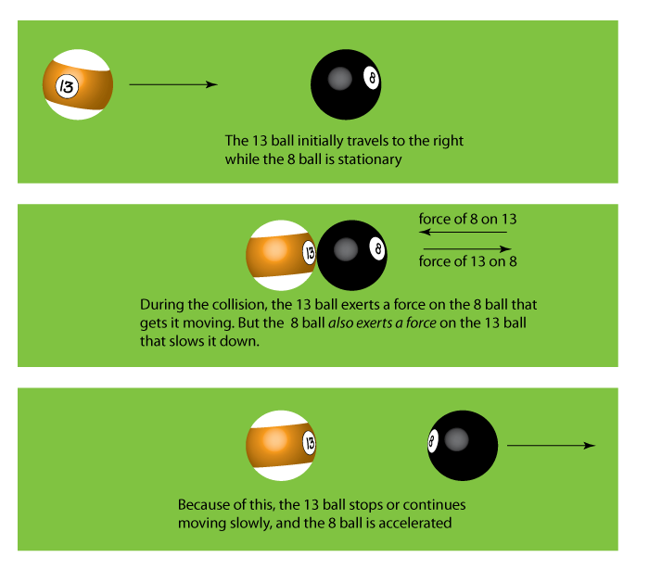
Newton’s 3rd Law
Law of Conservation of Momentum
The total momentum of a group of objects stays the same unless outside forces act on the object

Slide 22
Newton’s 3rd Law
Forces to Stop Momentum
Elastic Collision
Objects collide and bounce off each other
No net loss of kinetic energy in the system

Slide 23
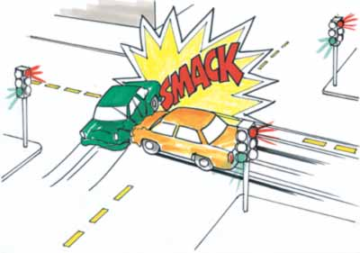
Newton’s 3rd Law
Forces to Stop Momentum
Inelastic Collision
Objects collide and stick together
There is a loss of kinetic energy
It is transferred to something else

