Slide 1
Natural Resources

Slide 2
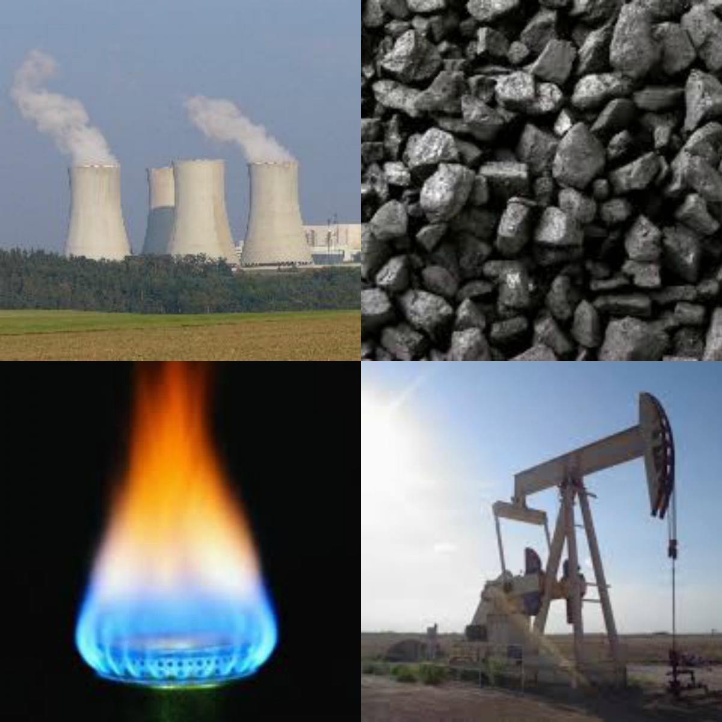
Sources of Energy
Nonrenewable Resources
Resources used faster than they can be replaced by natural processes
Provide 93% of energy

Slide 3
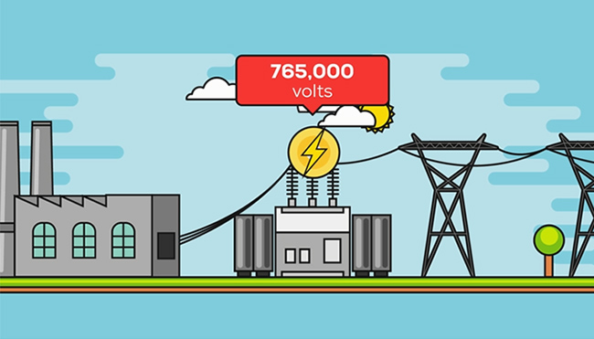
Sources of Energy Nonrenewable Resources
Fossil Fuels
Advantages
Easy to transform chemical energy to electric energy
Relatively inexpensive
Easy to transport

Slide 4
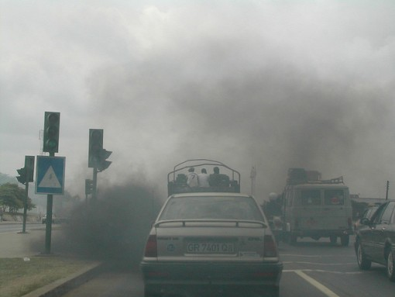
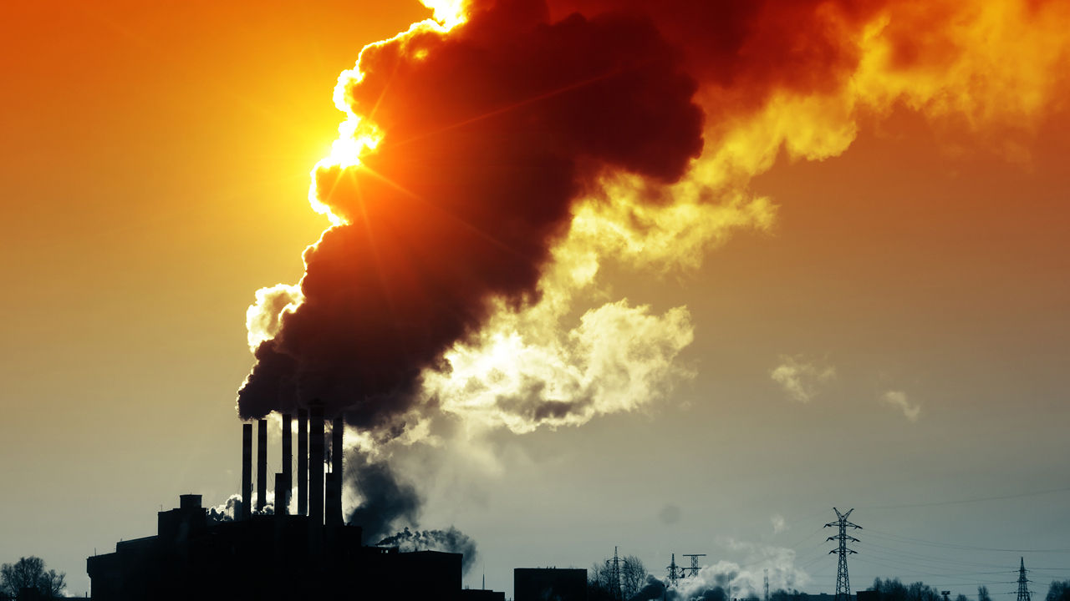
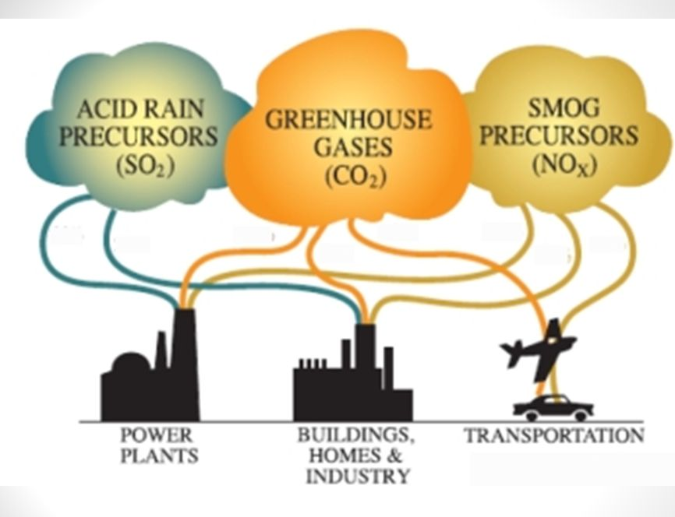
Sources of Energy Nonrenewable Resources
Fossil Fuels
Disadvantages
Limited supply (nonrenewable)
Habitat disruption
Pollution
Run-off
Burning

Slide 5
Sources of Energy Nonrenewable Resources
Fossil Fuels
Type of fossil fuel depends on:
Type of organic matter
Temperature and pressure
Length of time buried

Slide 6
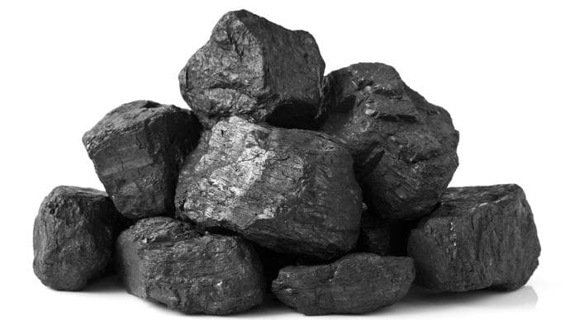
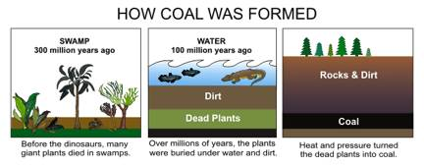
Sources of Energy Nonrenewable Resources

Slide 7
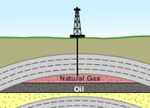
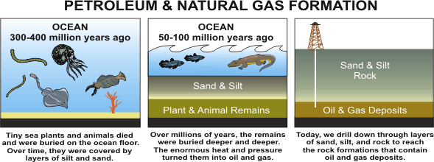
Sources of Energy Nonrenewable Resources

Slide 8
How to Clean Up Oil Spills

Slide 9
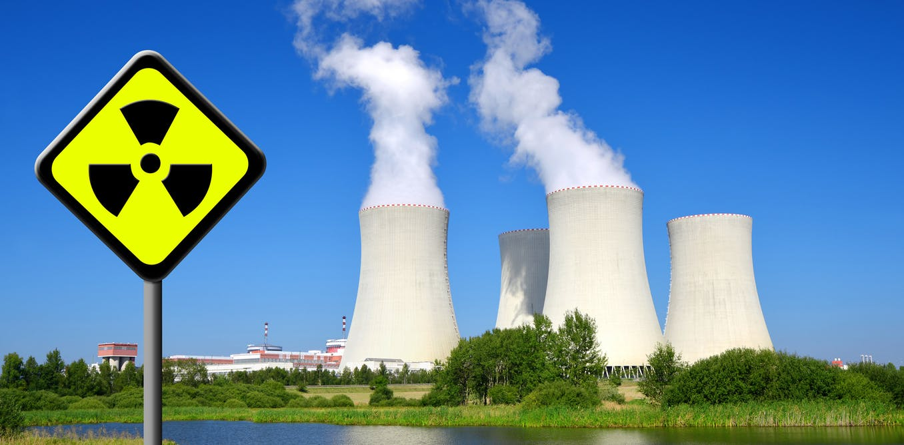
Sources of Energy Nonrenewable Resources
Nuclear Energy
Energy released from atomic reactions
Nuclear Fission
Process of splitting atoms that releases thermal energy

Slide 10
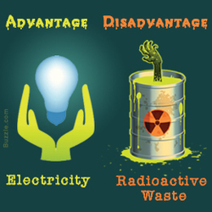
Sources of Energy Nonrenewable Resources
Nuclear Energy
Advantages
Small amount of uranium produces a large amount of energy
Does not pollute air, soil, or water

Slide 11
Sources of Energy Nonrenewable Resources
Nuclear Energy
Disadvantages
Limited supply
Must be carefully monitored to avoid radioactive release
Waste materials are radioactive and dangerous

Slide 12
Sources of Energy renewable Resources
Renewable Resources
Resources that can be replaced by natural processes in a relatively short amount of time

Slide 13
Sources of Energy renewable Resources
Renewable Resources
Advantages
Renewable (will not run out)
Produce less pollution
Disadvantages
Can be costly or limited to certain areas

Slide 15
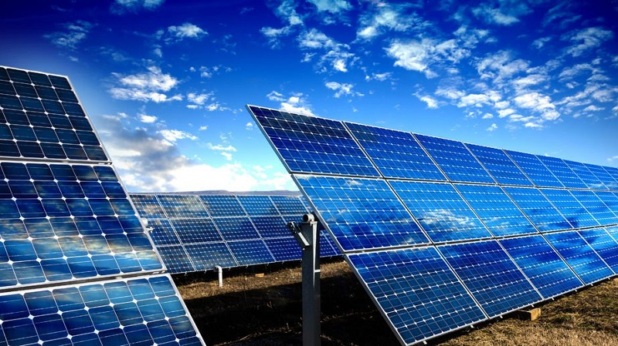
Sources of Energy renewable Resources
Solar Energy
Energy from the sun
Solar cells capture light energy and transform in to electrical energy

Slide 16
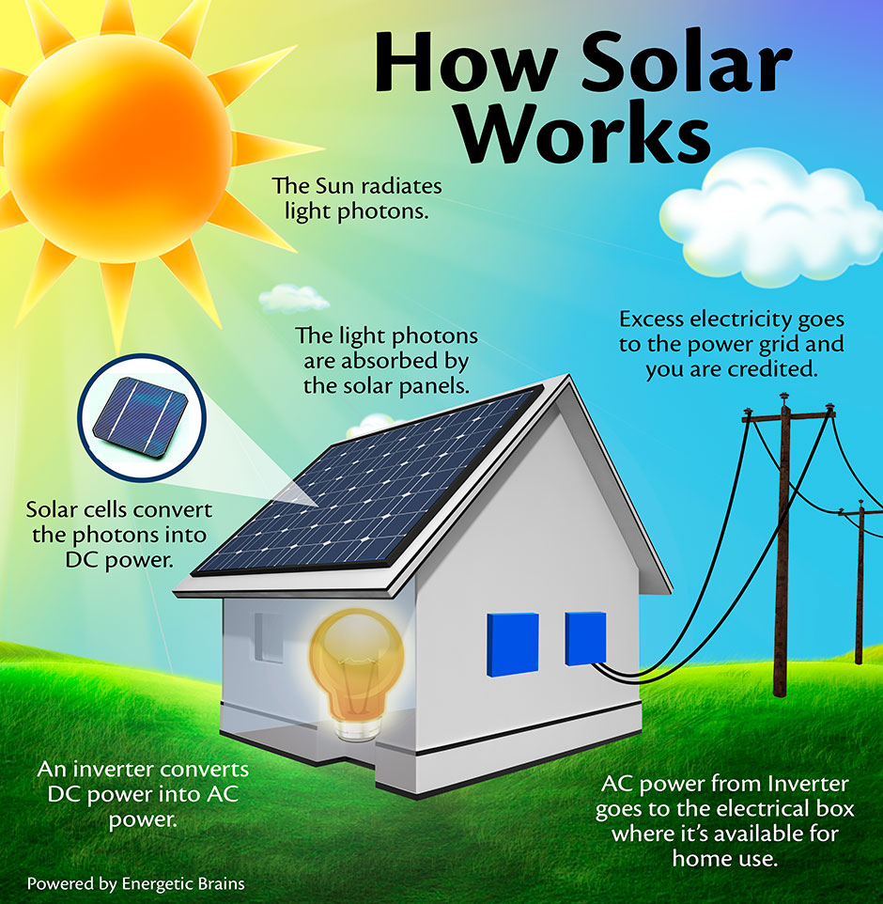

Slide 18
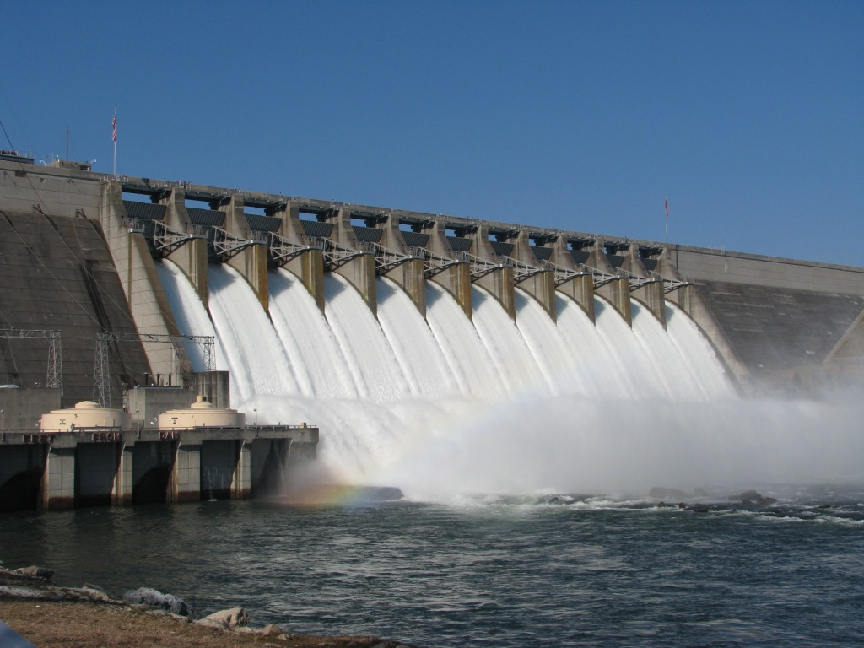
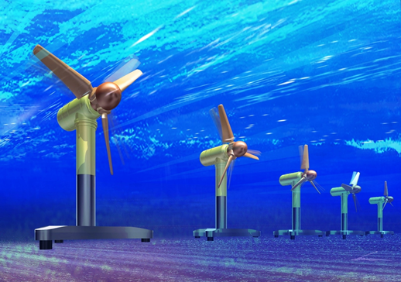
Sources of Energy renewable Resources
Water Energy
Hydroelectric Power
Electricity produced by flowing water
Tidal Power
Water flows across turbines as tide comes in a goes out

Slide 20
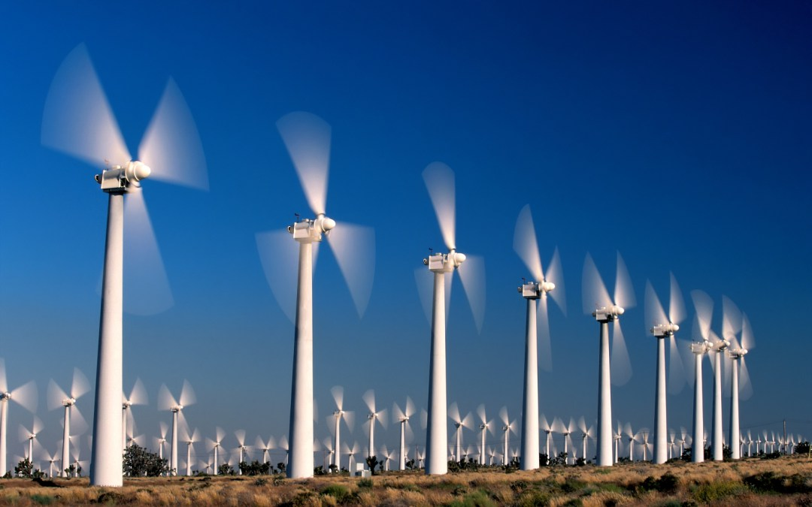
Sources of Energy renewable Resources
Wind Energy
Wind turbines produce electricity
Wind farms: group of wind turbines that produce electricity

Slide 22
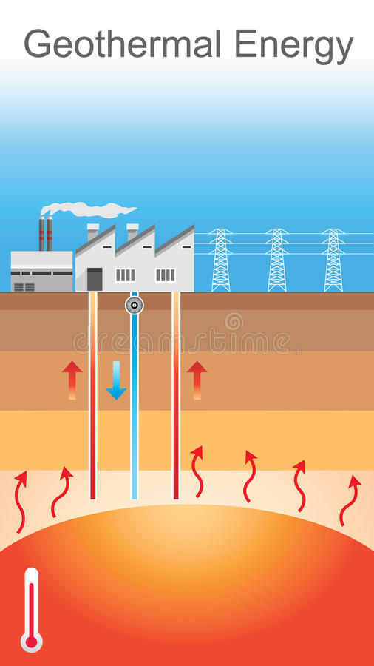
Sources of Energy renewable Resources
Geothermal Energy
Thermal energy from earth’s interior
Wells are drilled to reach hot rocks or magma
Thermal energy heats water, makes steam to produce electricity

Slide 24
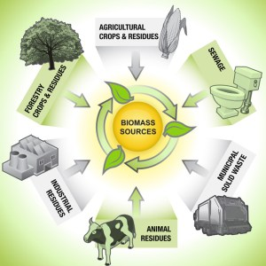
Sources of Energy renewable Resources
biomass Energy
Energy produced by burning organic matter, such as wood, food scraps, and alcohol
Can be converted into fuel for vehicles

Slide 26
Natural Resources

Slide 27
Sources of Energy Natural Resources
Natural Resources
Something from earth that living things use to meet needs

Slide 28
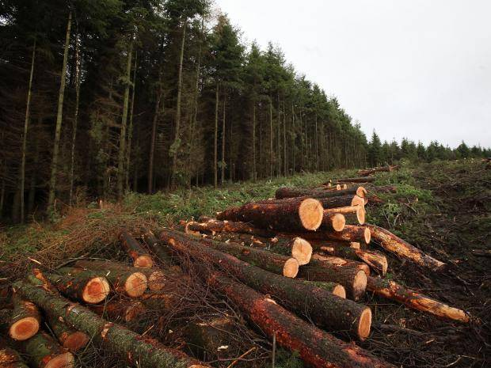
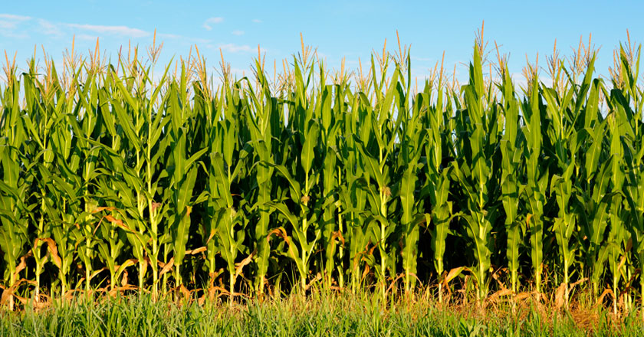
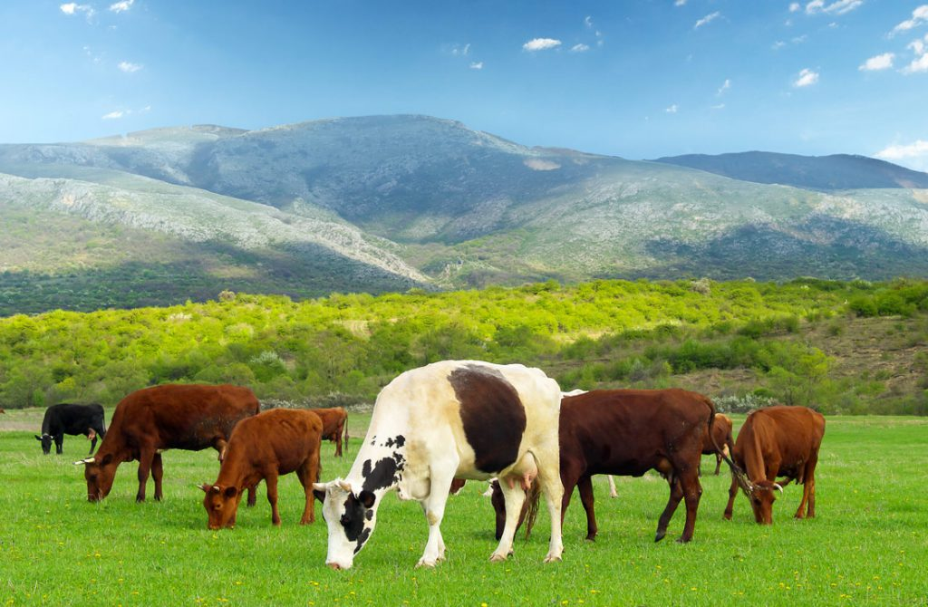
Sources of Energy Natural Resources
Examples of Land Resources
Forests and Agriculture
Mineral Resources

Slide 29
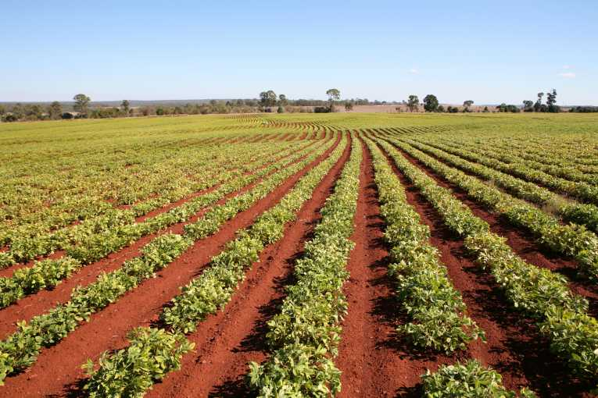
Sources of Energy Natural Resources
Advantages of Land Resources
Widely available
Easily accessed
Crops and trees are renewable

Slide 30
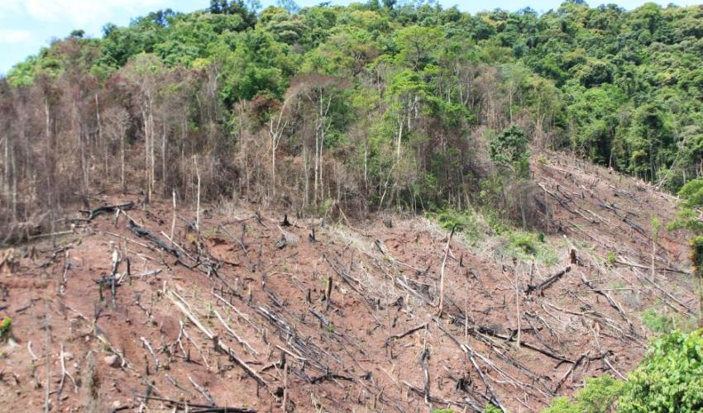
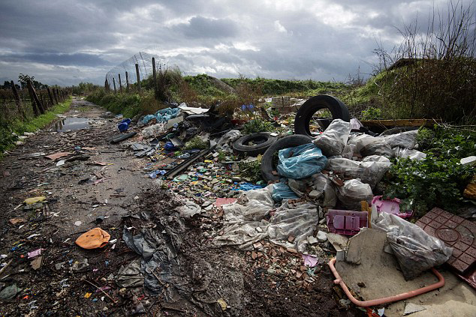
Sources of Energy Natural Resources
Disadvantages of Land Resources
Deforestation
Pollution
Some (minerals) are nonrenewable

Slide 31
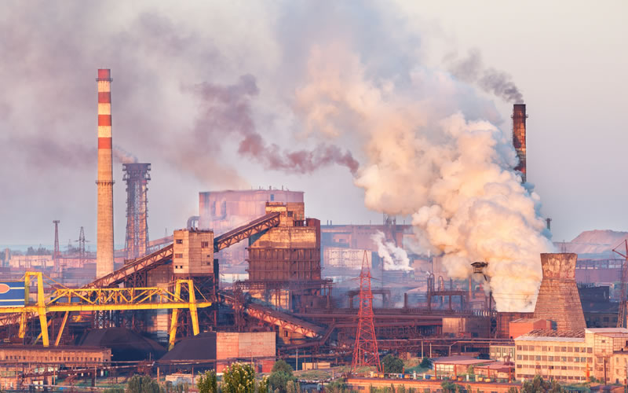
Sources of Energy Natural Resources
Advantages of Air Resources
Needed to survive
Disadvantages of Air Resources
Pollution

Slide 32
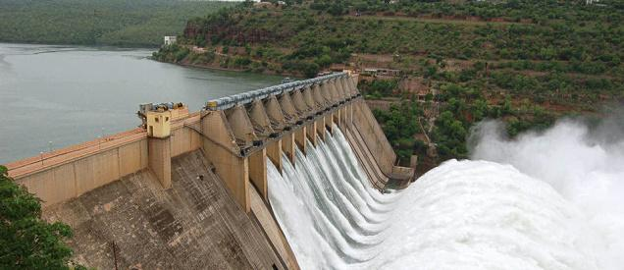
Sources of Energy Natural Resources
Advantages of Water Resources
Meets many needs—farming, industry, electricity, household activities, transportation, recreation
Disadvantages of Water Resources
Limited supply of freshwater
Pollution

Slide 33
Water Pollution

Slide 34
Natural Resources Human Impact
Sustainability
Using resources in a way that maintains biodiversity and ecosystem health

Slide 35
Human Impact

Slide 36
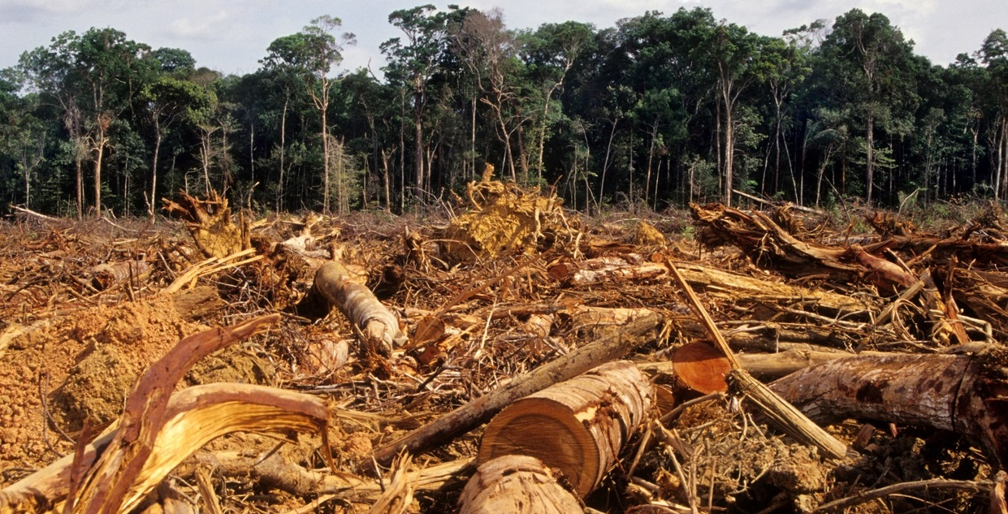
Natural Resources Human Impact
Deforestation
Logging or clearing forests for human use without replanting trees

Slide 37
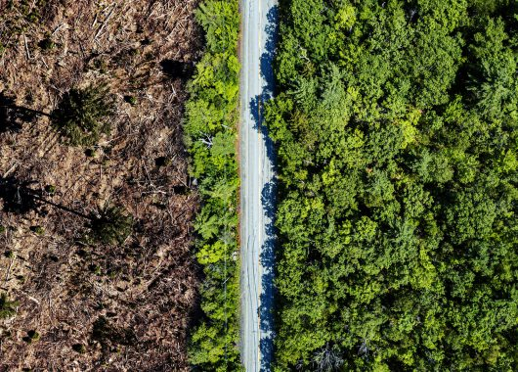
Natural Resources Human Impact
Deforestation Causes:
Fewer plants and animals in an ecosystem

Slide 38
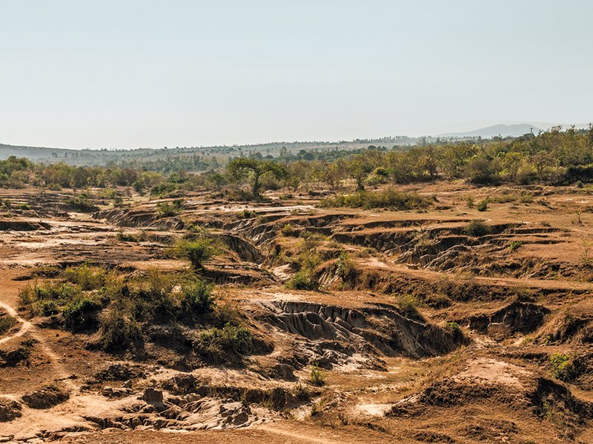
Natural Resources Human Impact
Deforestation Causes:
Soil Degradation
Water and wind remove the topsoil which has nutrients needed for plants to grow

Slide 39
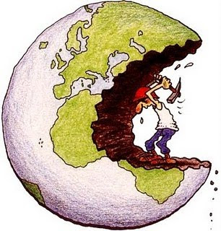
Natural Resources Human Impact
Overexploitation
The use of a resource until it is almost gone
Can lead to extinction
Negatively affects ecosystems

Slide 40
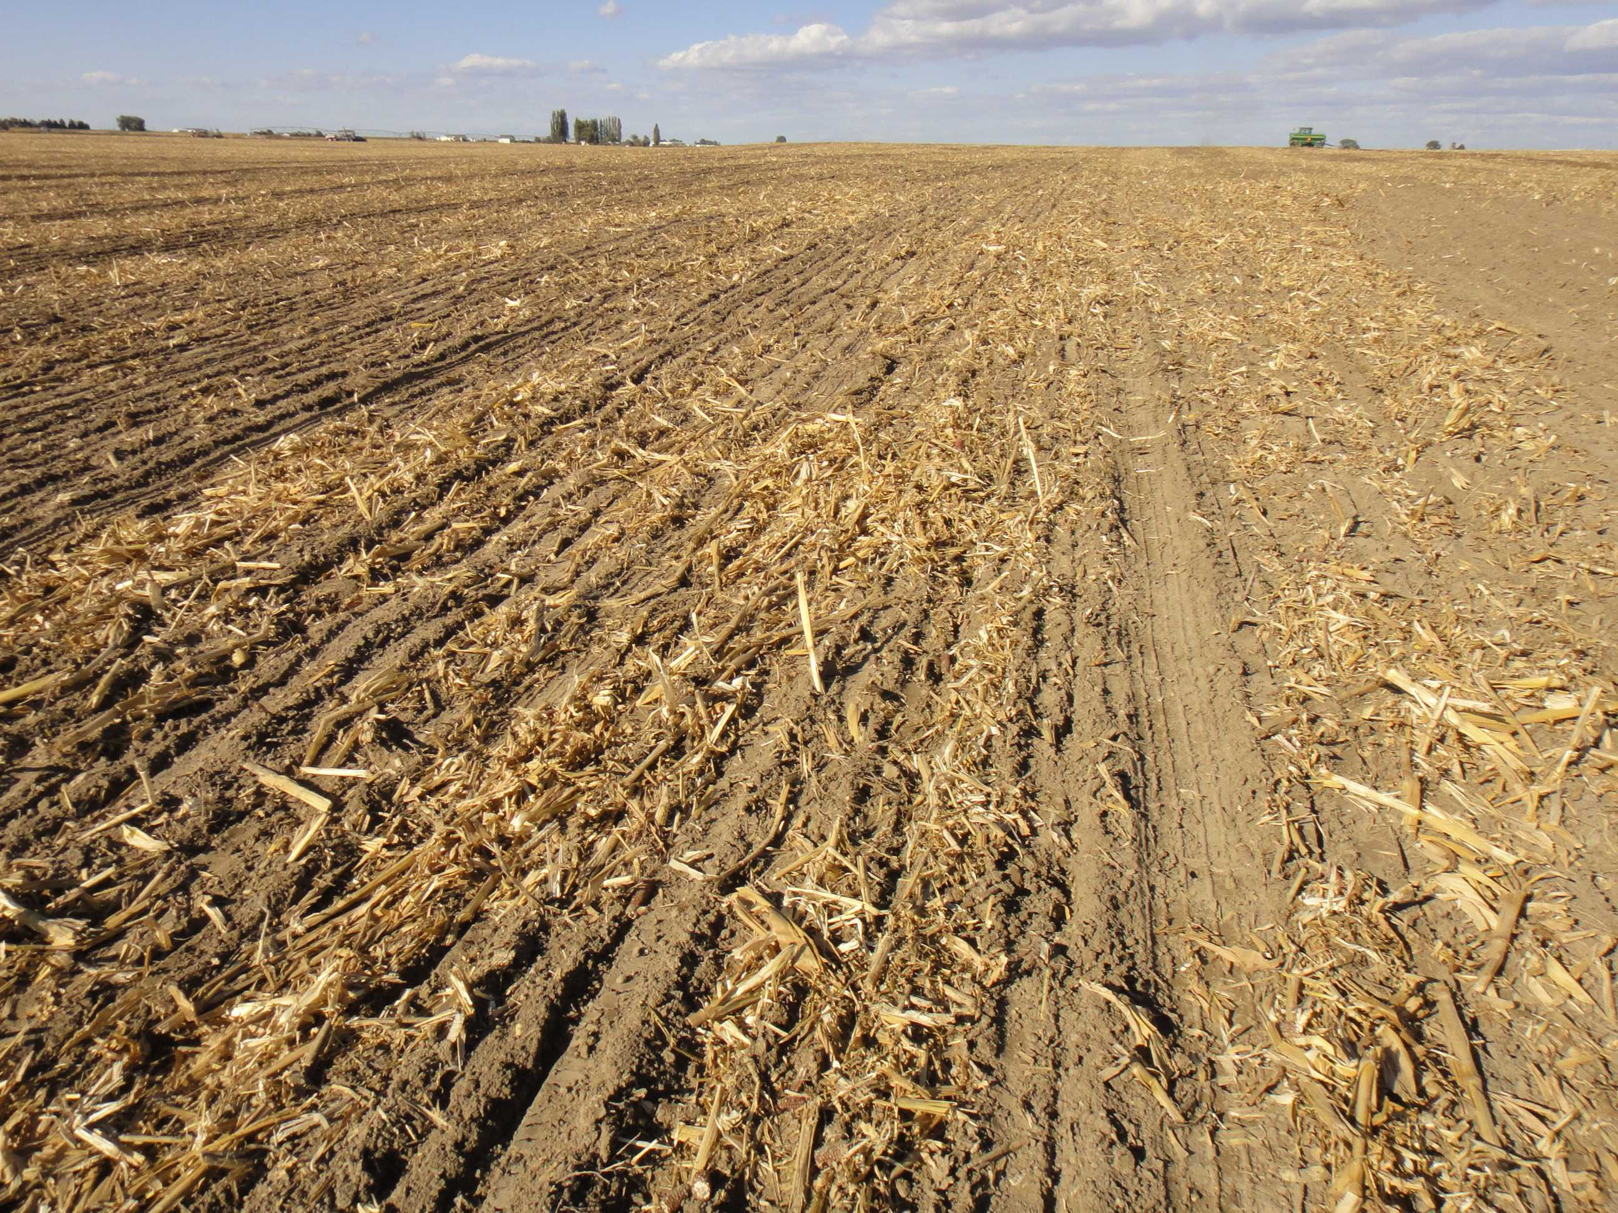
Natural Resources Human Impact
Agriculture
Leaving fields bare between planting cane result in soil degradation

Slide 41
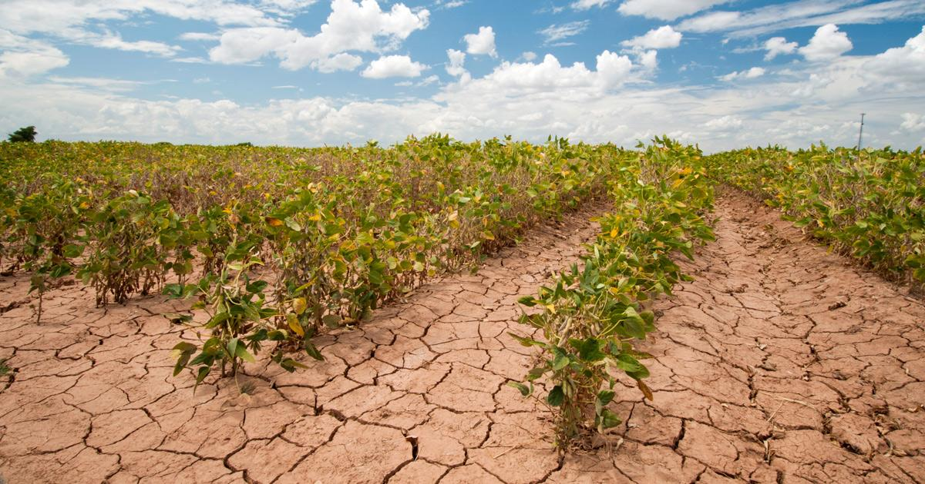
Natural Resources Human Impact
Agriculture
Soil compaction can occur
Soil particles are squeezed together → decreased plant growth, increased run-off
Aeration reduces compaction

Slide 42
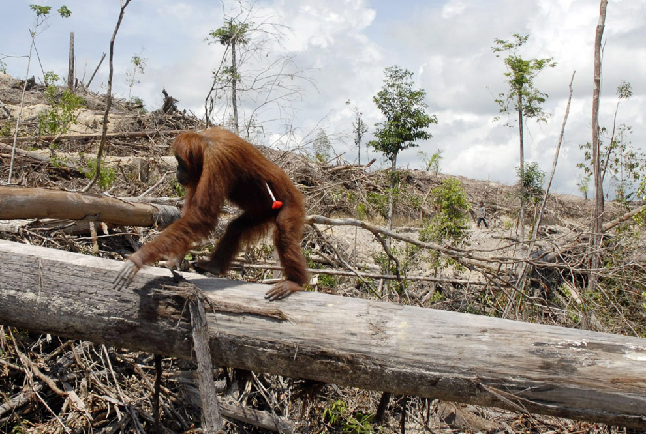
Natural Resources Human Impact
Habitat Loss
Human activities destroy habitats so they no longer support the original species that lived there

