Slide 1
Living Things

Slide 2
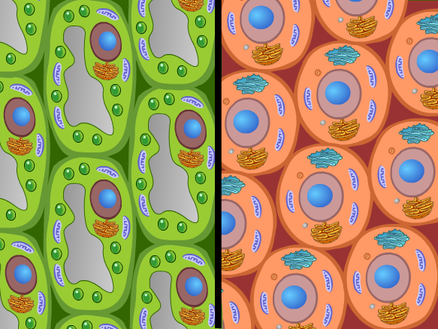
Six Characteristics of Living Things
1. Made of cells

Slide 3
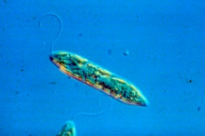
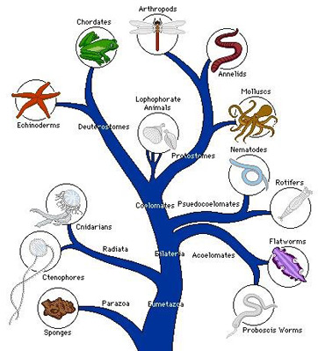
Six Characteristics of Living Things
2. Organized
Unicellular
All functions happen within one cell
Multicellular
Different types of cells carry out specialized functions

Slide 4
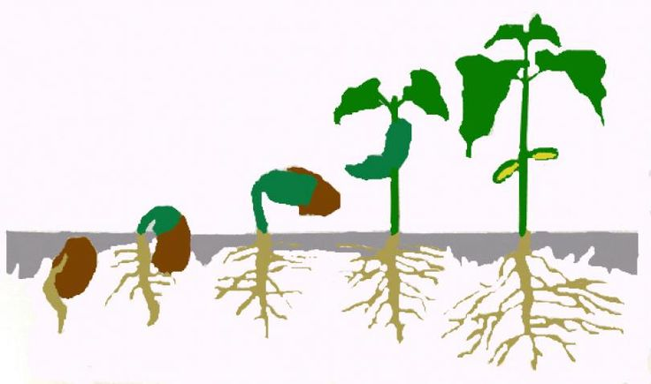
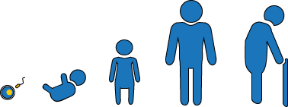
Six Characteristics of Living Things
3. Grow and Develop

Slide 5
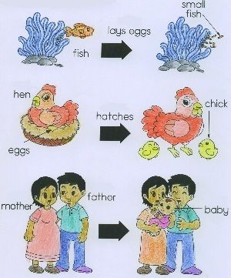
Six Characteristics of Living Things
4. Reproduce

Slide 6
Six Characteristics of Living Things
5. Use Energy
Autotroph
Organisms that convert energy from light to usable energy
Heterotroph
Organisms that obtain energy from other organisms

Slide 7
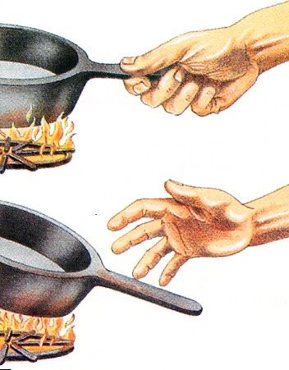
Six Characteristics of Living Things
6. Respond to the environment
Often used for protection
Organisms react to stimuli
Light
Temperature
Odor
Sound
Gravity
Heat
Water
Pressure

Slide 9
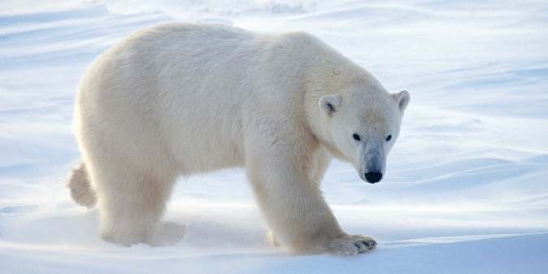
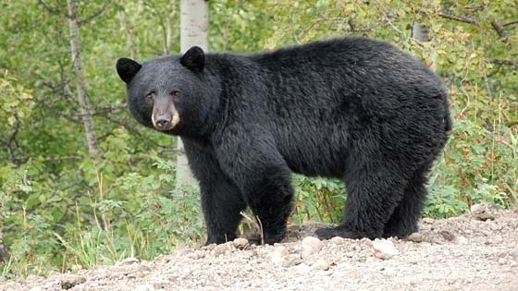
Binomial Nomenclature
Naming system that gives each living thing a two-word scientific name
Names are in Latin
EX: Ursus maritimus = polar bear
Ursus americanus = black bear

Slide 10
Taxonomy
Branch of Science that classifies living things
Taxon: group of organisms
Organized by behavior, appearance, how it reproduces, how it processes energy, and its types of genes

Slide 11
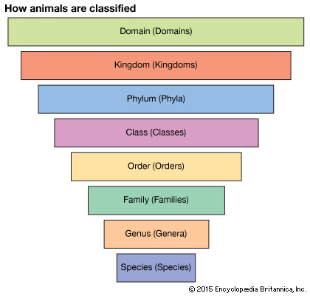
Taxonomy
Largest
Smallest

Slide 12
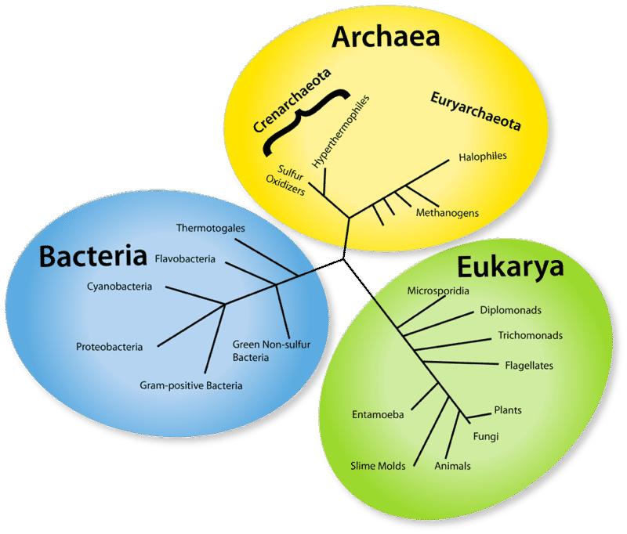
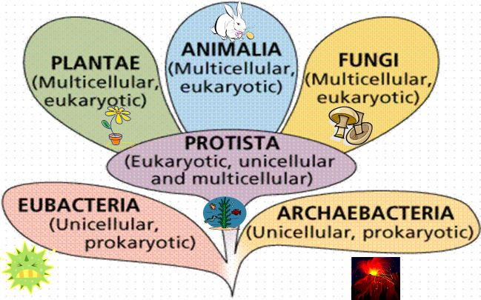
Taxonomy
Three main groups called domains
Archaea
Bacteria
Eukaryota
Kingdoms
Animals
Plants
Fungi
Bacteria
Protista
Archaebacteria

Slide 13
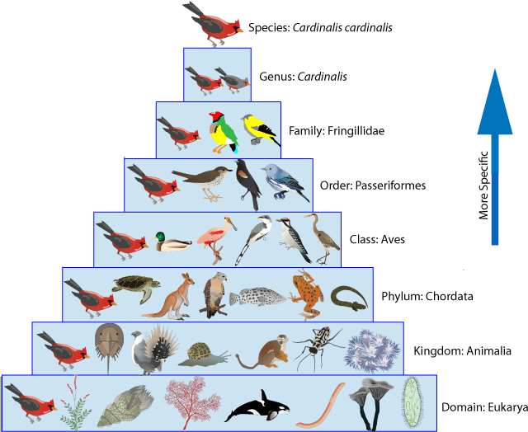
Taxonomy

Slide 15
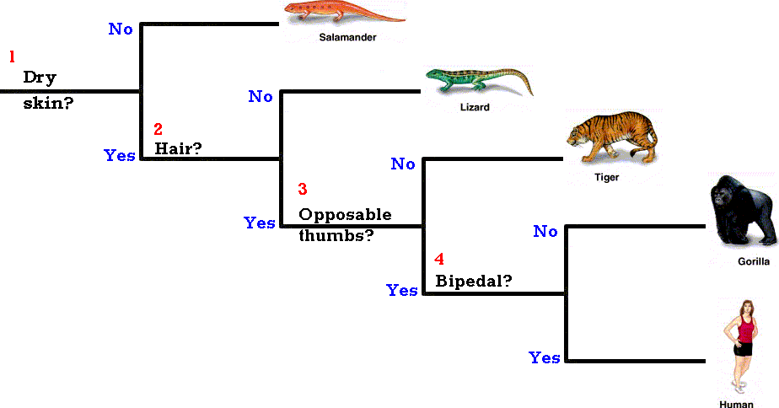
Dichotomous Key
A tool used to identify an organism based on its characteristics
Contain descriptions that are compared when classifying organisms

Slide 17
Dichotomous Key

