Slide 1
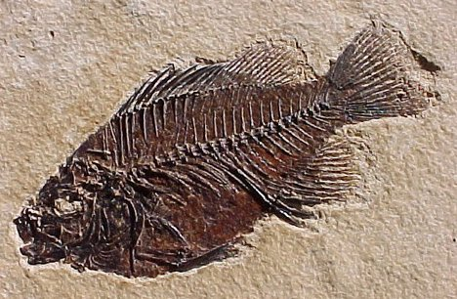
Clue’s to Earth’s Past

Slide 2
Clue’s to Earth’s Past
1. Answer the following questions in 2-3 sentences each in your Science Notebook.
What evidence do scientists use to learn about past environments?
What evidence do scientists use to determine the age of rocks?
2. Copy the following statements into your Science Notebook. After each statement, write if you agree or disagree and why.
Fossils are pieces of dead organisms.
Only bones can become fossils.
Older rocks are always located below younger rocks.

Slide 3
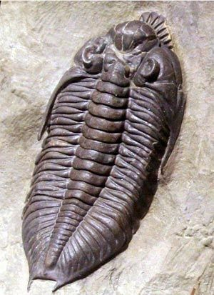
Clue’s to Earth’s Past
Fossil
Preserved remains or evidence of ancient living things
Two conditions
Hard parts such as teeth, bones, shells
Buried quickly after it dies

Slide 4
Fossils
Steps of Fossil Formation
A dead organism is quickly covered by sand or mud. Soft tissues decompose.

Slide 5
Fossils
Steps of Fossil Formation
Hard parts of the organism, called prefossil, remain.
Chemical changes occur that cause it to become a fossil.

Slide 6
Fossils
Steps of Fossil Formation
Processes inside earth move fossil toward surface.

Slide 7
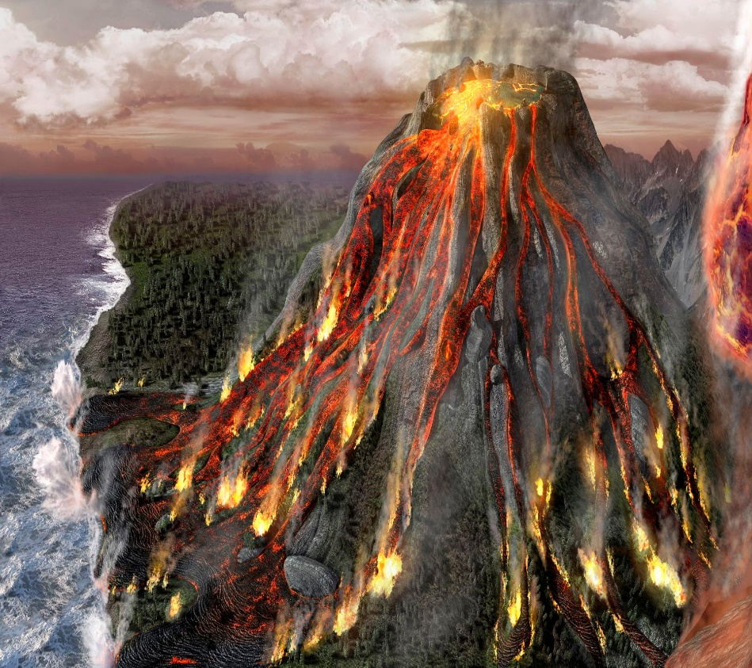
Clue’s to Earth’s Past
Catastrophism Theory
The idea that conditions and creatures on earth change in quick, violent events
EX: volcanic eruptions
Supernatural beings often blamed

Slide 8
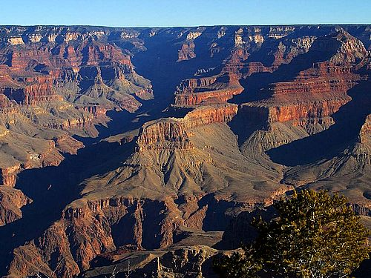
Clue’s to Earth’s Past
Uniformitarianism Theory
Earth’s surface is constantly being reshaped in a uniform manner

Slide 9
Clue’s to Earth’s Past
Today
Uniformitarianism is basis for understanding Earth’s past
Catastrophic events do change Earth’s surface quickly

Slide 10
Types of Preservation
Types | Definition | Examples
Preserved Remains
Carbon Films
Mineral Replacement
Molds
Casts
Trace Fossils

Slide 11
Preserved Remains
Actual remains of an organism are preserved
Examples:
Ice
Tar
Amber (hardened tree sap)

Slide 12
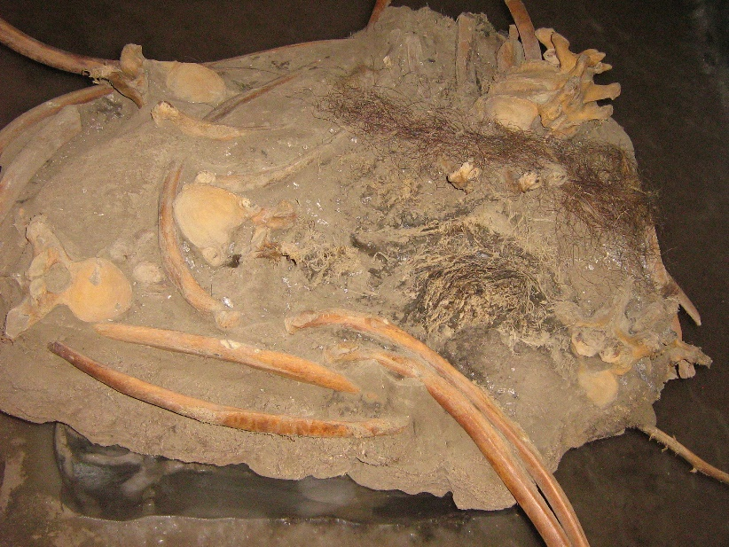
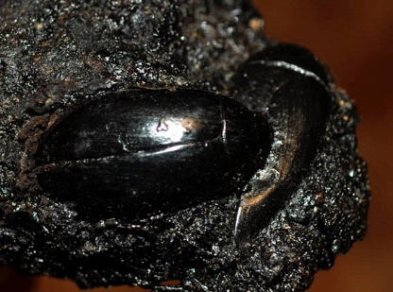
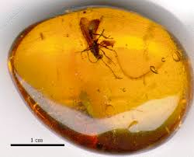
Preserved Remains
Ice
Tar
amber

Slide 13
Carbon Films
Fossilized carbon outline of an organism
Generally shiny or black-brown

Slide 14
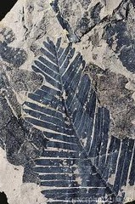
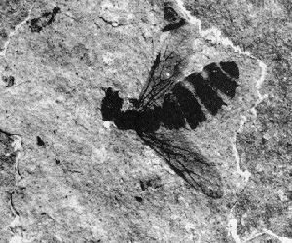
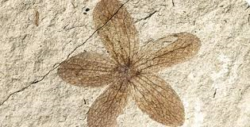
Carbon Films

Slide 15
Mineral Replacement (Permineralization)
Copies of organisms formed from minerals that fill in the spaces of dead organisms
Example:
Petrified wood

Slide 16
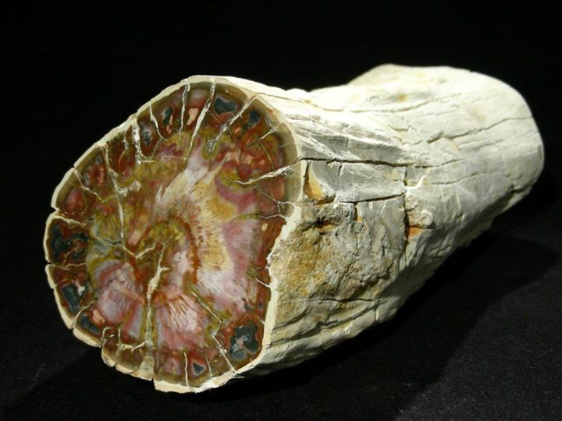
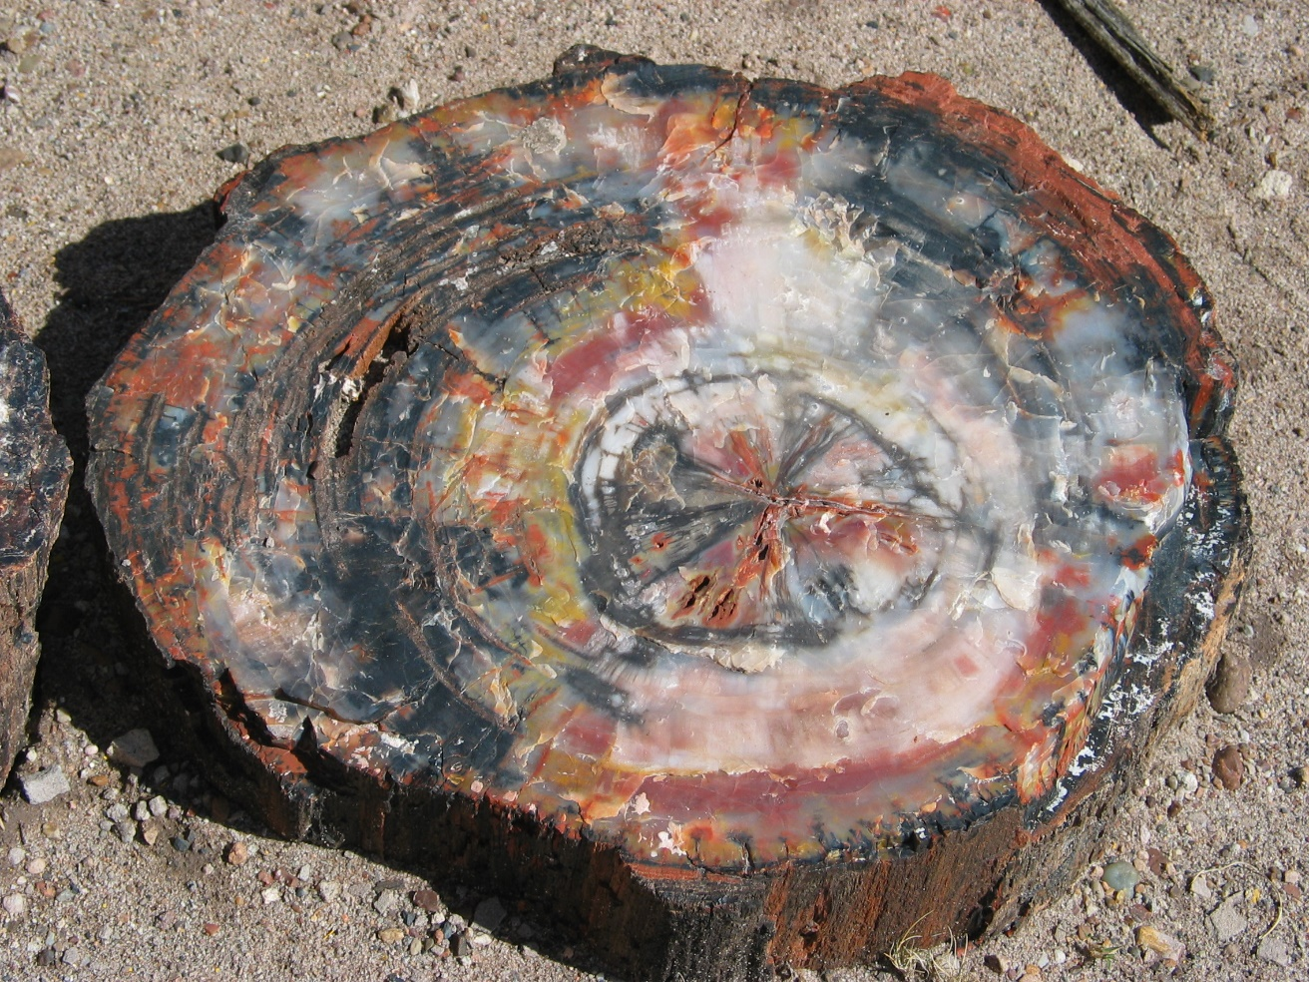
Mineral Replacement
Petrified Wood
Bone

Slide 17
Molds
Impression in a rock left by an ancient organism

Slide 18
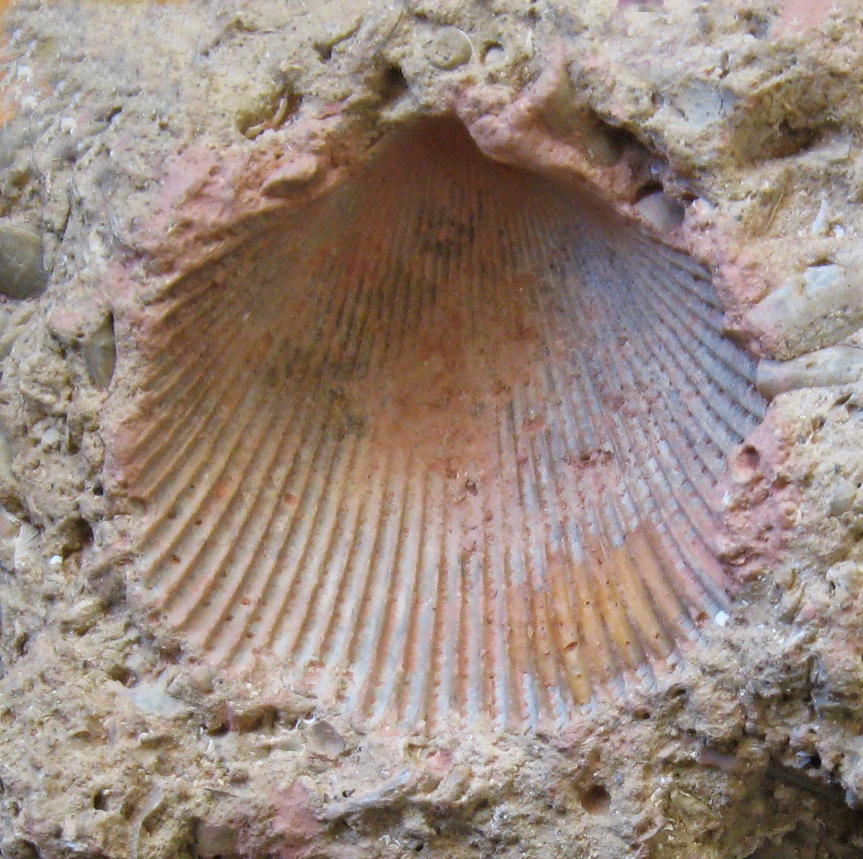
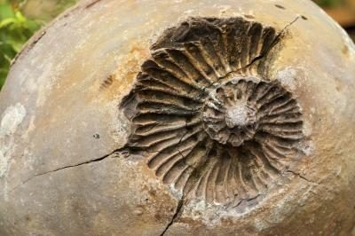
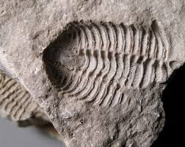
Molds

Slide 19
Casts
Fossil copy of an organism when a mold of an organism is filled with sediments

Slide 20
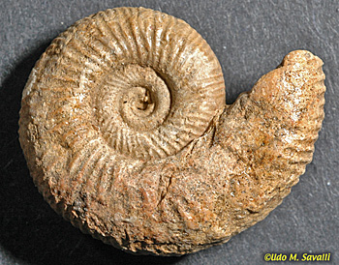
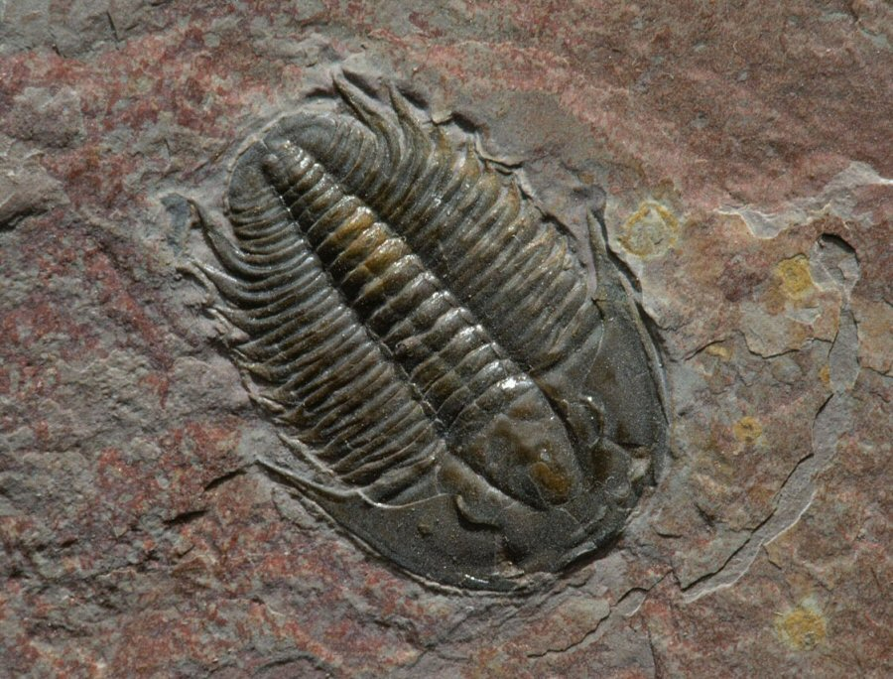
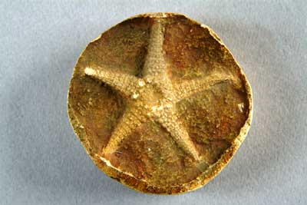
Casts

Slide 21
Trace Fossils
Preserved evidence of activity of an organism

Slide 22
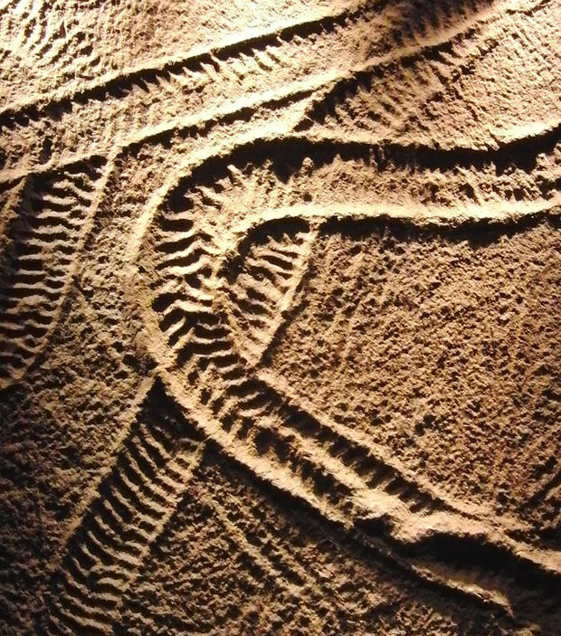
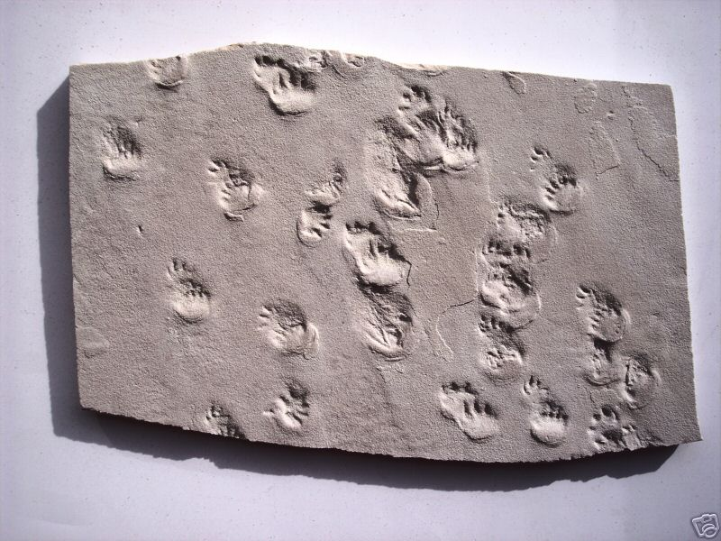
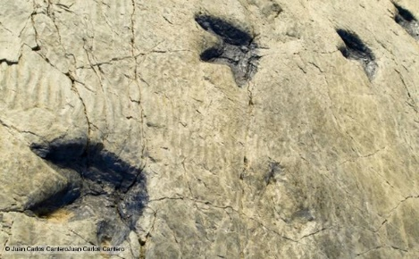
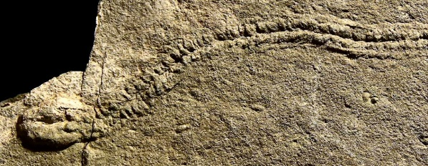
Trace Fossils
Evidence of Movement
Footprints

Slide 23
Sponge Fossils
In this experiment, what does the sponge represent?
What does the wax represent?
What type of fossil preservation is this a model of? Why?

Slide 24
Plaster Fossils
In this experiment, what represented a mold? Why?
What represented a cast? Why?
What type of fossil preservation is this a model of? Why?

Slide 25
Petoskey Stones
State stone of Michigan
350 million years ago, lower Michigan was covered by a shallow sea
The climate was tropical
The sea was full of coral reefs
These marine animals eventually died and became covered by sediment
Movement by glaciers millions of years later exposed these solidified fossils
Each coral forms a hexagonal pattern

Slide 26
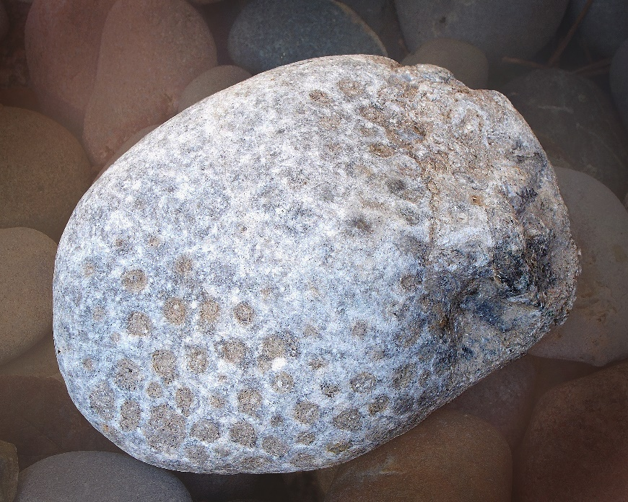
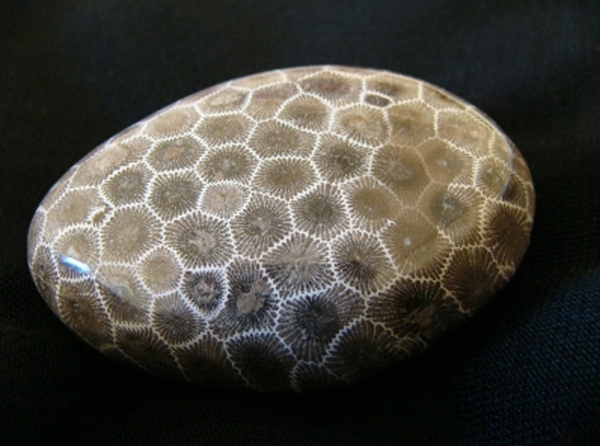
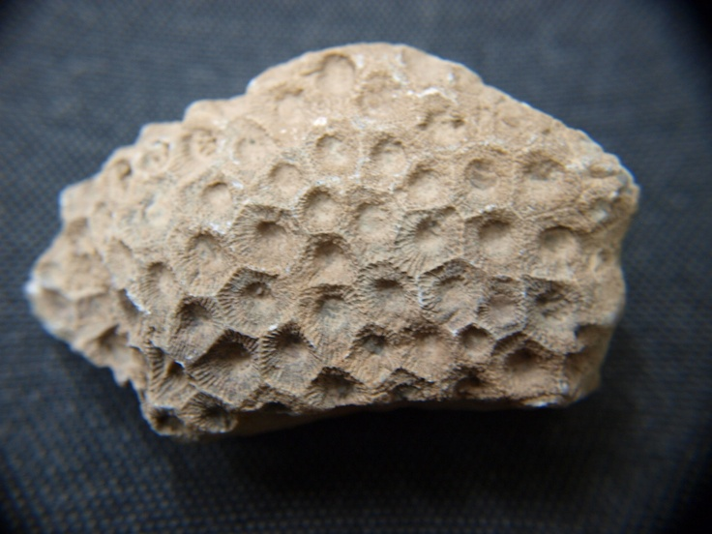
Petoskey Stones

Slide 27
Ancient Environments
Fossils provide evidence for scientists to learn about past organisms and environments
Fossils show Earth’s climate has warmed and cooled many times in the past

Slide 28
Fossil Sample Id
1. Label a new page of your SNB- Fossil Sample ID.
2. Examine your fossil carefully.
3. Draw a picture of it in your SNB. Include all important details.
4. What type of fossil do you have?
5. Explain what evidence leads you to choose this type of fossil. (min. 2 sentences)

