Slide 1
Energy

Slide 2
Energy
Launch Lab p. 421
Write a hypothesis.
If the cup of sand is shaken, then ______.
Independent Variable:
Dependent Variable:
Constants:
Data:
Temperature before shaking:
Temperature after shaking:
Think About This:
What change did you observe in the sand?
How could you change your results?
What do you think caused the change you observed in the sand?

Slide 3
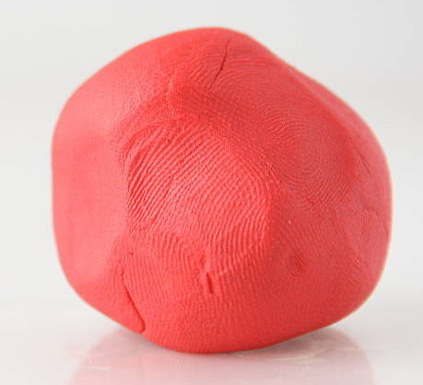
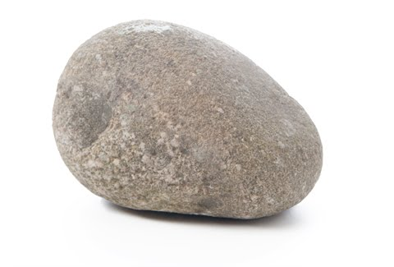
Energy
Define Energy
Does this have energy?
Does this have energy?

Slide 4
Energy
The ability to cause change

Slide 5
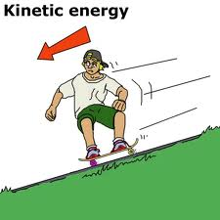
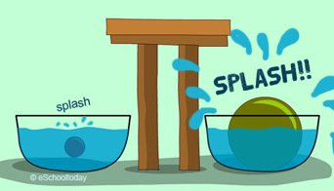
Energy
Kinetic Energy
Energy due to motion
More mass=more kinetic energy
More speed=more kinetic energy

Slide 6
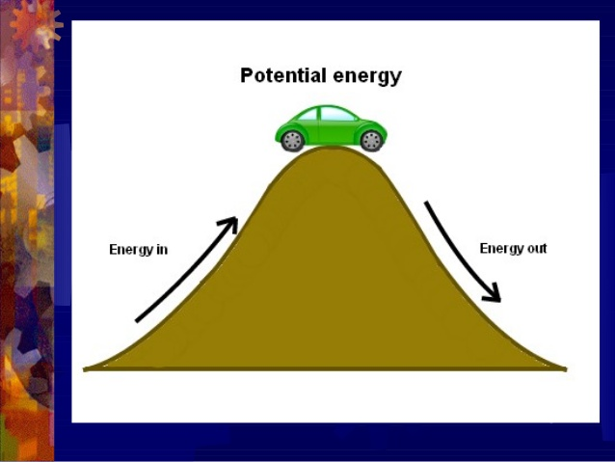
Energy
Potential Energy
Stored energy due to interactions between objects or particles

Slide 7
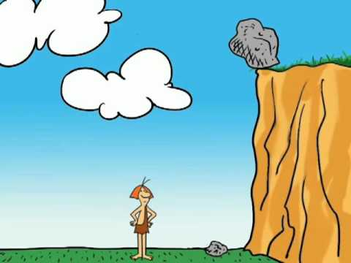
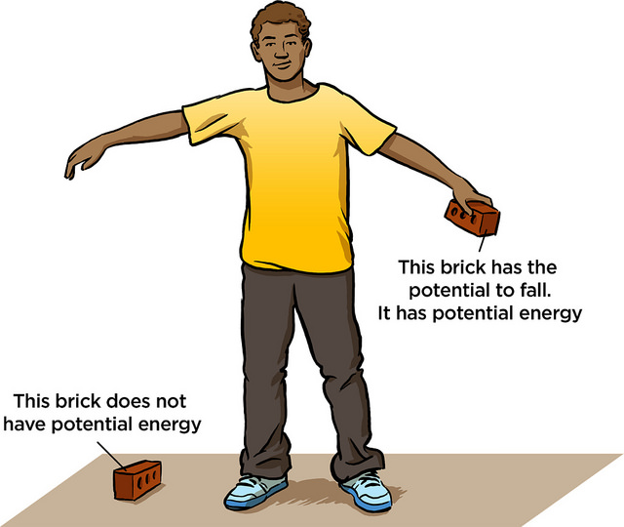
Energy
Gravitational Potential Energy
Energy stored between an object and Earth
Depends on objects weight and height

Slide 8
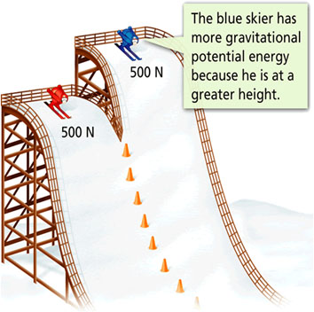
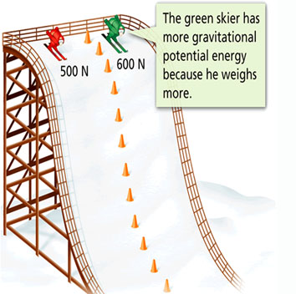
Energy
Gravitational Potential Energy

Slide 9
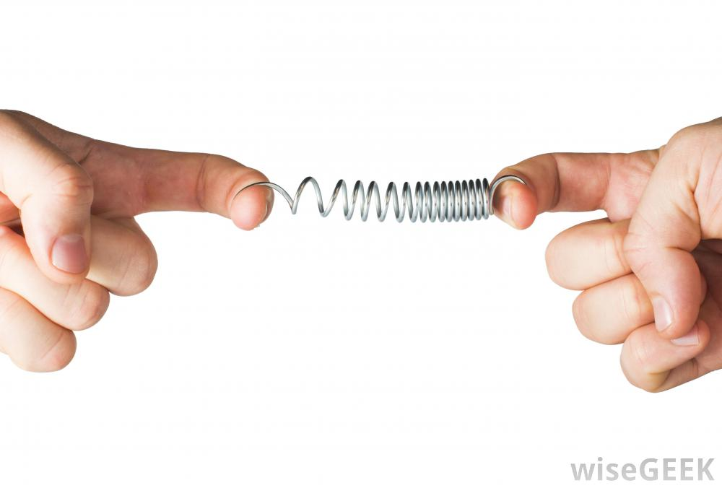
Energy
Elastic Potential Energy
Stored in objects that are compressed or stretched
When you release the end, stored elastic potential energy is transformed into kinetic energy
Examples
Rubber band
Spring

Slide 10
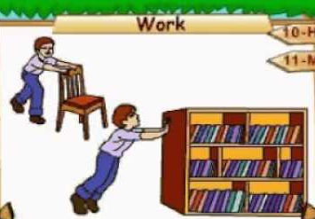
Energy
Work
Transfer of energy that occurs when a force makes an object move in the direction of the force while the force is acting on the object

Slide 11
Energy
Mini Lab p. 424
Write a hypothesis.
If the marble rolls down the ruler, then ______.
Independent Variable:
Dependent Variable:
Constants:
Observations: (Draw a picture and write two sentences about what happened.)
Think About This:
Compare the kinetic energy of the marble just before and just after it hit the cup.
Is work being done on the cup? Explain your answer.

Slide 12
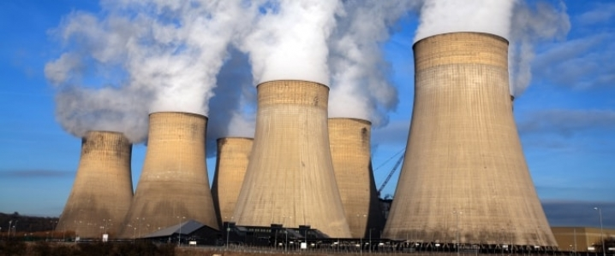
Energy
Nuclear Energy
Energy that is stored and released in the nucleus of an atom
Example:
Nuclear power produced in a power plant when the nuclei of uranium atoms are split

Slide 13
Energy
Chemical Energy
Energy from the breaking of chemical bonds
Example:
Food being digested in the stomach

Slide 14
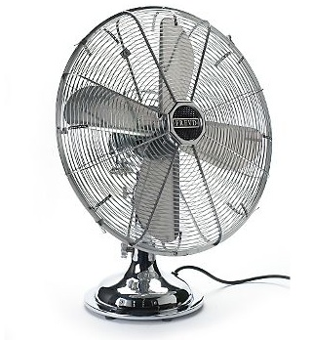
Energy
Electric Energy
Energy an electric current carries
Example:
Fan

Slide 15
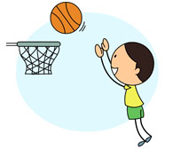
Energy
Mechanical Energy
The sum of kinetic and potential energy in a system of objects
Due to large-scale motions and interactions in a system
Example:
A player shooting a basketball

Slide 16
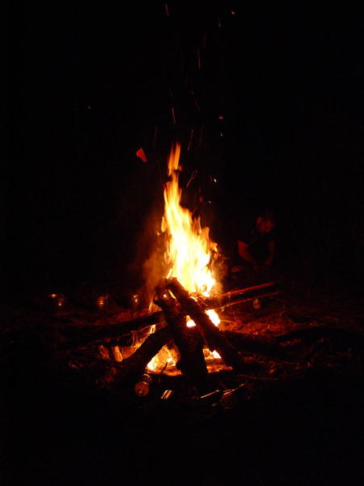
Energy
Thermal Energy
The sum of kinetic and potential energy of the particles that make up an object
Due to atomic –scale motions and interactions of particles
Moves from warmer objects to cooler objects
Example:
Burning wood

Slide 17
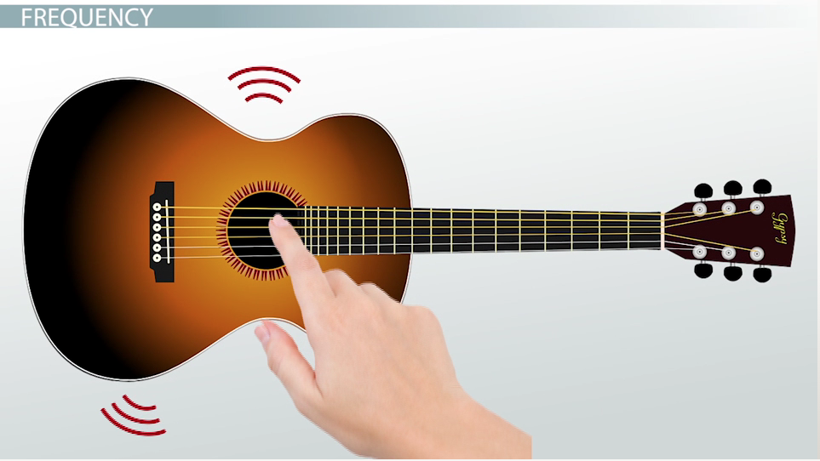
Energy
Sound Energy
Energy that sound carries
Emitted by vibrating objects
Cannot travel in a vacuum
Example:
Guitar strings

Slide 18
Energy
Radiant (Light) Energy
Energy that electromagnetic waves carry
Can travel through a vacuum
Example:
Light waves from the sun

Slide 19
Energy
Law of Conservation of energy
Energy can be transformed from one form to another
OR
Energy can be transferred from one region to another
BUT
Energy cannot be created or destroyed.

Slide 20
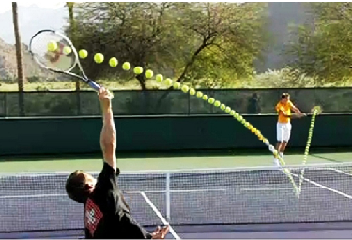
Energy
Energy Transfer
When energy moves from one object to another without changing form
Examples
Mechanical energy moves from a tennis racket to a ball

Slide 21
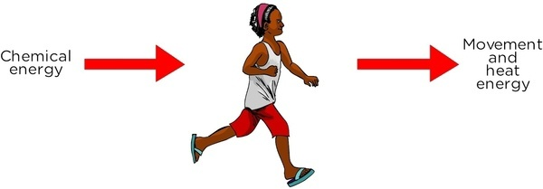
Energy
Energy Transformation
When one form of energy is converted to another form of energy
Example
Chemical energy in muscles transforms to mechanical energy so you can move

Slide 22
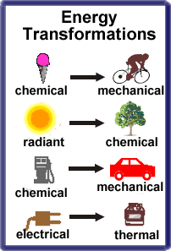
Energy

Slide 23
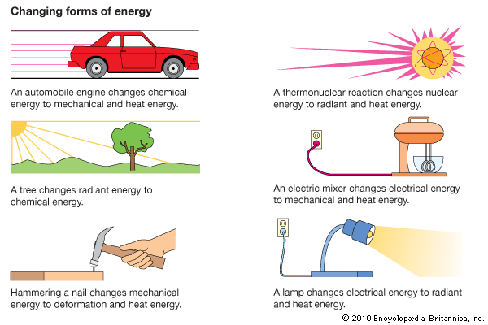
Energy
Energy transfers and transformations are inefficient because some energy is always transformed to thermal energy

Slide 24
Energy
Waste Energy
Thermal energy that cannot be used

Slide 25
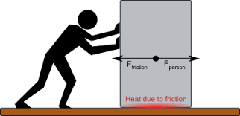
Energy
Friction
A force that resists the sliding of two surfaces that are touching
Thermal energy is always produced

Slide 26
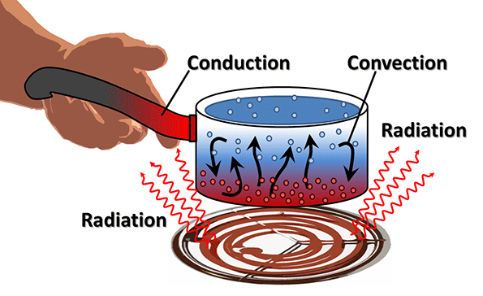
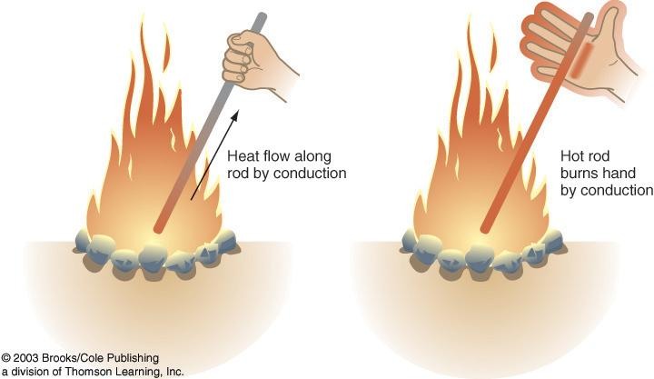
Energy
Thermal Energy Transfer
Conduction
The transfer of thermal energy by collisions between particles in matter

Slide 27
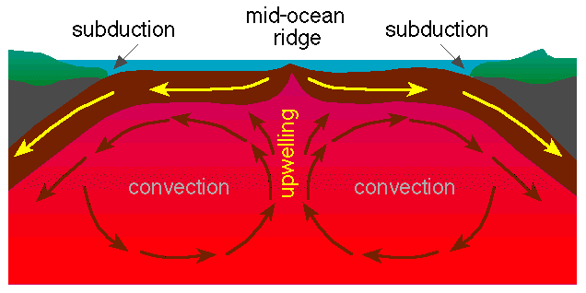
Energy
Thermal Energy Transfer
Convection
The transfer of thermal energy by the movement of particles from one part of a material to another

Slide 28
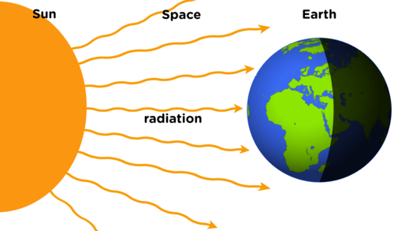
Energy
Thermal Energy Transfer
Radiation
The transfer of thermal energy by electromagnetic waves

