Slide 1
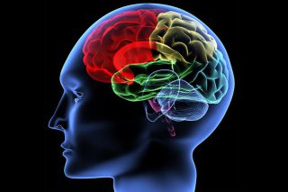
The Brain

Slide 2
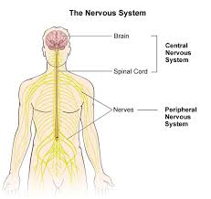
Nervous System
Central Nervous System
Brain, spinal cord, nerves
Peripheral Nervous System
Nerves outside of the brain and spinal column
Fun Fact: The brain operates on the same amount of power as a 10-watt lightbulb
and generates as much energy as a small light bulb, even when you’re sleeping!

Slide 3
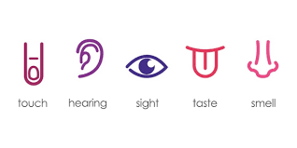
Nervous System
Jobs
1.Processing information
2.Voluntary activities
Require thought-walking, thinking
3. Involuntary activities
Breathing, digestion
4. Reflexes
Automatic movements in response to a signal
5. Senses

Slide 4
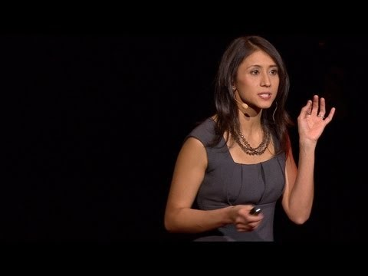

Slide 5
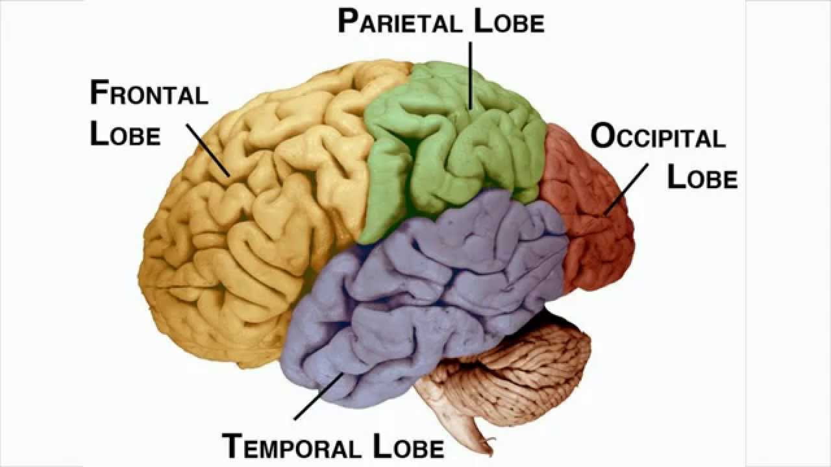
The Brain
Cerebrum

Slide 6
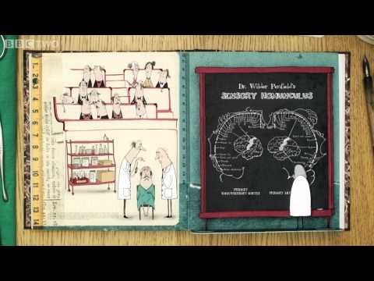

Slide 7
The Brain
Frontal Lobe
Memory
Thinking
Concentration
Problem solving
Fun Fact: MYTH “LEFT BRAIN” and “RIGHT BRAIN” PEOPLE DIFFER FACT The contention that we have a rational left brain and an intuitive, artistic right side is fable: humans use both hemispheres of the brain for all cognitive functions

Slide 8
The Brain
Parietal Lobe
Processing
Sensory information
Fun Fact: MYTH HUMANS USE ONLY 10 PERCENT OF THEIR BRAIN FACT The 10 percent myth is mere urban legend. Humans use 100% of their brain!

Slide 9
The Brain
Temporal Lobe
Memory storage
Smell, taste, and sound
Language
Fun Fact: MYTH Brain damage is always permanent
FACT The brain can repair or compensate for certain losses, and even generate new cells.

Slide 10
The Brain
Occipital Lobe
Vision
Fun Fact: MYTH Male brains are biologically better suited for math and science, female brains for empathy.
FACT There are small anatomical differences between male and female brains. The hippocampus, involved in memory, is usually larger in women, while the amygdala involved in emotion, is larger in men. (The opposite of what you'd expect from this myth.) But evidence suggests gender disparities are due to cultural expectations, not biology.

Slide 11
The Brain
Cerebellum
Cerebellum
Receives information from sensory systems, spinal cord, and other parts of the brain
Coordination
Balance
Speech

Slide 12
The Brain
Medulla
Medulla (Brain Stem)
Controls flow of messages between the brain the rest of the body
Breathing
Swallowing
Heart Rate/Blood pressure
Consciousness

Slide 13
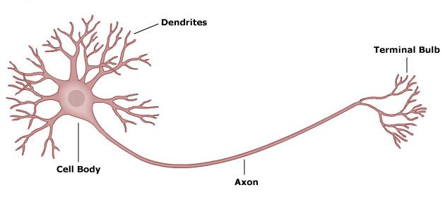
The Neuron
Fun Fact: Neuro- is a prefix that signals a word is related to the brain, nerves, or nervous system.

Slide 14
The Neuron
Neuron
Brain cell
Fun Fact: Humans have about 100 billion neurons!

Slide 15
The Neuron
Cell Body (Soma)
Central part of a neuron

Slide 16
The Neuron
Axon
Sends electrical signals from the cell body

Slide 17
The Neuron
Dendrites
Branches of a neuron that receive signals

Slide 18
The Neuron
Synapse
When two neurons exchange a signal between one’s dendrite and the other’s axon

Slide 19
