Slide 1
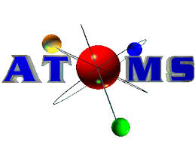

Slide 2
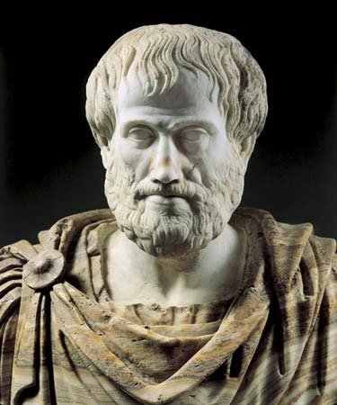
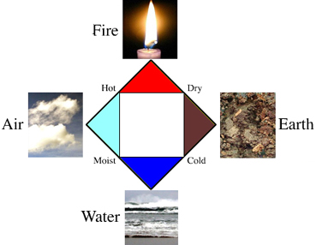
Greek Philosophers Aristotle
Over 2000 years ago
Defined atoms as four elements:
Fire
Air
Earth
Water

Slide 3
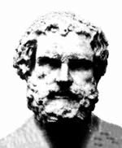
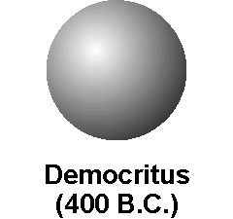
Democritus
460-370 B.C.
Atoms are small, solid objects that cannot be divided, created, or destroyed
Atoms are constantly moving in empty space
Different types of matter are made of different types of atoms
Properties of atoms determine properties of matter
He could not test scientifically to prove

Slide 4
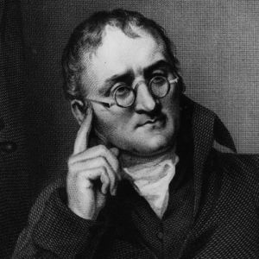
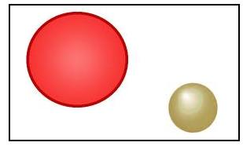
John Dalton
Early 1800’s
All matter is made of atoms that cannot be divided, created or destroyed
Atoms of the same element are the same in size, properties, and mass
Each type of atom is unique
Used better technology and scientific methods

Slide 5
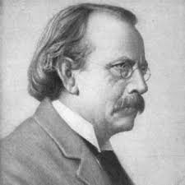
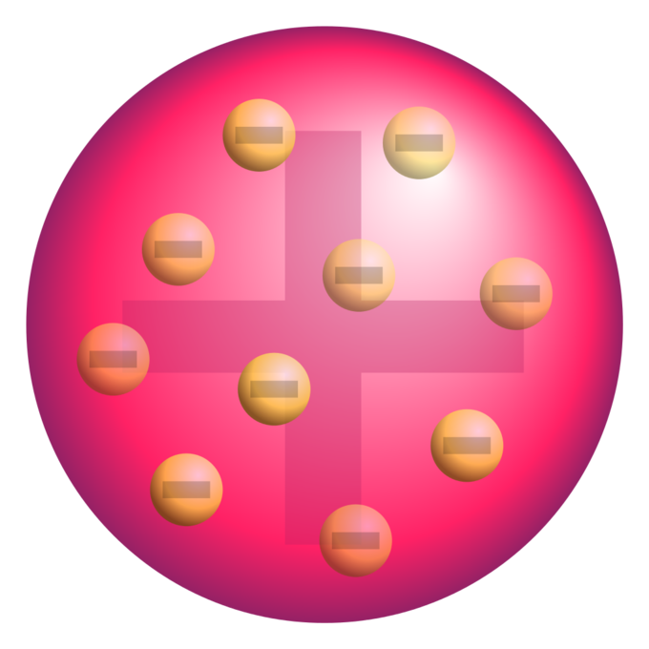
JJ Thomson
Late 1800’s
Atoms are made of smaller particles
Performed cathode ray experiment to discover negatively charged particles
These particles were spread evenly through positively charged material

Slide 6
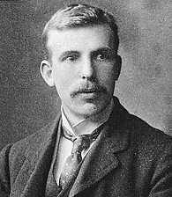
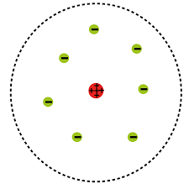
Ernest Rutherford
Early 1900’s
Former student of Thomson
Atoms had a small, dense positively charged nucleus made of protons
Surrounded by electrons that orbit the nucleus
Performed the gold foil experiment to make this discovery
Most of atom is empty space

Slide 7
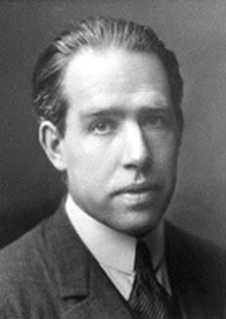
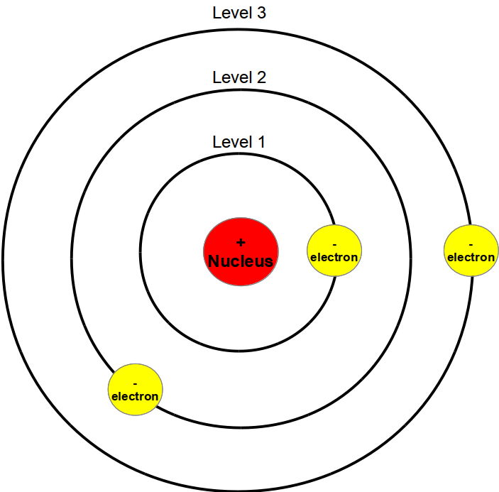
Niels Bohr
1913
Agreed with Rutherford
Electrons revolve around nucleus in circular orbits
Electrons can only exist in certain orbits at certain energy levels

Slide 8
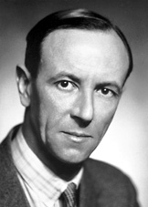
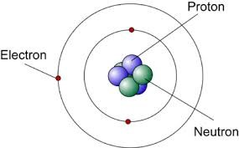
James Chadwick
1932
Student of Rutherford
Discovered particles in nucleus not affected by electric field called neutrons
Mass of neutral particles equals mass of protons

Slide 9
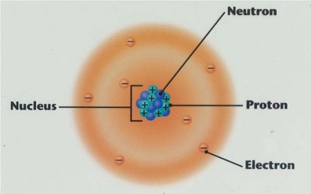
Today
Matter is made of atoms
Atom is the smallest part of an element that still represents that element
Are made of smaller particles
Electrons move in an area around nucleus called electron cloud
Very small—7.5 trillion carbon atoms fit on a period
● = 7.5 trillion carbon atoms
Can be seen with STM (scanning tunnel microscope)

