Slide 1
Inheritance

Slide 2
Inheritance
Trait
A distinguishing characteristic of an organism

Slide 3
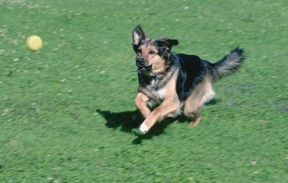
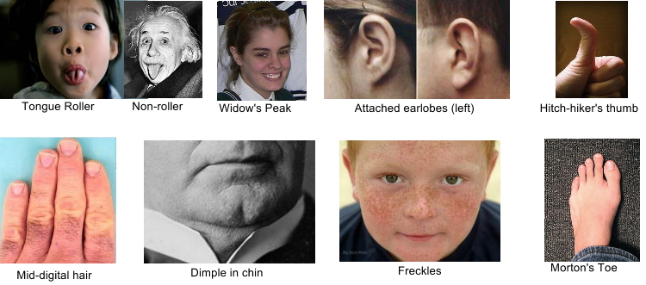
Inheritance
Acquired Trait
A trait an organism acquires or develops during its lifetime
Inherited Trait
Traits passed from generation to generation

Slide 4
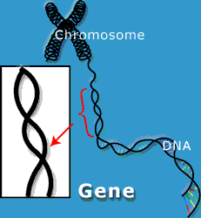
Inheritance
Gene
Section of DNA that has genetic information for one trait

Slide 5
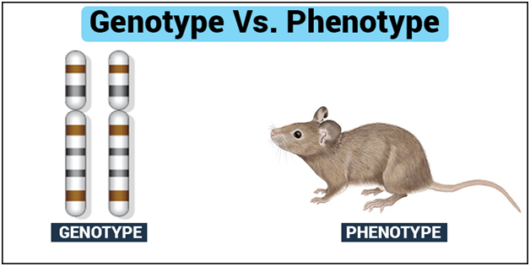
Inheritance
Genotype
An organisms complete set of genes
Does not change

Slide 6
Inheritance
Phenotype
How that trait appears (or is expressed)

Slide 7
Inheritance
Phenotype
Changes in response to the environment
Physical Factors
Light, temperature, nutrients
Social Factors
Social groups affect color, body structure, or behavior

Slide 8
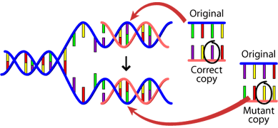
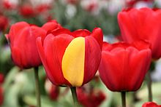
Inheritance
Mutation
Permanent change in sequence of DNA in a gene
Some harm chance for survival
Some cause no harm
Some help the organism survive

Slide 9
ADAPTATIONS

Slide 10
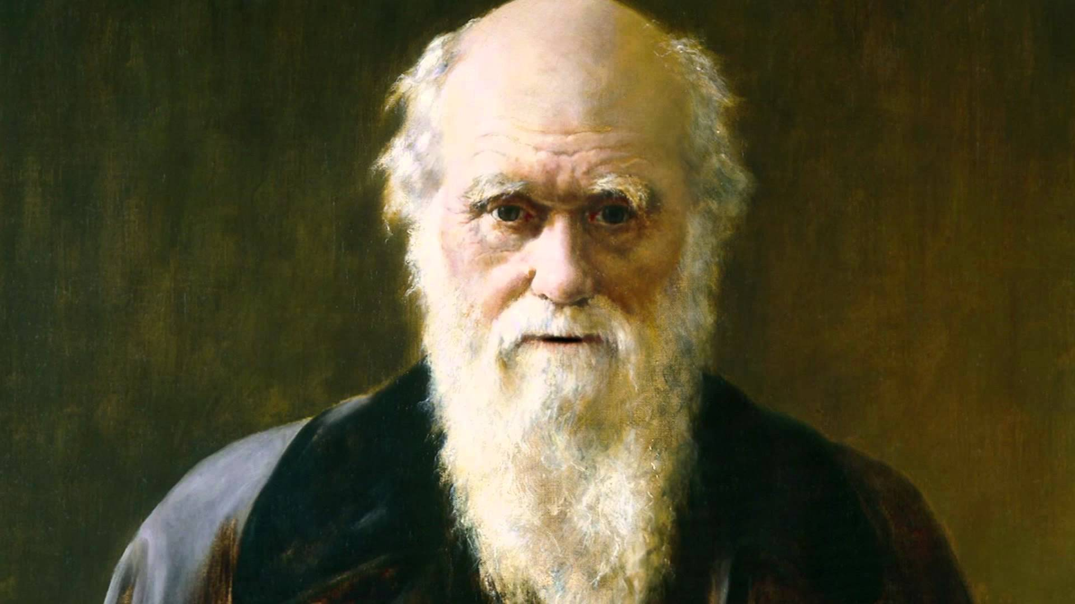
Charles Darwin
Created the Theory of Evolution by Natural Selection
Naturalist
Person who studies plants and animals by observing them
“It is not the strongest of the species that survives, nor the most intelligent, but the one most responsive to change.”

Slide 11
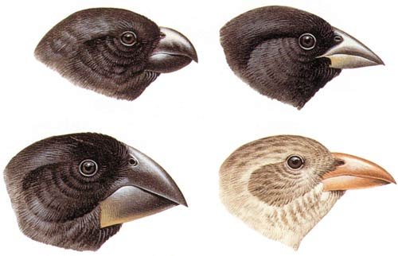
Adaptations
Variations
Slight differences in inherited traits among individual members of a species

Slide 12
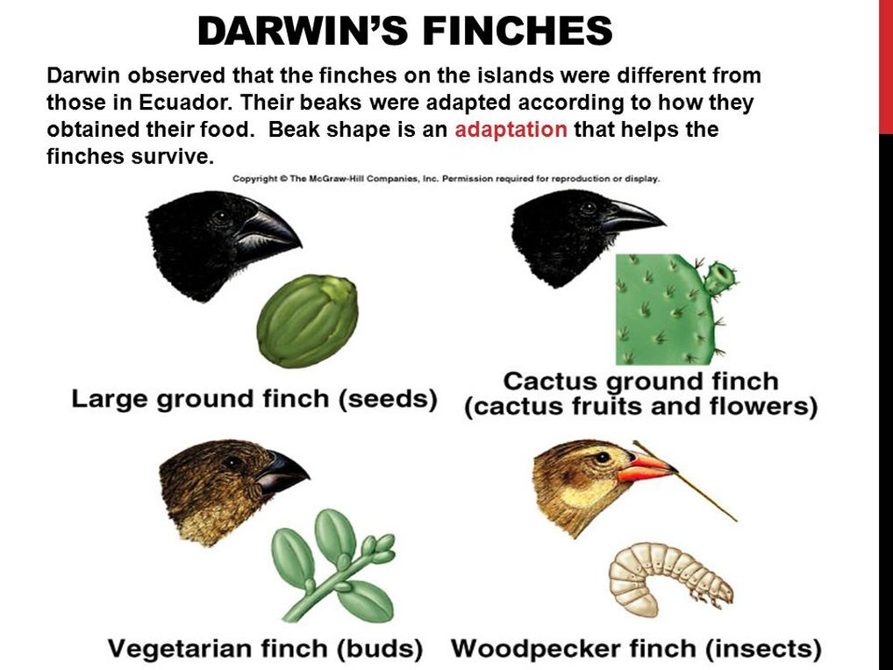
Adaptations
Adaptation
An inherited trait that helps a species survive and reproduce in its environment

Slide 13
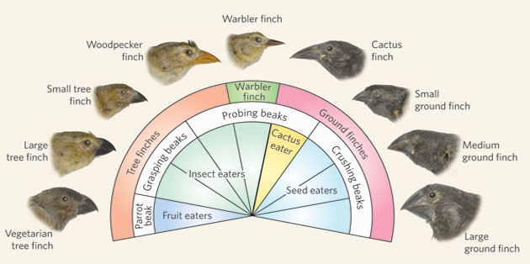
Adaptations

Slide 14
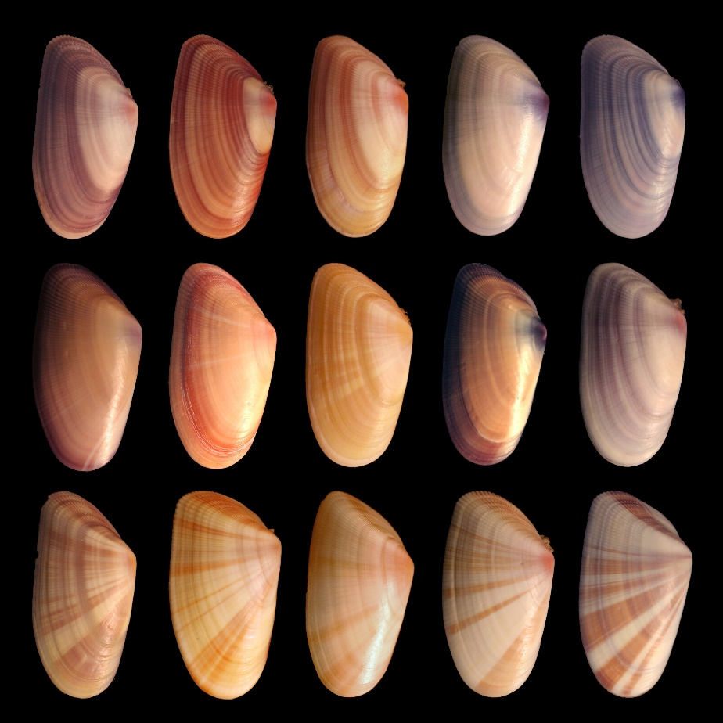
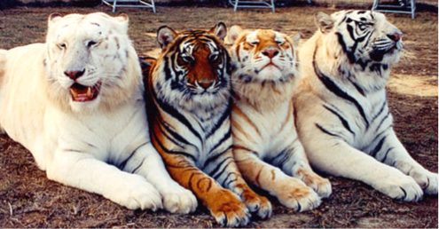
Theory of Evolution by Natural Selection
Individual members of species have variations

Slide 15
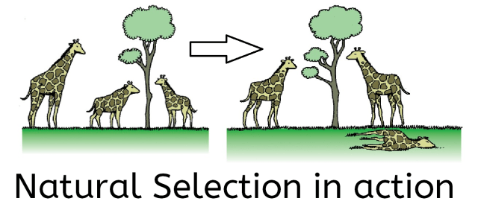
Adaptations
Natural Selection
The process by which organisms with variations that help them survive:
Live longer
Compete better (food, resources)
Reproduce more
Explains how all species change over time as the environment changes

Slide 17
Adaptations

Slide 18
Adaptations

Slide 19
Adaptations

Slide 20
Adaptations

Slide 21
Adaptaions

Slide 22
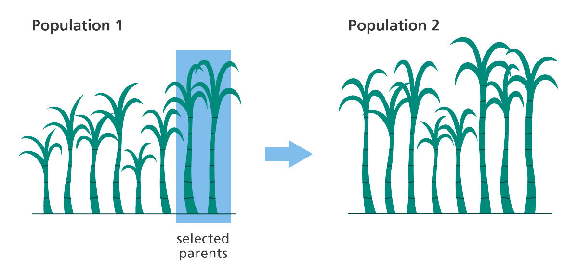
Adaptations
Selective Breeding
Selection and breeding of organisms with desired traits
Humans do selecting
May prevent diseases

Slide 24
Adaptations
Types of adaptations:
Structural
Physical traits
Examples:
Mimicry
Camouflage
Protective Coloration
Body Structure

Slide 25
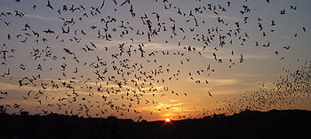
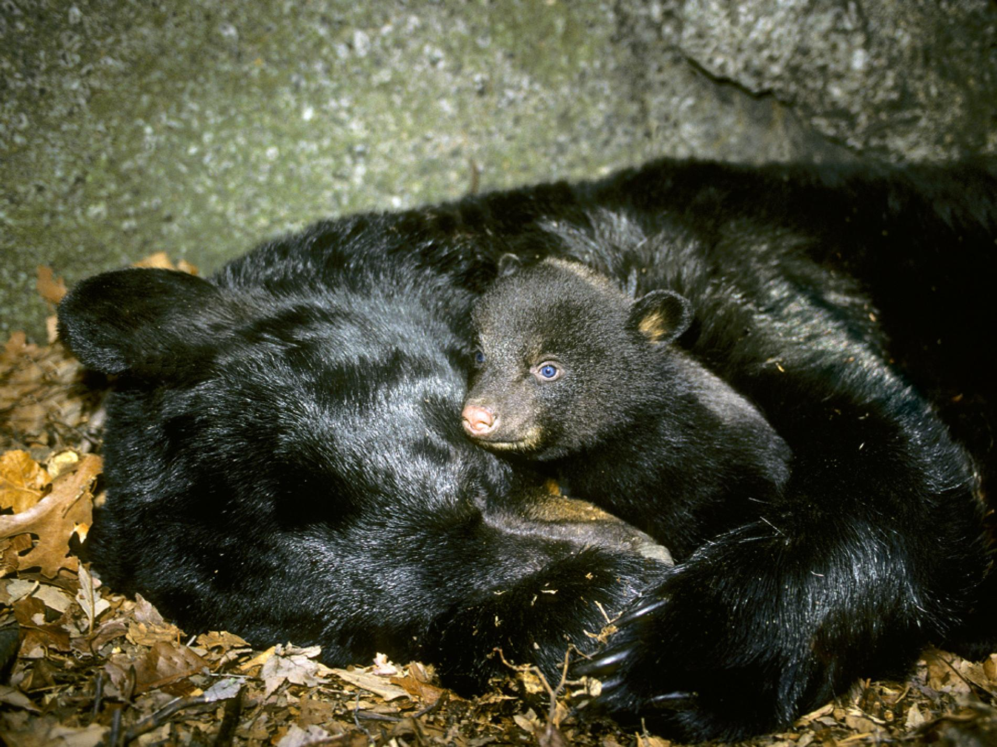
Adaptations
Types of adaptations:
Behavioral
Behavior or action
Examples:
Migration
Hibernation

Slide 26
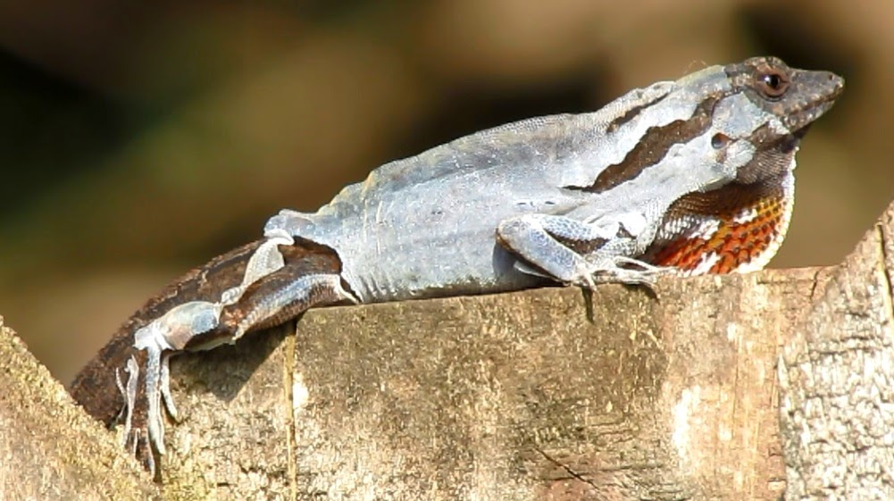
Adaptations
Types of adaptations:
Functional
Biochemical change
Example:
Shedding

Slide 27
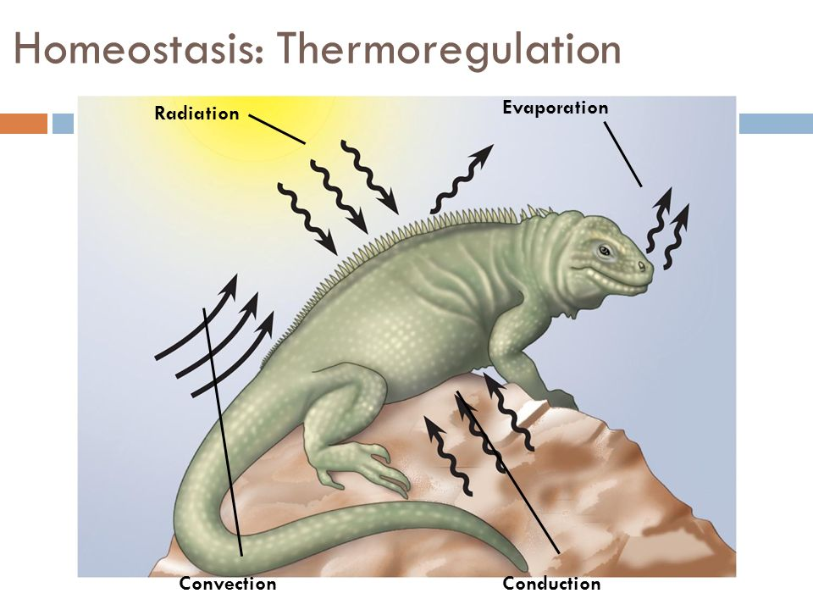
Adaptations
Reasons for Adaptations
Maintaining Homeostasis
Keeps internal conditions within certain limits
Helps to adapt to environment

Slide 28
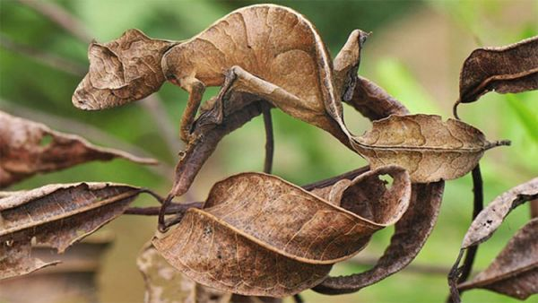
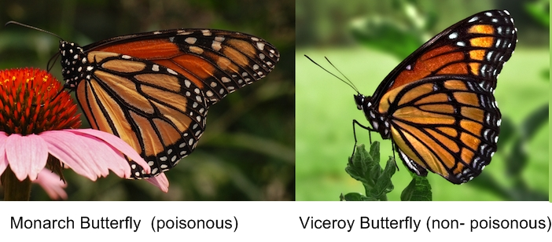
Adaptations
Reasons for Adaptations
Protection from Predators
Camouflage
An adaptation that enables a species to blend with its environment
Mimicry
An adaptation in which one species looks like another species

Slide 29
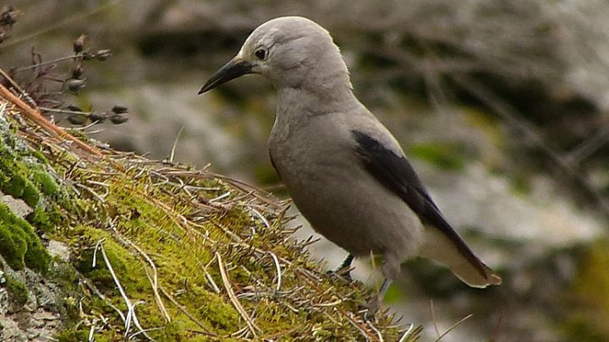
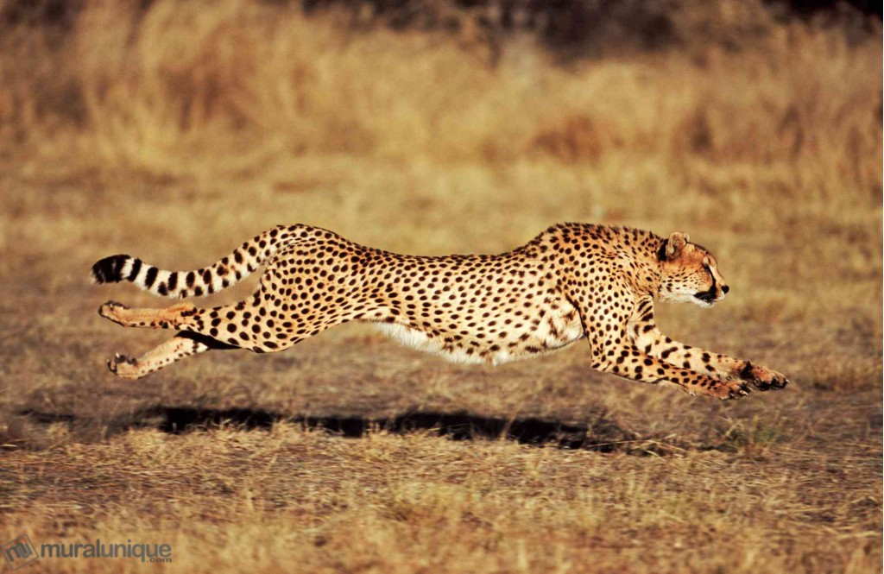
Adaptations
Reasons for Adaptations
Food Gathering
Used to gather and eat food
Species adapt to each other
EX: beak, speed

Slide 30
Adaptations
Reasons for Adaptations
Movement
Movement helps search for food, avoid predators
Legs, fins, wings, tails, flippers

Slide 31
EVOLUTION

Slide 32
Evidence for Evolution
Comparative Anatomy
Homologous Structures
Analogous Structures
Vestigial Structures
Developmental Biology
Molecular Biology

Slide 33
Evidence for Evolution
1. Comparative Anatomy
The study of similarities and differences among structures of living species

Slide 34
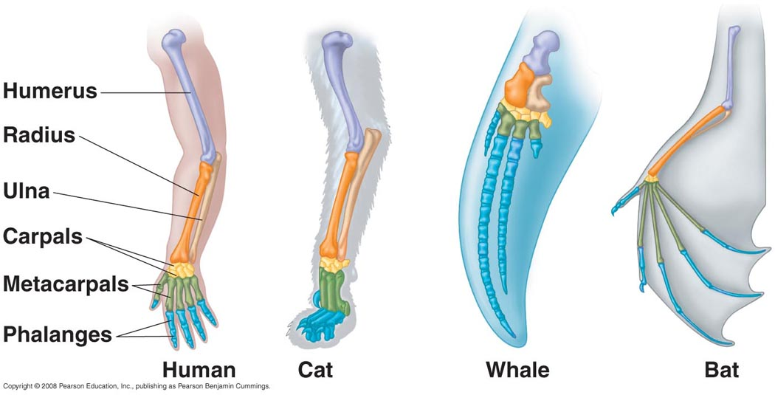
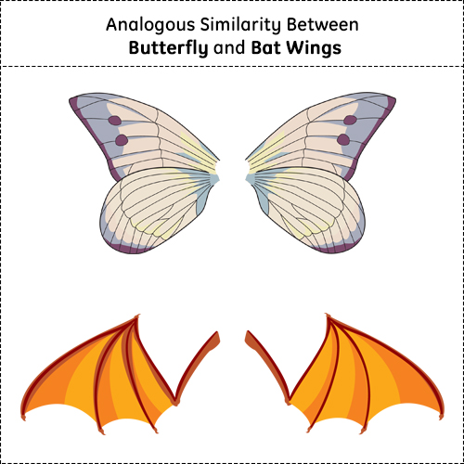
Homologous Structures
Analogous Structures
Body parts of organisms that are similar in structure and position but different in function
Body parts of organisms that perform a similar function but differ in structure

Slide 35
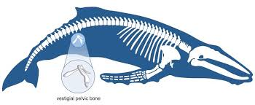
Evidence for Evolution
2. Vestigial Structures
Body parts that have lost their original function through evolution
Example: Pelvic bone in a whale

Slide 36
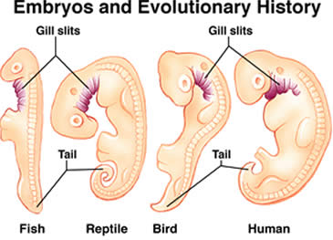
Evidence for Evolution
3. Developmental Biology
Embryos of different species resemble each other at different stages of development
These vertebrates all contain pharyngeal pouches
While they develop into different parts, they suggest evolutionary relationships

Slide 37
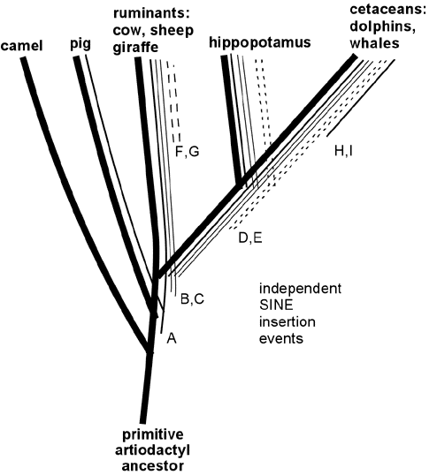
Evidence for Evolution
4. Molecular Biology
Study of gene structure and function
Comparing gene sequences lets scientists see how closely related species are
Divergence shows when a species diverged from common ancestors

Slide 38
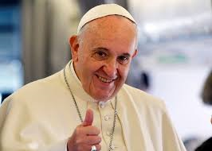
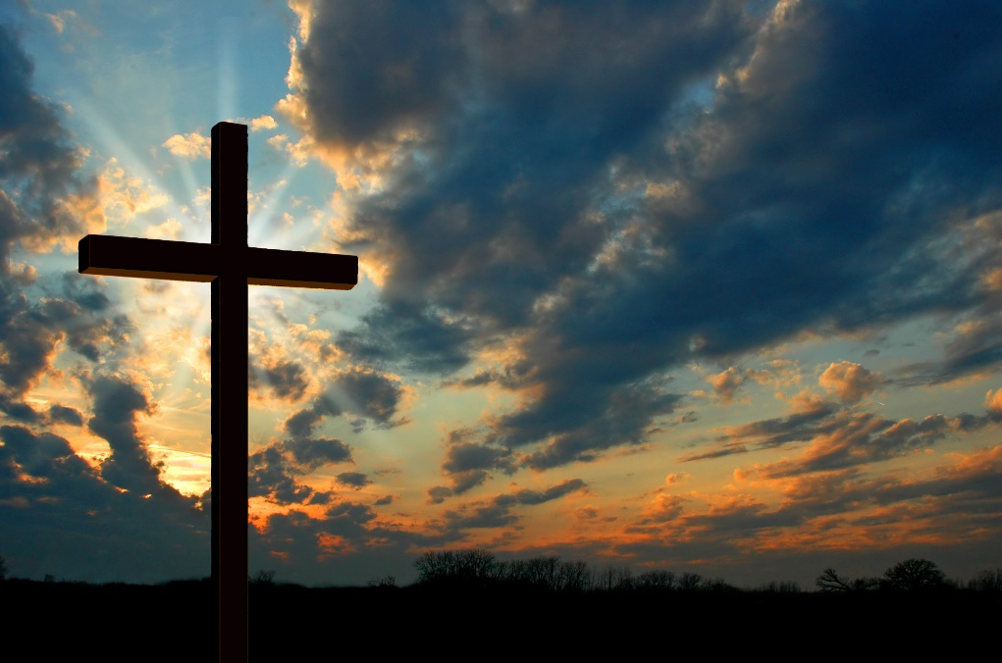
Catholics and Evolution
What is the Catholic perspective on evolution?

