Slide 1
Some words sound alike but have very different meanings.
It is important to learn the difference between these words that are frequently confused with each other.

Slide 2
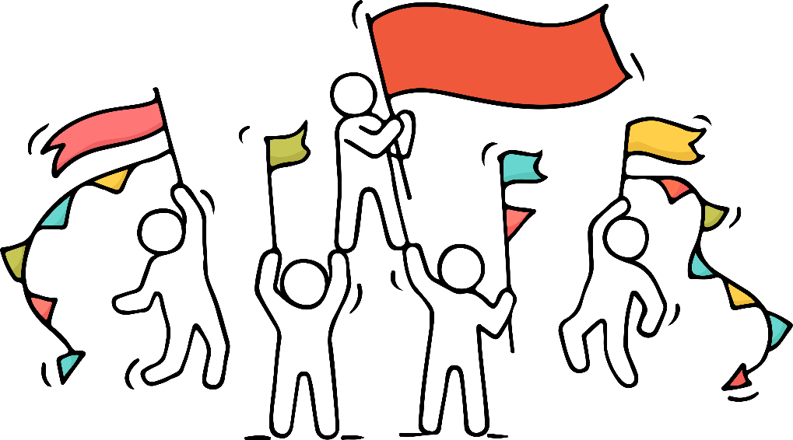
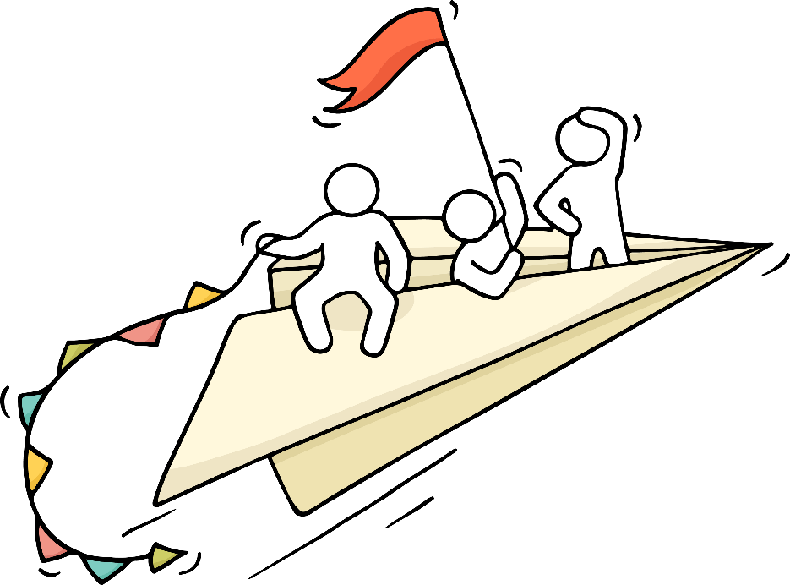
there
Look over there!
It means “in that place,” the opposite of “here.”
their
It shows that something belongs to them.
their
flags
they’re
It is a contraction of “they are.”
They’re flying!

Slide 3
there
,
their
,
or
they’re
?
The students read library books.
He placed the book over by the blue lamp.
The boys told me running late.
their
there
they’re

Slide 4
there
,
their
,
or
they’re
?
are many fun things to do at the beach.
The fans are excited. cheering and clapping for the players.
The couple and children are going on a camping trip.
There
They’re
their

Slide 5
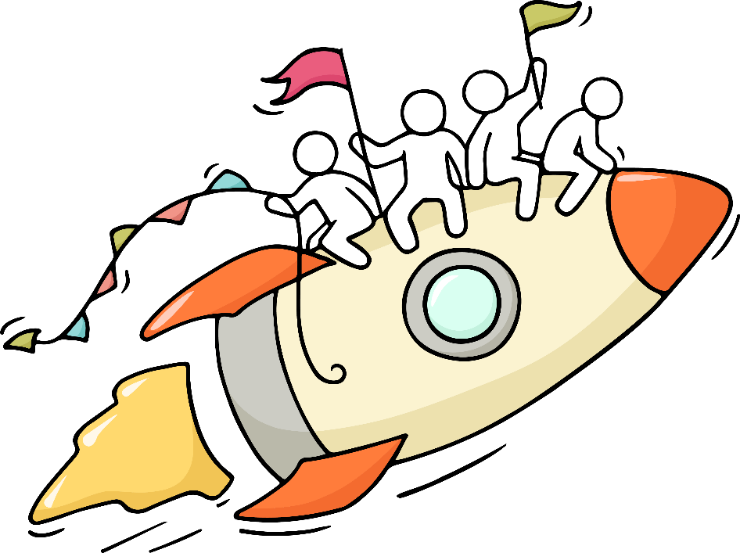
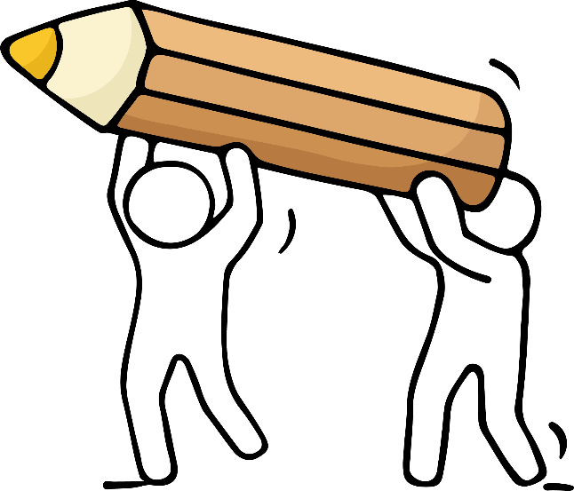
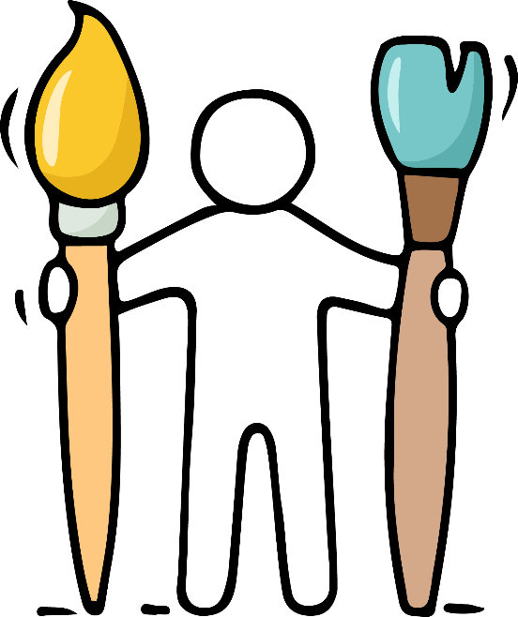
to
A preposition that shows movement. It means “toward.”
Fly me to the moon.
too
It means “as well,” “also.” Can also show excess.
It was too heavy, so he carried it too.
two
Only used to refer to the number 2.
I have two paintbrushes.

Slide 6
to
,
too
,
or
two
?
The chair is heavy. I need help moving it.
We rescued cats from the shelter.
My little brother whined, “I want play .”
too
two
to
too

Slide 7
to
,
too
,
or
two
?
Our class is going the aquarium for a field trip!
We went the candy store and bought pounds of chocolate.
It’s cold to play outside today.
to
to
two
too

Slide 8
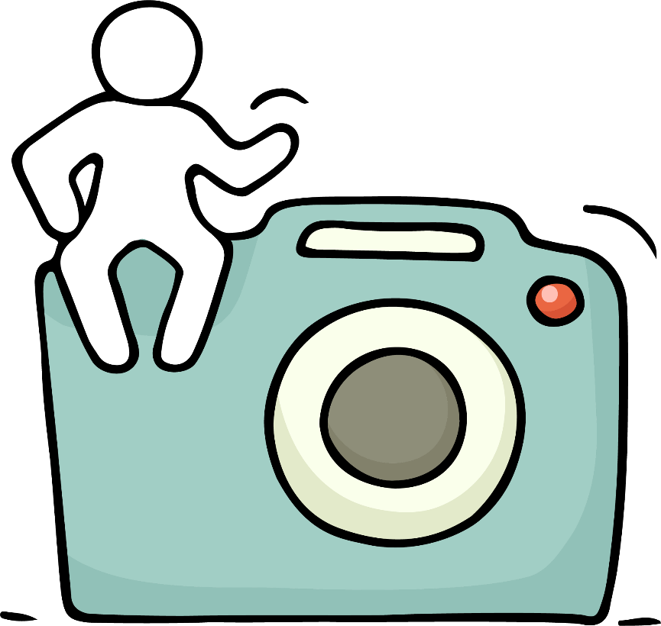
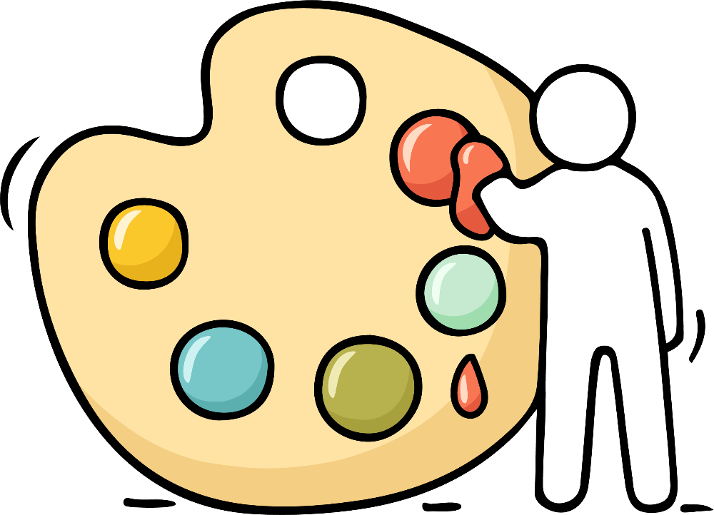
your
A possessive adjective that expresses ownership.
Bring your camera on the field trip.
you’re
A contraction combining the words “you” and “are.”
You’re a talented artist.

Slide 9
your
or
you’re
?
Did he read poem to the class?
I think ready for the math test.
mom said that sick.
Deon read book and loved it!
your
you’re
Your
you’re
your

Slide 10
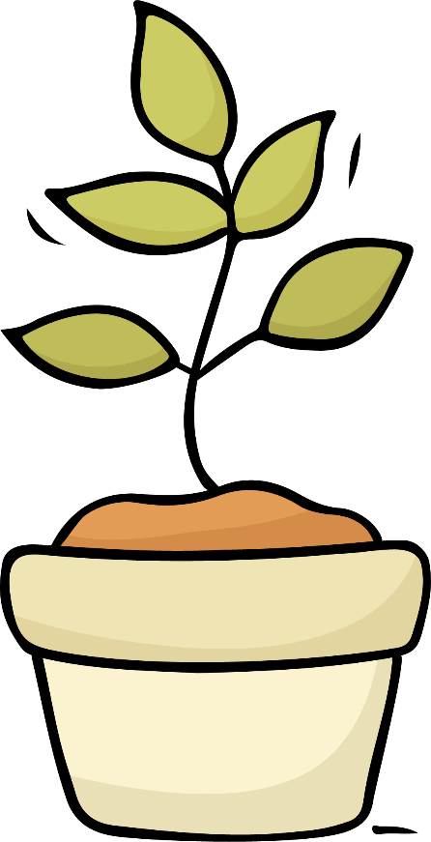
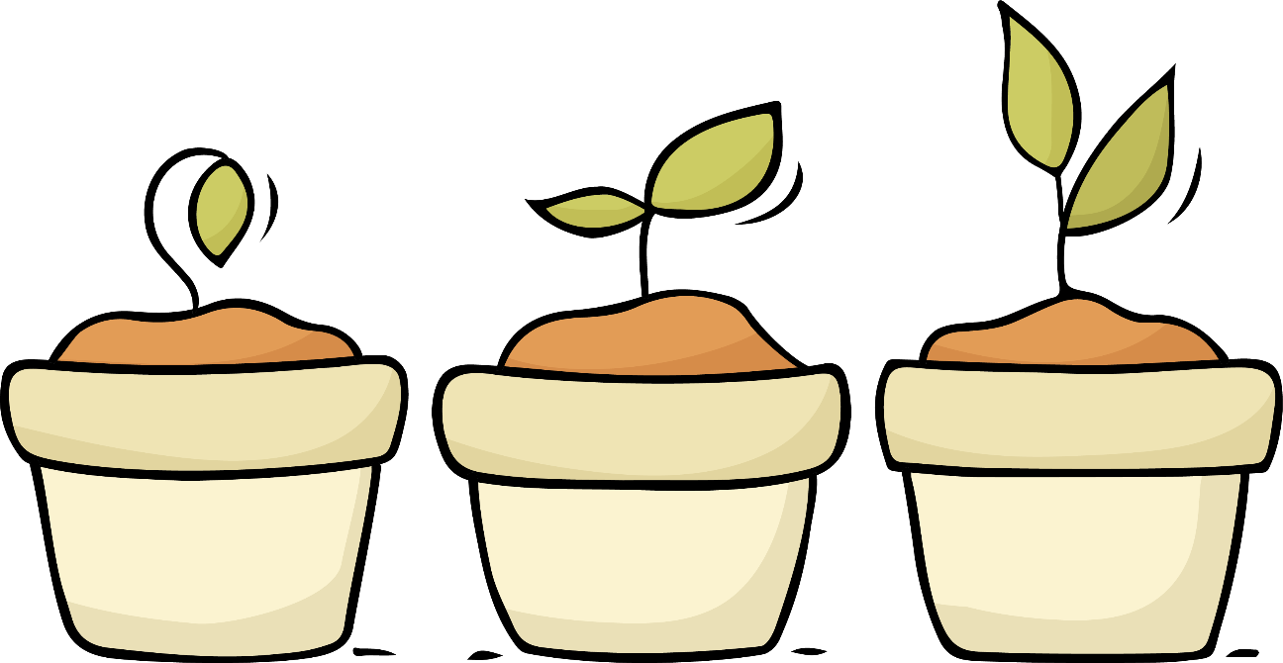
its
The possessive form of “it.” Belonging to it.
The plant is growing in its pot.
The pot “belongs” to the plant.
it’s
A contraction combining the words “it” and “is.”
It’s growing!

Slide 11
its
or
it’s
?
The turtle stuck head out.
I think going to snow soon.
The post office said on the way.
impossible for the dog to scratch back.
its
it’s
it’s
It’s
its

Slide 12
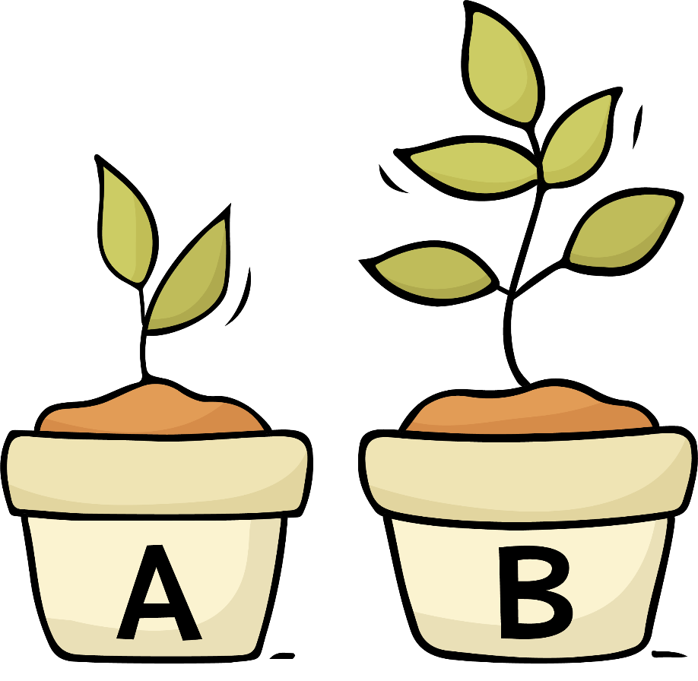
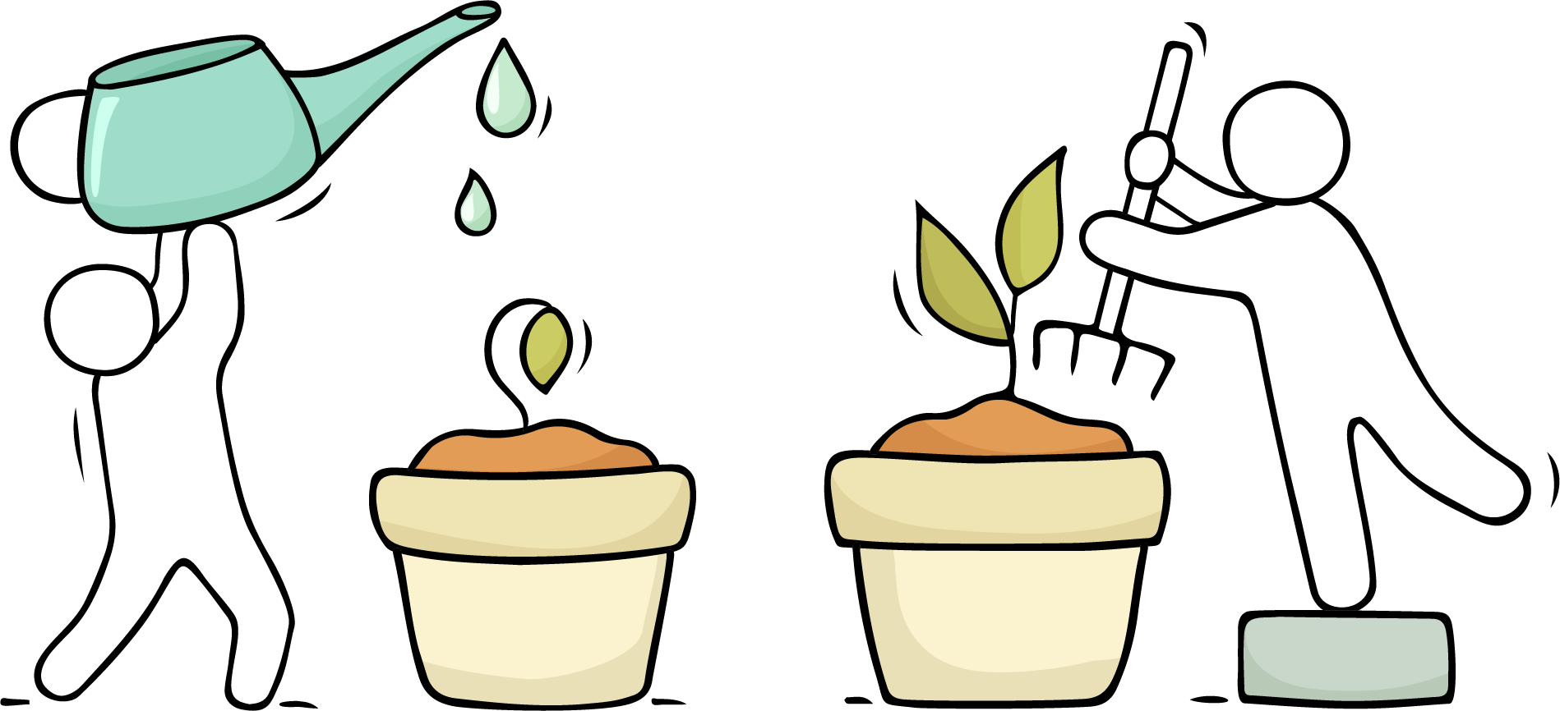
than
is used for comparison.
Plant B is taller than plant A.
then
is used for time or to indicate a result.
He took care of the plant and then it grew.

Slide 13
then
or
than
?
I can’t come over .
I am older my cousin.
If you want to be better me,
you’ll need to start practicing.
He is happier ever!
then
than
than
then
than

Slide 14
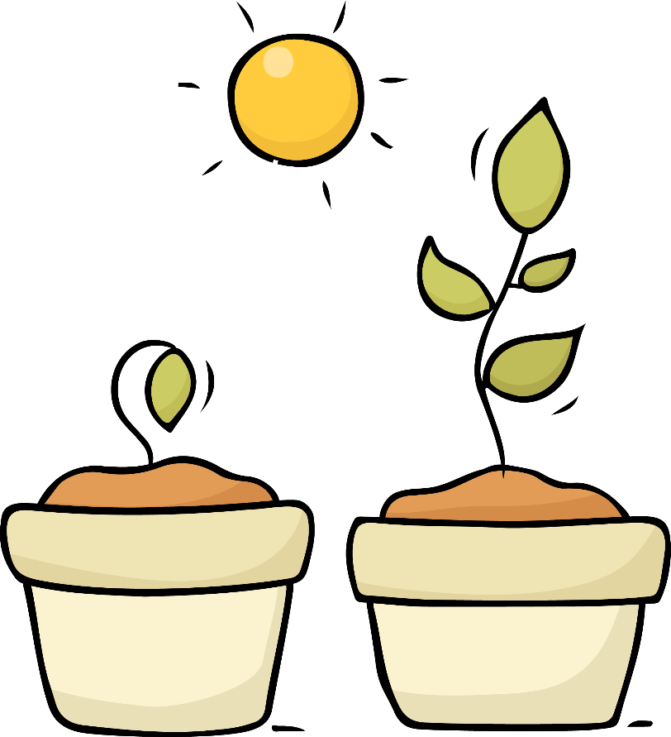
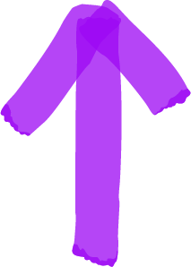
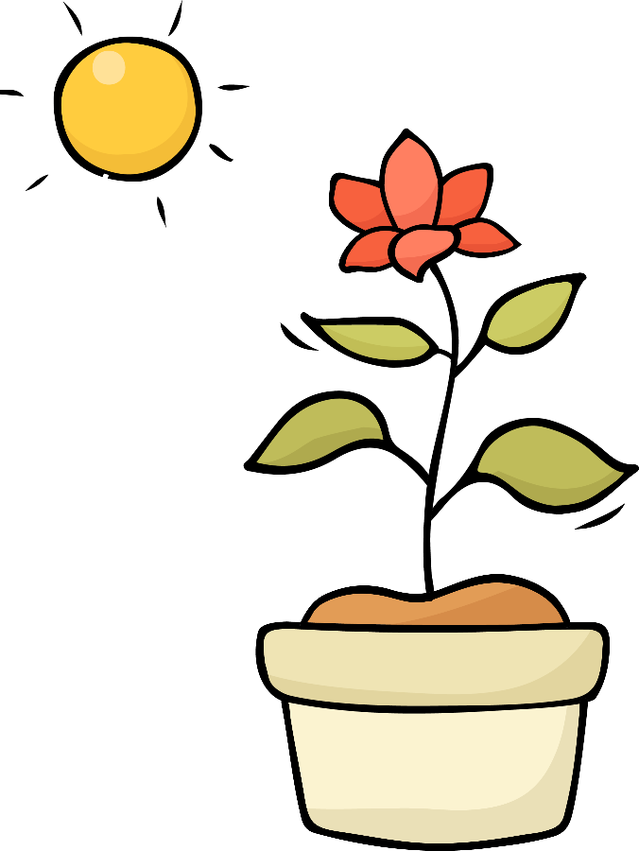
effect
is [noun] something that is produced by a cause; a result
Plant growth is an effect of sunshine.
affect
is [verb] to act on; to cause an effect or change in
The sun affects the plant by causing it to bloom.

Slide 15
effect
or
affect
?
Too much water can the recipe.
What is an of too much sun?
Swelling is an of a bee sting.
The flood didn’t our house.
affect
effect
effect
affect

