Slide 1
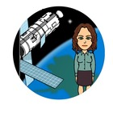
What Determines Climate Patterns?
By: Mrs. Proton Priest

Slide 2
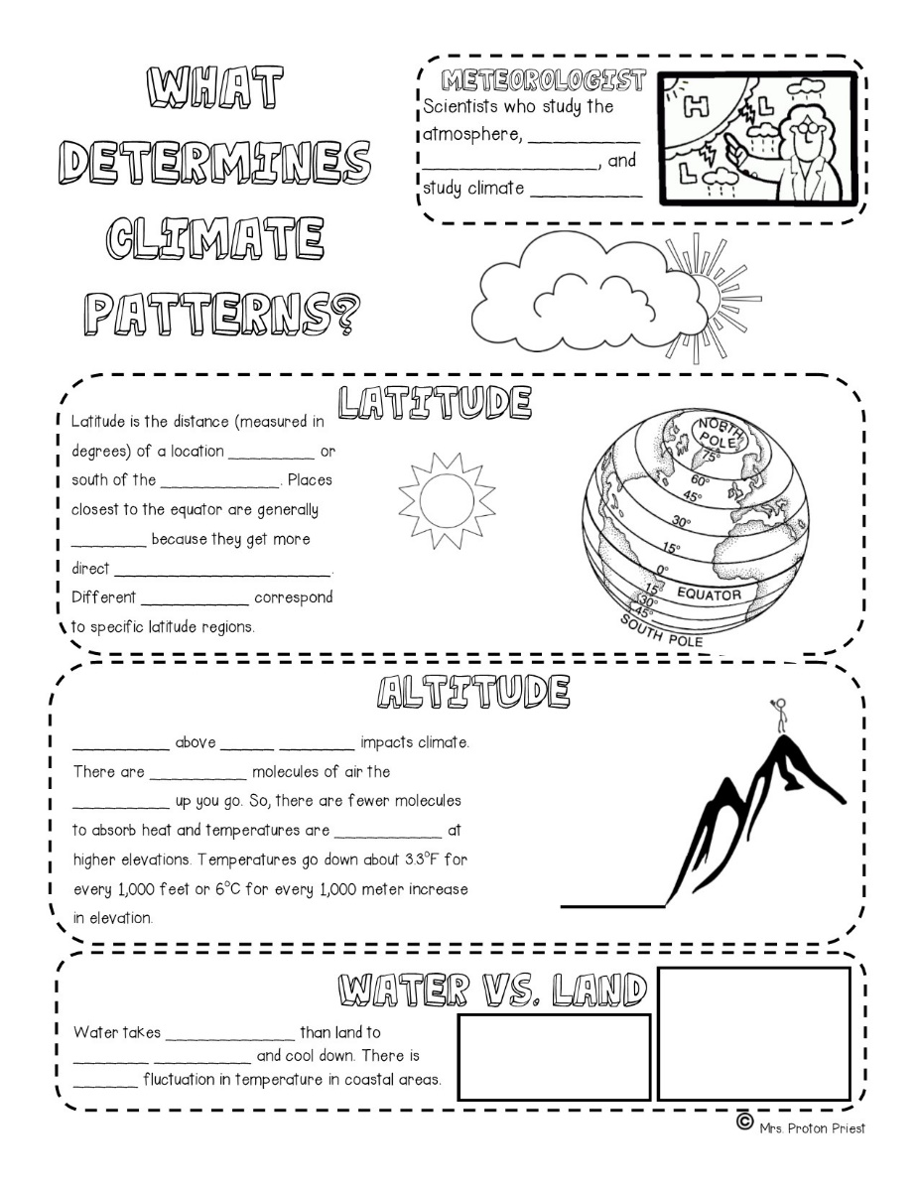
What Determines Climate Patterns?
Start here
Fill in your sketch notes. The words you need to write are underlined.

Slide 3
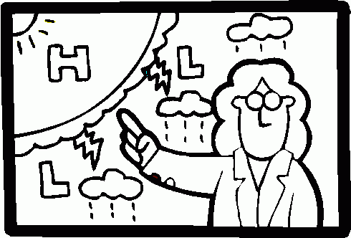
Meteorologists are…
Scientists who study the
atmosphere, predict weather,
and study climate patterns.

Slide 4
What Determines Climate Patterns?
Fill this out next

Slide 5
Latitude
Latitude is the distance (measured in degrees) of a location north or south of the equator. Places closest to the equator are generally warmer because they get more direct sun. Different climates correspond to specific latitude regions.

Slide 6
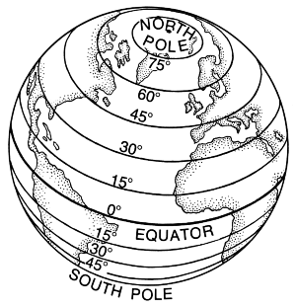
Latitude

Slide 7
What Determines Climate Patterns?
Now go here

Slide 8
Altitude
Height above sea level impacts climate. There are fewer molecules of air the higher up you go.

Slide 9
Altitude
So, there are fewer molecules to absorb heat and temperatures are cooler at higher elevations. Temperatures go down about 3.3°F for every 1,000 feet or 6°C for every 1,000 meter increase in elevation.

Slide 10
Altitude
Less Air Pressure
More Air Pressure
Sea Level

Slide 11
What Determines Climate Patterns?
Now go here

Slide 12
Water vs Land
Water takes longer than land to heat up and cool down. There is less fluctuation in temperature in coastal areas.

Slide 13
Water vs Land
Night
Day
65F
60 F
75 F
100 F
sand
sand

Slide 14
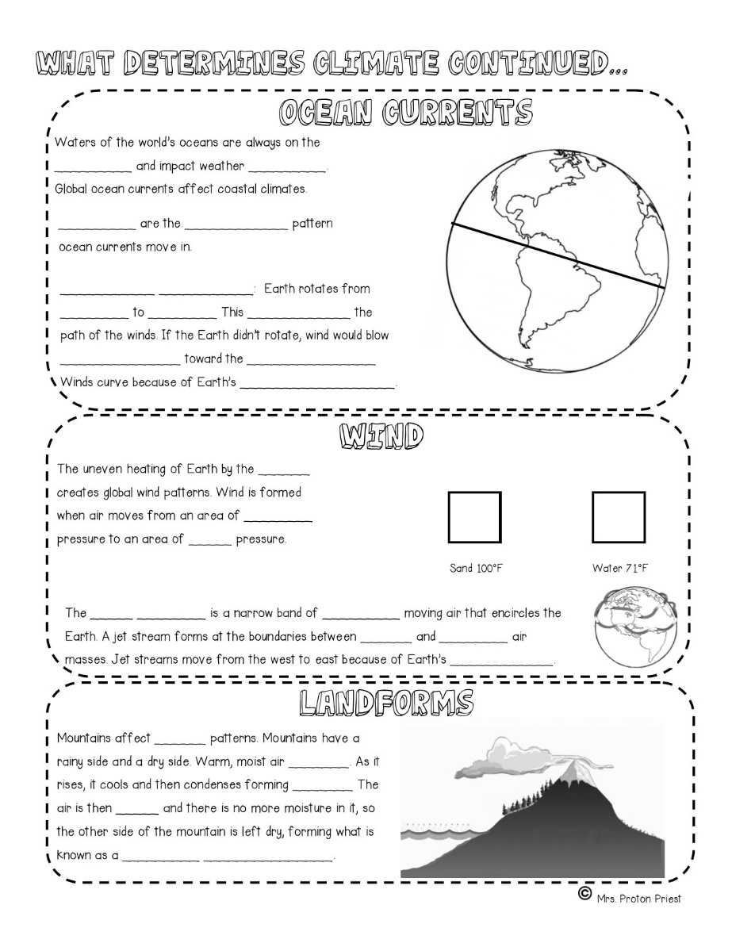
What Determines Climate Patterns?
2nd Page Start Here
Fill in your sketch notes. The words you need to write are underlined.

Slide 15
Ocean Currents
Water of the world’s oceans are always on the move and impact weather patterns. Global ocean currents affect climates. Gyres are the circular patterns ocean currents move in.

Slide 16
Ocean Currents
Coriolis Effect: Earth rotates from west to east. This curves the path of the winds. If the Earth didn’t rotate, the wind would blow straight towards the equator. Winds curve because of Earth’s rotation.

Slide 17
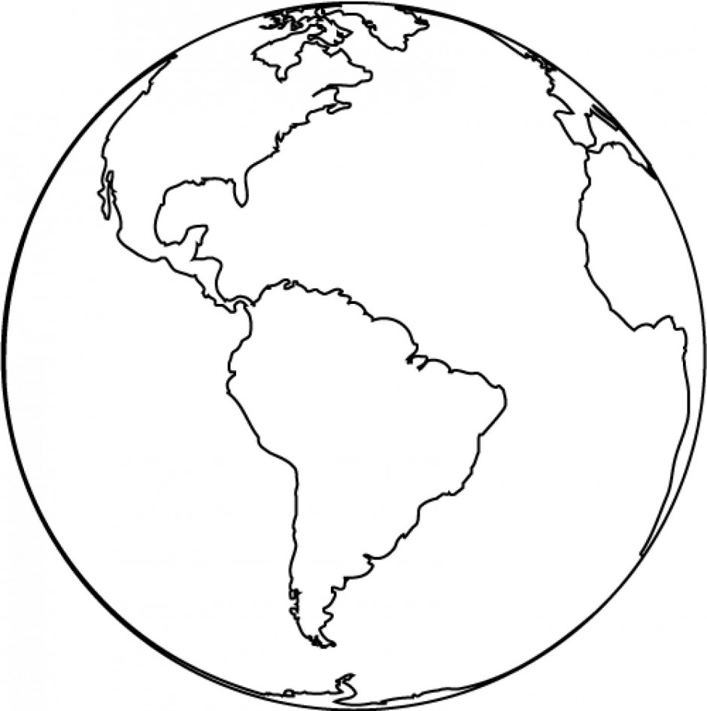
Ocean Currents
Rotation of Earth

Slide 18
Wind
Fill this out next

Slide 19
Wind
The uneven heating of the Earth by the sun creates global wind patterns. Wind is formed when air moves from an area of high pressure to an area of low pressure.

Slide 20
Hot Air Rises
L
H
Sea Breeze
Sand 100°F
Water 71°F

Slide 21
Wind
The jet stream is a narrow band of fast moving air that encircles the Earth. A jet stream forms at the boundaries between hot and cold air masses.

Slide 22
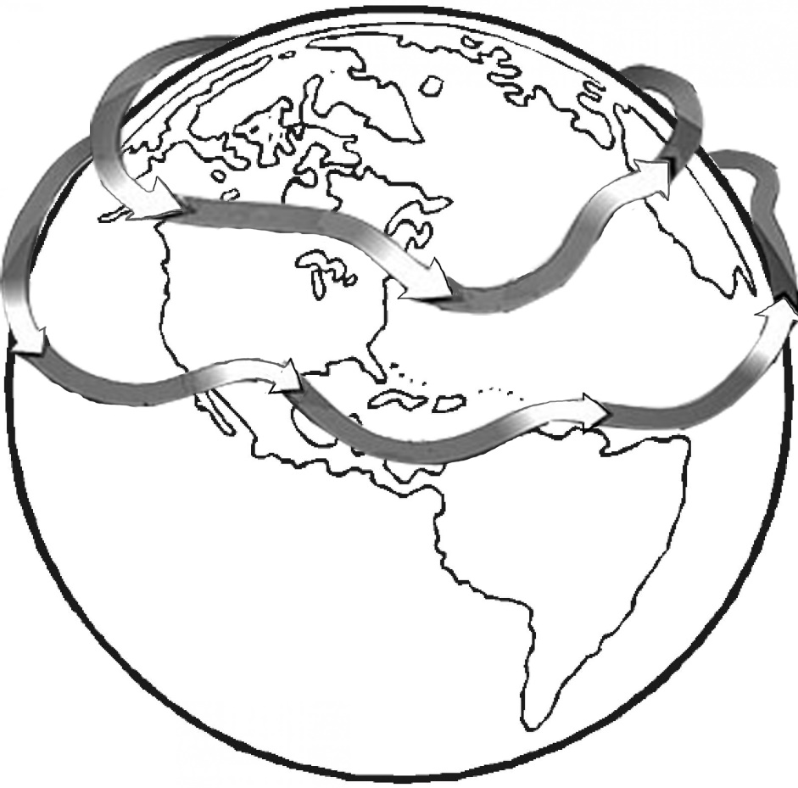
Wind
Jet Stream
Jet streams move from west to east because of Earth’s rotation.

Slide 23
Landforms
Now go here

Slide 24
Landforms
Mountains affect rain patterns. Mountains have a rainy side and a dry side. Warm, moist air rises. As it rises, it cools and condenses forming rain.

Slide 25
Landforms
The air is then dry and there is no more moisture in it, so the other side of the mountain is left dry, forming what is know as a rain shadow.

Slide 26
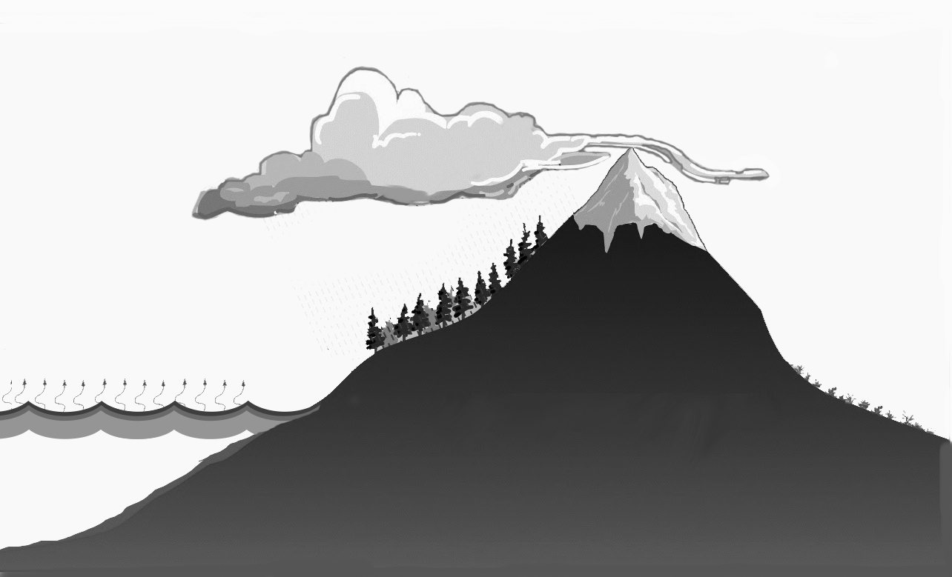
Landforms
Windward Side
Leeward Side
Rainy
Dry
Sea

