Slide 1
Waves

Slide 2
Types of Waves
Mechanical
A wave that travels only through matter (medium)
Caused by vibrating particles
Energy is transferred

Slide 3
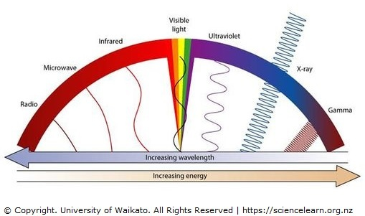
Types of Waves
Electromagnetic
A wave that can travel through empty space or matter
Formed when a charged particle vibrates

Slide 4
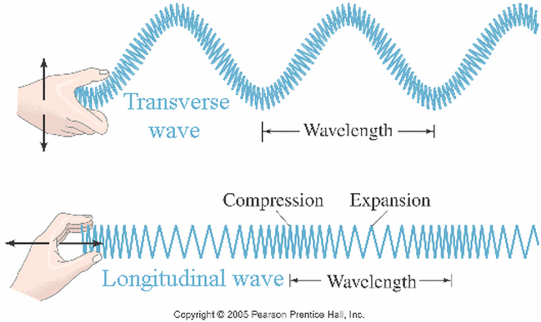
Wave Motions
Transverse Waves
A wave in which the disturbance is perpendicular to the direction a wave travels
Start at 11 sec

Slide 5
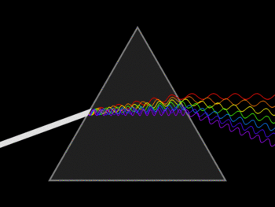
Wave Motions
Transverse Waves
Examples:
Mechanical waves
Flag waving in a breeze
Electromagnetic Waves
Light waves

Slide 6
Wave Motions
Longitudinal Waves
A wave that makes the particles of a medium move back and forth parallel to the direction a wave travels

Slide 7
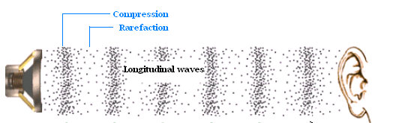
Wave Motions
Longitudinal Waves
Example:
Mechanical waves
Sound waves

Slide 8
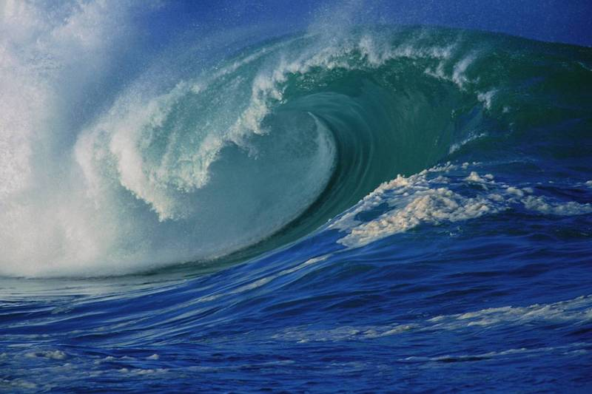
Wave Motions
Combination Wave
Both transverse and longitudinal
Example:
Mechanical waves
Water waves

Slide 9
Wave Motions

Slide 10
Waves in Nature
Water Waves
Combination (transverse and longitudinal)
Mechanical
Circular path
Friction between water and wind forms waves

Slide 11
Waves in Nature
Seismic Waves
P Waves
Longitudinal
S Waves
Transverse
Surface waves
Combination

Slide 13
Properties of Waves
Wave
A disturbance that transfers energy
Some require a medium to travel through, some do not
Medium
Matter that a wave travels through (solid, liquid, gas)

Slide 14
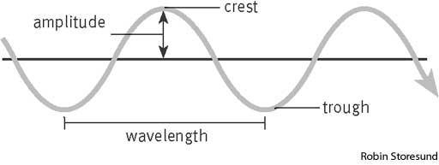
Properties of Waves
Crest
The peak, or highest, point of a transverse wave
Trough
The valley, or lowest point, of a transverse wave

Slide 15
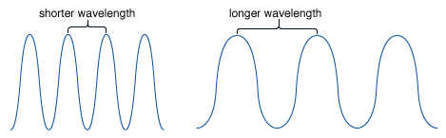
Properties of Waves
Wavelength
The distance from a point on one wave to the same point on the next wave

Slide 16
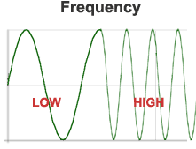
Properties of Waves
Frequency
The number of wavelengths that pass a point each second
Measured in hertz (Hz)

Slide 17
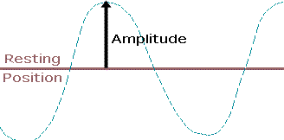
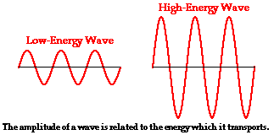
Properties of Waves
Amplitude
The maximum distance a wave varies from its rest position
The larger the amplitude, the more energy

Slide 18
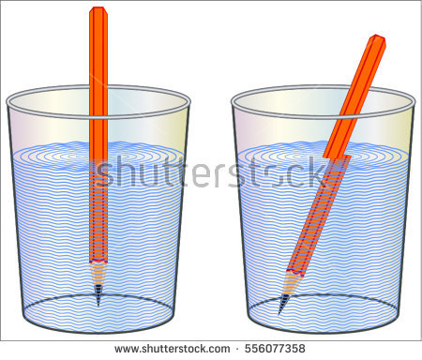
Wave Interactions with Matter
Refraction
The change in direction of a wave as it changes speed, moving from one medium to another
Refraction only happens if wave moves at an angle into a medium

Slide 19
Wave Interactions with Matter
Diffraction
The change in direction of a wave when it travels past the edge of an object

Slide 20
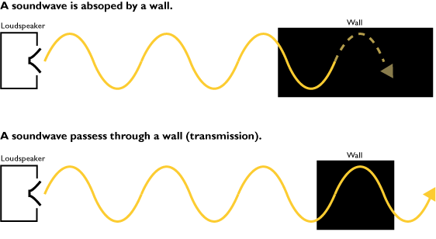
Wave Interactions with Matter
Transmission
Electromagnetic waves carry energy

Slide 21
Wave Interactions with Matter
Absorption
Some energy is absorbed by an object

Slide 22
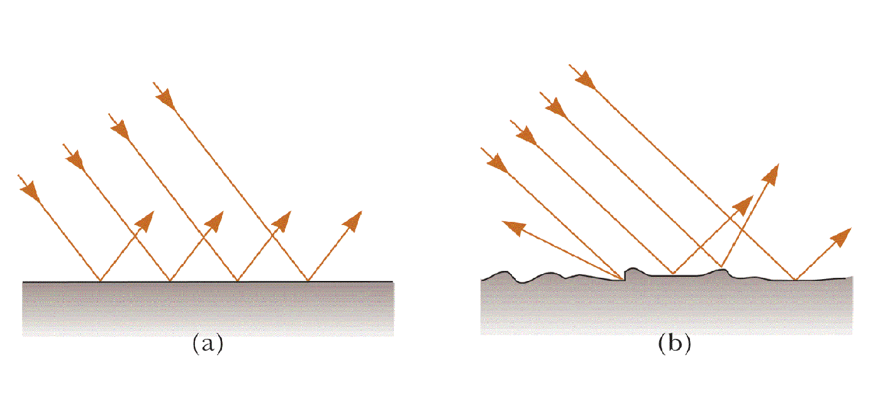
Wave Interactions with Matter
Reflection
Some electromagnetic waves are reflected back to the source

Slide 23
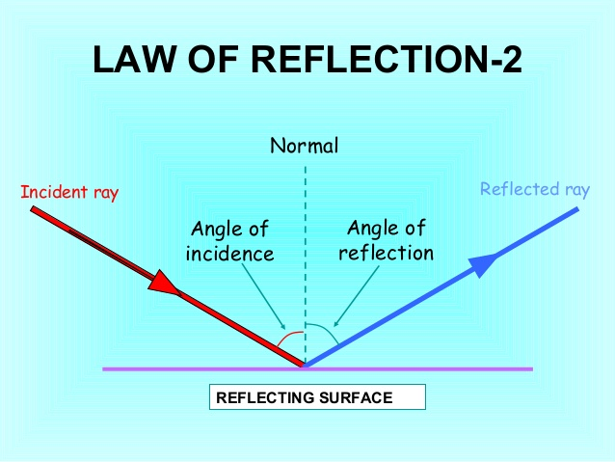
Law of Reflection
Law of Reflection
Angle between the incident ray (a light ray approaching a surface at an angle) and the normal (line perpendicular to surface where wave hits) equals the angle between the reflected ray and the normal.

