Slide 1
Sound

Slide 2
Straw Launch Lab p. 470
Read the directions on p. 470. Write a hypothesis about this experiment. If … then…because…
List the variables:
Independent:
Dependent:
Constants:
Complete the experiment, following the directions in the book.
Create a chart to list your observations.
Complete the Think About This questions.
Straw Length | Bottom Covered? | Description of Sound
Half | No
Quarter | No
Eighth | No
Half | Yes
Quarter | Yes
Eighth | Yes

Slide 3
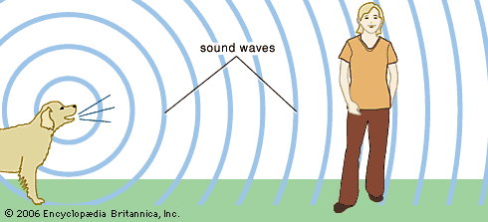
Sound Waves
Travel through air
Change air pressure

Slide 4
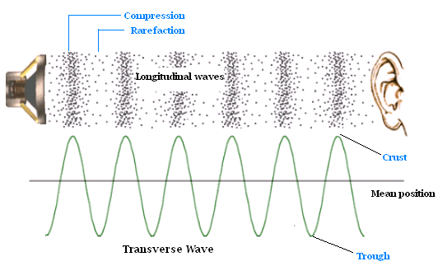
Sound Waves
Compressions
Area of a longitudinal wave where particles of the medium are closer together
Rarefactions
The region of a longitudinal wave where particles are farthest apart

Slide 5
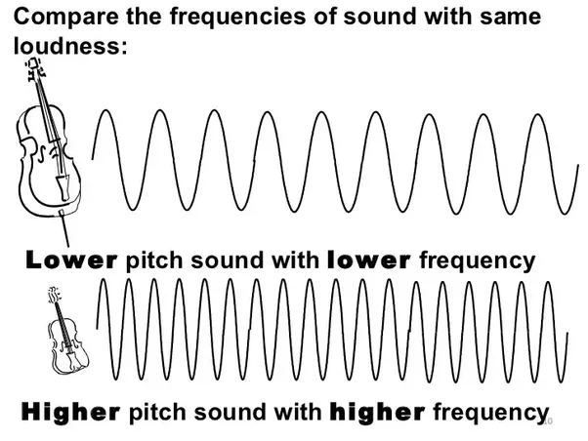
Sound Waves
Properties of Sound Waves
Pitch
How high or low a sound is
Higher frequency = higher pitch

Slide 6
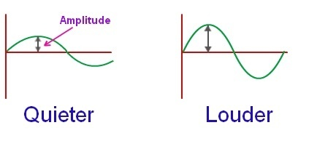
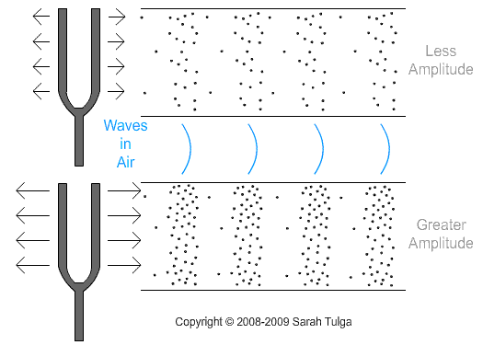
Sound Waves
Properties of Sound Waves
Amplitude and Energy
More energy = more amplitude

Slide 7
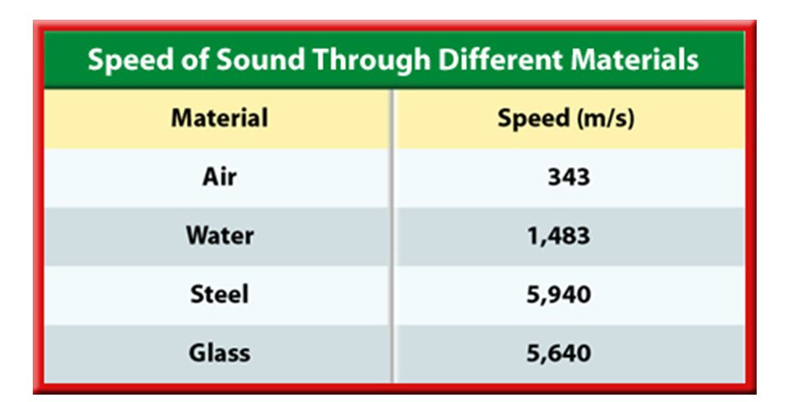
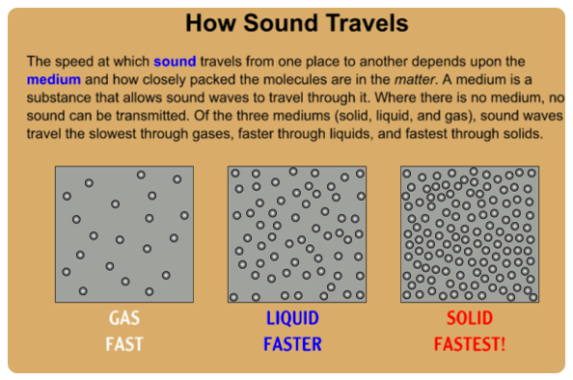
Sound Waves
Properties of Sound Waves
Speed
Depends on type of medium and temperature
In a gas = faster as temp increases
In a solid/liquid = faster as temp cools

Slide 8
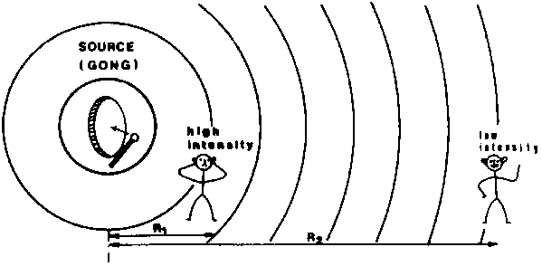
Sound Waves
Properties of Sound Waves
Intensity (Loudness)
Farther from source = less energy and less intensity (loudness)

Slide 9
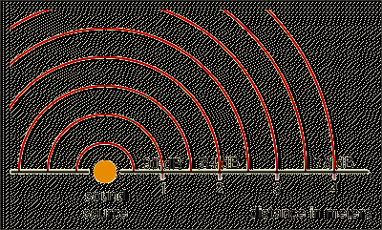
Sound Waves
Properties of Sound Waves
Decibel (dB)
Unit used to measure sound intensity (loudness)
Increase of 10dB is 2 times as loud

Slide 10
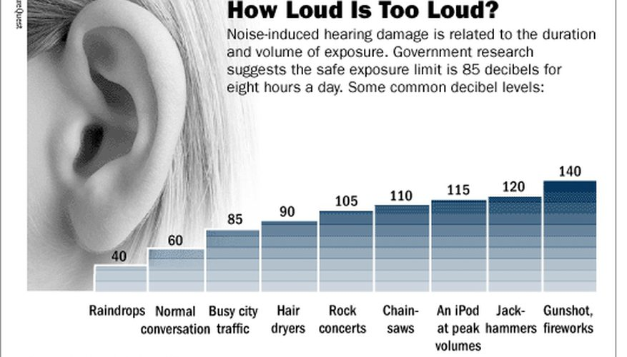
Sound Waves

Slide 11
Ear

