Slide 1
Science Fair
Helpful Hints and Timely Tips!

Slide 2
Step 1: Choose a Topic
Step 2: Formulate a Research Question
Be creative!
Make sure there is ACTUAL science behind your idea!!!
Use multiple resources to look for a topic. The internet is a great resource!
Begin with a question word. Use a question mark!!
Example:
Bad Question: Which piece of bread will get moldy?
Good Question: Which type of bread will get moldy faster, white or rye?

Slide 3
Science Project Topics to Avoid | Why
Any topic that boils down to a simple preference or taste comparison. For example, "Which tastes better: Coke or Pepsi?" | Such experiments do not involve the kinds of numerical measurements you want in a science fair project. They are more of a survey than an experiment.
Most consumer product testing of the "Which is best?" type. This includes comparisons of popcorn, bubblegum, makeup, detergents, cleaning products, and paper towels. | These projects only have scientific validity if the investigator fully understands the science behind why the product works and applies that understanding to the experiment. While many consumer products are easy to use, the science behind them is often at the level of a graduate student in college.
Any topic that requires people to recall things they did in the past. | The data tends to be unreliable.
Effect of music or talking on plants. | Difficult to measure.
Effect of running, music, video games, or almost anything on blood pressure. | The result is either obvious (the heart beats faster when you run) or difficult to measure with proper controls (the effect of music).
Effect of color on memory, emotion, mood, taste, strength, etcetera. | Highly subjective and difficult to measure.
Any topic that requires measurements that will be extremely difficult to make or repeat, given your equipment. | Without measurement, you cannot do science.
Graphology or handwriting analysis. | Questionable scientific validity.
Astrology or ESP. | No scientific validity.
Any topic that requires dangerous, hard-to-find, expensive, or illegal materials. | Violates the rules of virtually any science fair.
Any topic that requires drugging, pain, or injury to a live vertebrate animal. | Violates the rules of virtually any science fair.
Any topic that creates unacceptable risk (physical or psychological) to a human subject. | Violates the rules of virtually any science fair.
Any topic that involves collection of tissue samples from living humans or vertebrate animals. | Violates the rules of virtually any science fair.

Slide 4
Step 3: Do Your Research
Start researching your question.
Find out:
Is there actual science to support what you are doing?
What information will help you write the best hypothesis?
Write a one page essay explaining the science behind the experiment you are proposing.
What scientific ideas and concepts contribute to your experiment?
Make sure to explain and define all science terms.
Example:
If your research question is what type of bread will mold fastest, then you will research how mold is formed and what factors contribute to its formation.

Slide 5
Step 4: Write a Hypothesis
Use an If…then…because… statement
DO NOT use I think!
This should be an educated, research-based guess
You must choose an outcome
Bad Example: If I leave bread out, then it will mold.
Good Example: If rye and white bread are left on the counter, then white bread will mold faster.

Slide 6
Step 5: Materials
Step 5: Procedure
This is a step that is often forgotten.
List all the materials you used in your experiment.
List the procedure you followed to complete your experiment.
It is helpful if you write the steps down as you complete them.
Be specific and detailed. Someone should be able to do your experiment based on your directions.

Slide 7
Step 6: Variables
You must have two variables and constants listed for your experiment.
If your experiment does not, then it is not a scientifically valid experiment!
Remember:
Your independent variable is the factor you are changing.
Your dependent variable is the factor you are measuring.
Your constants are the things you will keep the same.
Examples:
Independent Variable: type of bread (white, rye)
Dependent Variable: time it takes bread to mold
Constants: size of bread, location

Slide 8
Step 7: Data
Data includes graphs, charts, data tables, and pictures
Pictures add a lot to the project
You must include one graph and one data table
Use a graphing program in word or excel to create a professional looking graph
Make sure to include the following:
Title
X and Y axis labels
Accurate data
Example:

Slide 9
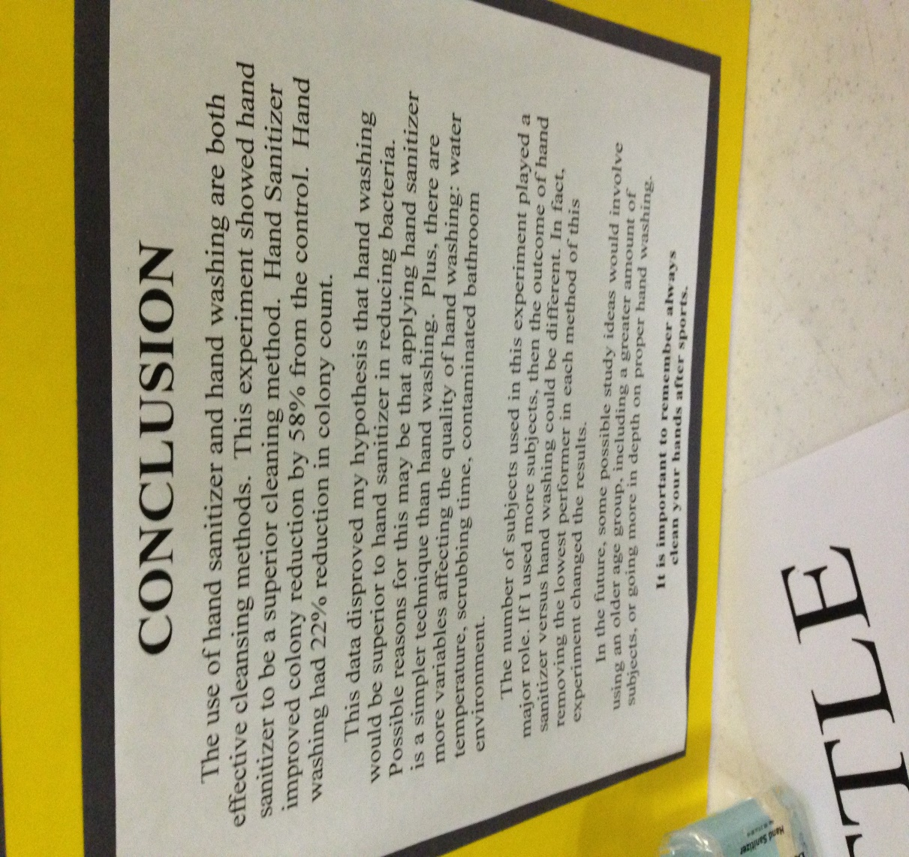
Step 8: Conclusion
Examples:
Must be ½ to 1 page long
Tells us what happened in your experiment
Answer your research question
Summarize the hypothesis
SCIENTIFIC EVIDENCE to show why your hypothesis is true or not
Sums up the charts and graphs
Explain results/data
Did your data match your research? Analyze why or why not

Slide 10
Step 9: Putting it Together
Set up your display board!
Colored boards look best
Use backing paper of a contrasting color.
Use 16 point font or bigger. Make sure it is easy to read.
Use a ruler! Make straight lines.
Make your title large-print or cut out letters.

Slide 11
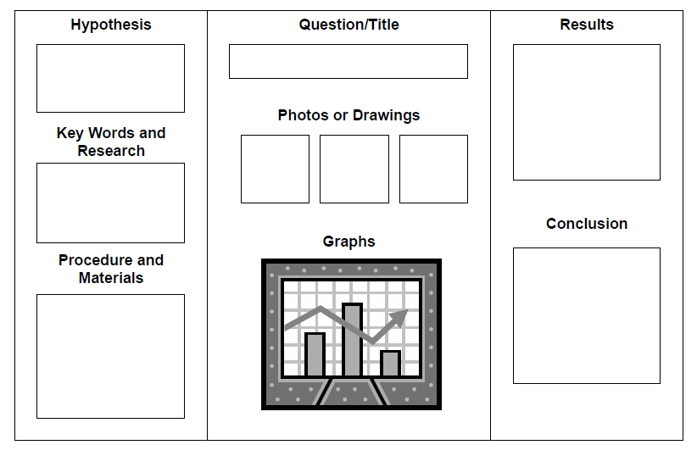
Research Paper
Materials
Procedure

Slide 12
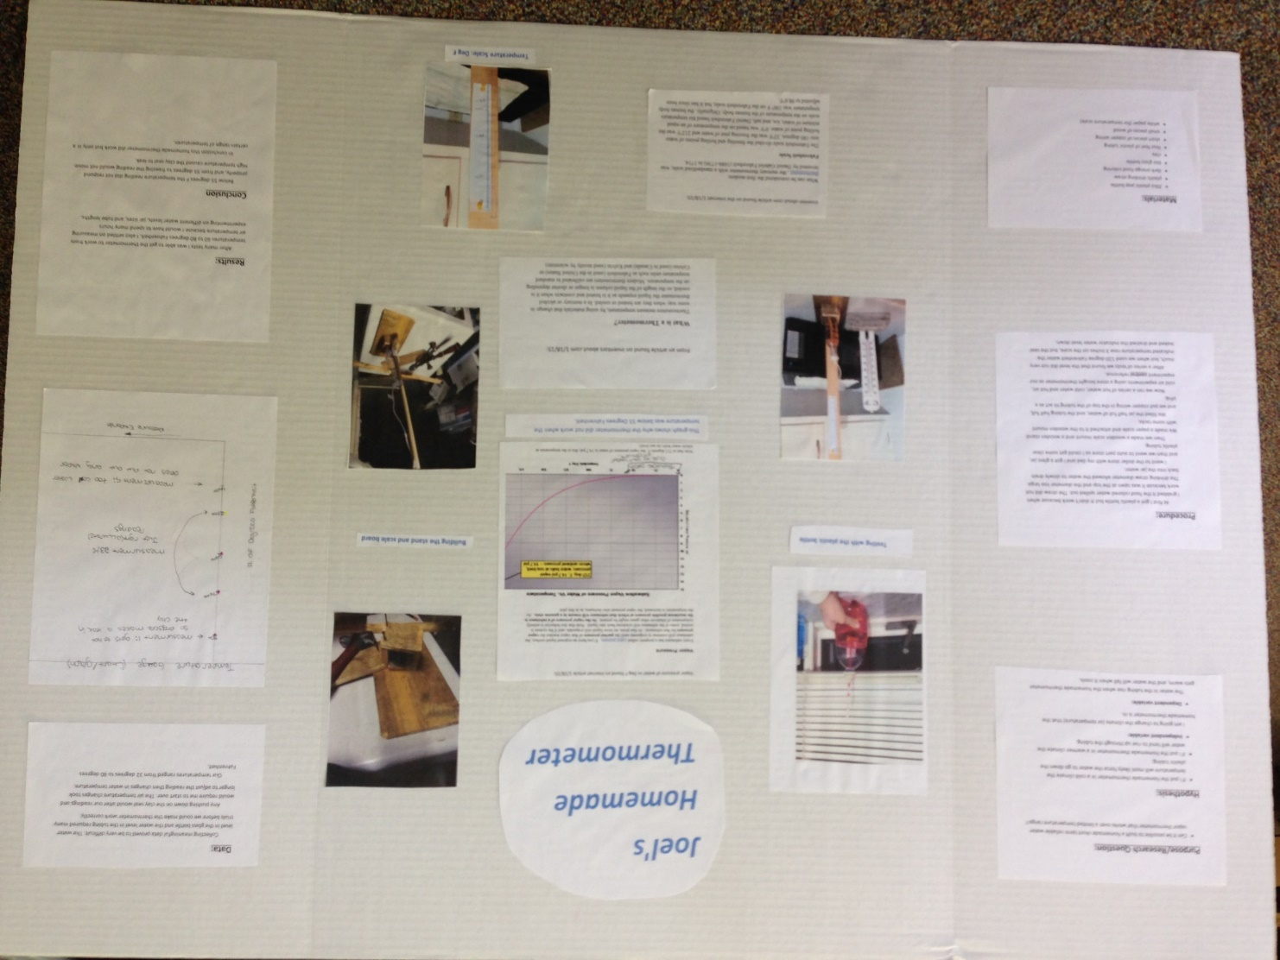
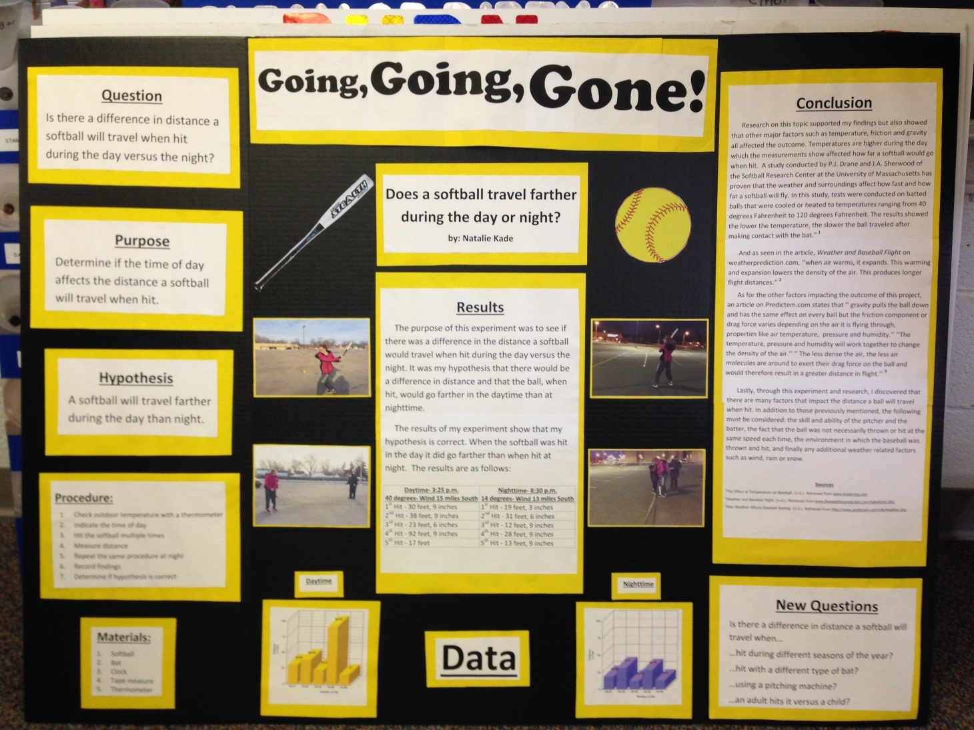
Samples

