Slide 1
Principles of Relative Age Dating

Slide 2
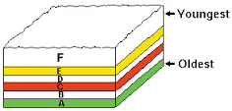
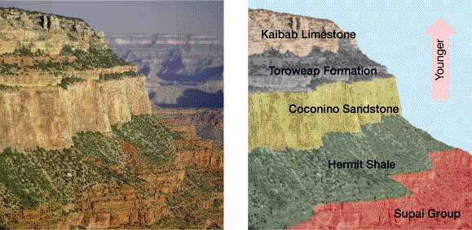
Principles of Relative Age Dating
Superposition
The principal that in undisturbed rock layers, the oldest rocks are on the bottom
Each layer is younger than the one below it

Slide 3
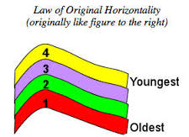
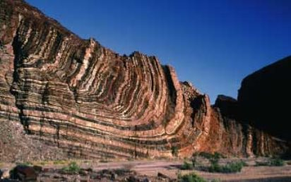
Principles of Relative Age Dating
Original Horizontality
Most rock forming materials are deposited in horizontal layers
Some layers are deformed or disturbed (tilted or folded) after formation

Slide 4
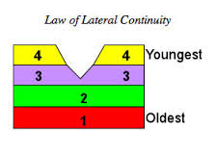
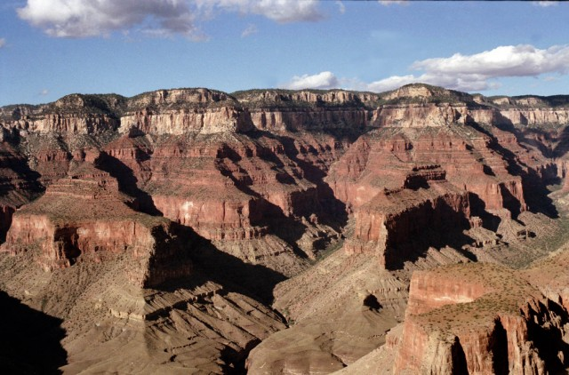
Principles of Relative Age Dating
Lateral Continuity
Sediments are deposited in large, continuous sheets in all lateral directions
The layers continue until they this out or meet a barrier
Something (a river) might cut through layers, but placement doesn’t change

Slide 5
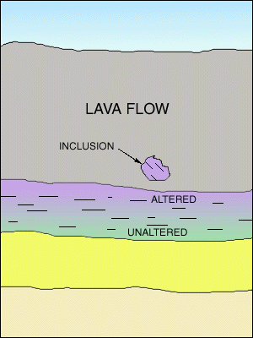
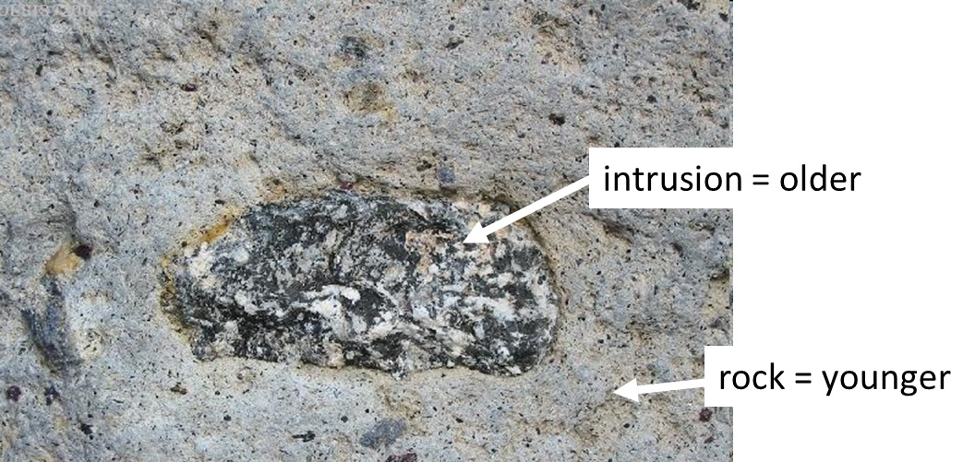
Principles of Relative Age Dating
Inclusions
A piece of an older rock that becomes part of a new rock
Part of an older rock may break off and fall into soft sediment or magma and becomes part of it as rock hardens
Vertical intrusion=dike
Principal of Inclusions
If one rock contains pieces of another rock, the rock containing the pieces is younger than the pieces

Slide 6
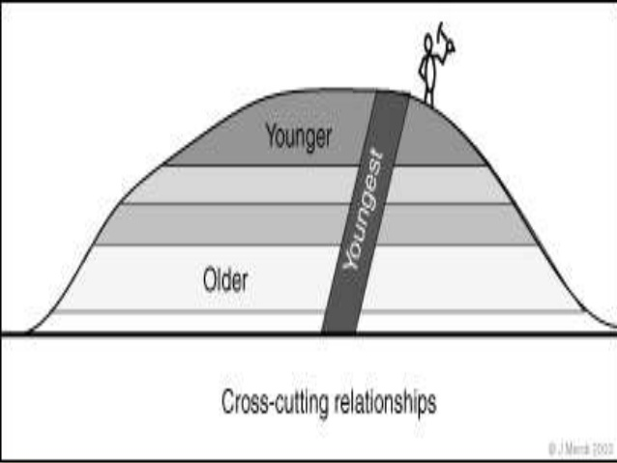
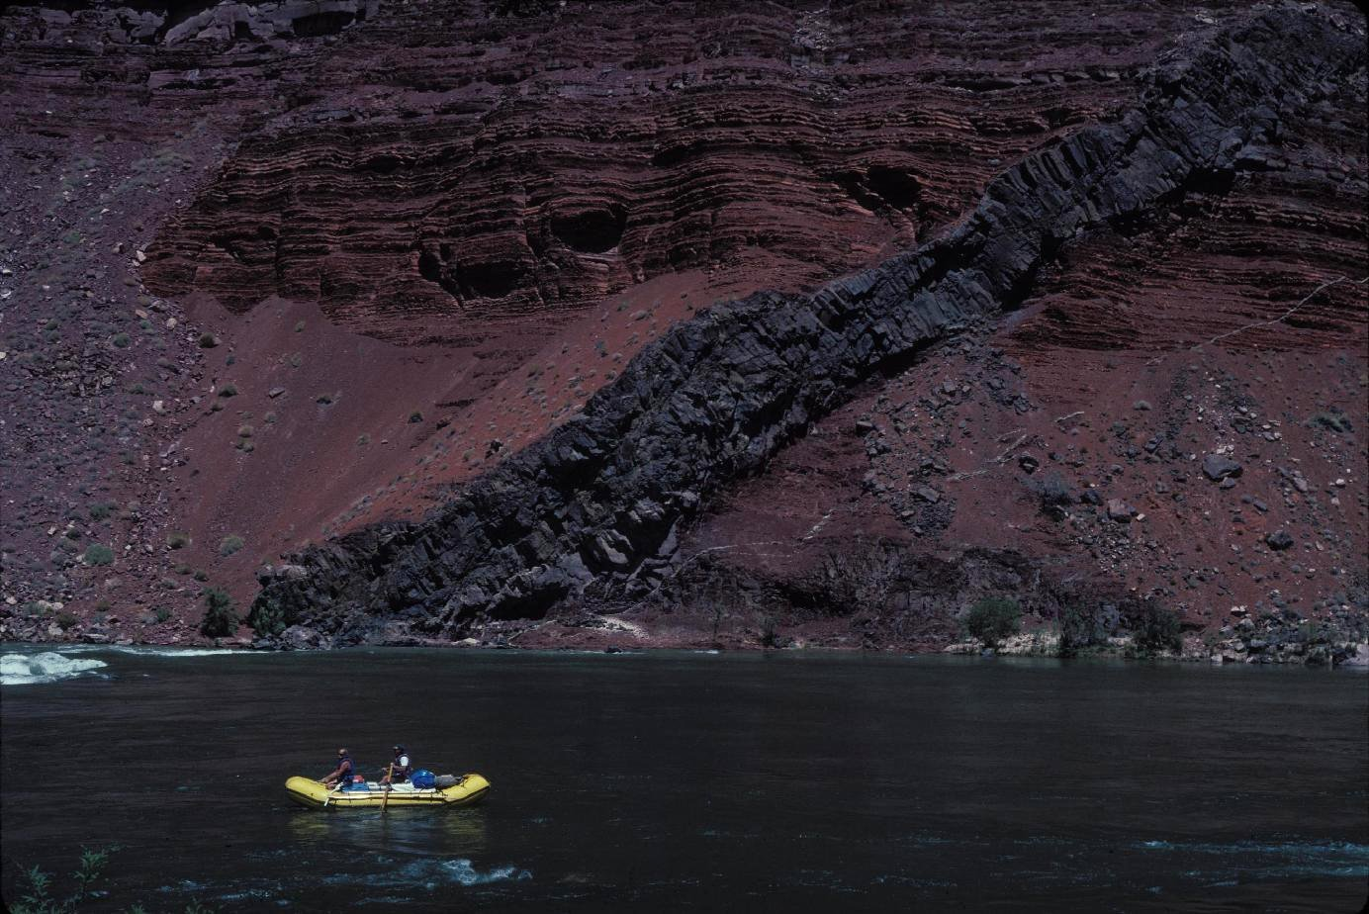
Principles of Relative Age Dating
Cross Cutting Relationships
If one geologic feature cuts across another feature, the feature that it cuts across is older

Slide 7
Unconformity
A surface where rock has eroded producing a gap in the rock record

Slide 8
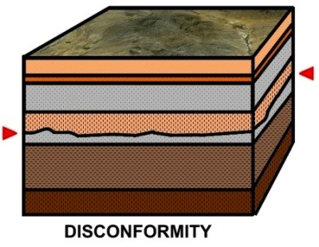
Unconformity
Disconformity
Younger sedimentary rock layers are deposited on top of older horizontal sedimentary layers that have been eroded

Slide 9
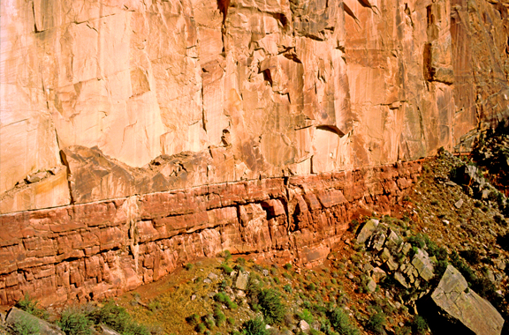

Slide 10
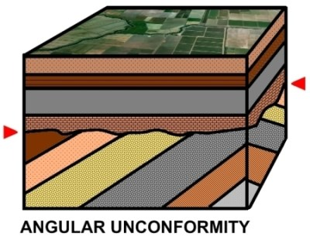
Unconformity
Angular Unconformity
Sedimentary layers are deposited on top of folded or tilted sedimentary layers that have been eroded

Slide 11
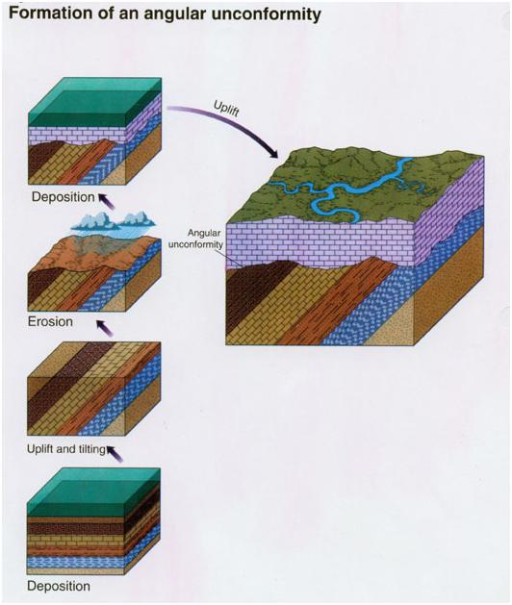
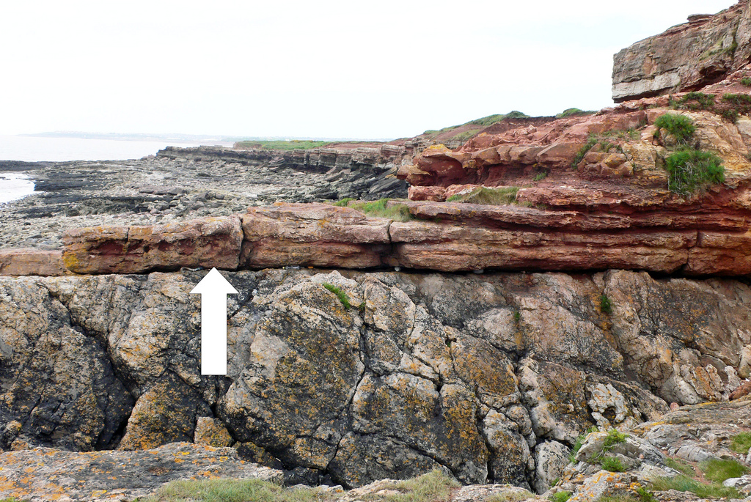

Slide 12
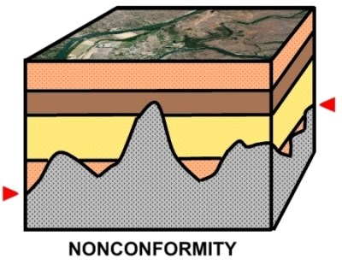
Unconformity
Nonconformity
Sedimentary layers are deposited on older igneous or metamorphic layers that have been eroded

Slide 13
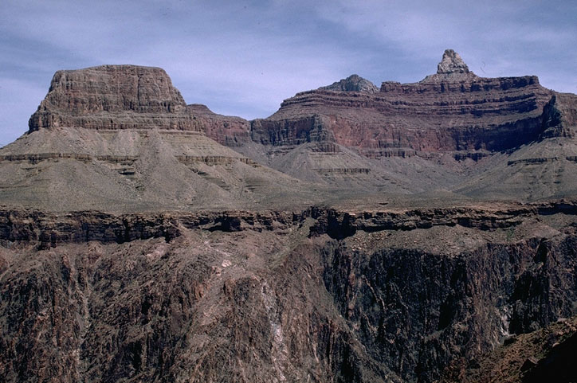

Slide 14
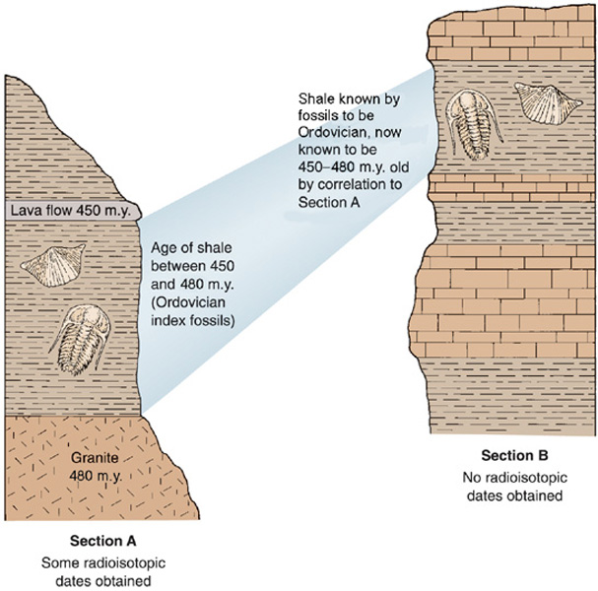
Unconformity
Correlation
Matching rocks and fossils from separate locations
Index Fossils
Represent species that existed on Earth for a short length of time, were abundant and inhabited many locations.

