Slide 1
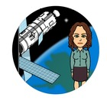
Human Activity & Global Climate Change
By: Mrs. Proton Priest

Slide 2
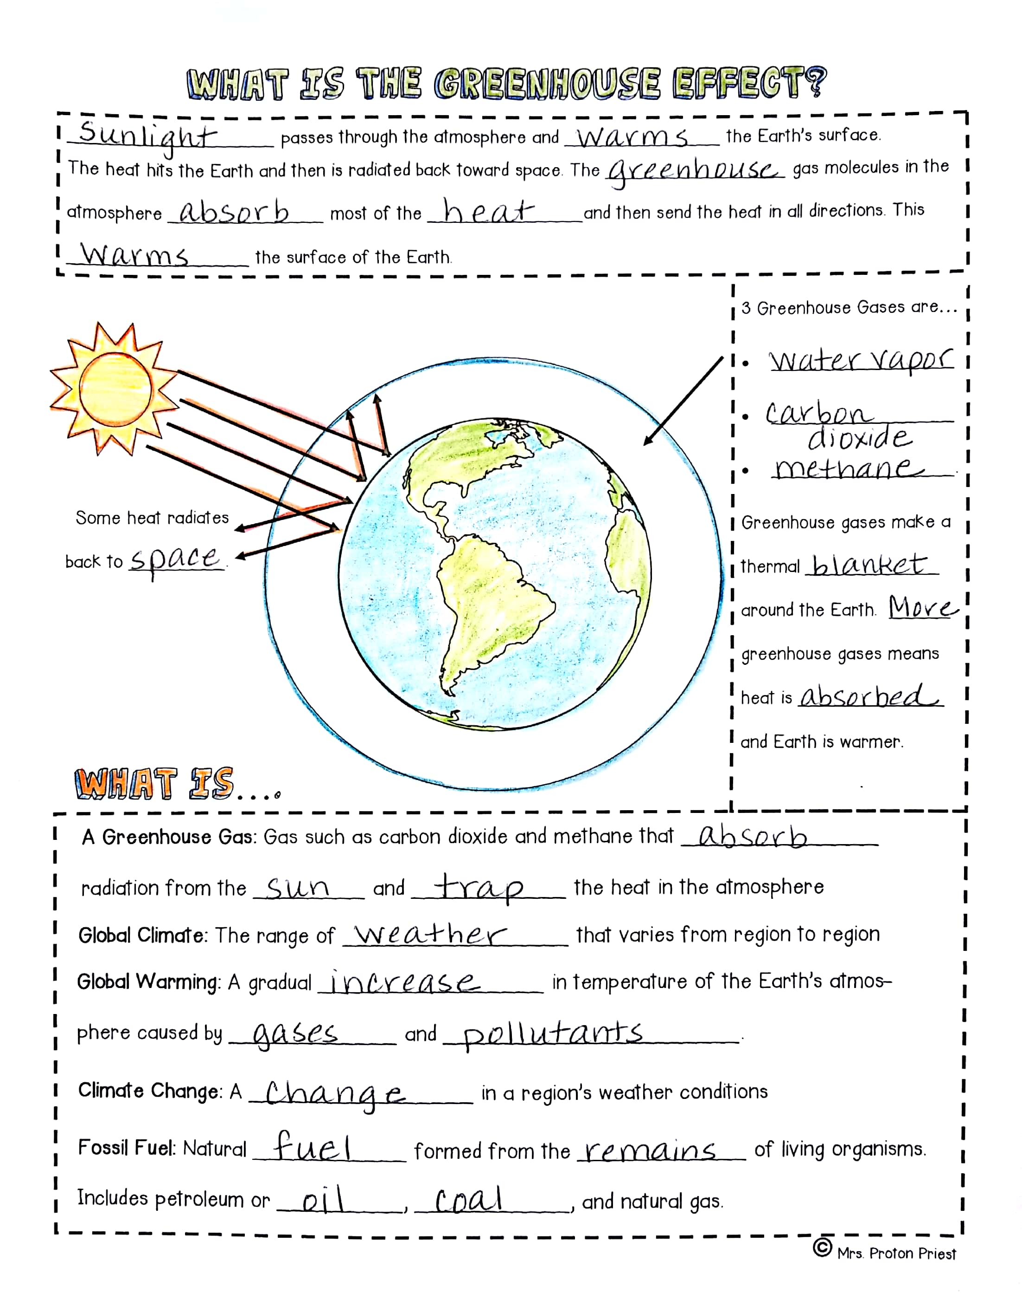
What is the Greenhouse Effect?
Start here
Fill in your sketch notes. The words you need to write are underlined.

Slide 3
What is the Greenhouse Effect?
Sunlight passes through the atmosphere and warms the Earth’s surface.
The heat hits the Earth and then is radiated back toward space.

Slide 4
What is the Greenhouse Effect?
The greenhouse gas molecules in the
atmosphere absorb most of the heat and then
send the heat in all directions. This
warms the surface of the Earth.

Slide 5
What is the Greenhouse Effect?
Now go here
Fill in your sketch notes. The words you need to write are underlined.

Slide 6
What is the Greenhouse Effect?
Some heat radiates back to space.

Slide 7
3 Greenhouse Gases are…
Now go here
Fill in your sketch notes. The words you need to write are underlined.

Slide 8
3 Greenhouse Gases are..
Water vapor
Carbon dioxide
Methane

Slide 9
Greenhouse Gases are..
Greenhouse gases make a
thermal blanket around the Earth. More greenhouse gases mean
heat is absorbed
and Earth is warmer.

Slide 10
3 Greenhouse Gases are…
Now go here
Fill in your sketch notes. The words you need to write are underlined.

Slide 11
What is…
A Greenhouse Gas: Gases such as carbon dioxide and methane that absorb
radiation from the sun and trap the heat in the atmosphere

Slide 12
What is…
Global Climate: The range of weather that varies from region to region
Global Warming: A gradual increase in temperature of the Earth’s atmos-
phere caused by gases and pollutants.

Slide 13
What is…
Climate Change: A change in a region’s weather conditions.
Fossil Fuel: Natural fuel formed from the remains of living organisms.
Includes petroleum or oil, coal, and natural gas.

Slide 14
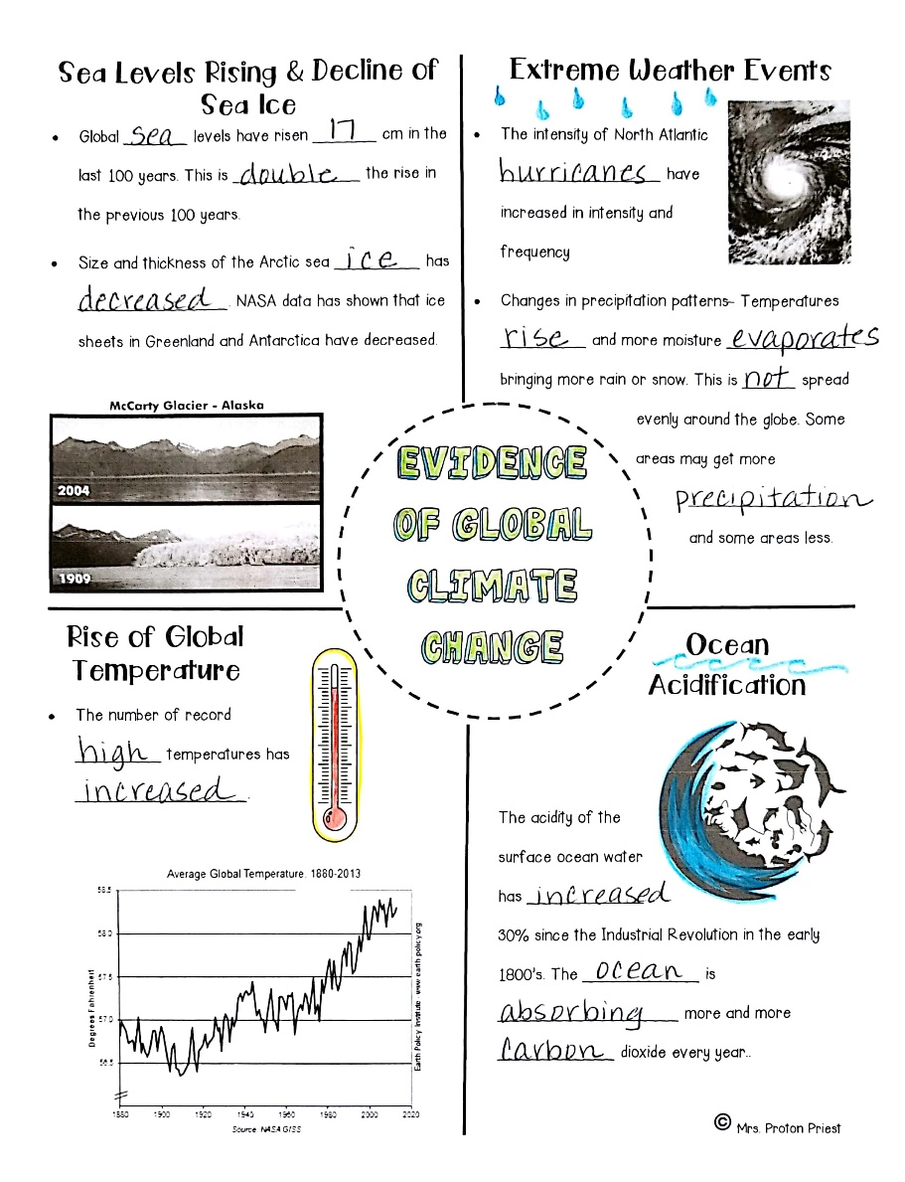
Evidence of Global Climate Change
Go here next
Fill in your sketch notes. The words you need to write are underlined.

Slide 15
Sea levels Rising & Decline of Sea Ice
Global sea levels have risen 17 cm in the
last 100 years. This is double the rise in
the previous 100 years.

Slide 16
Sea levels Rising & Decline of Sea Ice
· Size and thickness of the Arctic sea ice has decreased. NASA data has shown that ice
sheets in Greenland and Antarctica have decreased.

Slide 17
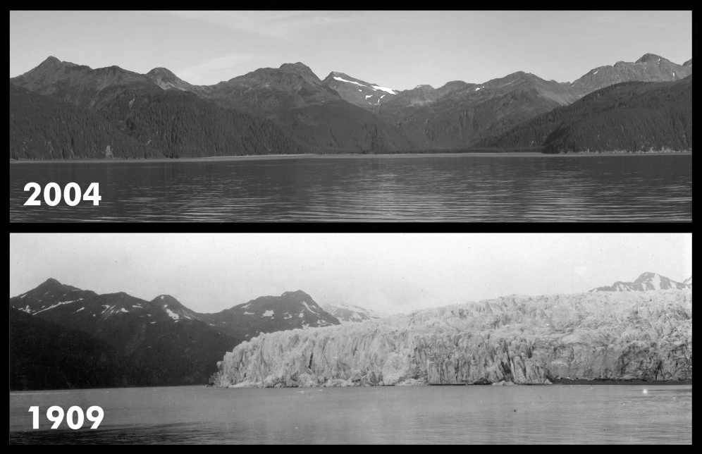
Sea levels Rising & Decline of Sea Ice
McCarty Glacier- Alaska
What differences do you see in the pictures from 1909 and 2004?

Slide 18
Evidence of Global Climate Change
Now go here
Fill in your sketch notes. The words you need to write are underlined.

Slide 19
Rise of Global Temperature
· The number of record high
temperatures has
increased.

Slide 20
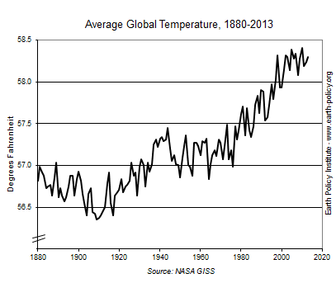
Rise of Global Temperature
What is the title of this graph?
What are the labels on the x and y axes?
What general pattern does this graph show?

Slide 21
Evidence of Global Climate Change
Now go here
Fill in your sketch notes. The words you need to write are underlined.

Slide 22
Extreme Weather Events
· The intensity of North Atlantic
hurricanes have
increased in intensity and
frequency.

Slide 23
Extreme Weather Events
· · Changes in precipitation patterns- Temperatures rise and more moisture evaporates
bringing more rain or snow. This is not spread evenly around the globe. Some areas may get more precipitation
and some areas less.

Slide 24
Evidence of Global Climate Change
Now go here
Fill in your sketch notes. The words you need to write are underlined.

Slide 25
Ocean Acidification
The acidity of the surface ocean water
has increased
30% since the
Industrial Revolution in the early
1800s. The ocean is
absorbing more and more
carbon dioxide every year.

Slide 26
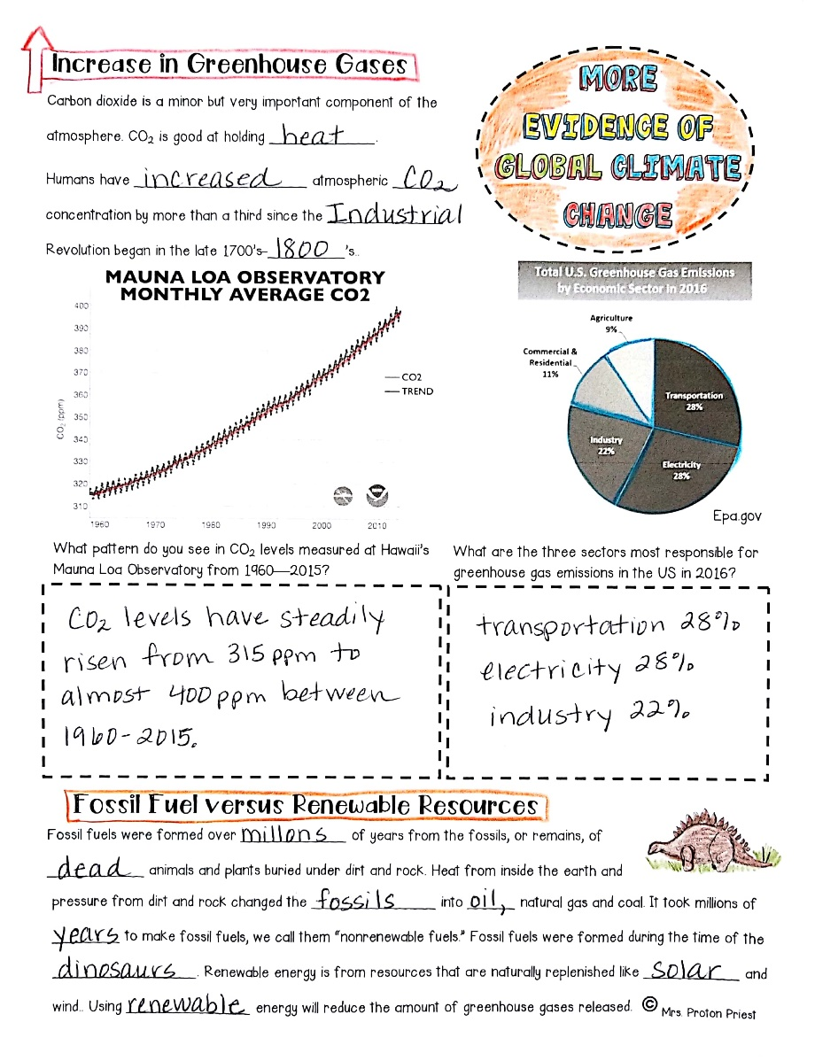
More Evidence of Global Climate Change
Now go here
Fill in your sketch notes. The words you need to write are underlined.

Slide 27
Increase in Greenhouse Gases
Carbon dioxide is a minor but very important component of the atmosphere. CO₂ is good at holding heat.

Slide 28
Increase in Greenhouse Gases
Humans have increased atmospheric CO₂ concentration by more than a third since the Industrial Revolution began in the late 1700s-1800s.

Slide 29
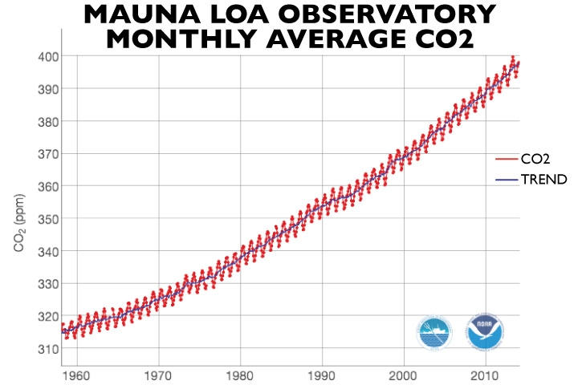
Increase in Greenhouse Gases
What is the title of this graph?
What are the labels on the x and y axes?
What general pattern does this graph show?

Slide 30
More Evidence of Global Climate Change
Now go here
Fill in your sketch notes. The words you need to write are underlined.

Slide 31
Increase in Greenhouse Gases
What patterns do you see in CO₂ levels measured at Hawaii’s Mauna Loa Observatory from 1960-2015?
Write your answer in the box

Slide 32
Increase in Greenhouse Gases
What patterns do you see in CO₂ levels measured at Hawaii’s Mauna Loa Observatory from 1960-2015?
CO₂ levels have steadily risen from 315 ppm to almost 400 ppm between 1960-2015.

Slide 33
More Evidence of Global Climate Change
Now go here
Fill in your sketch notes. The words you need to write are underlined.

Slide 34
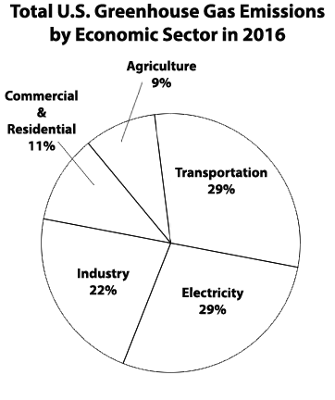
Increase in Greenhouse Gases
What is the title of this graph?
What does this graph tell us?

Slide 35
Increase in Greenhouse Gases
What are the three sectors most responsible for greenhouse gas emissions in the US in 2016?
Write your answer in the box

Slide 36
Increase in Greenhouse Gases
What are the three sectors most responsible for greenhouse gas emissions in the US in 2016?
Transportation 28%
Electricity 28%
Industry 22%

Slide 37
More Evidence of Global Climate Change
Now go here
Fill in your sketch notes. The words you need to write are underlined.

Slide 38
Fossil Fuels Versus Renewable Resources
Fossil fuels were formed over millions
of years from the fossils, or remains, of dead animals and plants buried under dirt and rock.

Slide 39
Fossil Fuels Versus Renewable Resources
Heat from inside the earth and
pressure from dirt and rock changed the fossils into oil, natural gas, and coal.
It took millions of years to make fossil fuels, we call them “nonrenewable fuels.”

Slide 40
Fossil Fuels Versus Renewable Resources
Fossil fuels were formed during the time of the dinosaurs. Renewable energy is from resources that are naturally replenished like solar and wind. Using renewable energy will reduce the amount of greenhouse gases released.

Slide 41
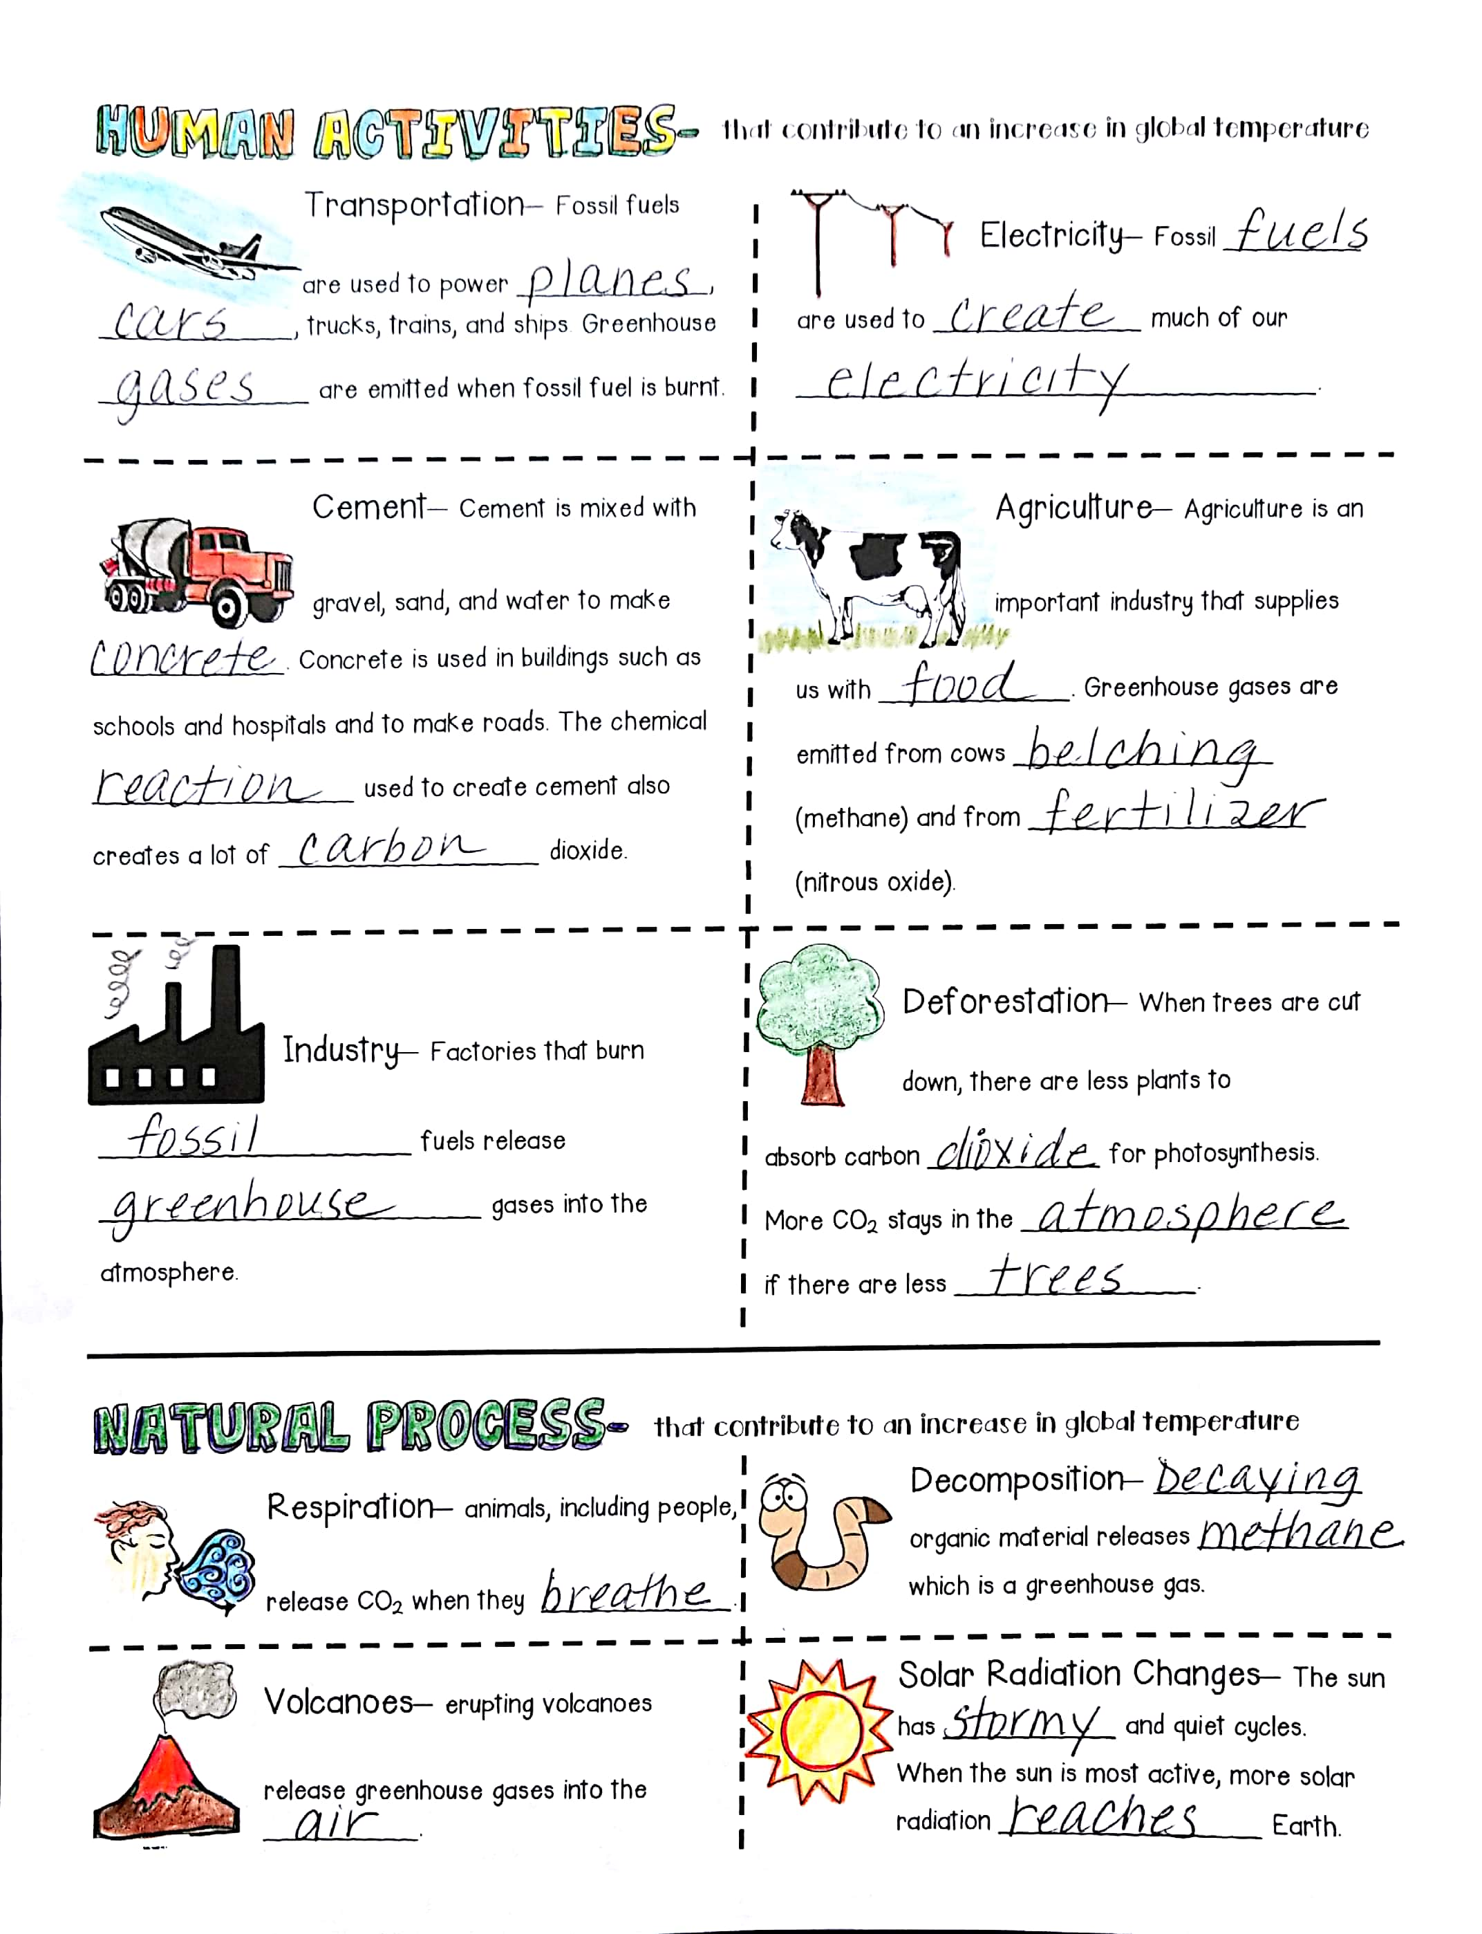
Human Activities
Now go here
Fill in your sketch notes. The words you need to write are underlined.

Slide 42
Human Activities
Transportation– Fossil fuels
are used to power planes,
cars, trucks, trains, and ships. Greenhouse
gases are emitted when fossil fuel is burnt.

Slide 43
Human Activities
Now go here
Fill in your sketch notes. The words you need to write are underlined.

Slide 44
Human Activities
Cement– Cement is mixed with
gravel, sand, and water to make
concrete. Concrete is used in buildings such as
schools and hospitals and to make roads. The chemical reaction used to create cement also
creates a lot of carbon dioxide.

Slide 45
Human Activities
Now go here
Fill in your sketch notes. The words you need to write are underlined.

Slide 46
Human Activities
Industry– Factories that burn
fossil fuels release
greenhouse gases into the
atmosphere.

Slide 47
Human Activities
Now go here
Fill in your sketch notes. The words you need to write are underlined.

Slide 48
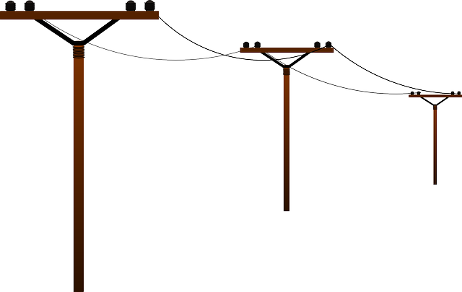
Human Activities
Electricity– Fossil fuels
are used to create much of our
electricity.

Slide 49
Human Activities
Now go here
Fill in your sketch notes. The words you need to write are underlined.

Slide 50
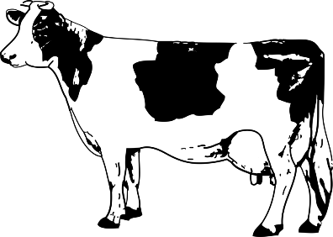
Human Activities
Agriculture– Agriculture is an
important industry that supplies
us with food. Greenhouse gases are
emitted from cows belching
(methane) and from fertilizer (nitrous oxide).

Slide 51
Human Activities
Now go here
Fill in your sketch notes. The words you need to write are underlined.

Slide 52
Human Activities
Deforestation– When trees are cut
down, there are less plants to
absorb carbon dioxide for photosynthesis.
More CO₂ stays in the atmosphere
if there are less trees.

Slide 53
Human Activities
Now go here
Fill in your sketch notes. The words you need to write are underlined.

Slide 54
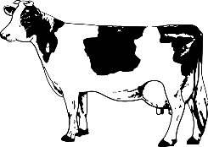
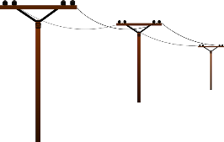
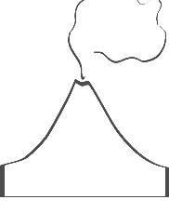
Climate Change…
Not only do human activities impact climate change but so do natural processes.

Slide 55
Natural Processes
Respiration– animals, including people,
release CO₂ when they breathe.

Slide 56
Natural Processes
Volcanoes– erupting volcanoes
release greenhouse gases into the
atmosphere.

Slide 57
Natural Processes
Decomposition– Decaying
organic material releases methane
which is a greenhouse gas.

Slide 58
Natural Processes
Solar Radiation Changes– The sun
has stormy and quiet cycles.
When the sun is most active, more solar radiation reaches Earth.

