Slide 1
Plate Tectonics

Slide 2
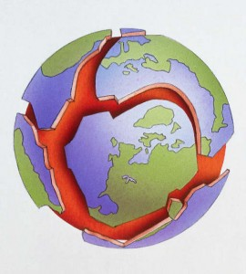
The “Puzzling” Earth
Plate Tectonics
Theory that Earth’s surface is broken into large, rigid pieces

Slide 3
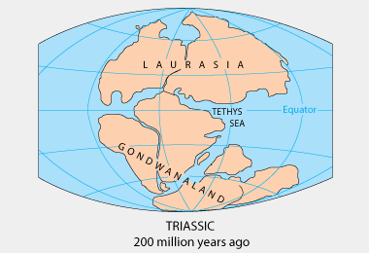
The “Puzzling” Earth
Pangea
Supercontinent that all continents were once a part of

Slide 4
The “Puzzling” Earth

Slide 5
The “Puzzling” Earth
Make a list of clues you used to put together your partner’s puzzle.

Slide 6
The “Puzzling” Earth

Slide 7
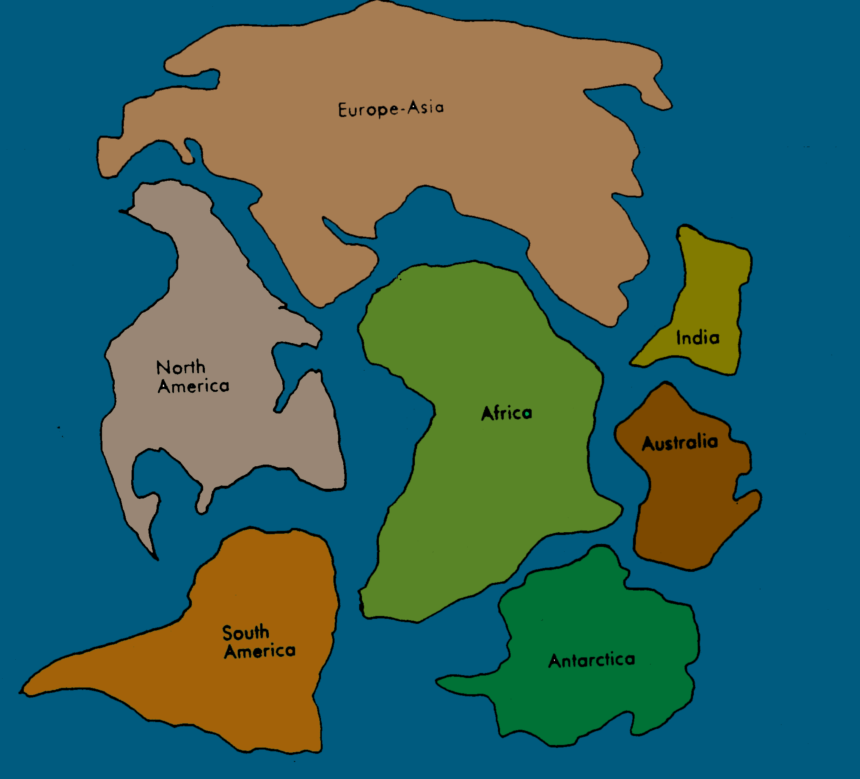
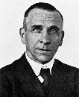
The “Puzzling” Earth
Continental Drift
Continents are in constant motion on the surface of earth
Originally proposed by Wegener 100 years ago

Slide 8
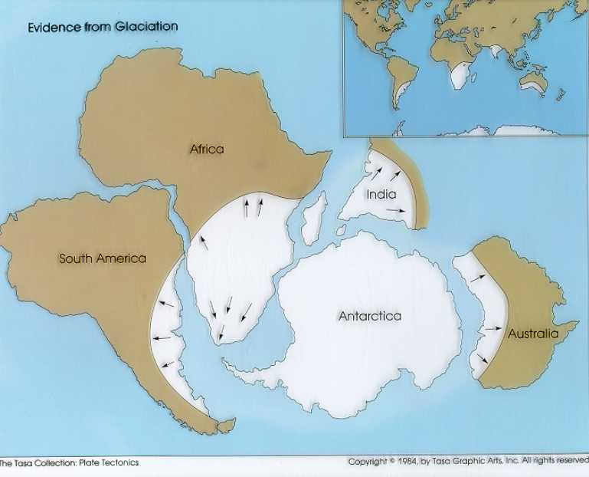
The “Puzzling” Earth
Wegener’s Evidence
Climate Clues
Sediments from glaciers in South America, Africa, India, and Australia match those in Antarctica

Slide 9
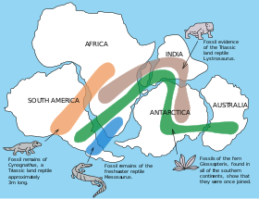
The “Puzzling” Earth
Wegener’s Evidence
Fossil Clues
Fossils of similar organisms found on continents now separated by oceans

Slide 10
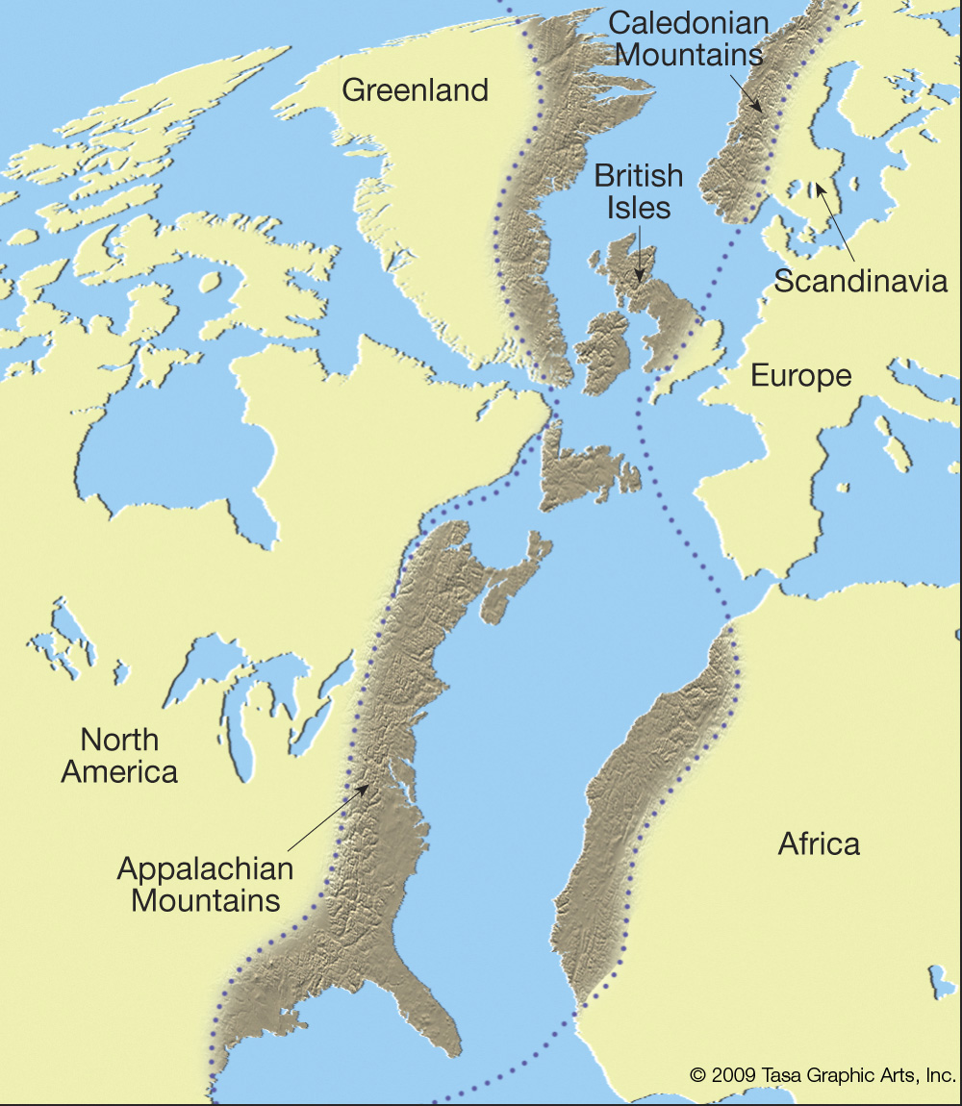
The “Puzzling” Earth
Wegener’s Evidence
Rock Clues
Similar rock types were found in mountain ranges in North America (Appalachian Mtns) and Europe (Caledonian Mtns)
Similar volcanic rocks were found in Africa and South America

Slide 11
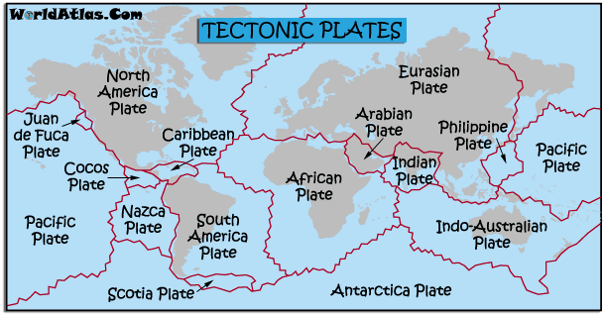
The “Puzzling” Earth

Slide 12
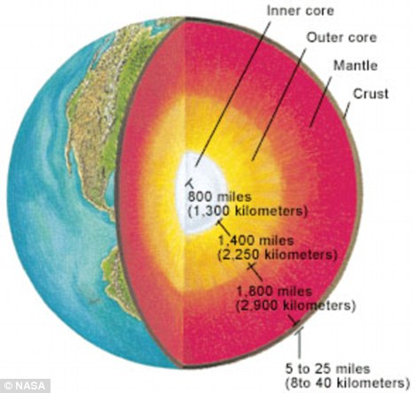
inside the Earth

Slide 13
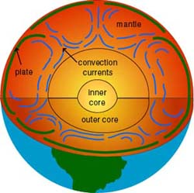
inside the Earth
Convection Current
Movement of liquid material that is heated from underneath, rises and cools on top

Slide 14
inside the Earth

Slide 15
Plate Boundaries
Plate Boundary | Motion | Landforms
Transform Boundary | Horizontal sliding motion *Also called strike-slip faults | Earthquakes Valleys Hills

Slide 16
Plate Boundaries
Plate Boundary | Motion | Landforms
Divergent Boundary | Plates move away from each other | Ocean: mid-ocean ridge Land: valley

Slide 17
Plate Boundaries
Plate Boundary | Motion | Landforms
Convergent Boundary (*Subduction) | Plates move toward each other *One plate slides under the other | Not subducted plate=volcanic arc

Slide 18
Plate Boundaries
Plate Boundary | Motion | Landforms
Convergent Boundary (*No subduction) | Plates move toward each other *Plates push upward | Mountains

Slide 19
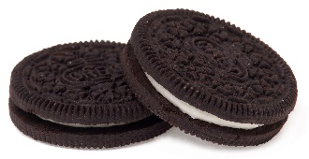
Plate Boundaries
Cookie Subduction
1. What does the cookie represent?
2. What does the cream filling represent?
3. What do your teeth represent?
4. What is being formed by the filling?

Slide 20
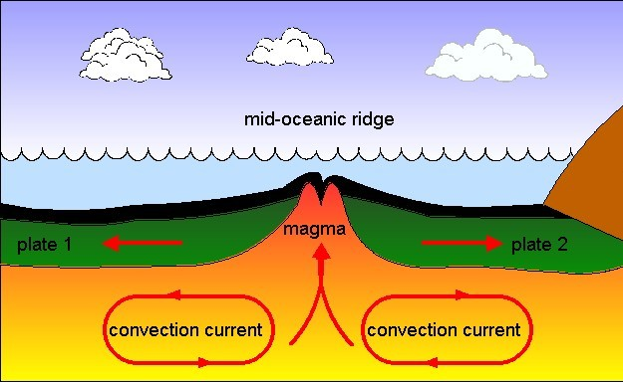
Ocean Floor
Mid-Ocean Ridges
Long, narrow mountains formed by magma at divergent boundaries on the ocean floor
Forms in two ways:
Large amounts of lava erupt and build up around ridge
As lava cools it cracks, rocks in those cracks form mountain ranges

Slide 21
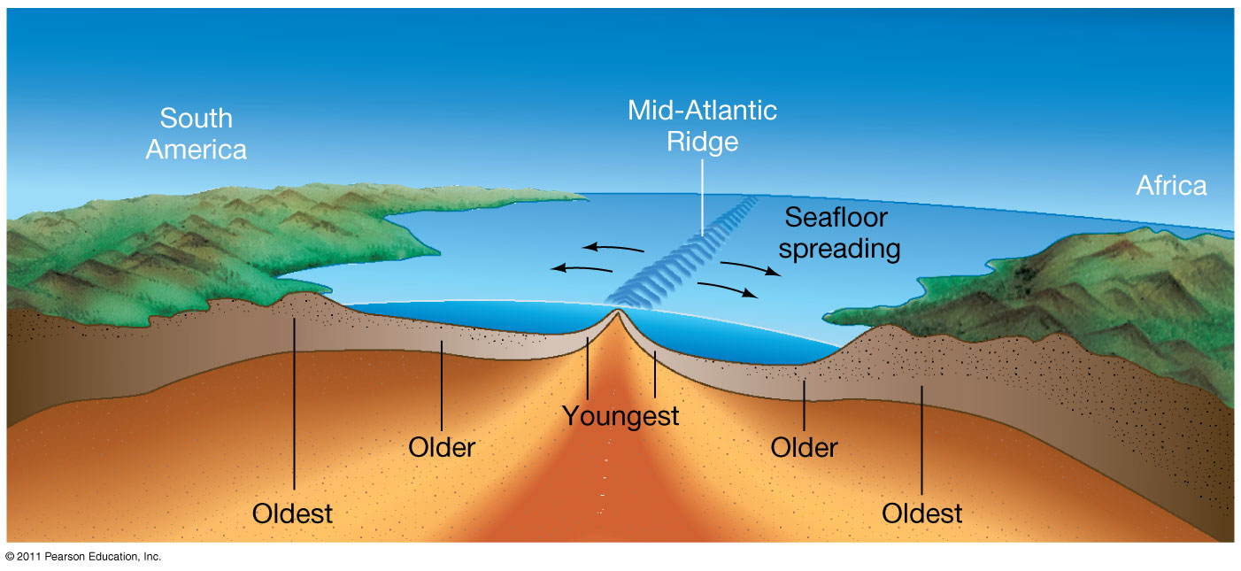
Ocean Floor
Seafloor Spreading
Process by which new oceanic crust forms along a mid-ocean ridge and older crust moves away from the ridge
As seafloor spreads, mantle below melts and forms magma
Rises through cracks

Slide 22
Ocean Floor

