Slide 1
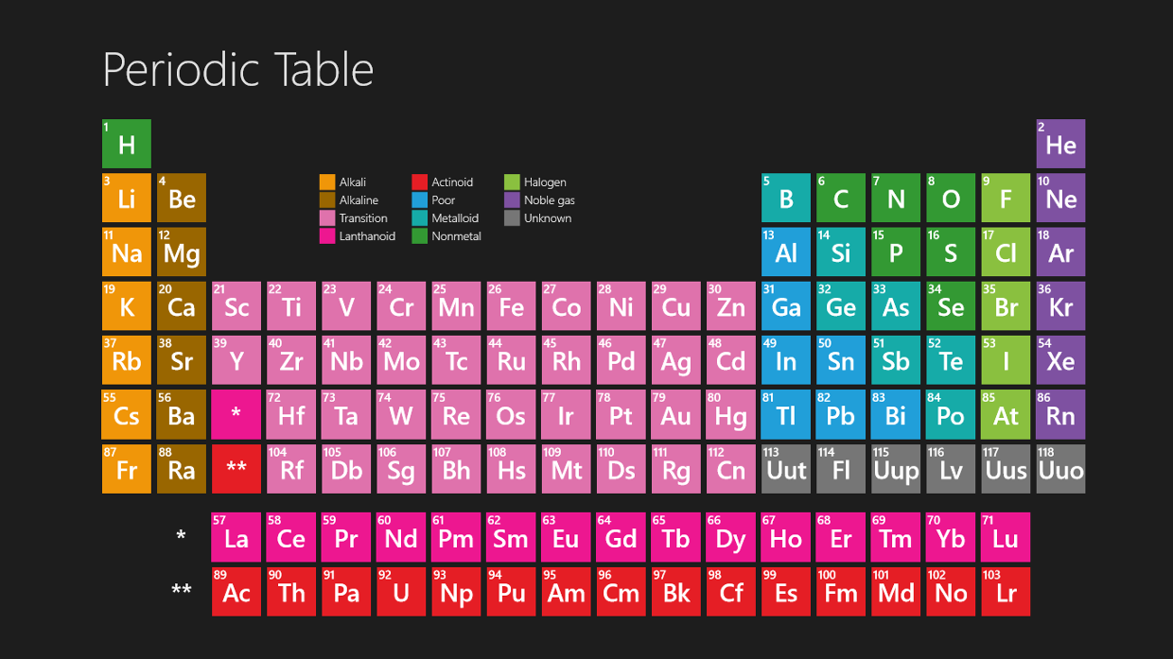
Periodic Table

Slide 2
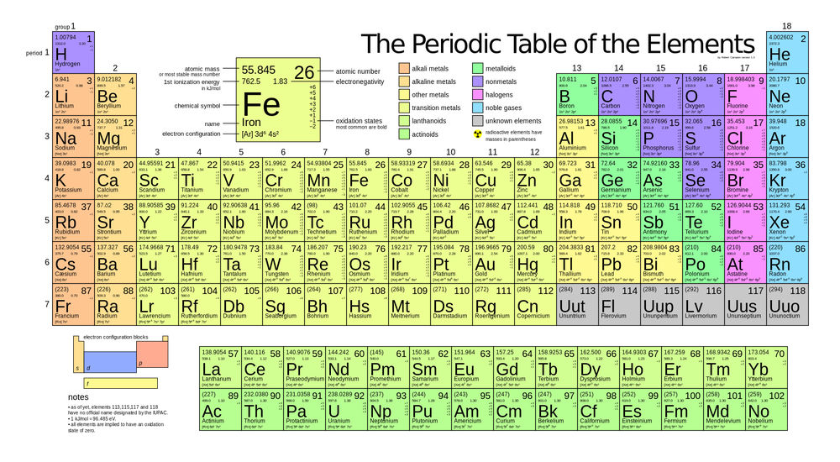
Periodic Table
A chart of the elements arranged into rows and columns according to their physical and chemical properties

Slide 3
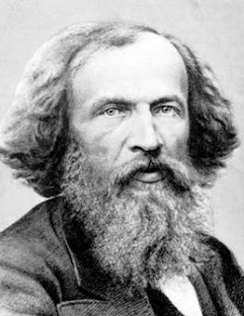
Developing the Periodic Table
Mendeleev
Arranged elements in rows of increasing atomic mass
Similar properties in similar columns
Arrangement did not always work out

Slide 4
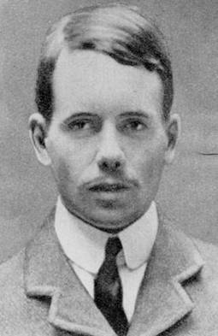
Developing the Periodic Table
Moseley
Arranged elements by atomic number, not mass
Columns still contained elements with similar properties

Slide 5
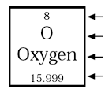
Element Key
Atomic number
Element symbol
Element name
Atomic mass

Slide 6
Element Key
Group
A column on the periodic table
Period
A row on the periodic table
Color (use key)
Generally indicates metal, metalloid, or nonmetal
Atomic number
Number of protons
Atomic mass
Number of protons and neutrons

Slide 7
Parts of an Atom
Atomic Model—Bohr Diagram
Electrons arranged in energy levels
1st energy level = up to 2 electrons
2nd energy level = up to 8 electrons
3rd energy level = up to 18 electrons
Valence Electrons
The electrons in the outermost energy level

Slide 8
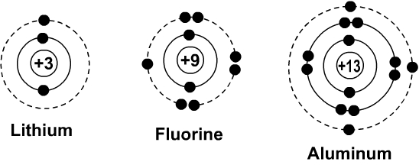
Parts of an Atom
Atomic Model—Bohr Diagram

Slide 9
Parts of an Atom
Atomic Model—Lewis Dot Diagram
Determine the number of valence electrons an element has
Place those dots around the elements symbol
Cannot exceed 8 dots

Slide 10
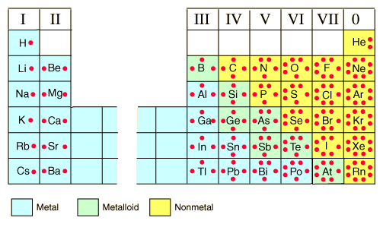
Parts of an Atom
Atomic Model—Lewis Dot Diagram

Slide 11
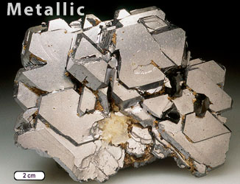
Physical Properties of Metals
Luster
The ability of metal to reflect light

Slide 12
Physical Properties of Metals
Conductivity
Good conductors of thermal and electrical energy

Slide 13
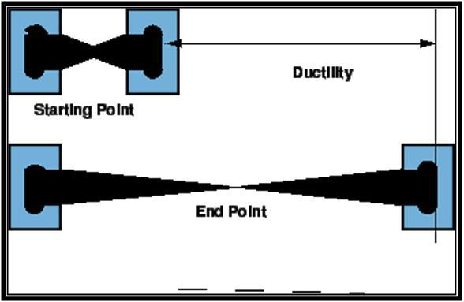
Physical Properties of Metals
Ductility
The ability to be pulled into thin wires

Slide 14
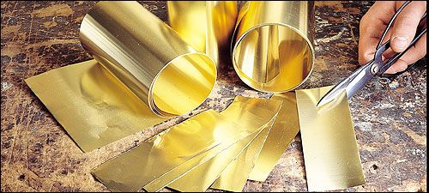
Physical Properties of Metals
Malleability
The ability of a substance to be hammered or rolled into sheets

Slide 15
Physical Properties of Metals
Density, Strength,
Boiling Point, Melting Point
All greater than those of other elements

Slide 16
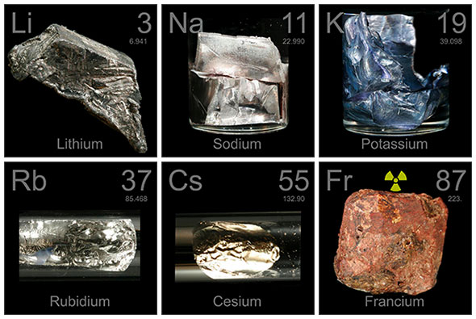
Metals
Group 1 - Alkali Metals
Examples
Lithium, potassium, sodium

Slide 17
Metals
Group 1 - Alkali Metals
Chemical Properties
React quickly with other elements
Occur only in compounds
Stored to avoid contact with oxygen and water vapor in air

Slide 18
Metals
Group 1 - Alkali Metals
Physical Properties
Silvery appearance
Soft (can cut with a knife
Lowest density

Slide 19
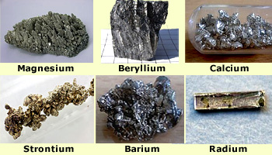
Metals
Group 2 – Alkaline Earth Metals
Examples
Radium, calcium, magnesium

Slide 20
Metals
Group 2 – Alkaline Earth Metals
Chemical Properties
React quickly with other elements (not as quickly as alkali metals)
Combines with other elements to form compounds

Slide 21
Metals
Group 2 – Alkaline Earth Metals
Physical Properties
Soft and silvery
Low density

Slide 22
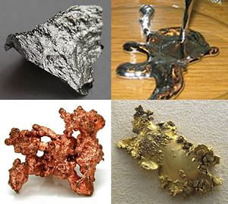
Metals
Group 3 – Transition Elements
Examples
Groups 3-12
Copper, gold, silver

Slide 23
Metals
Group 3 – Transition Elements
Chemical Properties
All metals
Some can exist in nature as free elements
Compared with alkali or alkaline earth:
Higher melting point
Greater strength
Higher density
React less quickly with oxygen

Slide 24
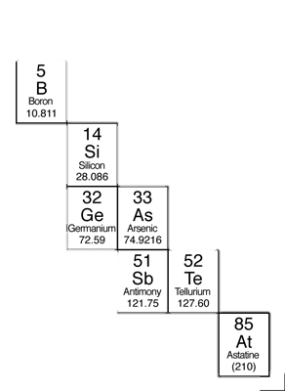
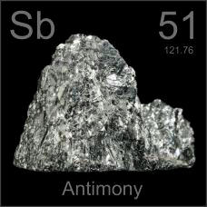
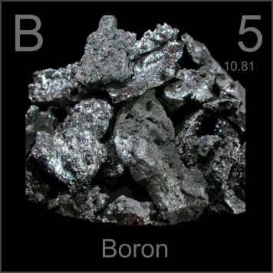
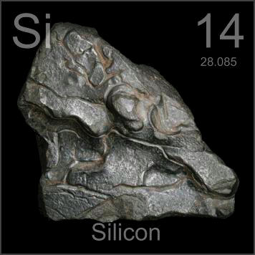
Metalloids
Groups 13 – 17
Properties
Properties of metals and nonmetals
Semi-conductor
Conducts at high heat
Does not conduct at low heat
Use
Electronic devices

Slide 25
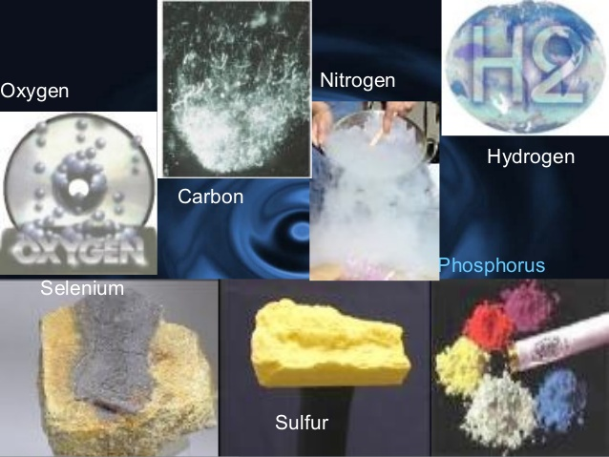
Nonmetals
Groups 14 – 18
Properties
No properties of metals
Non-conductors
Many are essential for life
Use
Good insulators

Slide 26
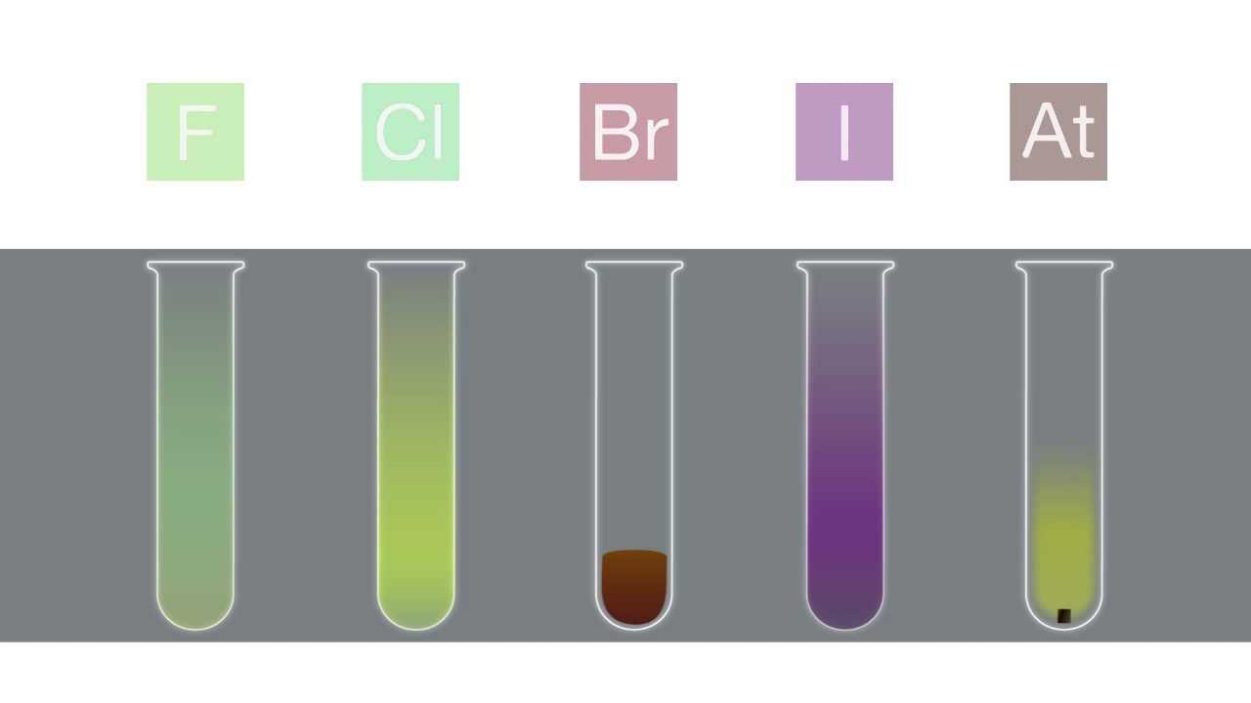
Halogens
Group 17
Properties
Reacts with other elements
Forms compounds
Do not exist as free elements
Use
Make salts

Slide 27
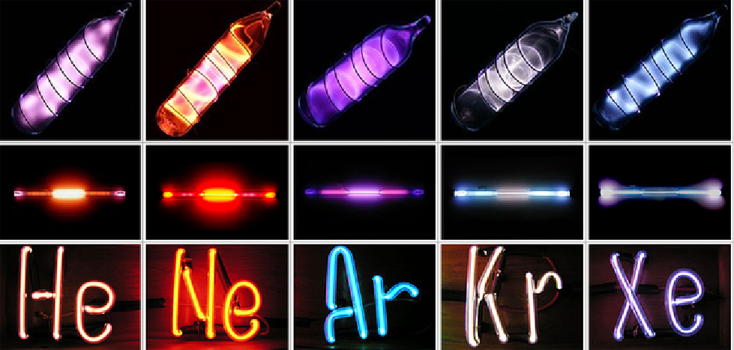
Noble Gases
Group 18
Properties
Do not form compounds
Use
Lighting
Balloons (helium)

