Slide 2
What is Science?

Slide 3
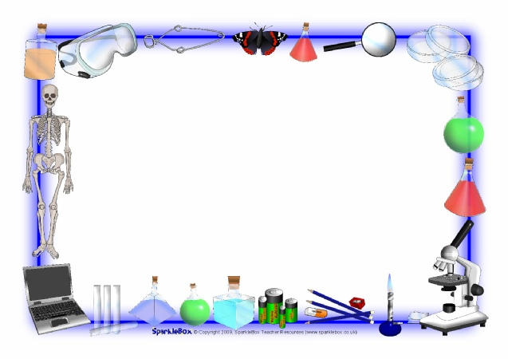
What is Science?
The exploration and investigation of natural events and of the new information that results from those investigations

Slide 4
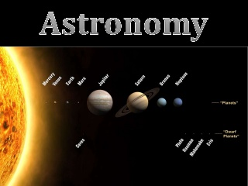
What is Science?
Branches of Science
Earth Science
Geosphere
Rocks/soil
Hydrosphere
Ocean
Atmosphere

Slide 5
What is Science?
Branches of Science
Life Science
Biosphere
Living Things

Slide 6
What is Science?
Branches of Science
Physical Science
Matter
Energy

Slide 7
Scientific Theory
Gained from many observations and investigations
Example
Theory of Relativity
Scientific Law
A rule that describes a pattern in nature
Example
Newton’s Laws

Slide 8
What is a Scientist?

Slide 9
What is a Scientist?
In your science notebook, label a new page
“What is a Scientist?”
Write and draw what you think a scientist looks like and describe them.

Slide 10
What is a Scientist?
Person who studies or has expert knowledge of one or more branches of science.

Slide 11
What is a Scientist?
When you ask questions about the world around you, make observations, look for information, try to figure out how something works, or try to solve a problem, you are acting like a scientist.

Slide 12
Scientific Method
Step 1: Observation
Observation
The art of using your senses to gather information and taking note of what occurs
Inference
Logical explanation of an observation that is drawn from prior knowledge and experience

Slide 13
Scientific Method
Step 2: Ask Questions
Use information from observations and inferences to ask well-informed questions

Slide 14
Scientific Method
Step 3: Hypothesis and Prediction
Hypothesis
A possible explanation for an observation that can be tested by scientific investigations

Slide 15
Scientific Method
Step 4: Test Hypothesis
Design an experiment
Make a model
Gather and evaluate evidence or research
Collect data/record observations

Slide 16
Scientific Method
Step 5: Analyze Data
Graph results
Classify information
Make calculations

Slide 17
Scientific Method
Step 6: Draw Conclusions
Infer
Summarize

Slide 18
Scientific Method
Step 7: Communicate Results
Scientific Theory
An explanation of observations or events that is based on knowledge gained from many observations and investigations
Scientific Law
A rule that describes a pattern in nature

Slide 19
Measurement
Description
Spoken or written summary of observations
Qualitative
Use your senses

Slide 20
Measurement
Quantitative
Use numbers and measurement
International System of Units (metric system)
Uses base units and prefixes in units of 10

Slide 21
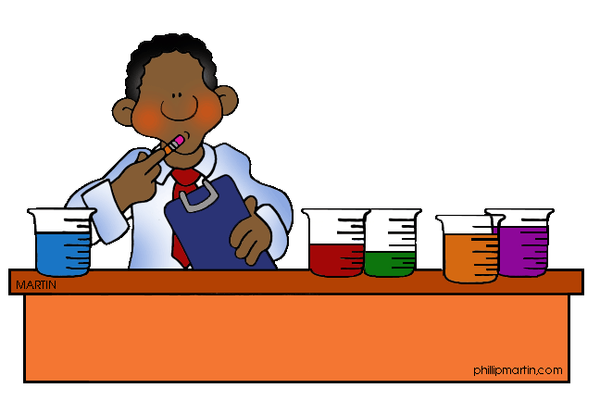
Experiments
Variable
Any factor that can have more than one value

Slide 22
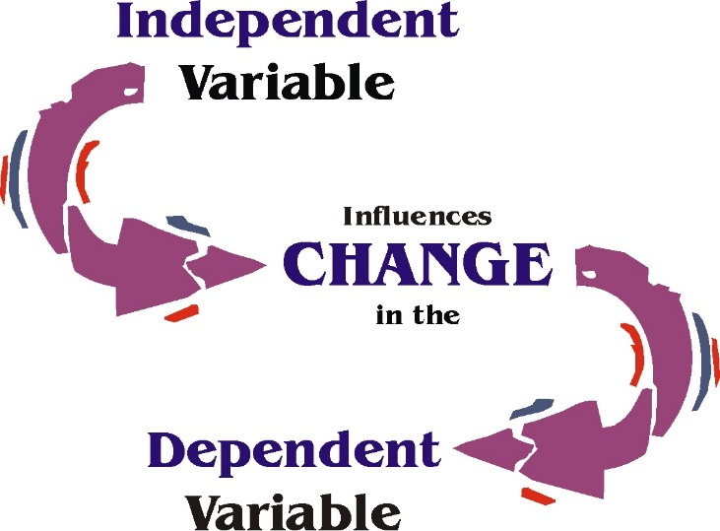
Experiments
Independent Variable
Represented on a graph on the X-axis
The factor you want to test
Can be changed by investigator
Observe how it affects dependent variable

Slide 23
Experiments
Dependent Variable
Represented on a graph on the Y-axis
The factor that you observe or measure during an experiment

Slide 24
Experiments
Constant
The factor in an experiment that a scientist or researcher keeps unchanged
There can be more than one constant in an experiment

Slide 25
Experiments
Controlled Experiment
Control Group
Contains the same factors as the experimental group, but the independent variable is not changed
Experimental Group
Used to study how a change in the independent variable changes the dependent variable

Slide 26
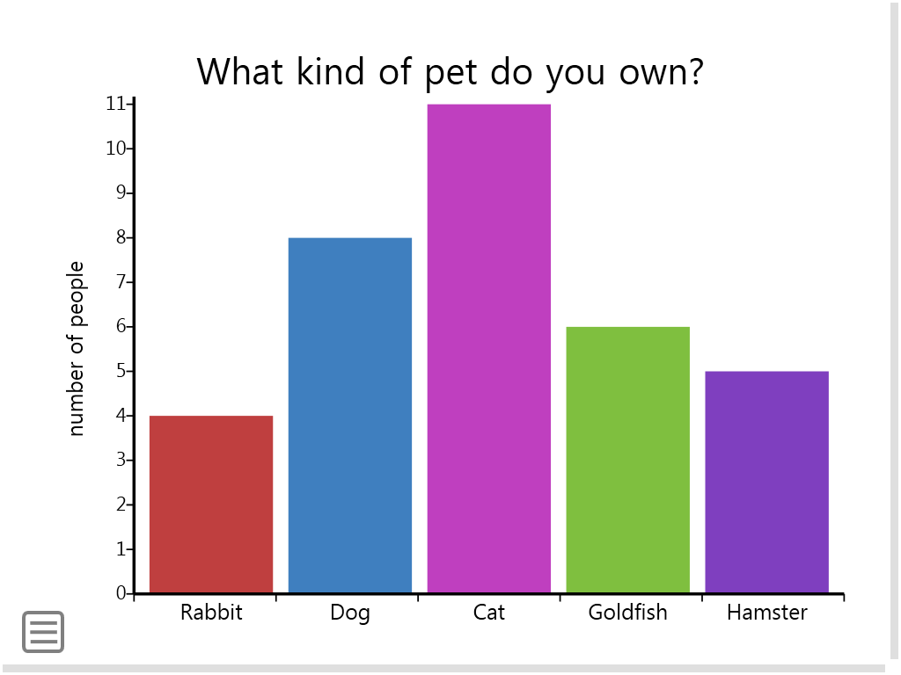
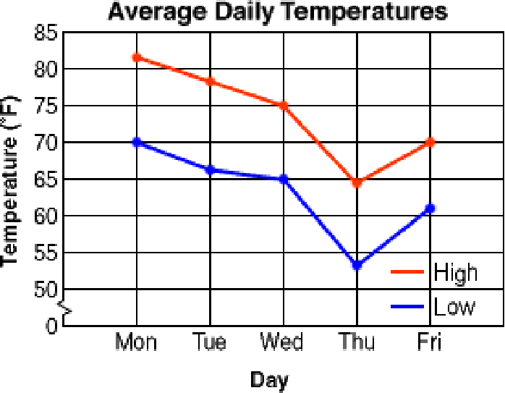
Graphing
#1 Pick the appropriate graph
1 set of numbers = BAR GRAPH
2 sets of numbers = LINE GRAPH
Change over time = LINE GRAPH

Slide 27
Graphing
#2 Find the Independent Variable
Known before the experiment begins
Chosen by the investigator
DATA TABLE = 1st COLUMN
GRAPH = X-AXIS
X-axis

Slide 28
Graphing
#3 Find the Dependent Variable
Data collected during the experiment
DATA TABLE = 2nd COLUMN
GRAPH = Y-AXIS
Y-axis

Slide 29
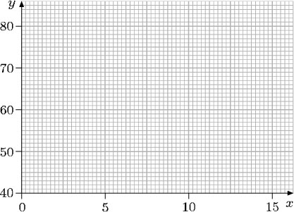
Graphing
#4 Determine the SCALE for the X and Y
Evenly space all the numbers
Each line is worth the same amount (EX: count by 5’s or 10’s). Don’t randomly write in numbers
Use as much graph as possible

Slide 30
Graphing
#5 Write a TITLE for the graph
Independent variable vs. Dependent variable
Label X and Y axis
Always include a term of measurement

Slide 31
Graphing
#6 Add DATA to the graph
BAR GRAPH
Bars should be straight, not touching
Data is charted in spaces
LINE GRAPH
Connect the DATA POINTS ONLY!! DO NOT connect the line of origin
Data is charted on lines

