Slide 1
Motion

Slide 2
Speed
Measure of the distance an object travels per unit of time

Slide 3
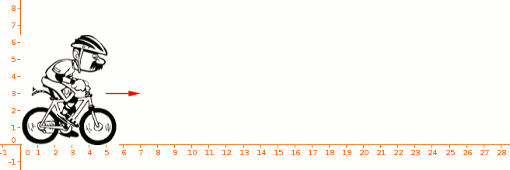
Speed
Constant Speed
The rate of change of position in which the same distance is traveled each second

Slide 4
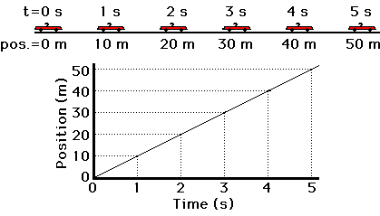
Speed
Constant Speed

Slide 5
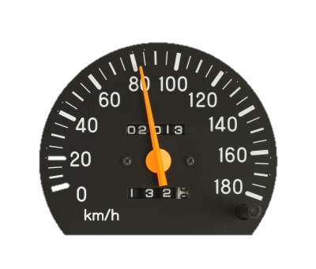
Speed
Instantaneous Speed
Speed at a specific instant in time

Slide 6
Speed
Instantaneous Speed

Slide 7
Speed
Average Speed
Total distance traveled divided by the total time taken to travel that distance

Slide 8
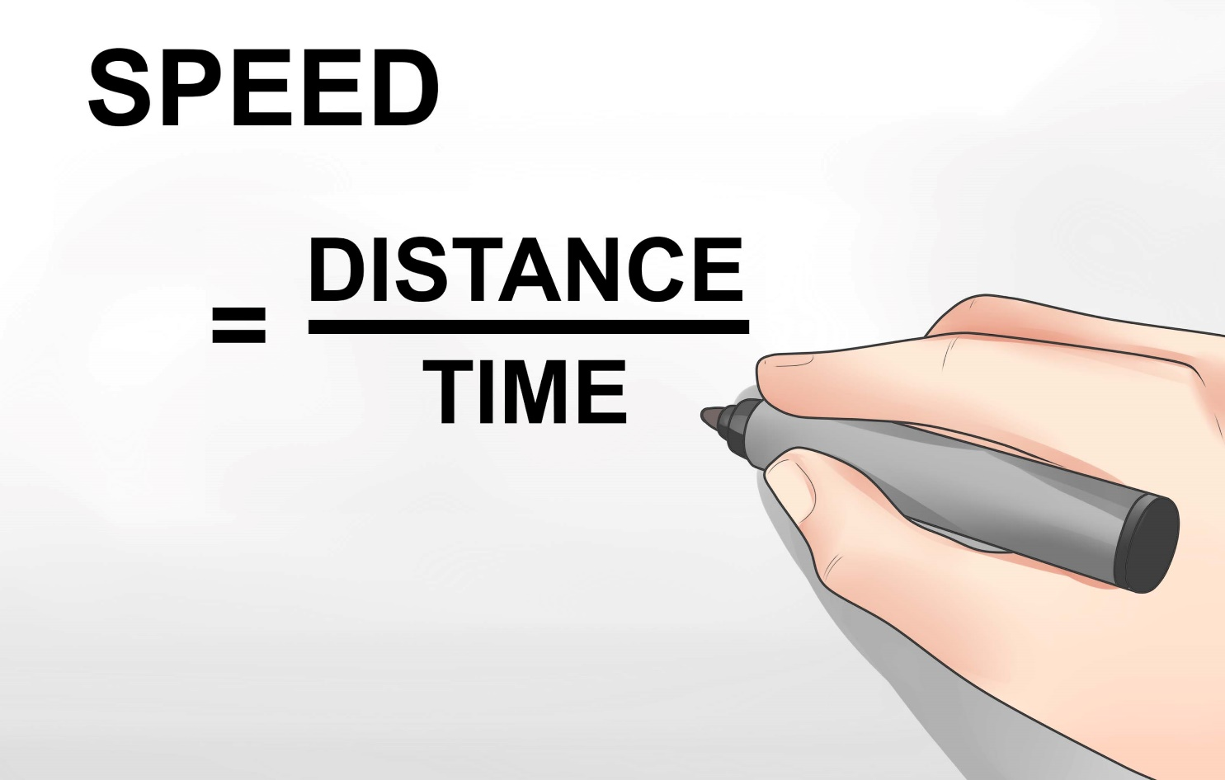
Speed
Average Speed
Measured in m/s

Slide 9
Velocity
Speed and direction of a moving object

Slide 10
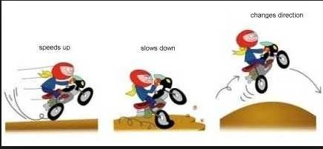
Velocity
Velocity changes when:
Speed changes
When direction of movement changes
When both speed and direction change

Slide 11
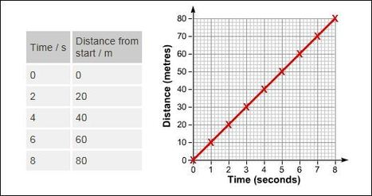
Distance/Time Graphs

Slide 12
Distance/Time Graphs
Stopping
Horizontal line
Speeding Up
Upward slope
Slowing Down
Downward slope

Slide 13
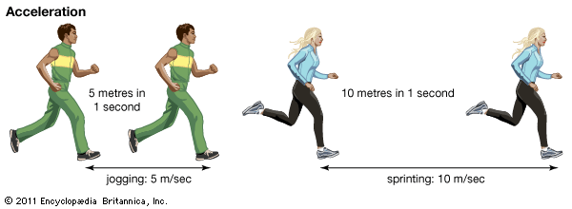
Acceleration
A measure of the change in velocity during a period of time

Slide 14
Acceleration
Change in acceleration occurs when:
Increasing speed
Decreasing speed
Change in direction

Slide 15
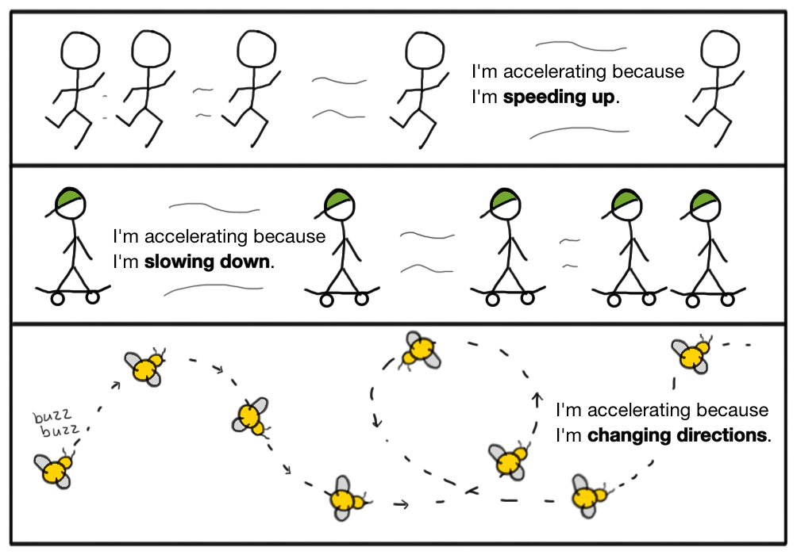
Acceleration

Slide 16
Acceleration
Average Acceleration
A change in velocity during a time interval divided by the time interval during which the velocity changes

Slide 17
Acceleration
If answer is positive, acceleration is in direction of motion (speeding up)
If answer is negative, acceleration is opposite direction of motion (slowing down)

Slide 18
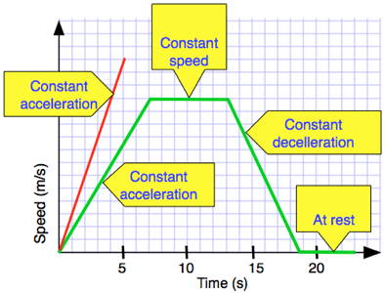
Speed/Time Graphs
Compare speed (y, vertical axis) and time (x, horizontal axis)
Don’t account for direction

Slide 19
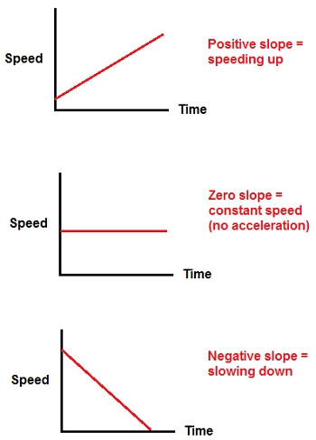
Speed/Time Graphs
At rest, speed=zero
Constant speed=horizontal line
Speeding up=slants upward
Slowing down=slants down

