Slide 1
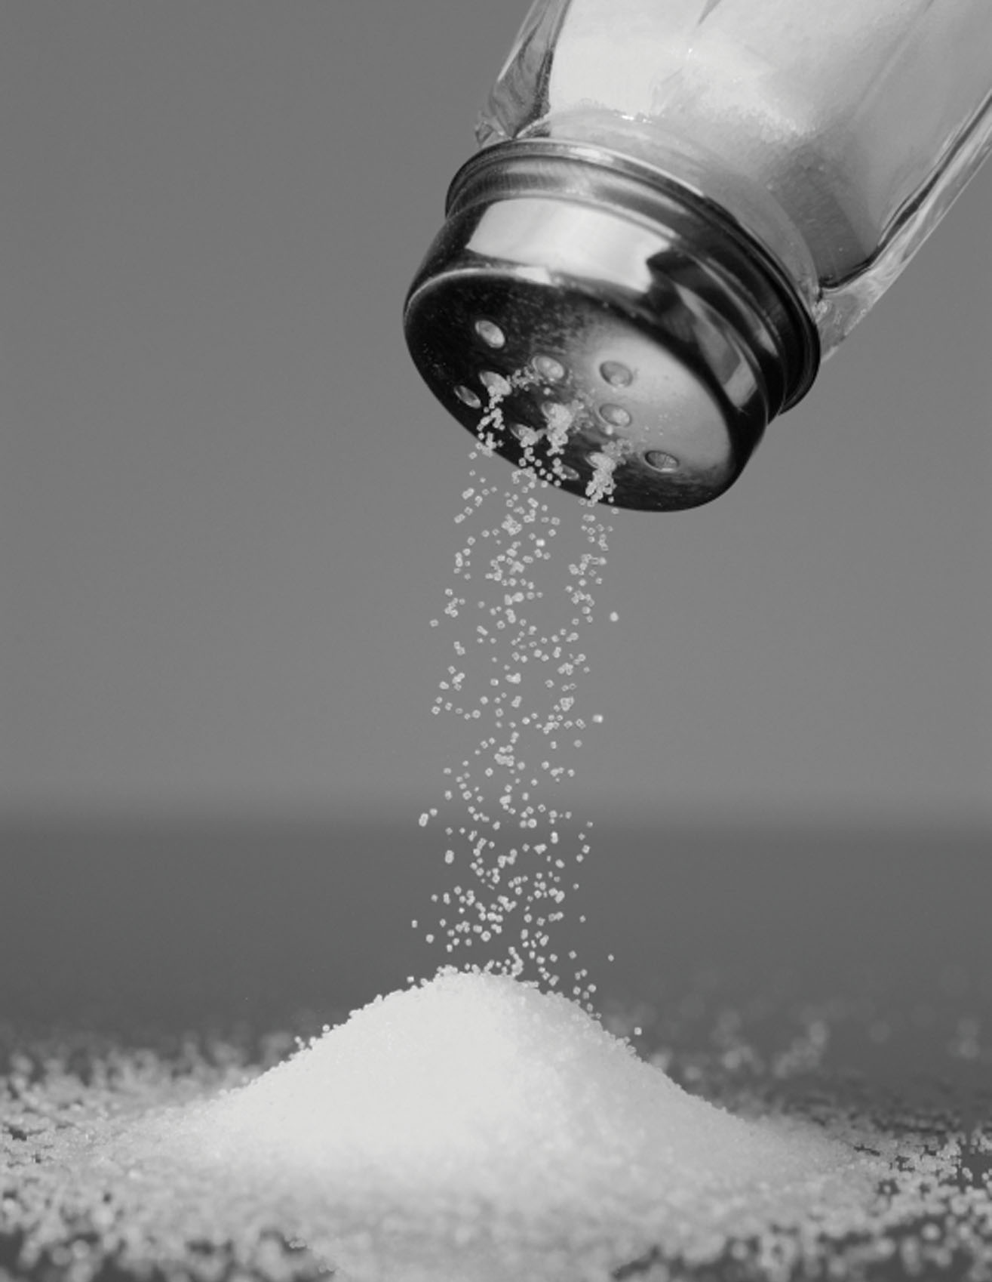
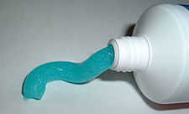
Preview Question
What do these three things have in common?
Toothpaste
Salt
Lipstick

Slide 2
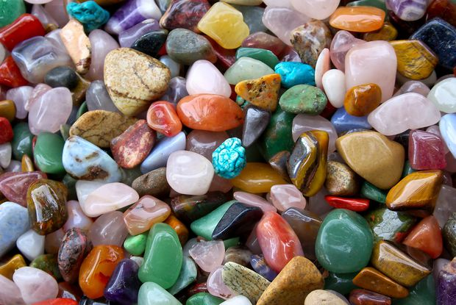
Minerals

Slide 3
Mineral Characteristics
Naturally occurring
Inorganic
Solid
Crystal structure
Definite chemical composition

Slide 4
Crystallization
Process by which atoms form a solid with an orderly, repeating pattern

Slide 5
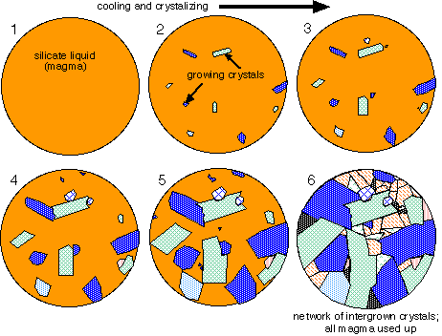
Crystallization
Crystallization from Magma
Magma (melted rock) cools
Atoms join together and form crystals
Cools quickly=small crystals
Cools slowly=large crystals

Slide 6
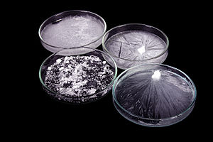
Crystallization
Crystallization from Water
Many substances dissolve in water
Water evaporates
Particles come together and crystallize

Slide 7
Crystallization
Crystal Creations Lab Part 1
Scientific Question:
Hypothesis:
Variables
Independent:
Dependent:
Constants:
Procedure:

Slide 8
Crystallization
Crystal Creations Lab Part 2
Data: (Draw pictures and use words to describe results)
Day 1
Day 3
Results and Conclusions:
Analyze crystal shape for each type of crystals (salt and sugar).
Compare to each other.

Slide 9
Mineral Identification
Density
Hardness
Color Streak
Luster
Cleavage Fracture
Crystal Shape
Unusual Properties

Slide 10
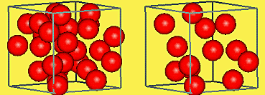
Mineral Identification
Density
Feels heavier
More mass per volume

Slide 11
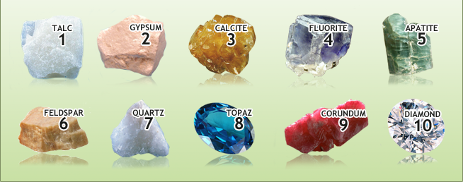
Mineral Identification
Hardness
How easily it is scratched
Measured using the Mohs scale

Slide 13
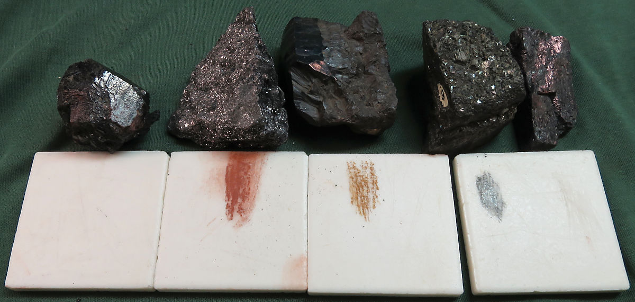
Mineral Identification
Color
Streak
Mineral color
Not always a reliable identification tool
Color of the minerals powder

Slide 14
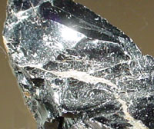
Mineral Identification
Luster
Describes how minerals surface reflects light

Slide 15
Mineral Identification
Cleavage and Fracture
How a mineral breaks into pieces
Not all minerals have cleavage, all have fracture
Smooth, flat breakages=cleavage
Rough, irregular breakages=fracture

Slide 16
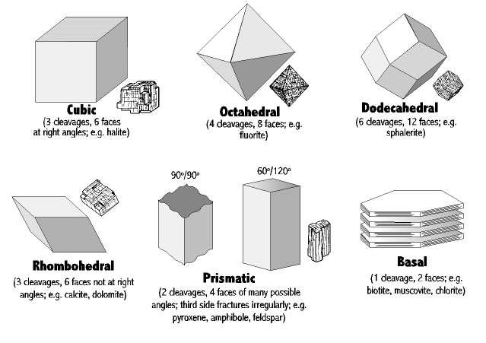
Cleavage

Slide 17
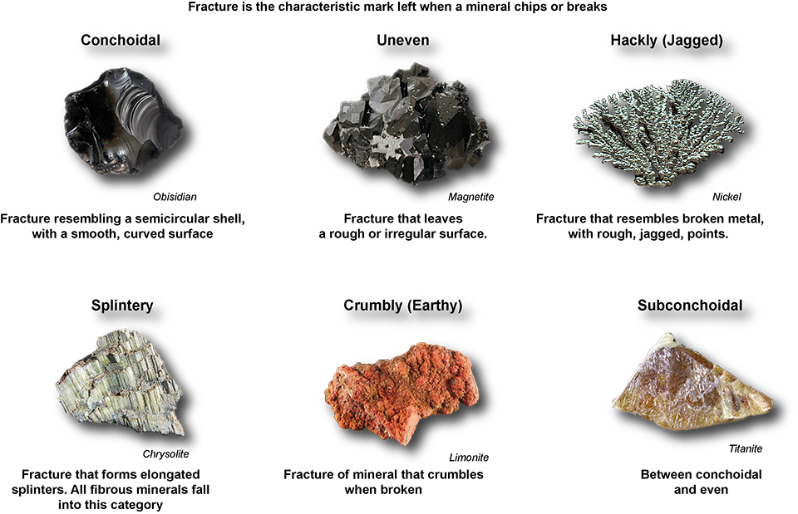
Fracture

Slide 18
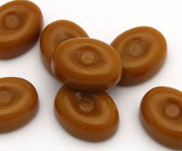
Mineral Identification
Fracture Lab
Cover your candy with a paper towel.
Use the mallet to gently tap your candy until it breaks. Large pieces are better than many small pieces.
Draw a picture in your SNB after breaking the candy.
Using the fracture chart in your SNB, determine what type of fracture your candy has.
Obtain a rock sample from the teacher.
Using the fracture chart in your SNB, determine what type of fracture your rock has.
Write at least two sentences comparing your rock sample and your candy.

Slide 19
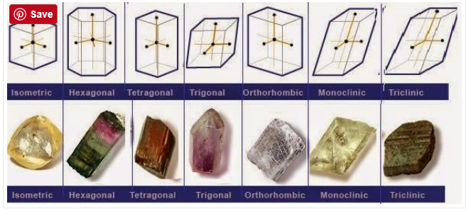
Mineral Identification
Crystal Shape
Determined by atomic structure
Vary greatly

Slide 20
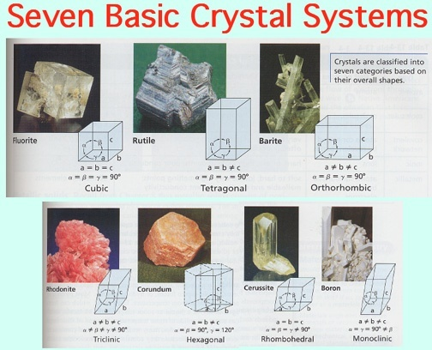

Slide 21
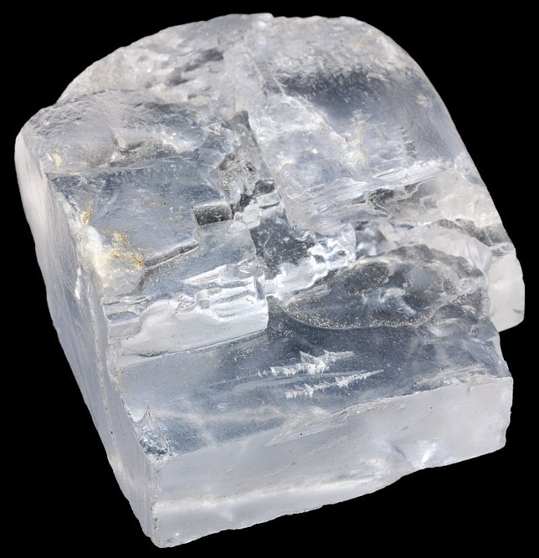
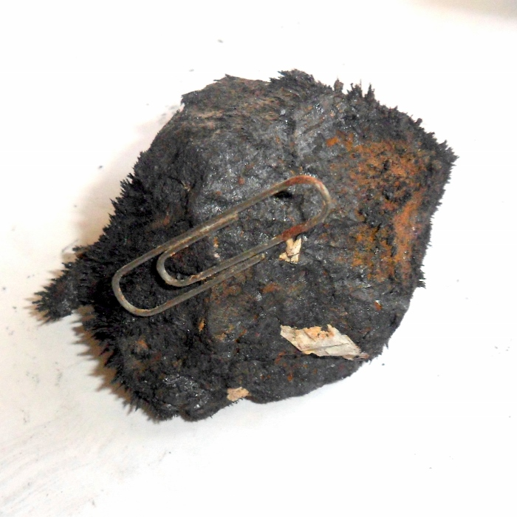
Mineral Identification
Unusual Property
Halite tastes salty
Magnetite is magnetic

