Slide 1
Matter

Slide 2
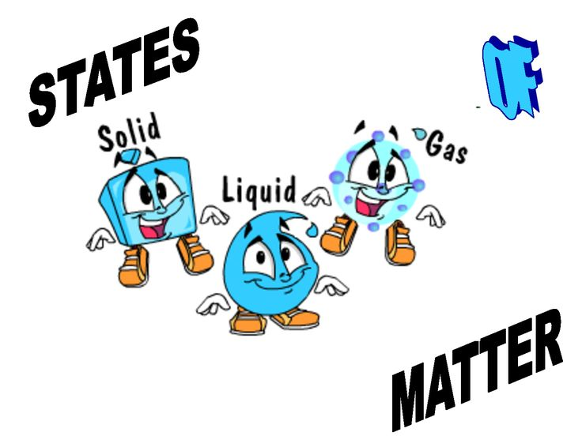
Matter
Matter
Anything that has mass and takes up space
States of Matter
Solid
Liquid
Gas
State of matter determined by:
Particle motion
Particle forces

Slide 3
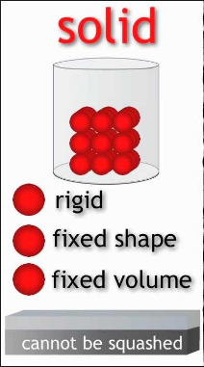
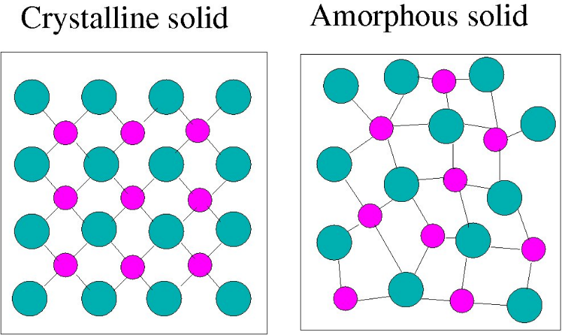
Solid
Matter that has a definite shape and a definite volume
Strong attractive forces
Slow motion
Vibrate back and forth
Particles are close together
Two Types of Solids
Crystalline
Particles arranged in a specific repeating order
Amorphous
Particles arranged randomly

Slide 4
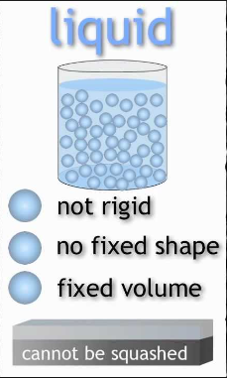
Liquid
Matter with a definite volume but no definite shape
Weaker attractive force
Faster moving particles
Particles spread apart
Flows and takes the shape of containers

Slide 5
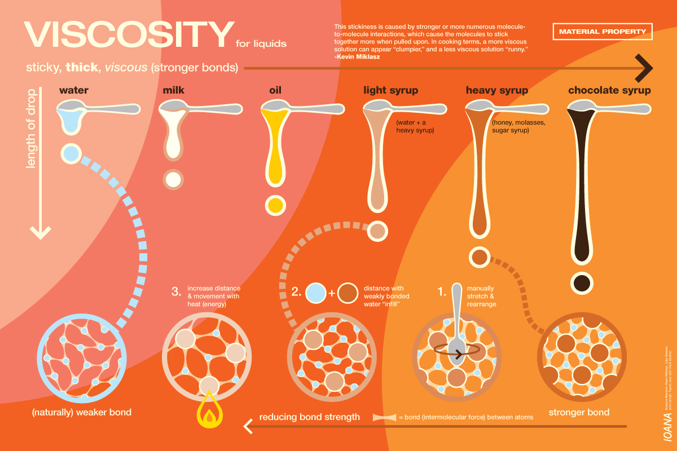
Liquid--Viscosity
Measurement of a liquids resistance to flow
High viscosity=slow flow
Low viscosity=fast flow
Depends on:
Particles mass
Particle shape
Attraction between particles
Decreases as liquid becomes warmer

Slide 6
Liquid—Surface Tension
Uneven forces acting on the particles on the surface of a liquid
Cohesion
Attraction between similar molecules

Slide 7
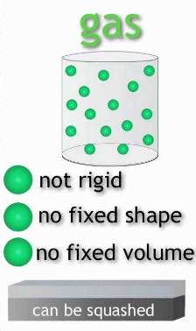
Gas
Matter that has no definite shape and no definite volume
Weak or absent attractive forces
Fastest moving particles
Particles spread to fill their container

Slide 8
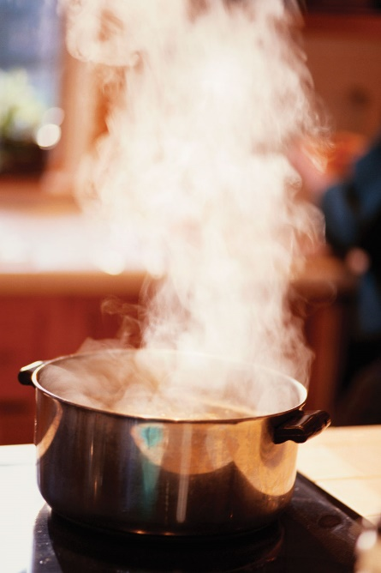
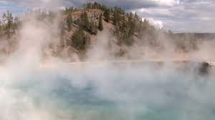
Vapor
Normally a solid or liquid at room temperature
Examples:
Water, rubbing alcohol, iodine, mercury, gasoline

Slide 9
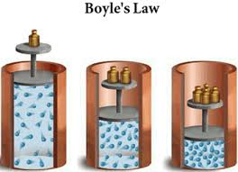
Gas Behavior
Pressure
Amount of force applied per unit
Result of constantly moving gas particles colliding with their container
Greatest volume → least pressure
Less volume → more pressure
Least volume → most pressure

Slide 10
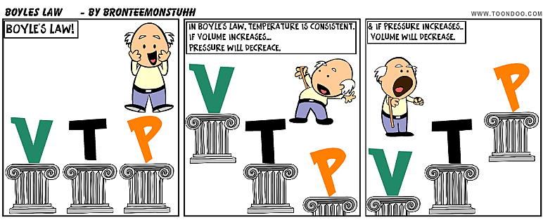
Gas Behavior
Boyle’s Law
Pressure of a gas increases if the volume decreases and pressure of a gas decreases if the volume increases, when temperature is constant

Slide 11
Gas Behavior
Robert Boyle

Slide 12
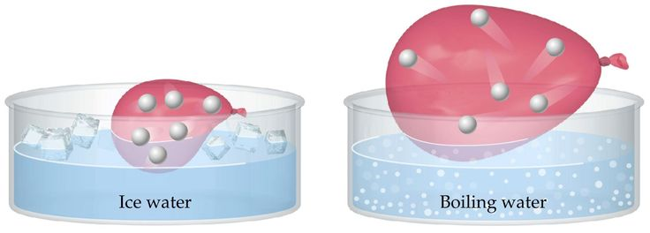
Gas Behavior
Temperature
Changing temperature of a gas affects its behavior
Low temperature=low kinetic energy=less volume
High temperature=high kinetic energy=more volume

Slide 13
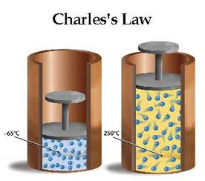
Gas Behavior
Charles’s Law
The volume of a gas increases with increasing temperature, if the pressure is constant

Slide 14
Gas Behavior
Jacques Charles

Slide 15
Gas Behavior
Charles’s Law
The volume of a gas increases with increasing temperature, if the pressure is constant

Slide 16
Kinetic Molecular Theory
Explanation of how particles in matter behave
Small particles make up all matter
Particles are in constant, random motion
Particles collide with other particles, other objects, and the walls of their container
When particles collide, no energy is lost

Slide 17
Physical Properties
Mass Dependent Amount of matter in an object
Conductivity Independent Ability of matter to conduct electricity or heat
Volume Dependent Amount of space something occupies
Density Dependent Amount of mass per unit of volume

Slide 18
Physical Properties
State of Matter Independent Solid, liquid, gas
Solubility Independent Ability of one substance to dissolve in another
Magnetism Independent Attractive forces for metals
Boiling/ Dependent Temperature at Melting Point which material changes state

Slide 19
Physical Changes
A change in size, shape, form or state of matter
Matter’s identity stays the same
Types
Change in shape or size
Change in state of matter
Adding thermal energy
Removing thermal energy
Dissolving

Slide 20
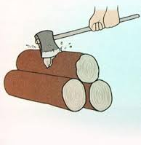
Physical Changes
Examples:

Slide 21
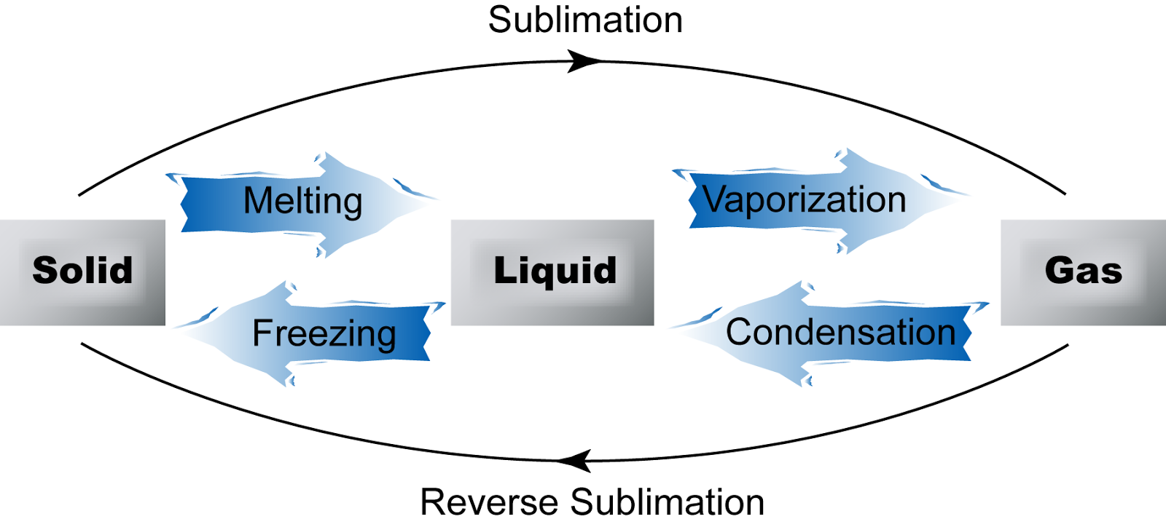
State Changes
Deposition

Slide 22
State Changes
Vaporization
Add thermal energy
Liquid to a gas
Melting
Add thermal energy
Solid to a liquid
Condensation
Remove thermal energy
Gas to a liquid
Freezing
Remove thermal energy
Liquid to a solid

Slide 23
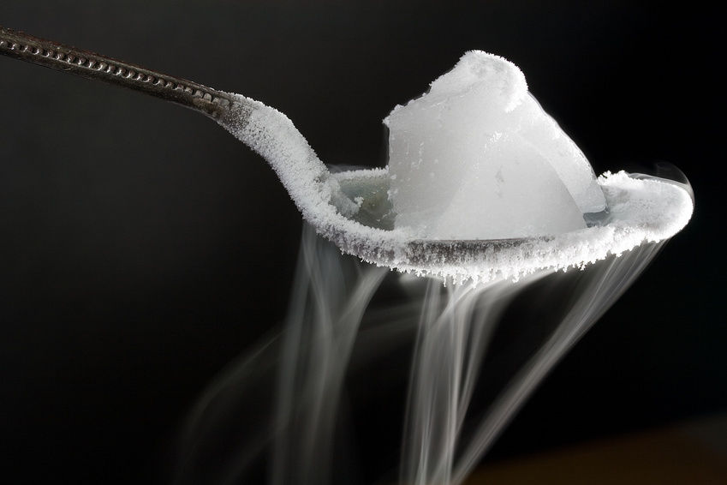
State Changes
Sublimation
Change from a solid to a gas without going through a liquid state
Example: dry ice
Deposition
Change from a gas to a solid without going through a liquid state
Example: frost

Slide 24
Physical Changes
Conservation of Mass
Mass is the same before and after change
Conservation of Matter
Particles are the same before and after change

