Slide 1
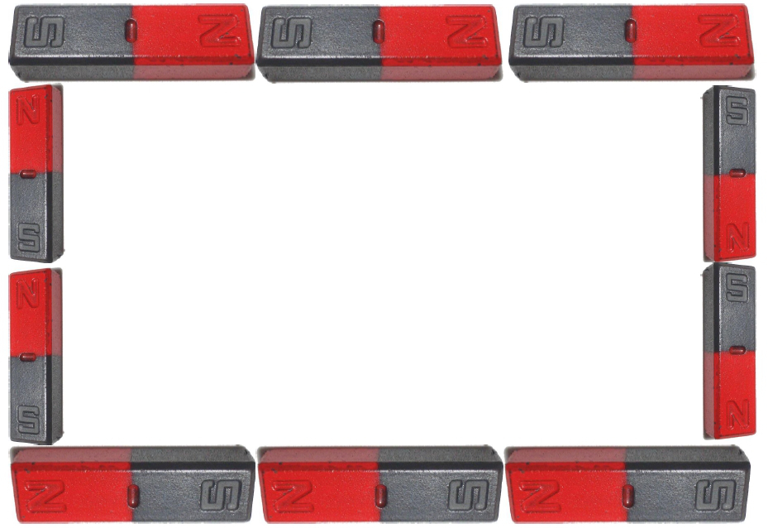
Magnetism

Slide 2
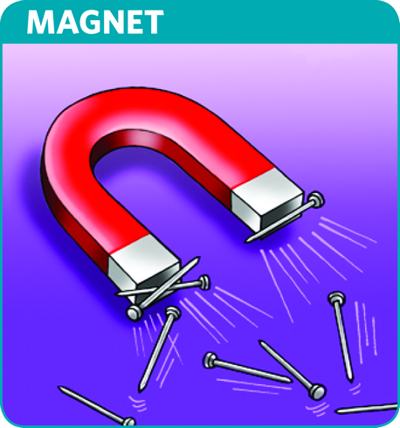
Magnet
An object that attracts iron and other materials that have magnetic qualities

Slide 3
Magnetic Materials
Any material a magnet attracts
Iron, nickel, cobalt

Slide 4
Magnetic Force
A push or pull in a magnetic field
Applies to either a magnetic material or an electric current

Slide 5
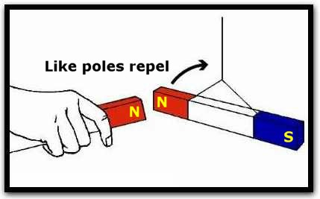
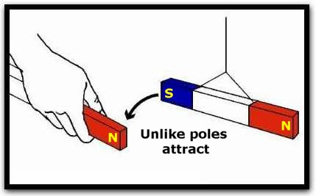
Magnetic Poles
Magnets have North and South poles
Like poles repel (N-N or S-S)
Opposite poles attract (S-N)

Slide 6
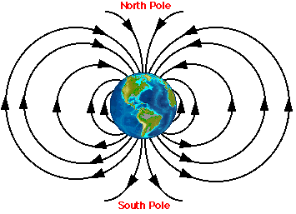
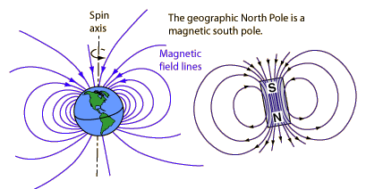
Earth is a Magnet
Iron and nickel in core of earth create a magnetic field
Has a magnetic N and S
Magnetic south is near the geographic north pole

Slide 7
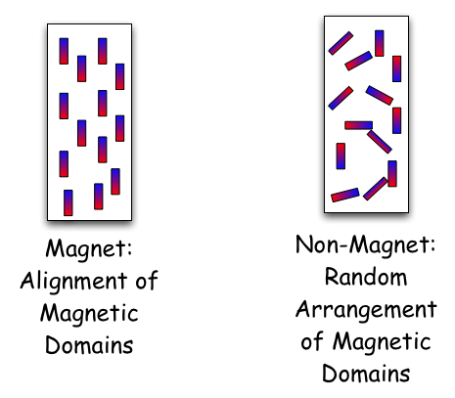
Magnetic Domain
Region in a magnetic material in which the magnetic fields of the atoms all point in the same direction

Slide 8
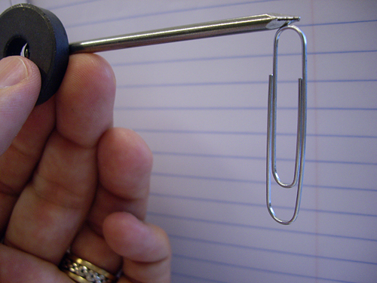
Temporary Magnet
Attracts other magnetic material only as long as it is within the magnetic field of another magnet

Slide 9
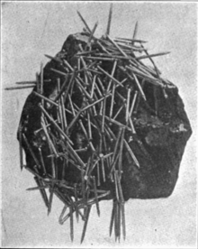
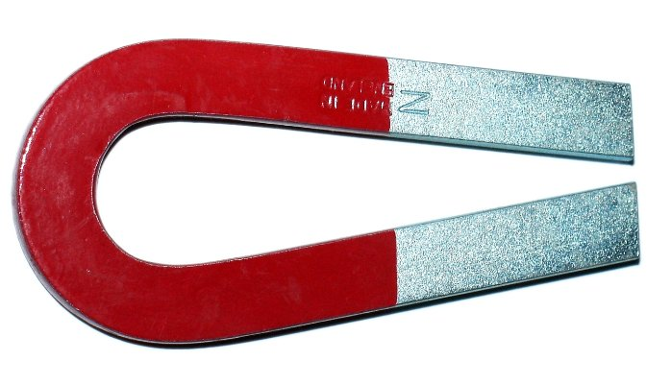
Permanent Magnet
Remains a magnet in any location
Can be naturally occurring, such as lodestone
Can be created by magnetizers

Slide 10
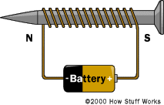
Electricity and Magnetism
Magnetic fields produce electric currents
Wire coil with a magnet in the center
Electric current forms
Flows through a circuit
Electromagnet is created

Slide 11
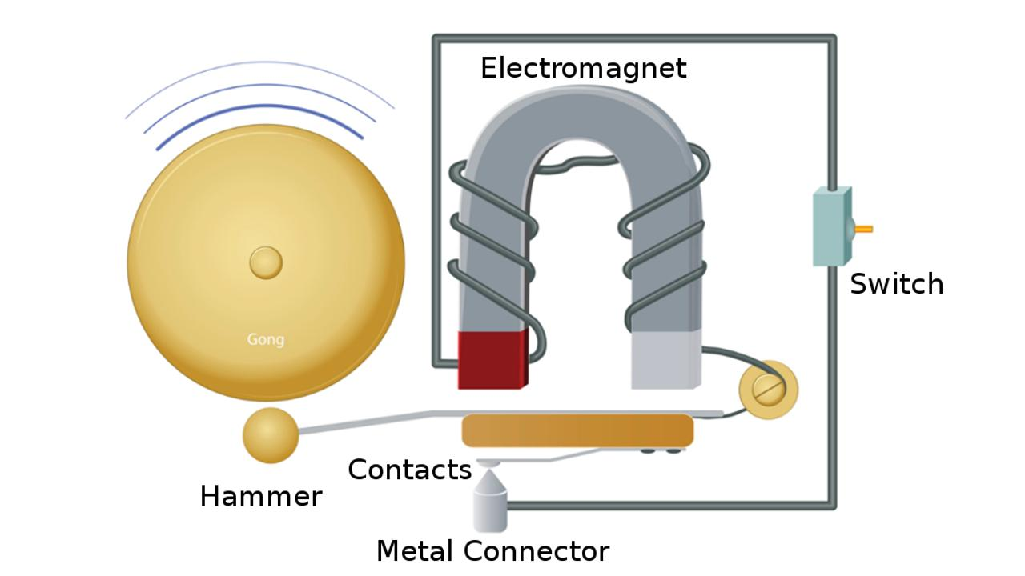
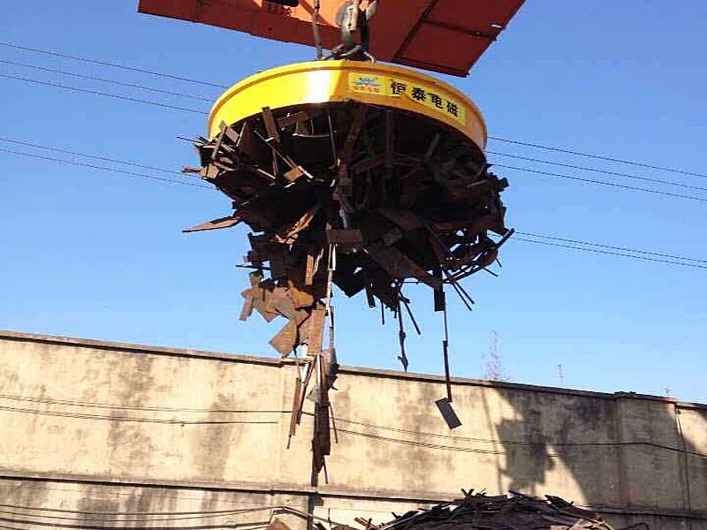
Electricity and Magnetism
Electromagnet
Temporary magnet
Can be turned on and off
Strength can be controlled
Used in generators

