Slide 1
Light

Slide 2
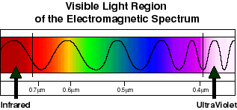
Visible Light
Wavelength and frequency determine color
Red=longest wavelength, lowest frequency
Violet=shortest wavelength, highest frequency

Slide 3
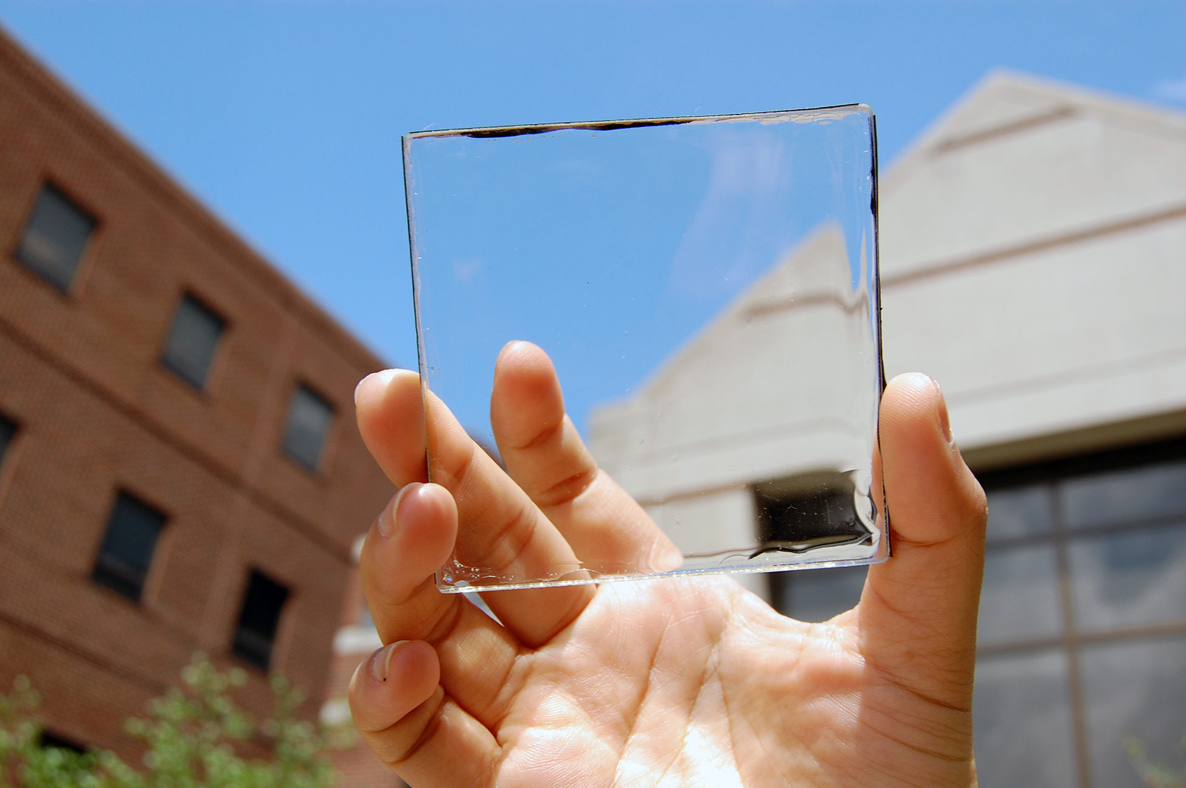
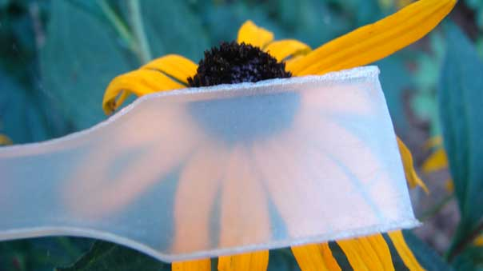
Transmission of Light
Transparent
Allows all light to pass through
See clearly
Translucent
Allows most light to pass through
Appears blurry

Slide 4
Absorption of Light
Opaque
No light passes through
Light is absorbed

Slide 5
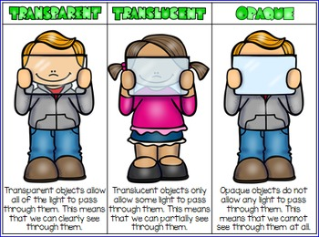

Slide 6
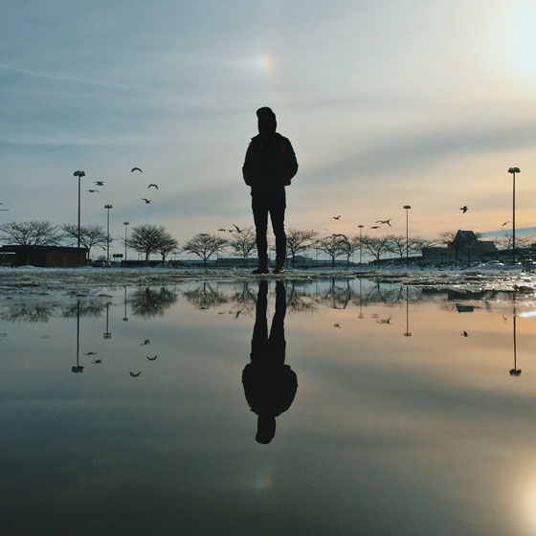
Reflection of Light
Waves reflect off surfaces according to the law of reflection
Smooth Surface
Clear image
Bumpy Surface
Not clear
Light scatters

Slide 7
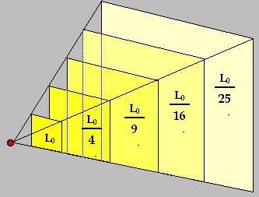
Intensity of Light
Intensity
The amount of energy that passes through a square meter of space in one second

Slide 8
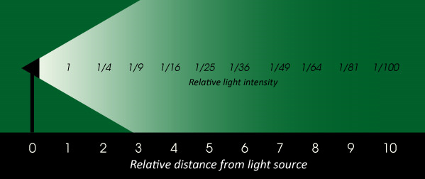
Intensity of Light
Intensity
Depends on the amount of energy a source emits
Depends on lights distance from the source

Slide 9
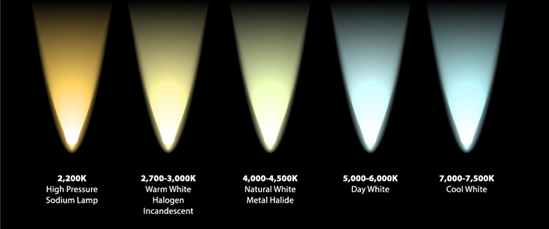
Intensity of Light
Brightness
A person’s perception of intensity (how we SEE the light)

Slide 10
Color
Luminous object
Is the color of the light it emits

Slide 11
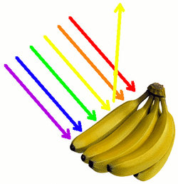
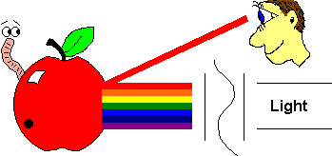
Color
Opaque object
Is the color it reflects

Slide 12
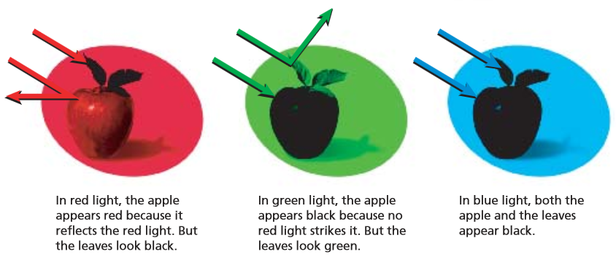
Color
Transparent/translucent objects
Appears to be the color of the filter

Slide 13
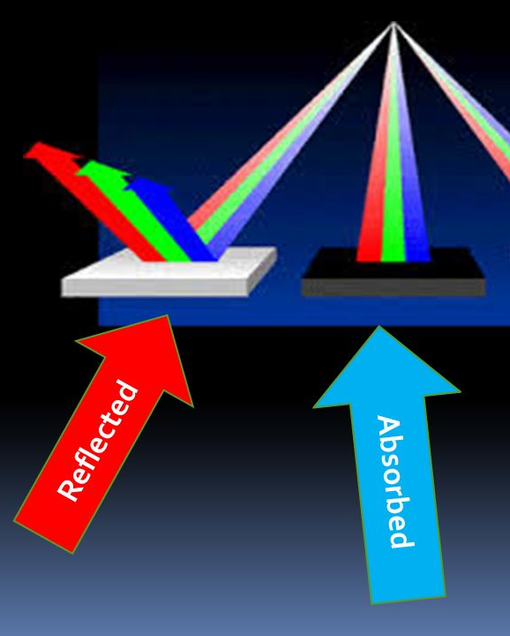
Color
White reflects all colors of light
Black absorbs all colors, but reflects a small amount of light
Red, green, and blue are considered the primary colors of light

Slide 14
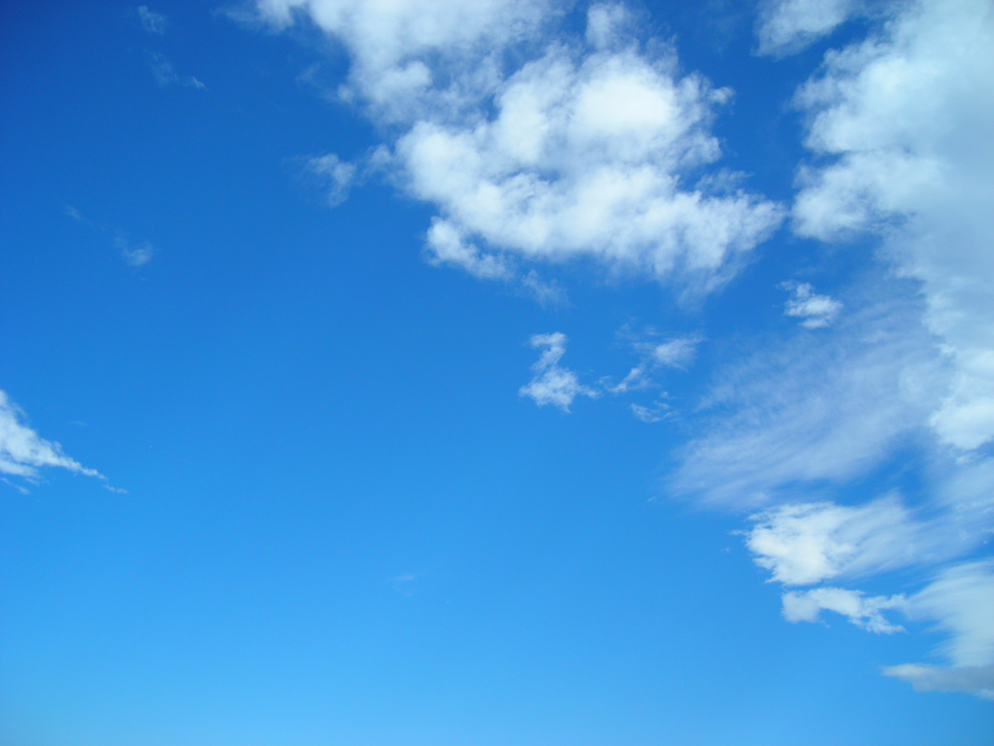
Why is the Sky Blue?
Blue wavelengths are shorter than red, so they scatter
They spread in all directions, making the sky appear blue
After the blue scatters, remaining light from the sun appears yellow

Slide 16
What About the Sunset?
Light changes speed as it moves from one medium to another
If it is at an angle, it refracts

Slide 17
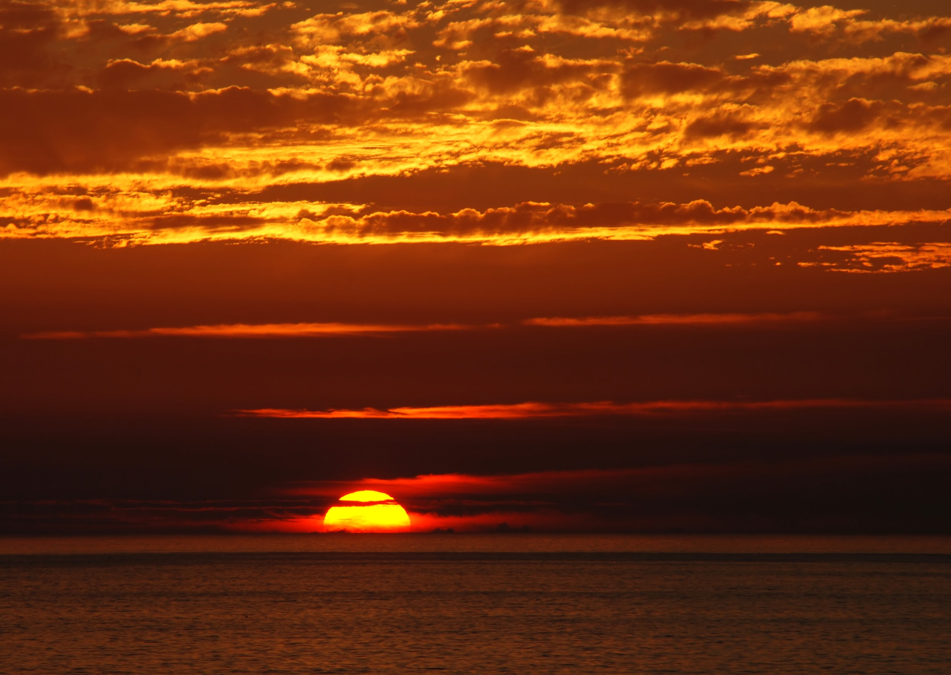
What About the Sunset?
Setting sun:
Suns ray’s slow down when they enter atmosphere
Rays refract toward Earth’s surface
Refractions causes you to see sun after its below the horizon

Slide 18
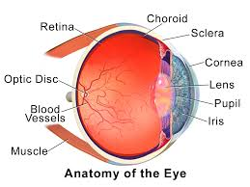
Eye

