Slide 1
Geologic Time Scale

Slide 2
Geologic Time Scale
A chart that divides Earth’s history into different time units
Longest
Shortest
Eons
Eras
Periods
Epochs

Slide 3
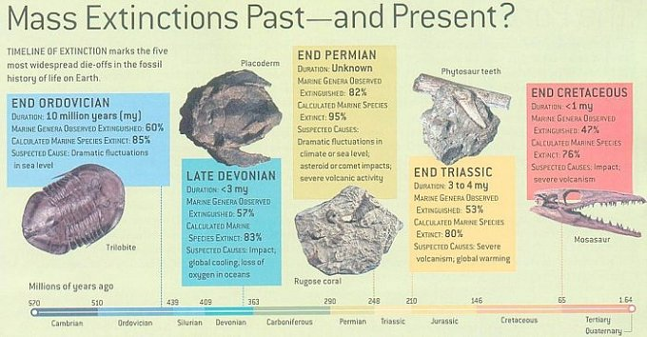
Mass Extinction
The extinction (dying off) of many species on earth within a short period of time

Slide 4
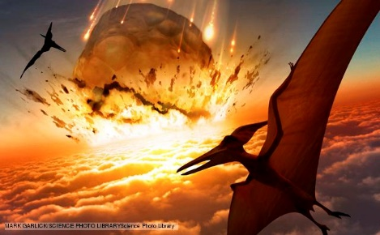
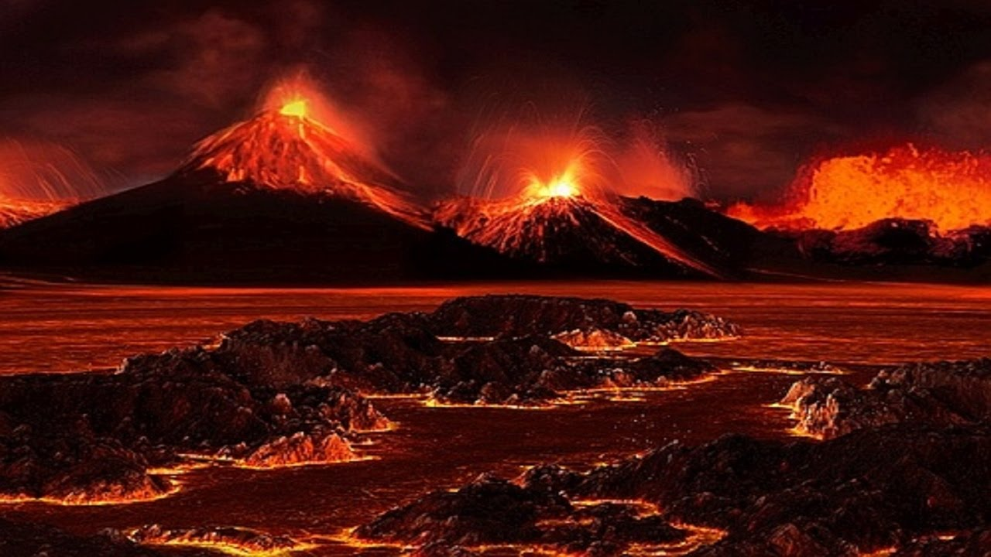
Sudden Mass Extinction Events
Climate Change
Meteorite Impact
Volcanoes

Slide 5
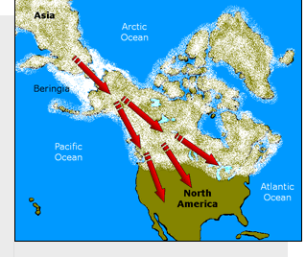
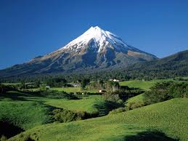
Gradual Mass Extinction Events
Geography and Evolution
Land bridge
Piece of land that connects two previously separated continents
Geographic Isolation
Separation of a population from the rest of its species due to a physical barrier (ocean, mountain)

Slide 6
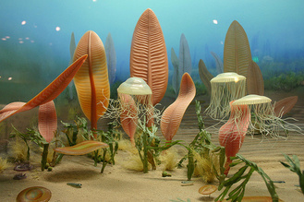
Precambrian Era
Includes Proterozoic, Archean, and Hadean Epochs
4.5 billion years ago to .5 billion years ago
90% of Earth’s history
Organisms lived at the bottom of the sea
Simple unicellular organisms

Slide 7
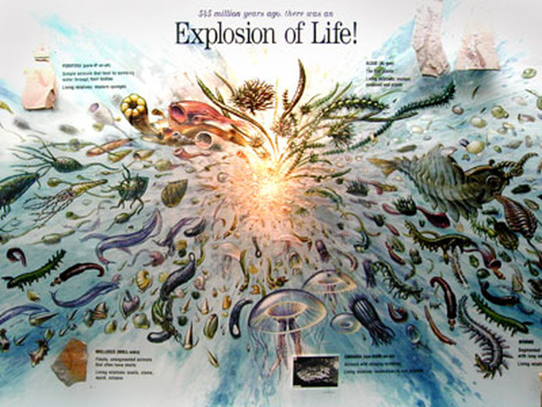
Paleozoic Era
Early Paleozoic Era
Age of Invertebrates
Cambrian Period
Began with a Cambrian explosion
Abundance of new life forms
Warm climate
All invertebrates lived in water

Slide 8
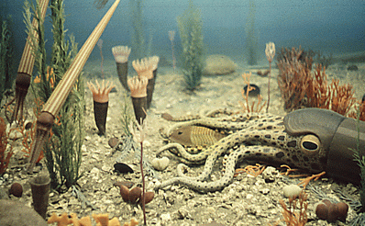
Paleozoic Era
Early Paleozoic Era
Age of Invertebrates
Ordovician
Rising sea levels caused flooding
Many inland seas
Ended in mass extinction

Slide 9
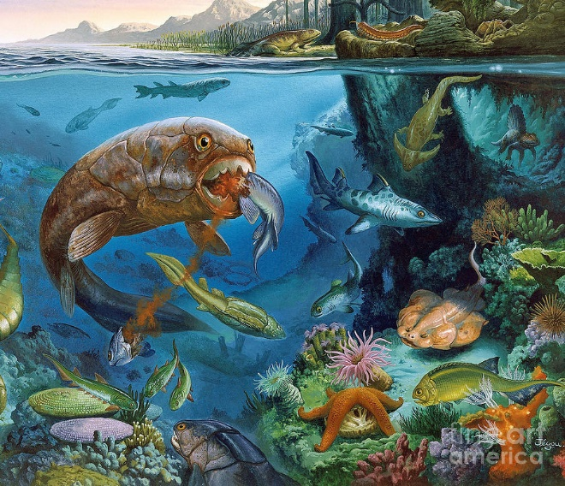
Paleozoic Era
Middle Paleozoic Era
Age of Fishes
Silurian
Many invertebrates survived
Vertebrates (fish, insects) evolved

Slide 10
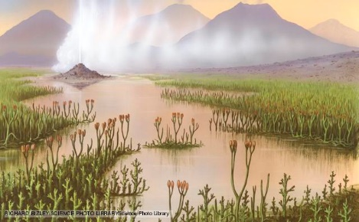
Paleozoic Era
Middle Paleozoic Era
Age of Fishes
Devonian
Multitude of fishes
First plants appeared
Colliding continents created mountains
Ended with mass extinction

Slide 11
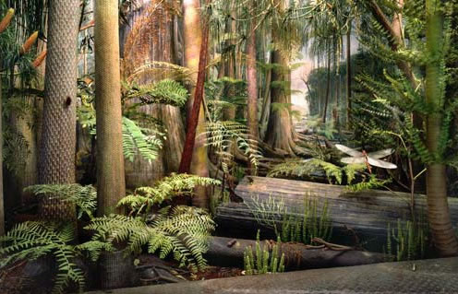
Paleozoic Era
Late Paleozoic Era
Age of Amphibians
Carboniferous
Dense tropical forests grew
New mountains formed
Coal swamps (source of coal we use today)
Amphibians developed and spent time on land

Slide 12
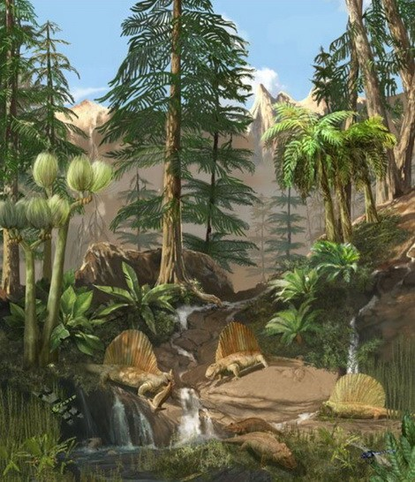
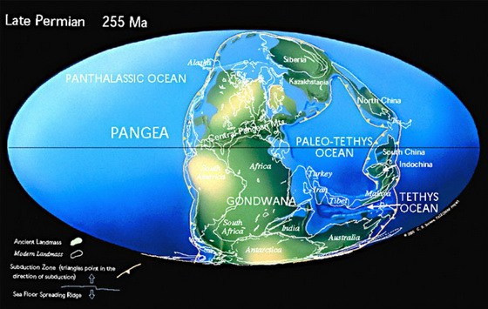
Paleozoic Era
Late Paleozoic Era
Age of Amphibians
Permian
Reptiles developed
Pangaea created
Coal swamps dried up
Climate became cooler an drier
Permian mass extinction killed 70% land creatures and 95% water creatures

Slide 13
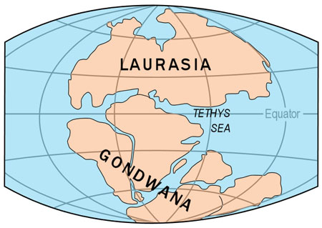
Mesozoic Era 251→65.5 million years ago
Geology
Pangea broke up in the late Triassic Period creating:
1. Gondwanaland
✓Southern Continent
✓Antarctica, Africa, Australia, South America
2. Laurasia
✓Northern Continent
✓North America, Europe, Asia

Slide 14
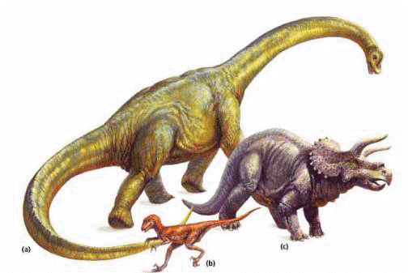
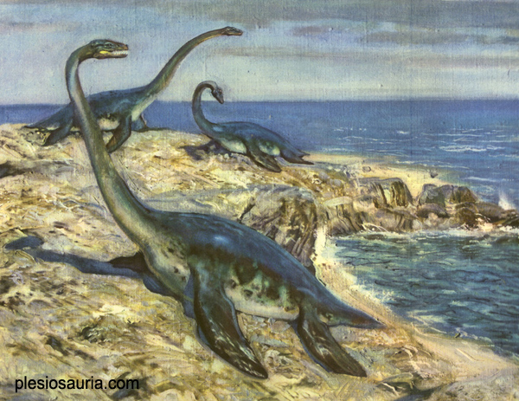
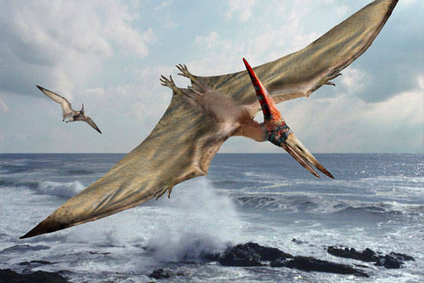
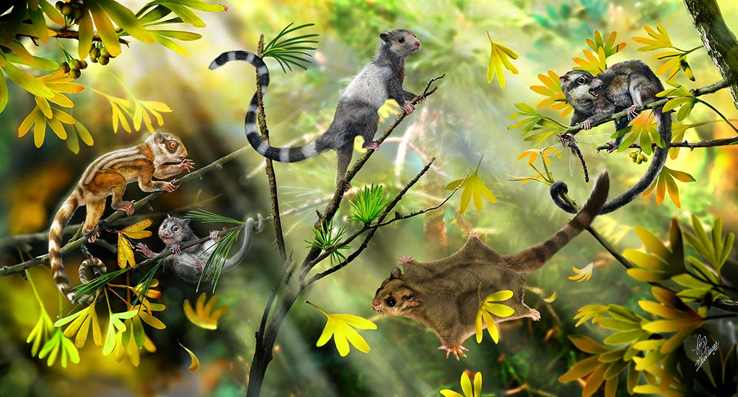
Mesozoic Era 251→65.5 million years ago
Life
Dinosaurs
Dominant land animals
Legs positioned directly below hips
Allowed them to walk upright
Plesiosaurs
Marine reptiles
Pterosaurs
Flying reptiles
Mammals
Very small

Slide 15
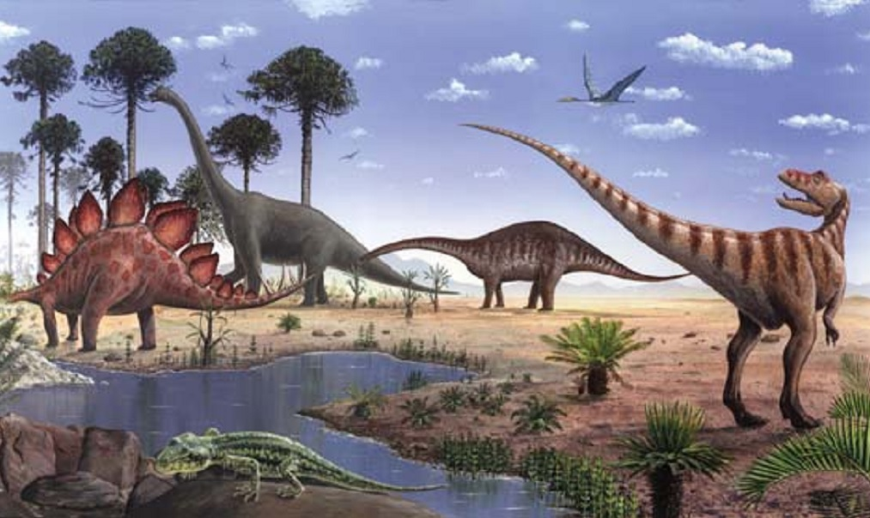
Mesozoic Era 251→65.5 million years ago
Climate
No ice caps
Warmer
Inland seas covered most continents
Oceans had more water

Slide 16
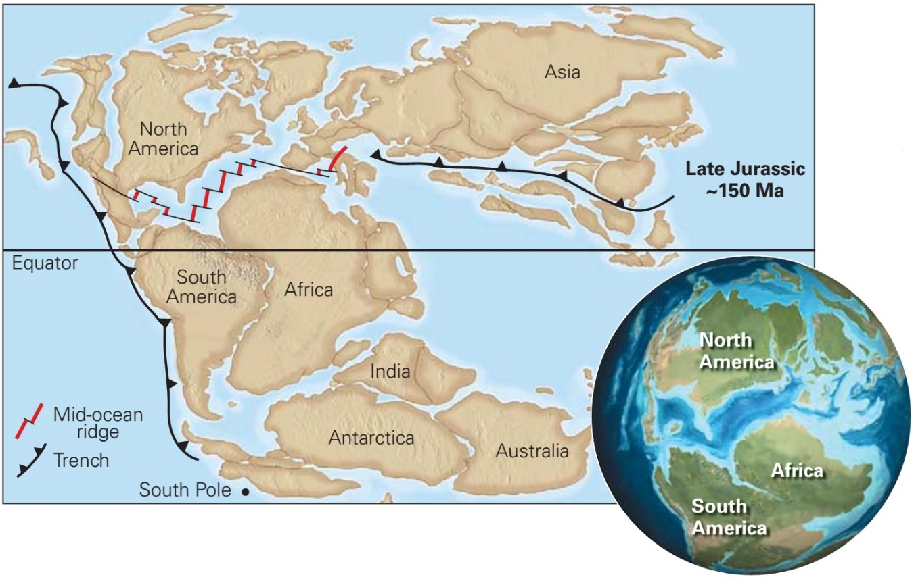
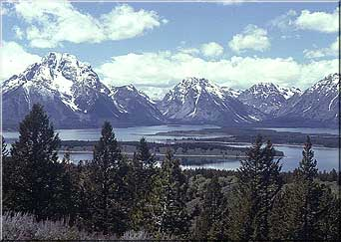
Mesozoic Era 251→65.5 million years ago
North America
Slow and steady westward movement
Rocky mountains formed
Salt deposits left by receding seas

Slide 17
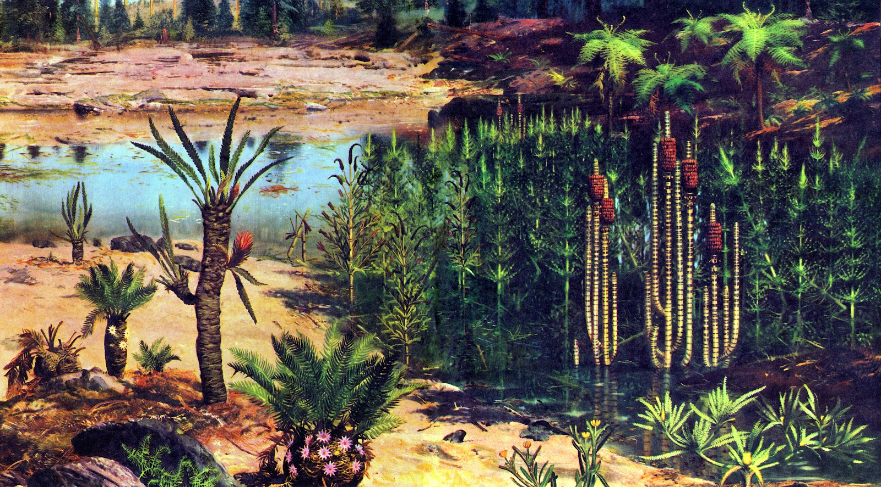
Mesozoic Era 251→65.5 million years ago
Plants
First flowering plants
Cone-bearing trees

Slide 18
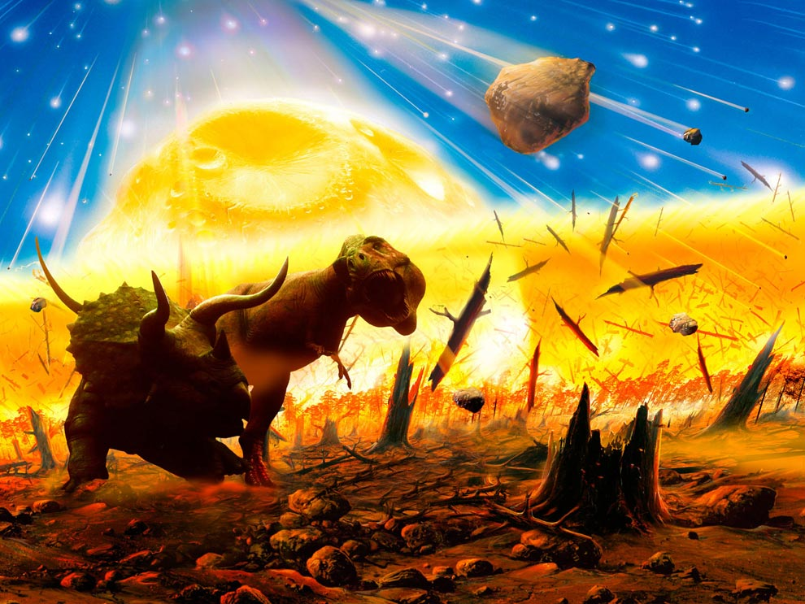
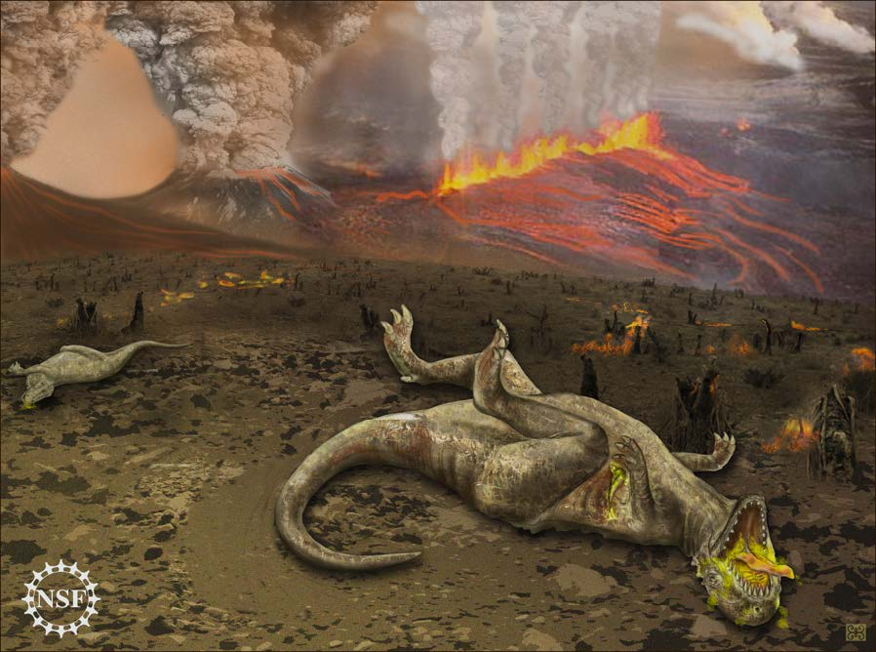
Mesozoic Era 251→65.5 million years ago
Mass Extinction
Ended 65.6 mya
Meteorite impact??
Volcanic eruption??

Slide 19
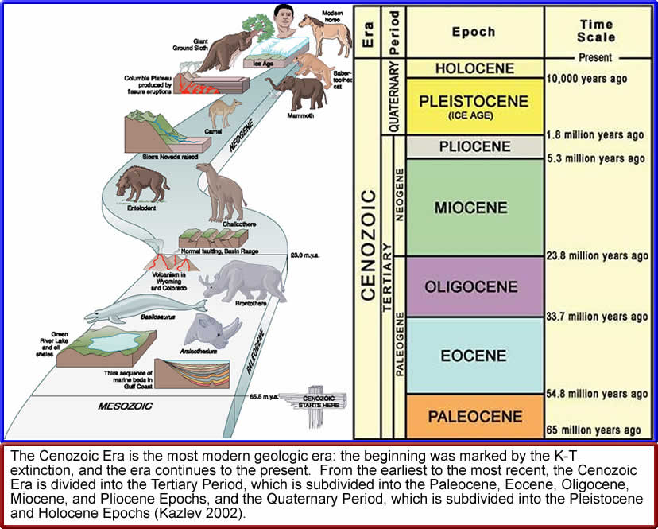
Cenozoic Era 65.5 million years ago →Today
Most recent, so fossil/rock record is better preserved
We live in Holocene Epoch
Began about 10,000 years ago

Slide 20
Cenozoic Era 65.5 million years ago →Today
Geology
Mountains created
India and Asia → Himalayas
Africa and Europe → Alps
West coast of N.A. → Cascades and Sierra Nevada

Slide 21
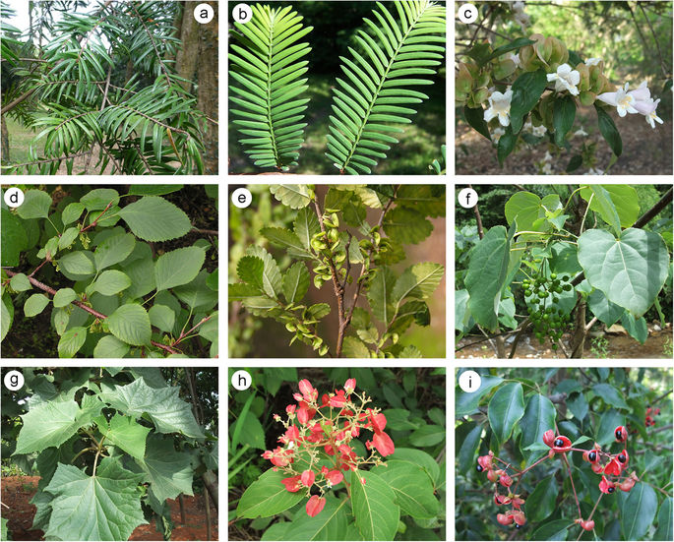
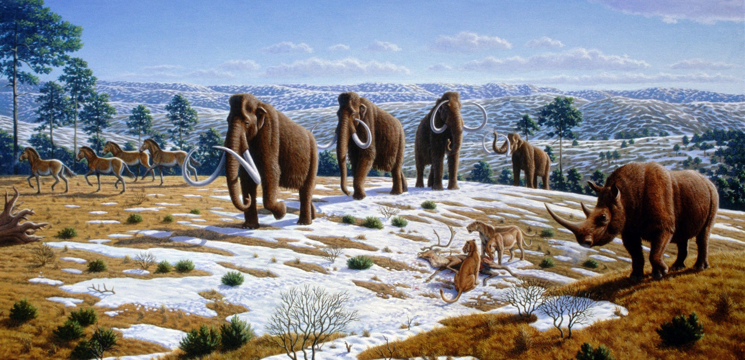
Cenozoic Era 65.5 million years ago →Today
Life
Age of Mammals
Flowering plants and grasses evolved creating new food sources
Allowed many new species to evolve
Mega-mammals
Migrated over land bridges
Became extinct due to climate change

Slide 22
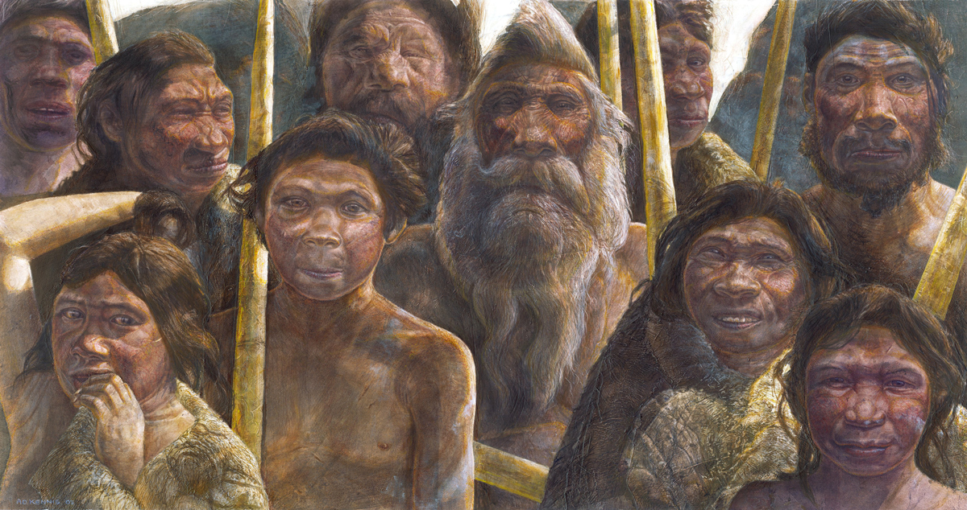
Cenozoic Era 65.5 million years ago →Today
Life
Humans
Oldest human fossils 6 million years old
Migrated to Europe, Asia, then N.A.

Slide 23
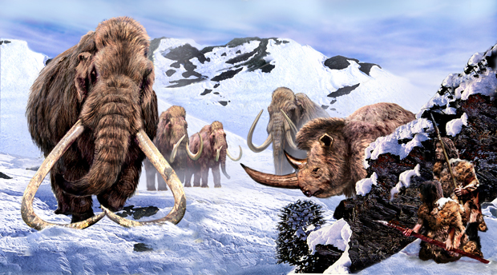
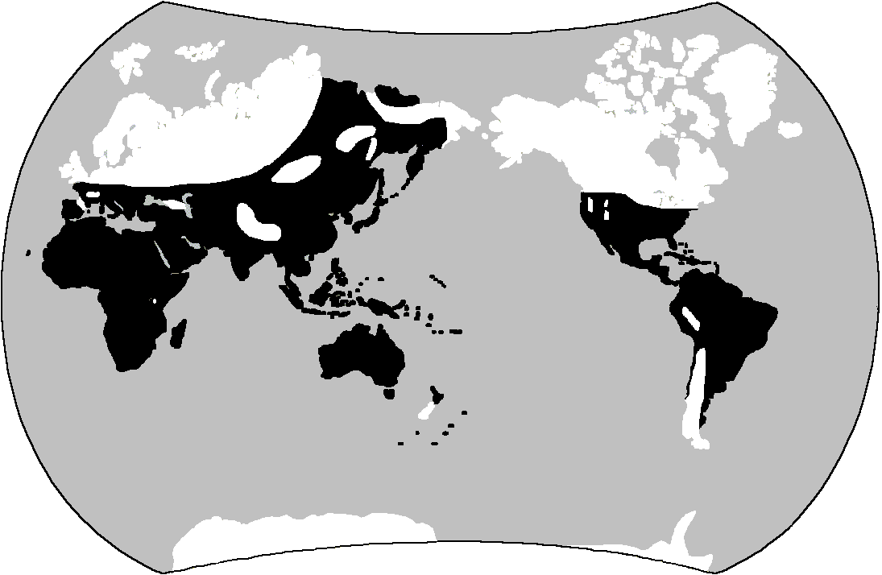
Cenozoic Era 65.5 million years ago →Today
Climate
Early Cenozoic
Warm
Middle Cenozoic
Began to cool
Late Cenozoic
Pleistocene Epoch
Ice Age
Glaciers created
Covered 30% of land
Sea levels dropped

