Slide 1
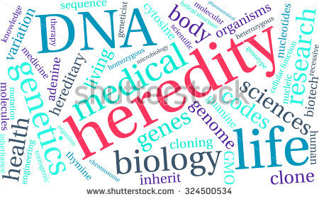

Slide 2
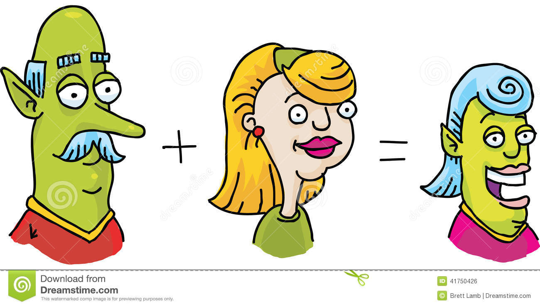
Genetics
Genetics
The study of how traits are passed from parents to offspring

Slide 3
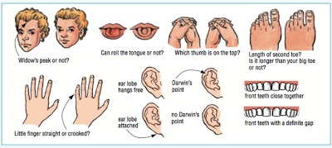
Genetics
trait
A distinguishing characteristic of an organism
Inherited trait
Passed on from parents to offspring
Acquired trait
Learned during a lifetime

Slide 4
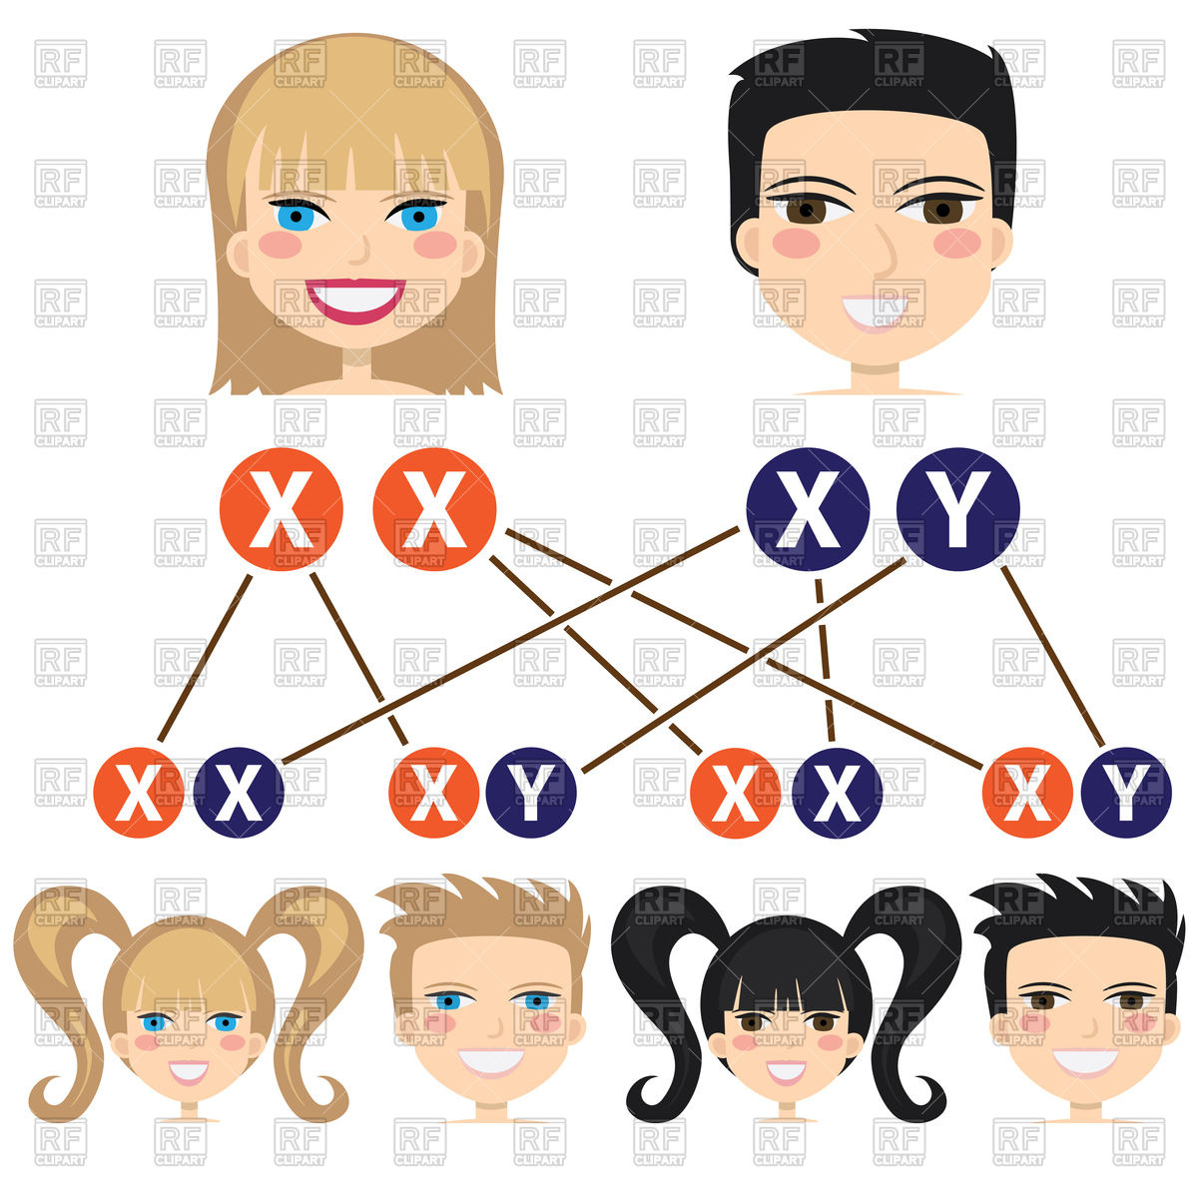
Genetics
Heredity
The passing of traits from parents to offspring

Slide 5
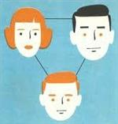
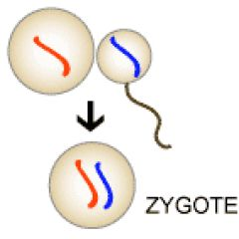
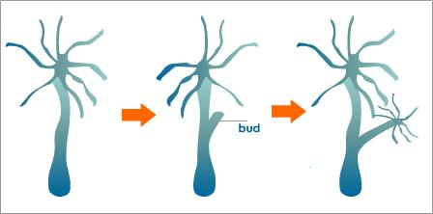
Genetics
Passed on through:
Sexual reproduction
Offspring receive half their genes from the egg cell and half from the sperm cell
Asexual reproduction
One organism makes a copy of its genes and itself

Slide 6
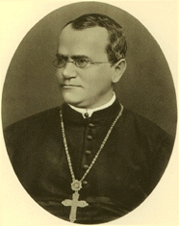
Genetics
Gregor Mendel
Lived and studied 150 years ago
Austrian monk
“Father of Genetics”
Performed controlled breeding experiments with pea plants

Slide 7
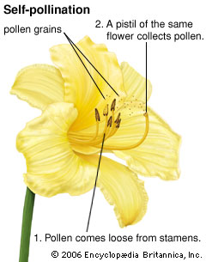
Genetics
Self-Pollination
Fertilization that occurs when pollen from one plant lands on the pistil of a flower on the same plant

Slide 8
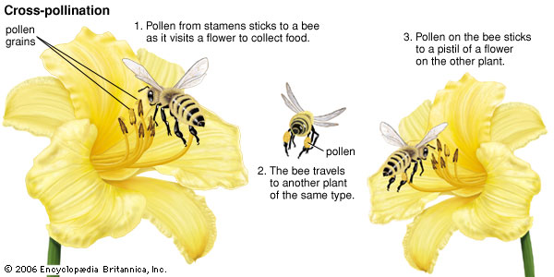
Genetics
Cross-Pollination
Fertilization that occurs when pollen from one plant lands on the pistil of a flower of a different plant

Slide 9
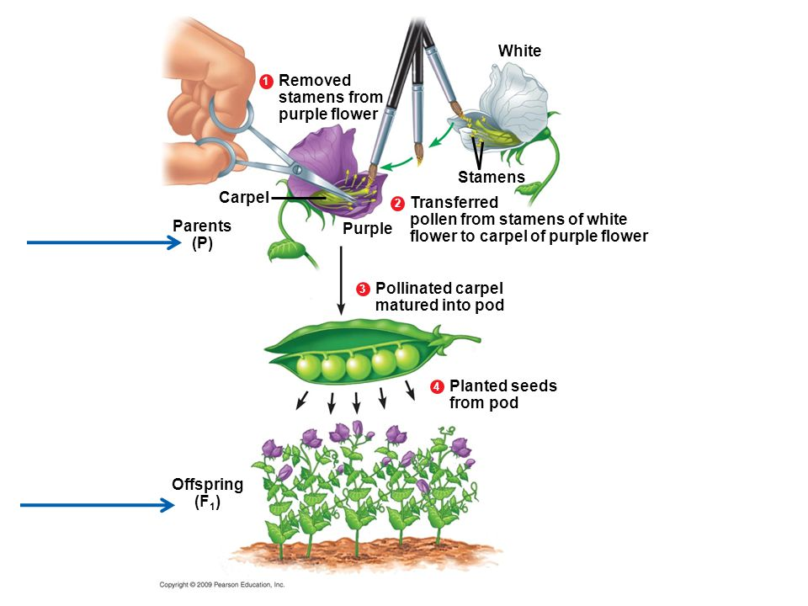
Mendel’s Cross-Pollination

Slide 10
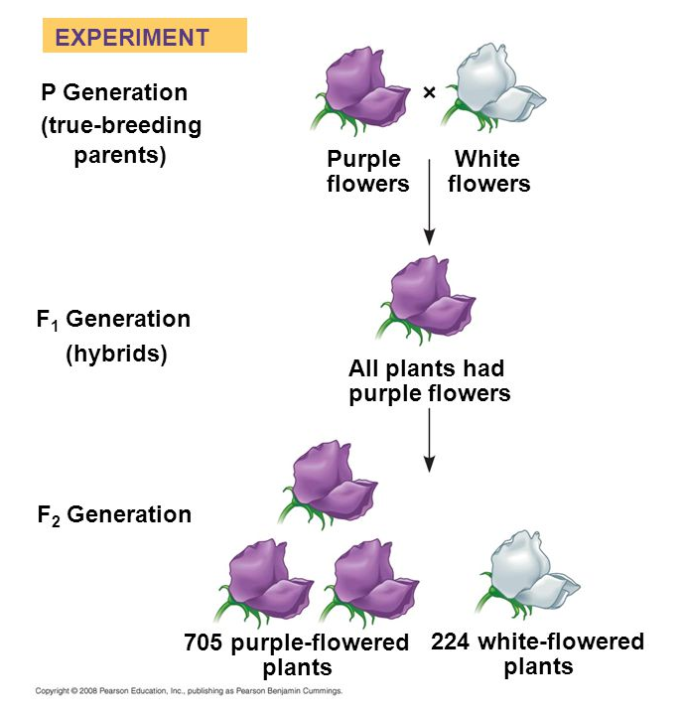
Genetics
true-Breeding
Plants that produce the same traits as parents when they are self-pollinated
Hybrid
The offspring of two animals or plants with different forms of the same trait

Slide 11
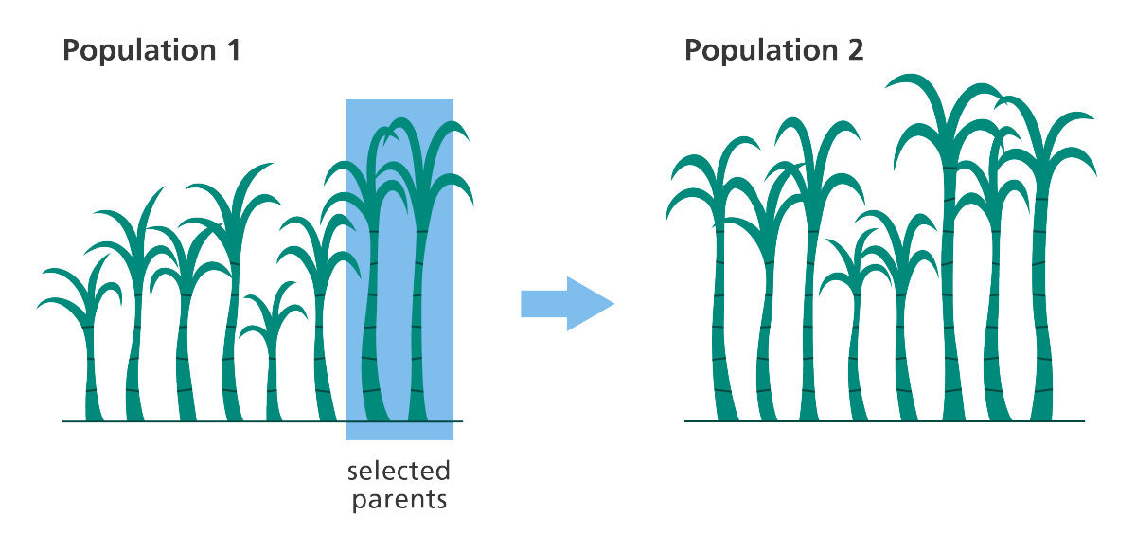
Genetics
Selective Breeding
The selection and breeding of organisms for desired traits

Slide 12
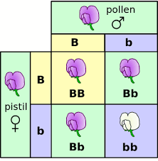
Genetics
Mendel’s Conclusions
Two genetic factors controlled each trait
When organisms reproduce, each reproductive cell (egg or sperm) contribute on genetic factor for each trait

Slide 13
Genetics
Dominant trait
A genetic factor that blocks another genetic factor
Recessive trait
A genetic factor that is blocked by the presence of a dominant factor

Slide 14
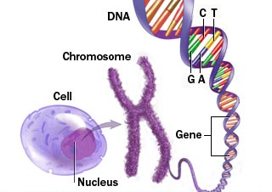
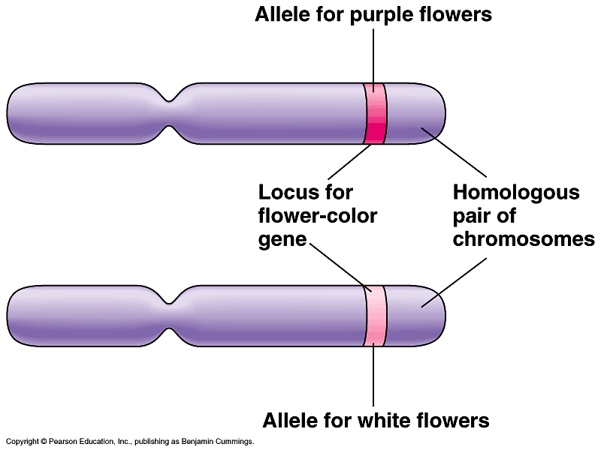
Genetics
Genes
A section on a chromosome that has genetic information for one trait
An offspring has two gene factors for each trait
Alleles
Different forms of a gene
EX: Purple or white flowers

Slide 15
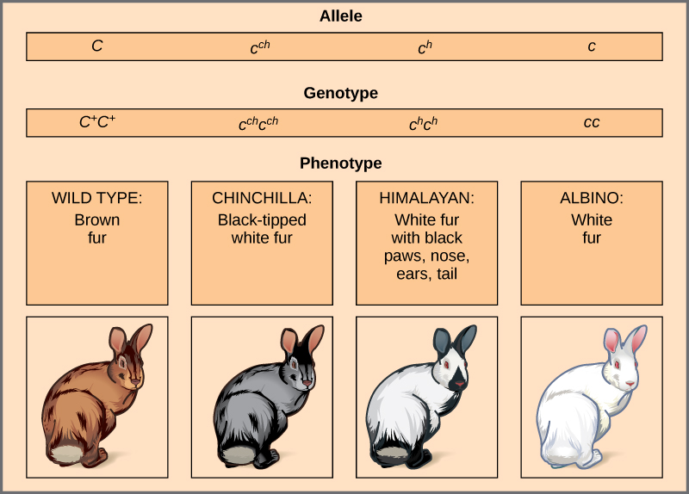
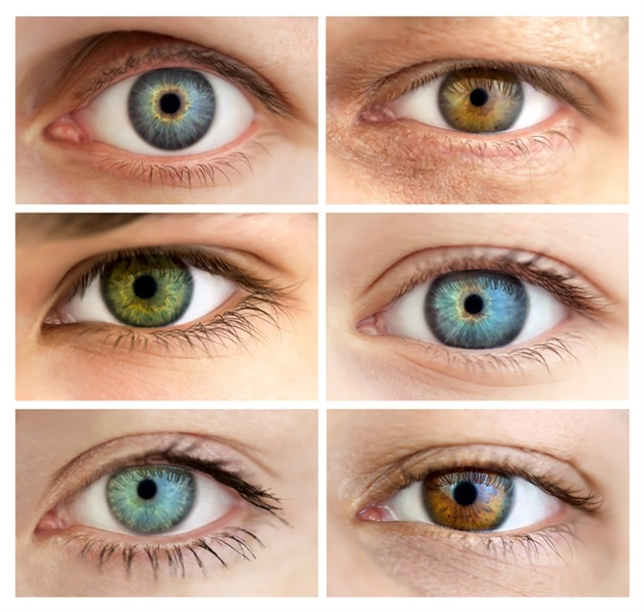
Genetics
Phenotype
How a trait appears, or is expressed
Can be seen
EX: blue or brown eye color

Slide 16
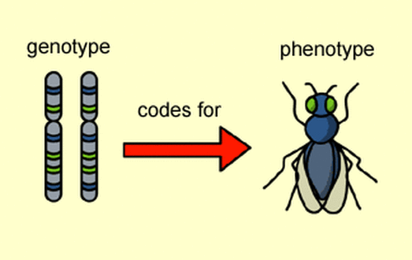
Genetics
Genotype
Two alleles that control the phenotype of a trait
Cannot be seen

Slide 17
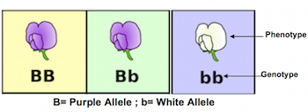
Genetics
Genotype
Symbols represent genotype
Uppercase letters=dominant alleles
Lowercase letters=recessive alleles
Dominant allele written first

Slide 18
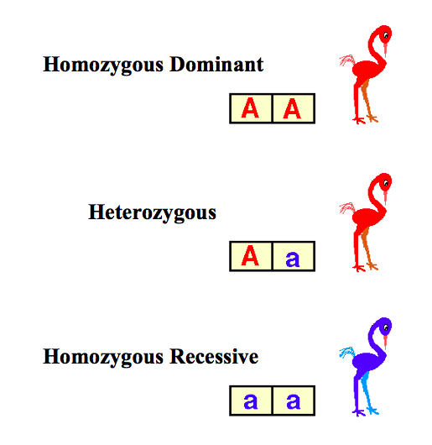
Genetics
Genotype
Homozygous
Two alleles are the same
Homozygous dominant= RR
Homozygous recessive= rr
Heterozygous
Two alleles are different
Rr

Slide 19
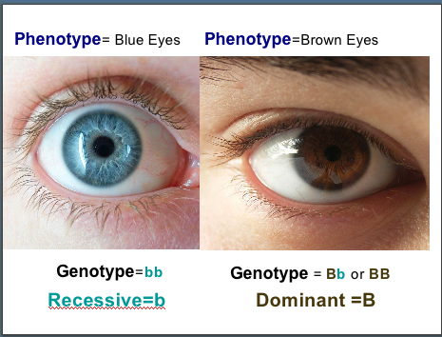
Genetics

Slide 20
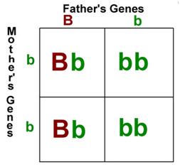
Genetics
tools to Model Inheritance
Punnett Square
Model used to predict possible genotypes and phenotypes of offspring
Can use ratios to predict

Slide 21
Genetics
Predicting Genetic Outcomes with Punnett Squares
Pea Pod Colors
G g
G=dominant; green
G
g=recessive; orange
g
Parents: Mom = Gg; Dad = Gg
Genotypes:
GG=25%
Gg=50%
gg=25%
Phenotypes:
Green=75%
Orange=25%
GG | Gg
Gg | gg

Slide 22
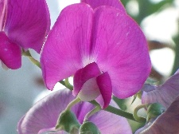
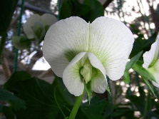
Genetics
Predicting Genetic Outcomes with Punnett Squares
Flower Color
P P
P=dominant; purple flowers
p
p=recessive; white flowers
p
Parents: Mom = PP; Dad = pp
Genotypes:
Pp=100%
Phenotypes:
Purple=100%
Pp | Pp
Pp | Pp

Slide 24
Genetics
tools to Model Inheritance
Pedigree
Shows phenotypes of genetically related family members
Can help determine genotypes

Slide 25
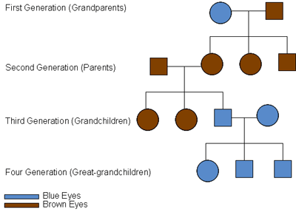
Genetics
tools to Model Inheritance
Pedigree

Slide 27
Genetics
Complex Patterns of Inheritance
Incomplete Dominance
When the offspring’s phenotype is a combination of the parents’ phenotypes
EX: cross between a red flower and a white flower is a pink flower

Slide 28
Genetics
Complex Patterns of Inheritance
Codominance
When both alleles can be observed in a phenotype
EX: A cow with an allele for a red coat from one parent and a white coat from another has a coat with both hair colors

Slide 29
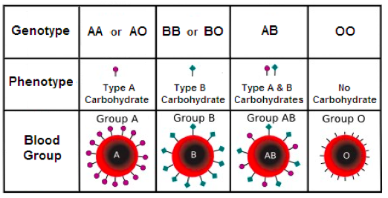
Genetics
Complex Patterns of Inheritance
Multiple Alleles
Some genes have more than two alleles
A person can only have two alleles, one from each parent
EX: human blood

Slide 30
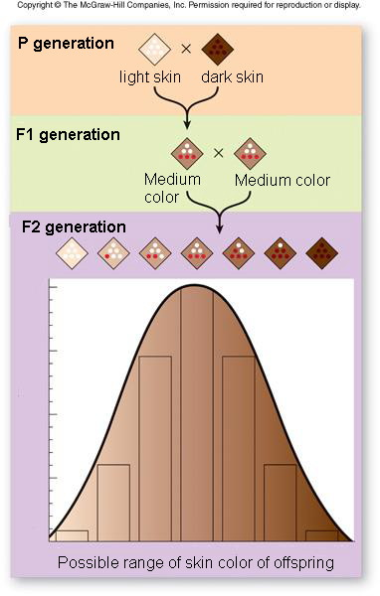
Genetics
Complex Patterns of Inheritance
Polygenic Inheritance
Occurs when multiple genes determine the phenotype of a trait
Many alleles affect the phenotype

Slide 31
Genetics
Complex Patterns of Inheritance
Environment
Environment can affect phenotype
EX: flower color determined by soil in genetically identical hydrangea plants

