Slide 1
Forces and Friction

Slide 2
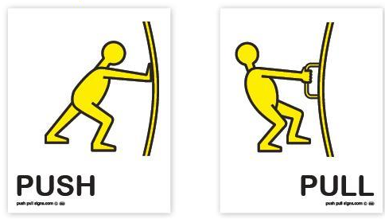
Force
A push or pull on an object
Measured in newtons (N)

Slide 3
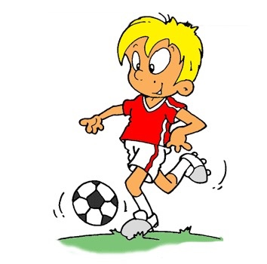
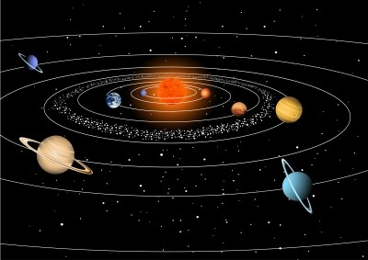
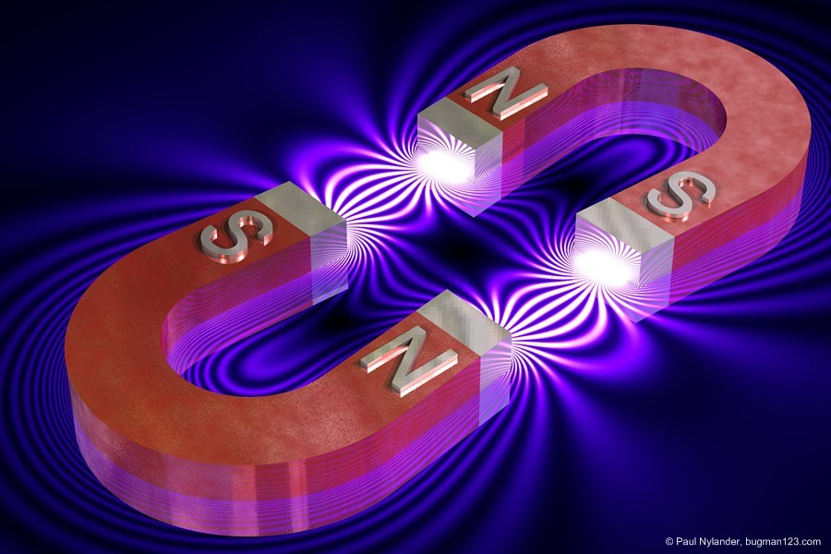
Force
Contact Force
Touching
Noncontact Force
Gravity
Magnetic

Slide 4
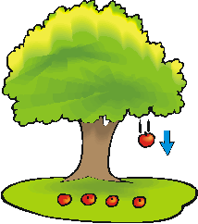
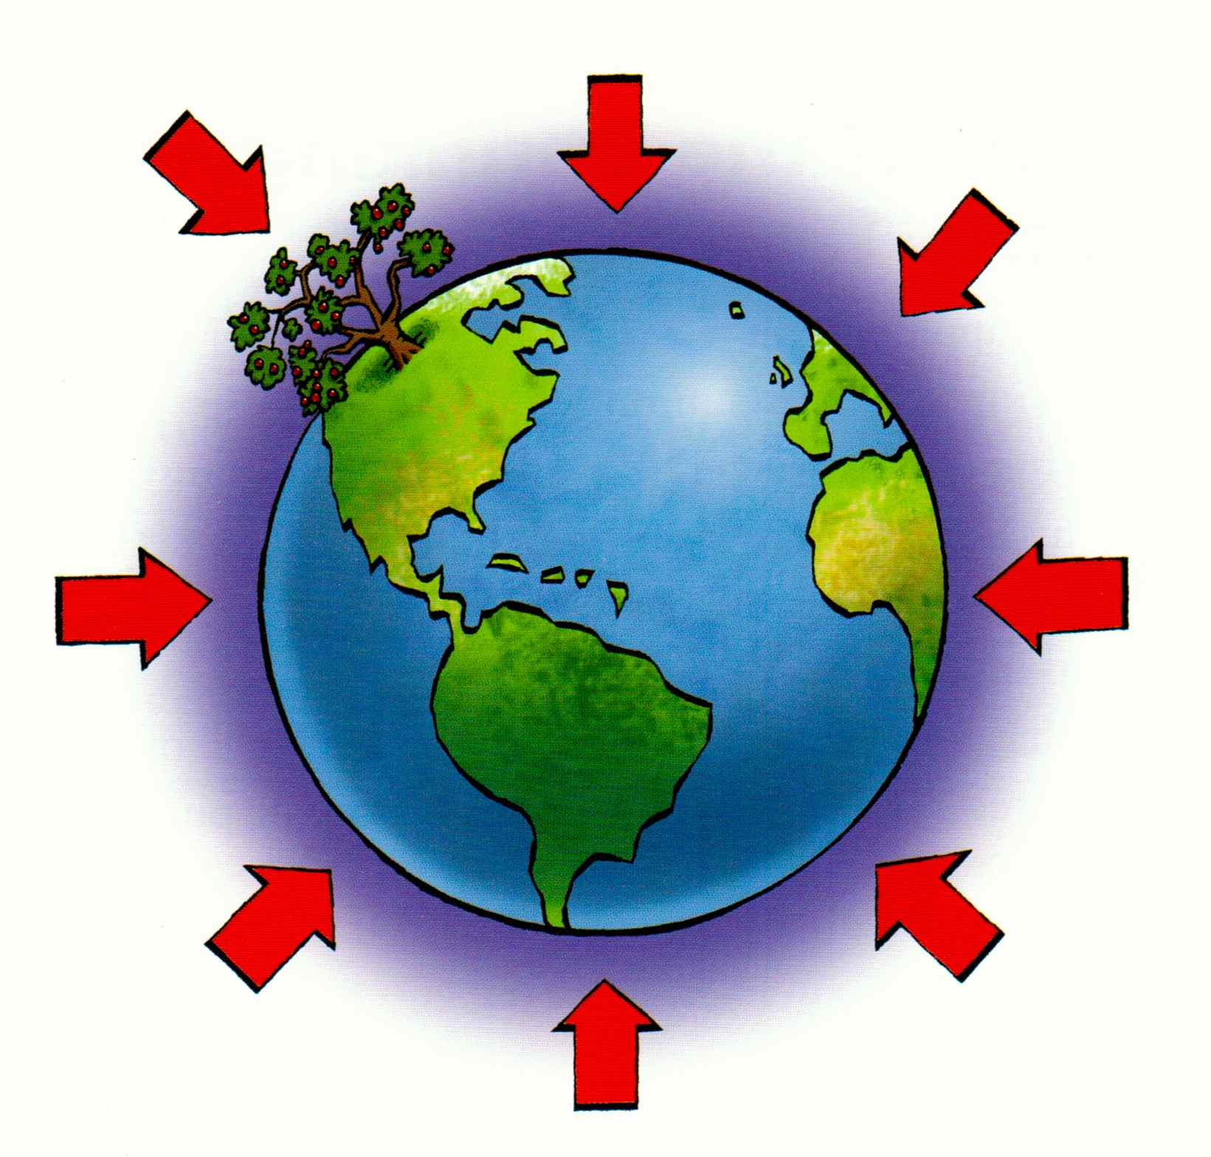
Gravity
Attractive force that exists between all objects that have mass

Slide 5
Law of Universal Gravitation
All objects are attracted to each other by gravitational force
Strength of force depends on:
Mass of each object
Distance between them

Slide 6
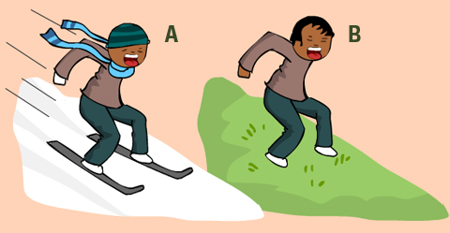
Friction
A force that resists the motion of two surfaces that are touching

Slide 7
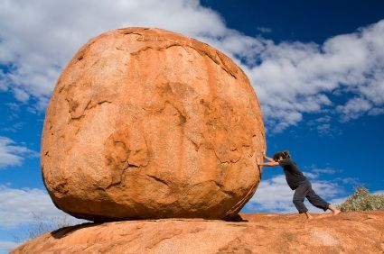
Static Friction
Prevents surfaces from sliding past each other
Strength of static friction matches applied force

Slide 8
Sliding Friction
Slows motion
Increasing applied force makes item slide faster

Slide 9
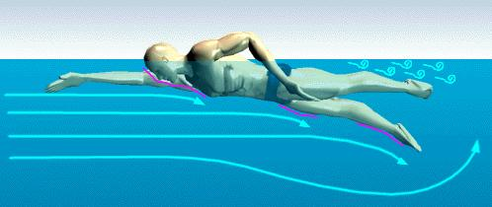
Fluid Friction
Friction between a surface and a fluid (water or air)
Between a surface and air is air resistance

Slide 10
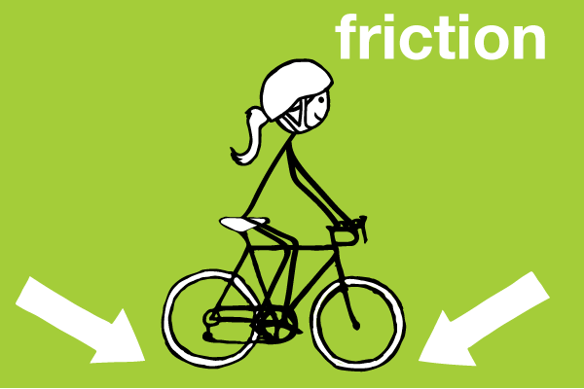
Causes of Friction
Bumps and dips on surfaces
Electrical charges

Slide 11
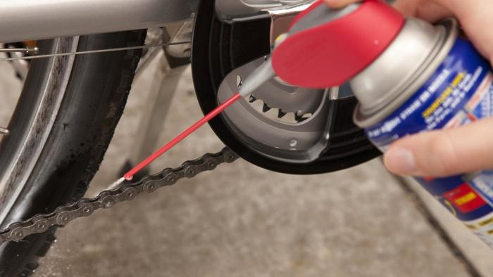
Reducing Friction
Lubricant
Reducing surface area

Slide 12
Net Force
Combination of all forces acting on an object

Slide 13
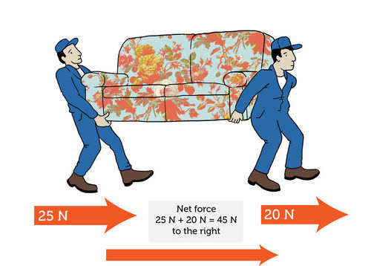
Net Force
Same Direction
When forces in the same direction combine, the net force is the sum of the forces

Slide 14
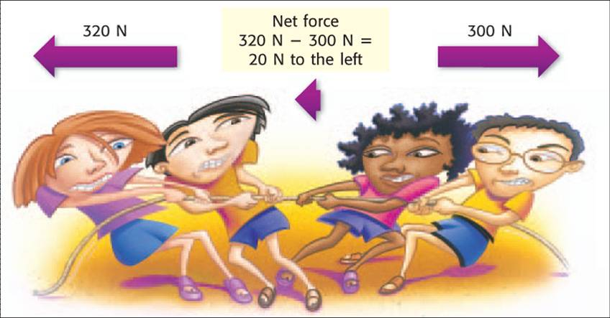
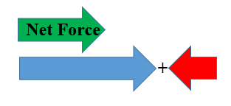
Net Force
Opposite Direction
When forces act in the opposite direction, the net force is the sum of the positive and negative forces

Slide 15
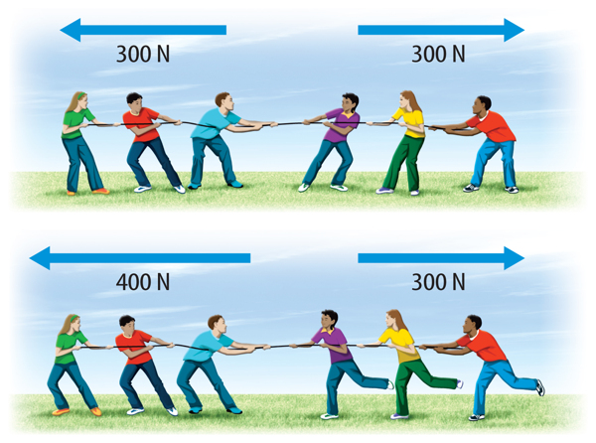
Balanced Forces
Forces acting on an object that combine and form a net force of zero

Slide 16
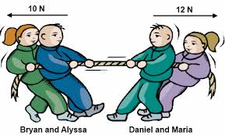
Unbalanced Forces
Forces acting on an object that combine and form a net force that is not zero

