Slide 1
Electromagnetic Waves

Slide 2
Electromagnetic Wave
A wave that can travel through empty space or through matter
Forms when a charged particle vibrates

Slide 3
Electromagnetic Spectrum
Seven main types of electromagnetic waves
Increasing frequency
Increasing energy
Increasing wavelength

Slide 4
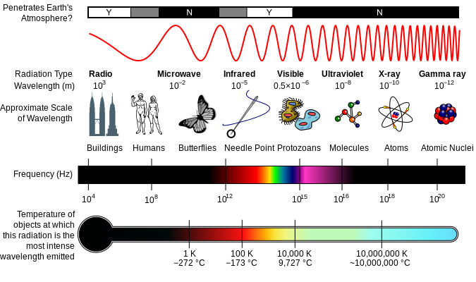
Electromagnetic Spectrum

Slide 5
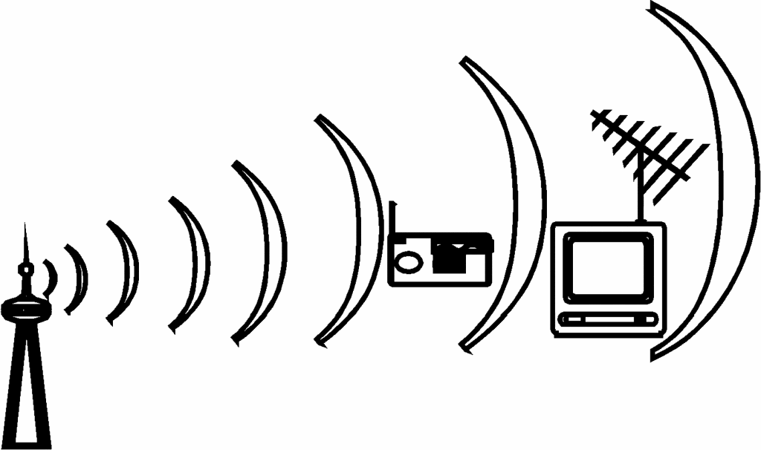
Electromagnetic Spectrum
Radio Wave
Low energy
Low frequency
Wavelength = 30+ cm
Signal for radio and TV

Slide 6
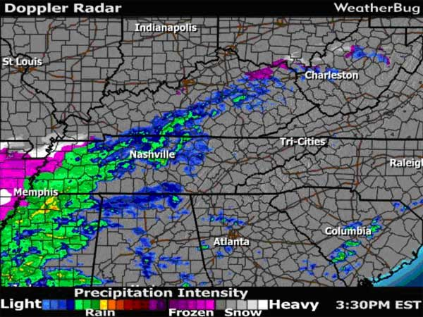
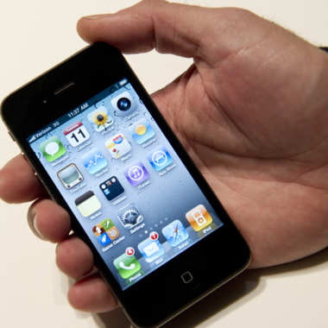
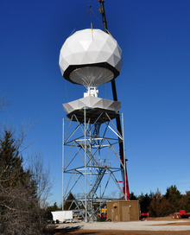
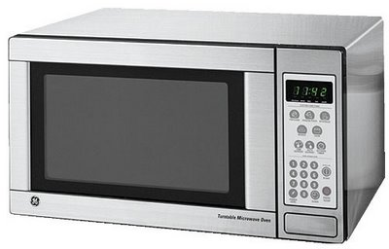
Electromagnetic Spectrum
Microwave
Low energy
Low frequency
Wavelength = 1 to 30 cm
Transmits info by satellites
Cell phones
Cooks food
Weather radar

Slide 7
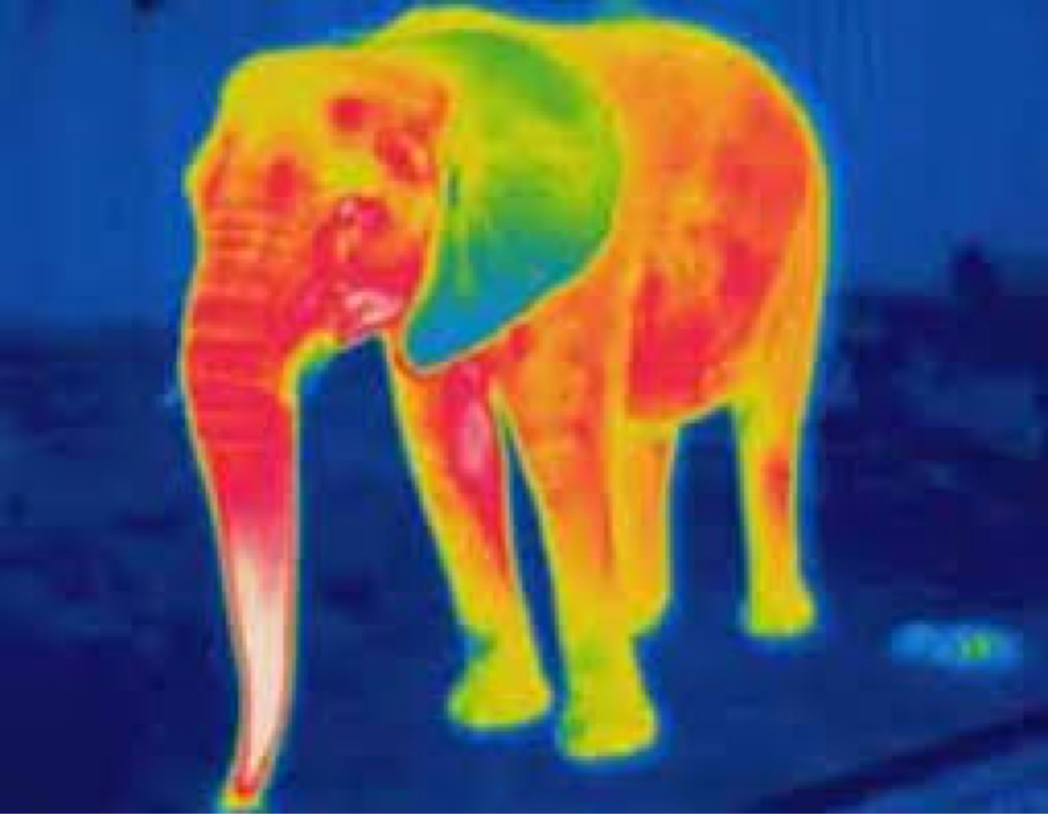
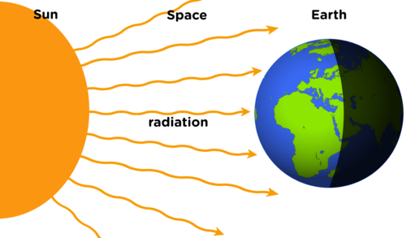
Electromagnetic Spectrum
Infrared Waves
Wavelength between microwaves and light waves
Transfers warmth
Energy from the sun

Slide 8
Electromagnetic Spectrum
Visible Light Waves
Range of wavelengths
Colors we see
Lights

Slide 9
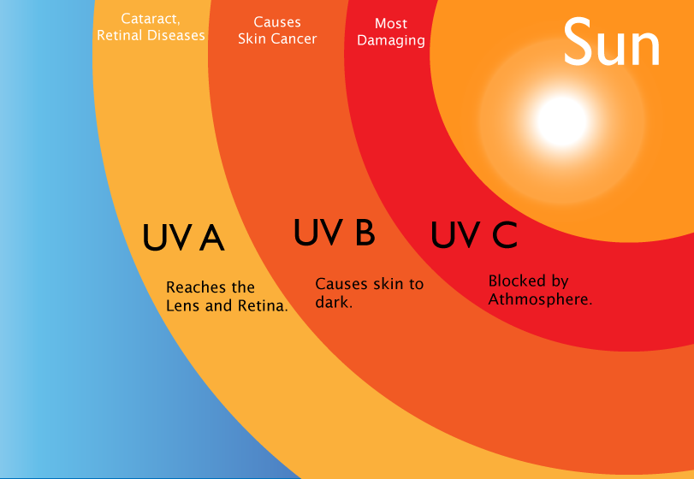
Electromagnetic Spectrum
Ultraviolet Waves
Also called UV rays
Can be harmful to living things
Earth’s atmosphere blocks most of these harmful rays

Slide 10
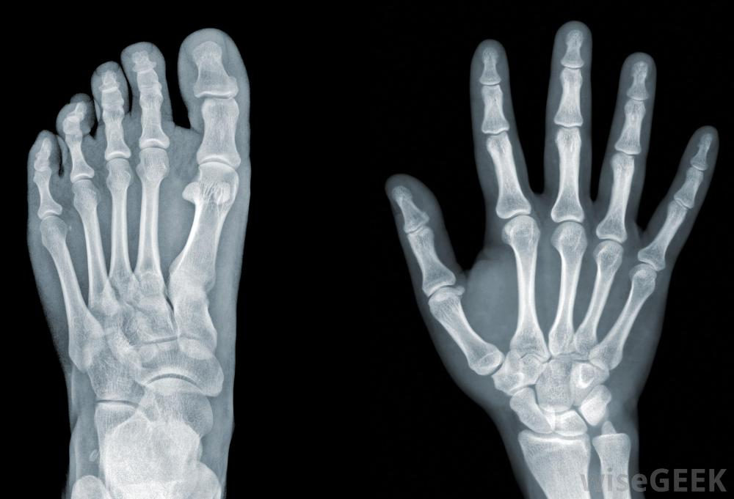
Electromagnetic Spectrum
X-Rays
High energy
Pictures of the body
Pass through skin and muscle, but not bones
Airport scanners

Slide 11
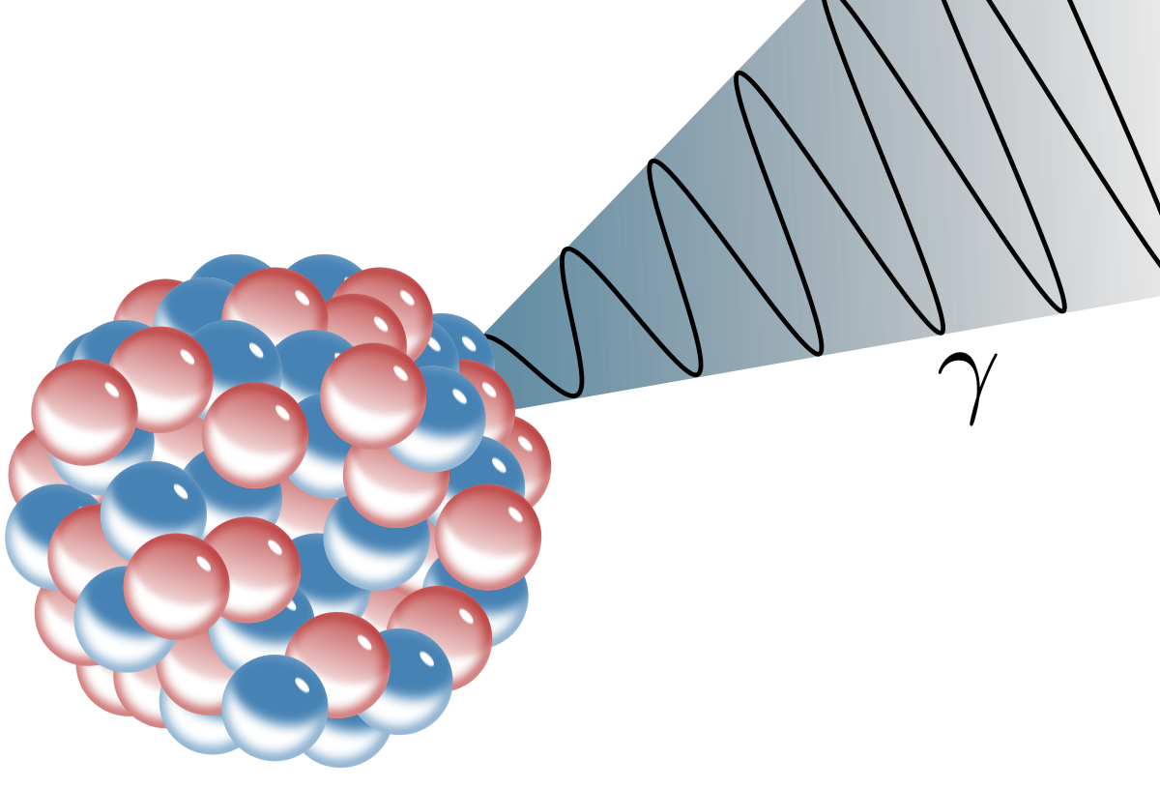
Electromagnetic Spectrum
Gamma Rays
Produced by vibrations in the nuclei of atoms
Penetrates lead
Causes nuclear reactions

