Slide 1
Electricity

Slide 2
Launch Lab p. 487
Read the Launch Lab on p. 487.
Complete a hypothesis for the scientific question “What will happen when wool cloth is rubbed on the bottle with pellets inside?
Complete the variables for this experiment:
Independent:
Dependent:
Constants:
List your observations for green number 3, 4, and 5.
Answer Think About This questions in complete sentences.

Slide 3
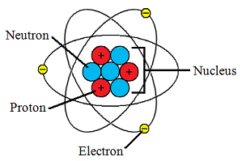
Atoms
Tiny particles that make up all matter
Contains a nucleus
Protons (+)
Neutrons (neutral)
Electrons (-) move around nucleus

Slide 4
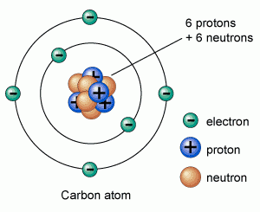
Electric Charges
An object can have positive or negative charges
Electrically neutral
Particle with equal amounts of positive and negative charge

Slide 5
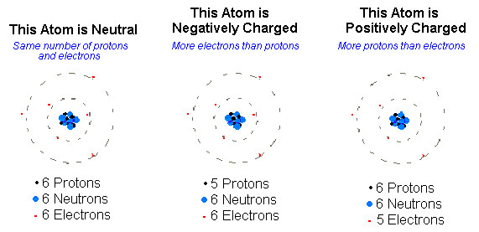
Electric Charges
Electrically Charged
An unbalanced amount of positive charge or negative charge
Happens when electrons are transferred

Slide 6
Electric Charges
If neutrally charged objects come into contact with each other, they transfer electric charge
It can become positively charged or negatively charged depending on the type of material

Slide 7
Electric Charges
Positively charged object
Lost one or more electrons
More protons than electrons

Slide 8
Electric Charges
Negatively charged object
Gained one or more electrons
Has more electrons than protons

Slide 9
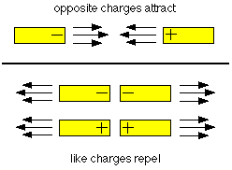
Electric Charges
Static Electricity
If two objects have similar electric charges, the objects repel each other
If two objects have opposite electric charges, the objects attract each other

Slide 10
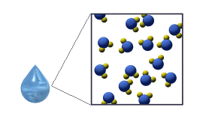
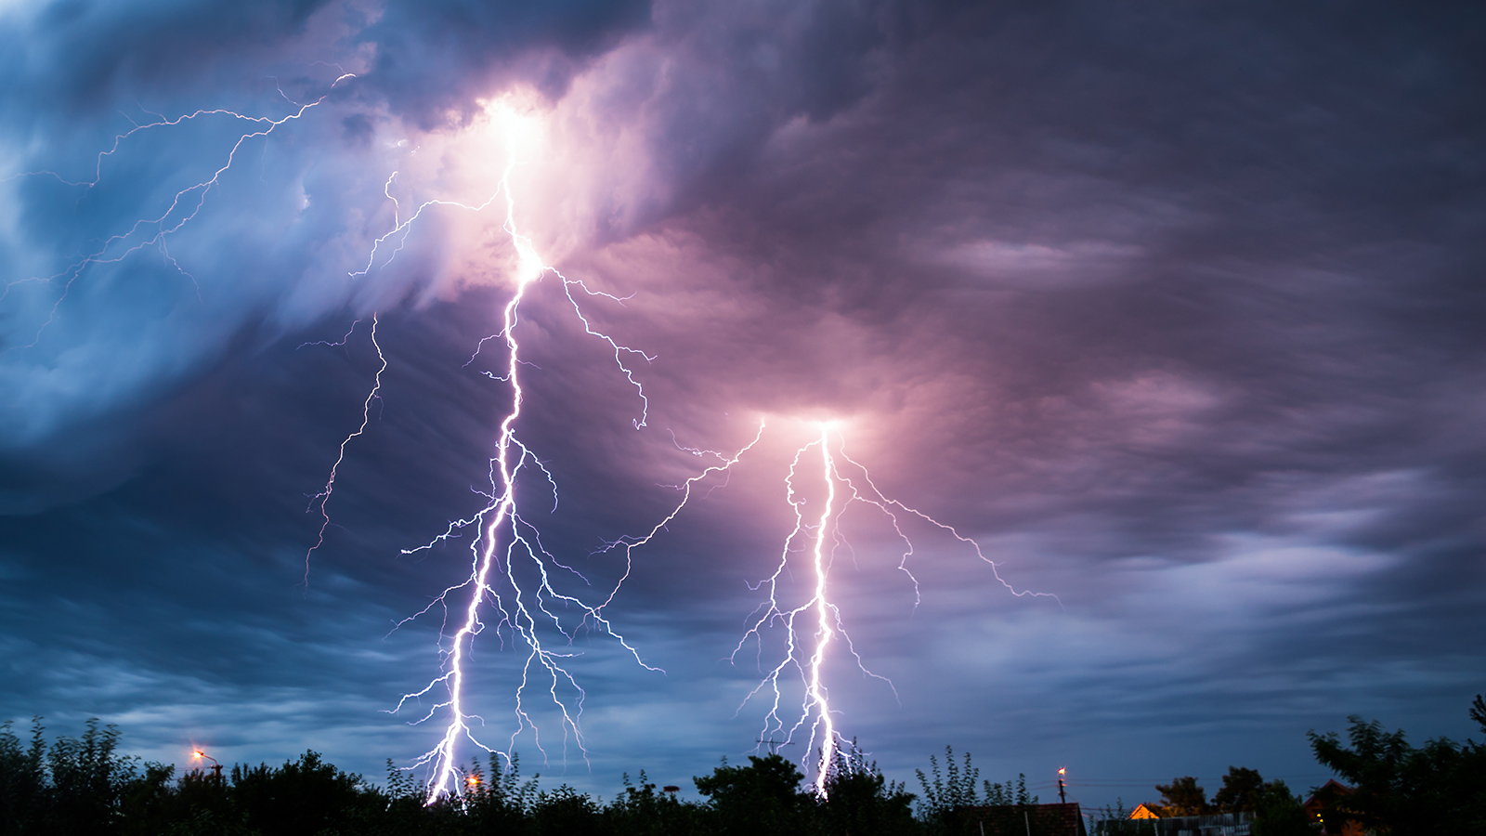
Electric Discharge
Loss of an unbalanced electric charge
Slowly
Electrons slowly move from object to water molecules in air
Quickly
Sudden discharge
Lightning, camera flash, fluorescent bulb

Slide 11
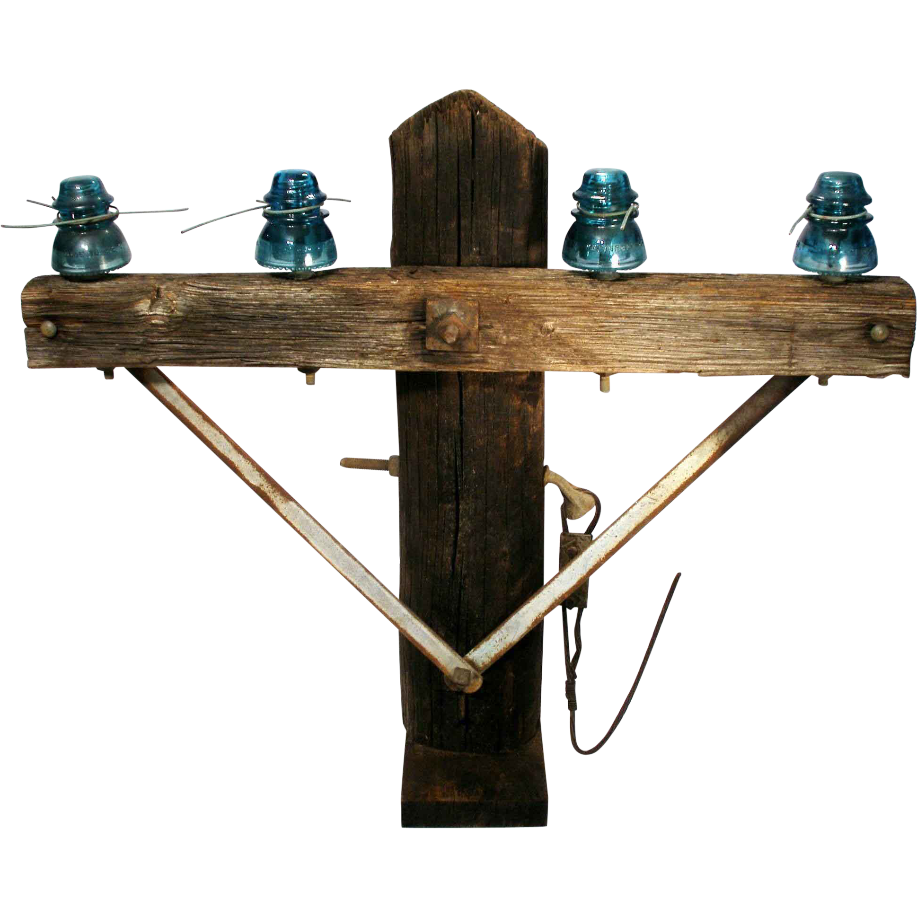
Insulators
Insulator
Material in which electric charges cannot easily move
Example: wood, glass

Slide 12
Insulators
In your SNB…
Explain why wood is a good material for telephone and electric poles.
Explain why glass is a good material for windows (aside from the fact that it is clear!)

Slide 13
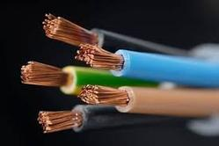
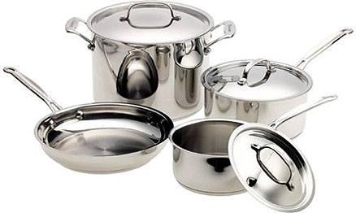
Conductors
Conductor
Material in which electric charges easily move
Example: copper, metal

Slide 14
Conductors
In your SNB…
Explain why copper is a good material for wiring.
Explain why metal is a good material for cooking pots and pans.

Slide 15
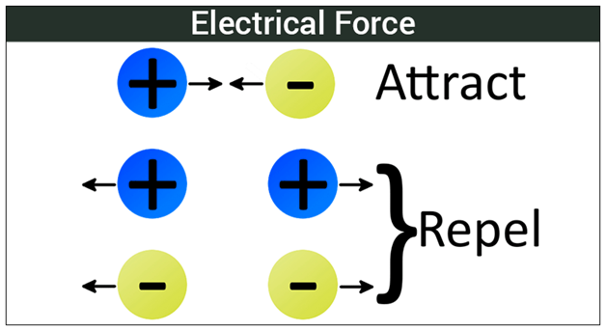
Forces and fields
Electric Force
Force that two charged objects apply to each other
Opposite charges attract
Like charges repel

Slide 16
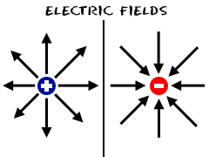
Forces and fields
Electric Field
Invisible area around any charged object where force is applied
Doesn’t have to be touching

Slide 17
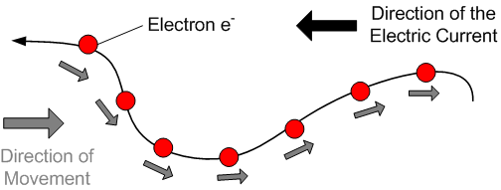
Electric Current
Kinetic Energy
Movement of electrically charged particles

Slide 18
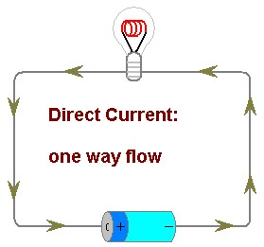
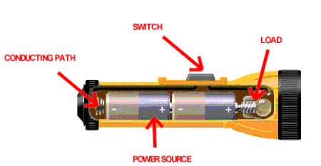
Electric Current
1. Direct Current
One way flow of electrons
EX: Flashlight batteries

Slide 19
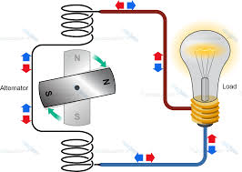
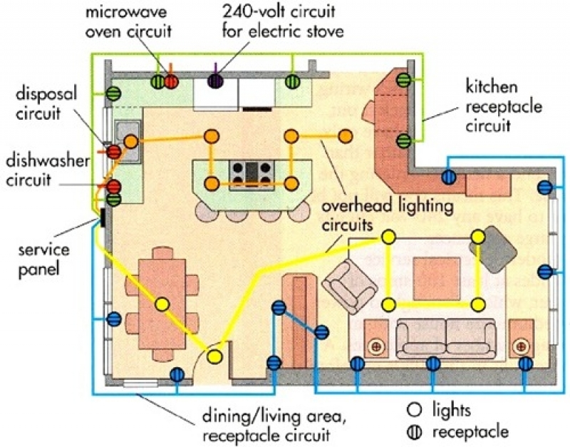
Electric Current
2. Alternating Current
Continually reverse directions
EX: House, power plants

Slide 20
Light a Bulb!
Use the materials in your basket to try to light the bulb.
Draw a diagram of your circuit. Label each part.
Answer the following questions:
In what order did you connect the parts?
How did you know electricity flowed?
Can you trace the path of electrons in your circuit? Highlight them in yellow.
What happened if the circuit was broken, that is if there was a gap in the circuit?
Challenge: Come get a switch. Try to recreate your circuit using the switch to be able to turn the light on and off.
Draw a new diagram, including the switch. Label all the parts.

Slide 21
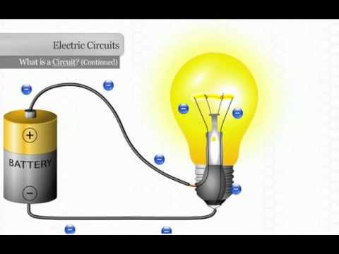
Electric Circuit
Transforms energy in an electric current into useful energy
A closed (complete) path in which an electron flows

Slide 22
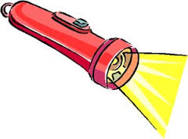
Simple Circuit
Example: Flashlight

Slide 23
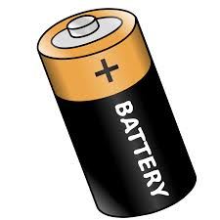
Simple Circuit
Needs three main components:
Source of electric energy
Batteries
-Can of chemicals
-Chemical reactions move electrons

Slide 24
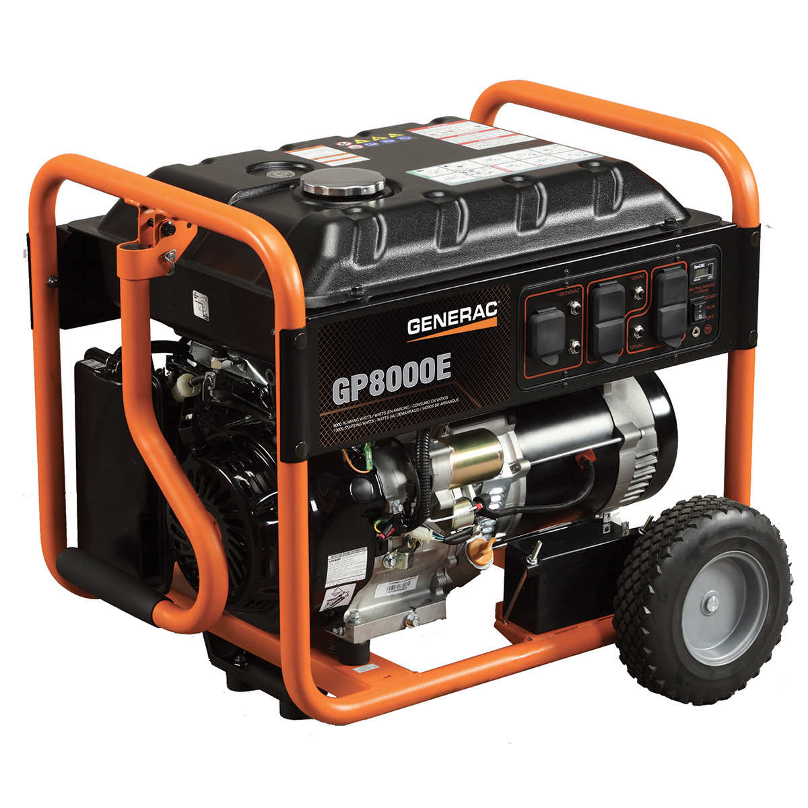
Simple Circuit
Needs three main components:
Source of electric energy
Generators
-Machines that transform mechanical energy to electrical energy
-Sources include fossil fuels, water, wind, nuclear energy

Slide 25
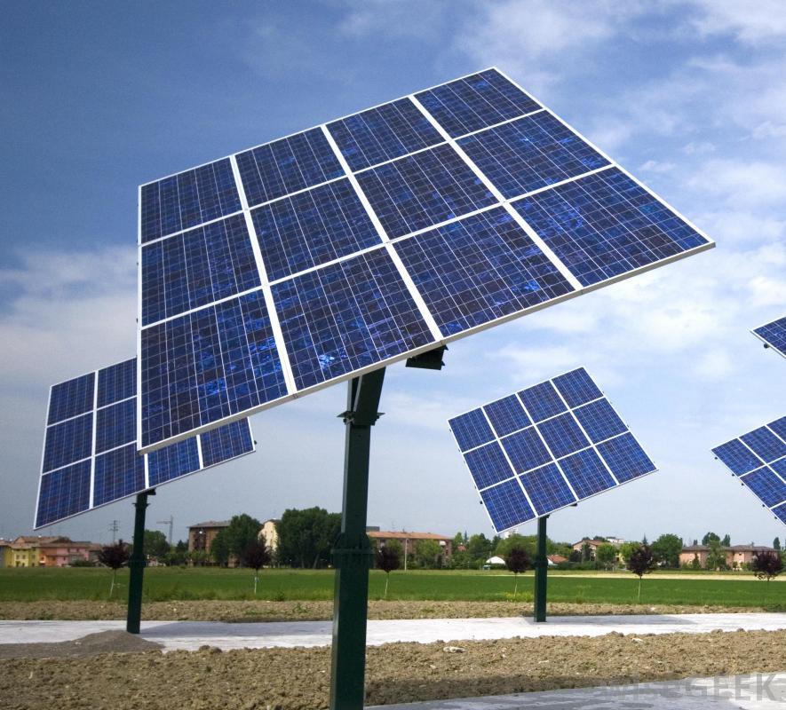
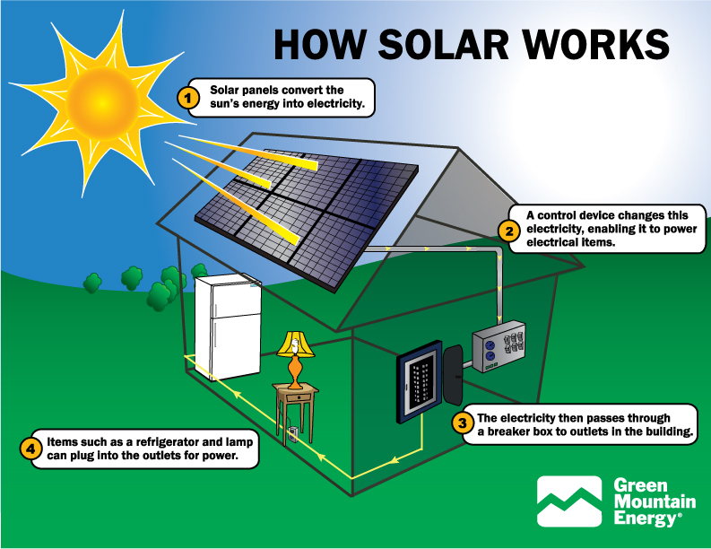
Simple Circuit
Needs three main components:
Source of electric energy
Solar Cells
-Transform sunlight to electric energy

Slide 26
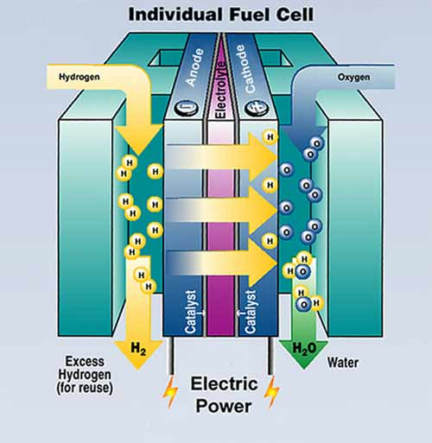
Simple Circuit
Needs three main components:
Source of electric energy
Fuel Cells
-Create a chemical reaction

Slide 27
Simple Circuit
Needs three main components
2. Electric device
-Transforms electric energy into a useful form
-Example: lightbulb

Slide 28
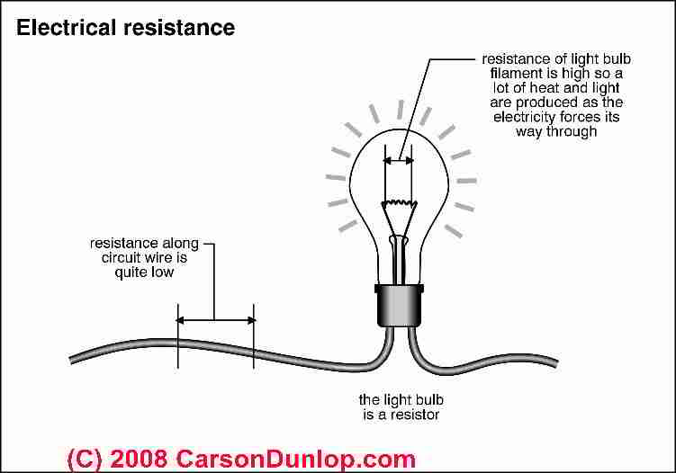
Simple Circuit
Electric Resistance
Measure of how difficult it is for an electric current to flow in a material

Slide 29
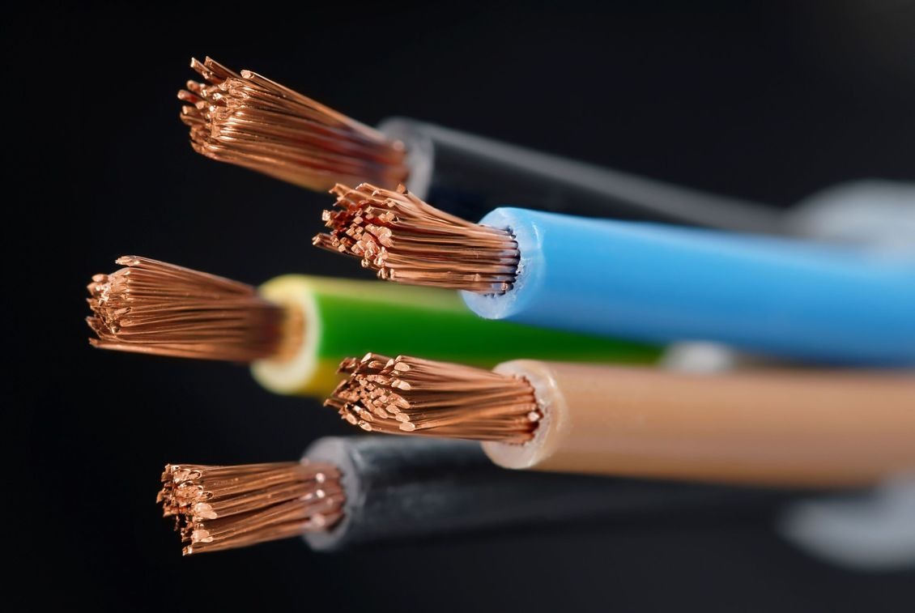
Simple Circuit
Needs three main components:
Electric Conductor
-Completes circuit by connecting energy source to electric device
-Example: copper wires

Slide 30
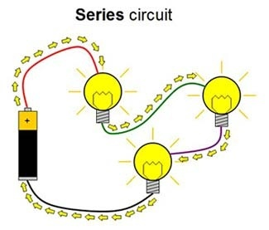
Series Circuit
One path through which electric current can flow
All devices connected end to end
Breaking the current can cause current to stop flowing

Slide 31
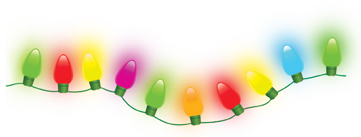
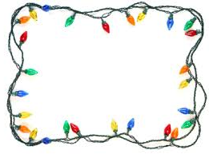
Series Circuit
Example:
Holiday Lights

Slide 32
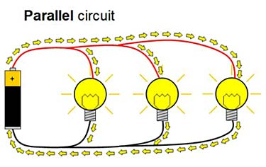
Parallel Circuit
Each device connects to the source through a different path
If one circuit breaks, the others will still work

Slide 33
Parallel Circuit
Example: House

Slide 34
Voltage
Amount of energy used to move one coulomb of electrons through a circuit
One coulomb = six quintillion

