Slide 1
DNA

Slide 2
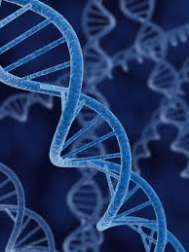
DNA
An organisms genetic material
Make up chromosomes
Tightly coiled strands (allows more genes to fit)
Shaped like a double helix

Slide 3
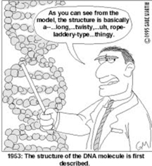
DNA
97% of DNA does not form genes
Called junk DNA
3% of useful DNA
Contain directions for an organism to:
Grow
Maintain itself
Reproduce

Slide 4
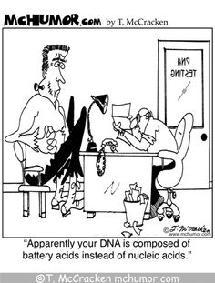
NUCLEOTIDES
A molecule made of a nitrogen base, a sugar and a phosphate group

Slide 5
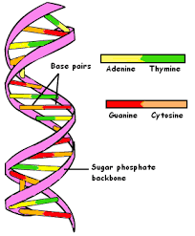
NUCLEOTIDES
Sugar-phosphate groups form the sides of the double helix
Nitrogen bases form the teeth (or center rungs) of the helix
Four bases
Adenine (A)
Cytosine (C)
Thymine (T)
Guanine (G)
A and T always bond
C and G always bond

Slide 6
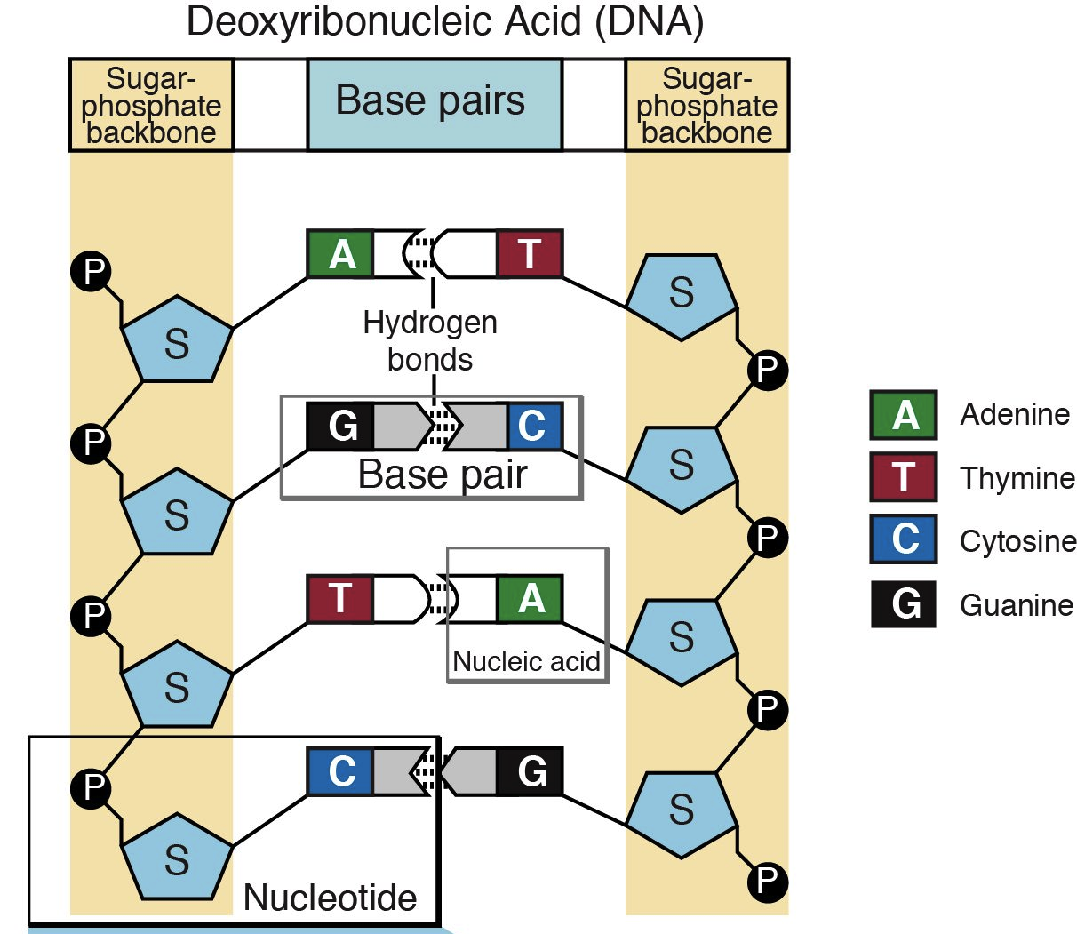
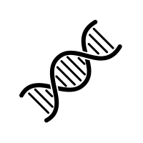
NUCLEOTIDES
Try It! Click on the DNA to try some matching!

Slide 8
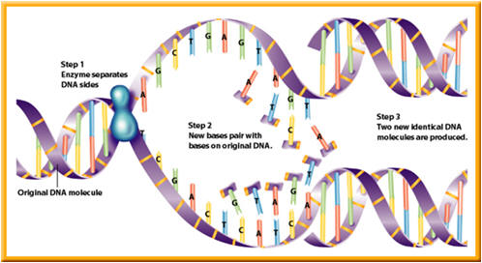
REPLICATION
Process of copying a DNA molecule to make another DNA molecule
Steps
DNA strand separates, exposing nitrogen bases
Nucleotides move in and form new nitrogen base pairs
Two IDENTICAL strands of DNA are produced

Slide 10
RNA
RNA is single stranded
Contains different sugars
Contain nitrogen base uracil (U) instead of thymine (T)

Slide 11
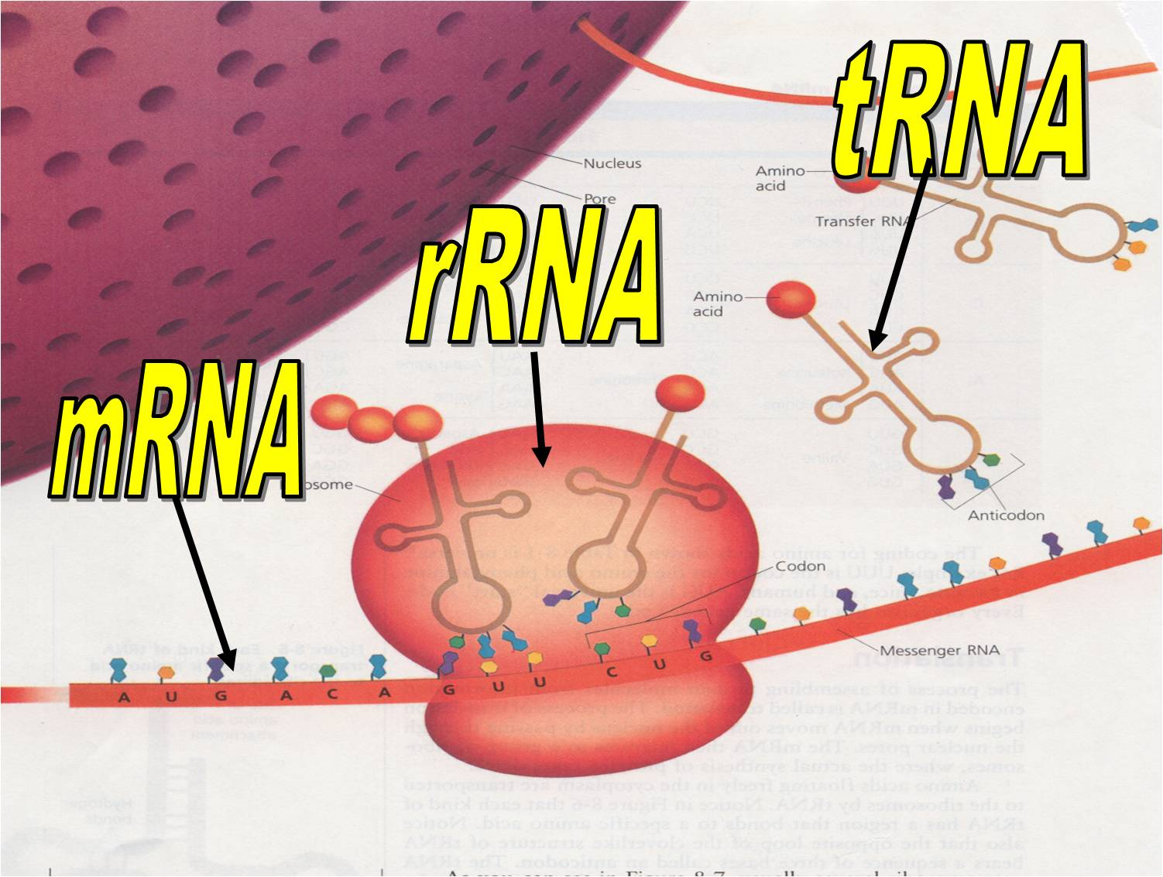
RNA
Three Types of RNA
1. mRNA=messenger RNA
2. tRNA=transfer RNA
3. rRNA=ribosomal RNA

Slide 12
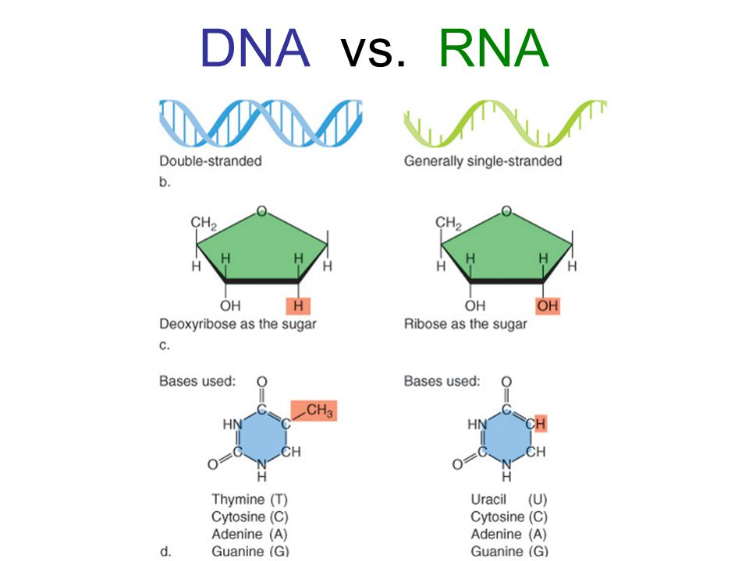

Slide 14
MAKING PROTEINS
Step 1
DNA contains instructions on how and when to make proteins
Step 2
Proteins made by RNA (ribonucleic acid)
Carries the code for making proteins from the nucleus to the cytoplasm

Slide 16
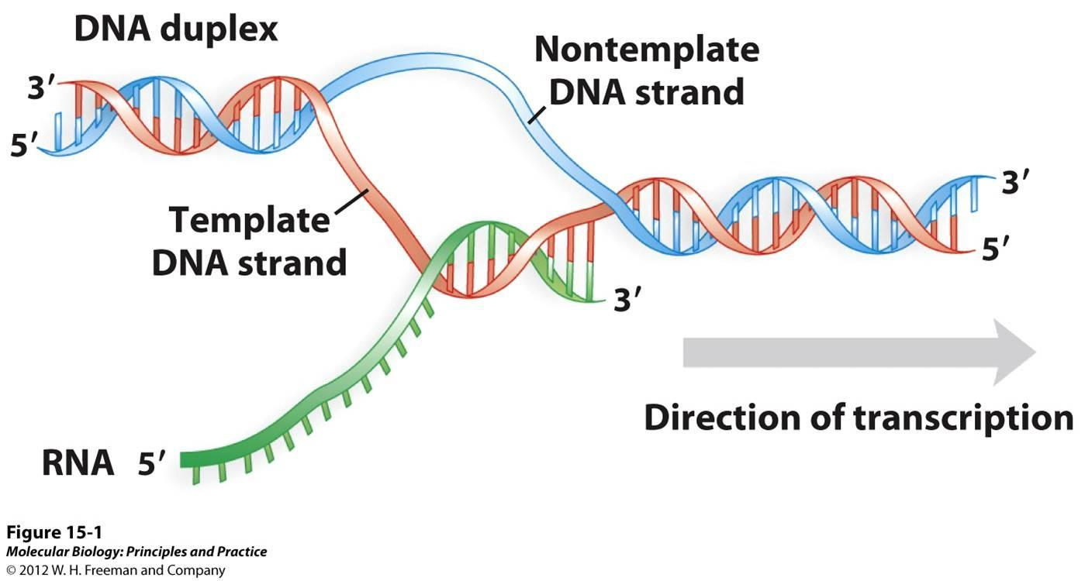
MAKING PROTEINS
TRANSCRIPTION
Process of making mRNA (messenger RNA) from DNA
mRNA nucleotides pair up with DNA nucleotides
Completed mRNA moves into cytoplasm

Slide 17
MAKING PROTEINS
TRANSLATION
Occurs in ribosomes
Process of making a protein from RNA
tRNA carries amino acids to the ribosome
rRNA forms chemical bonds to attach amino acids to each other
tRNA separates from amino acid and from mRNA

Slide 18
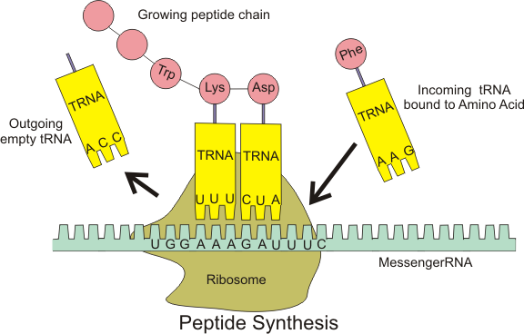
TRANSLATION

Slide 19
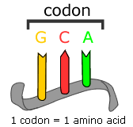
CODON
Proteins made of amino acids
Order of nitrogen bases determines order of amino acids
Three bases form code for one amino acid
Set of three nitrogen bases on mRNA called codon
64 codons, 20 amino acids

Slide 20
READING DNA LAB
Label a new page in your SNB: Reading DNA Lab
As you work through this lab, draw, label, and explain each step in your SNB
A. Transcription
Step 1:
Step 2:
Step 3:
B. Translation
Step 1:
Step 2:
Extension:

Slide 21
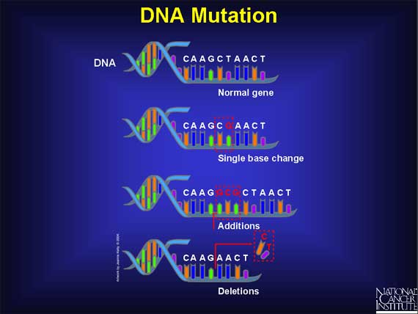
MUTATIONS
A change in the nucleotide sequence of a gene

Slide 23
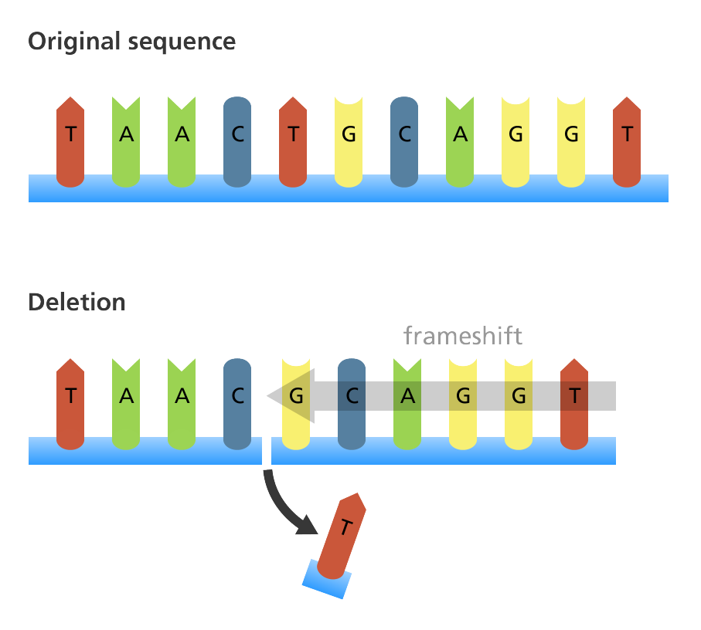
MUTATIONS
Deletion
One or more nitrogen bases are left out of the DNA sequence

Slide 24
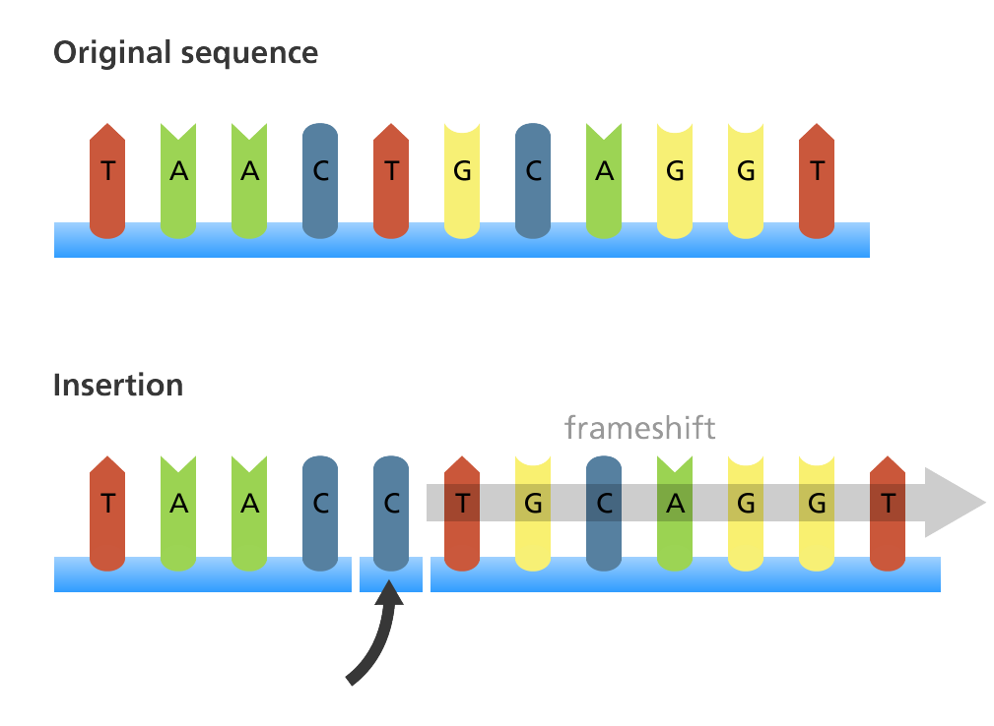
MUTATIONS
Insertion
One or more nitrogen bases are added to the DNA sequence

Slide 25
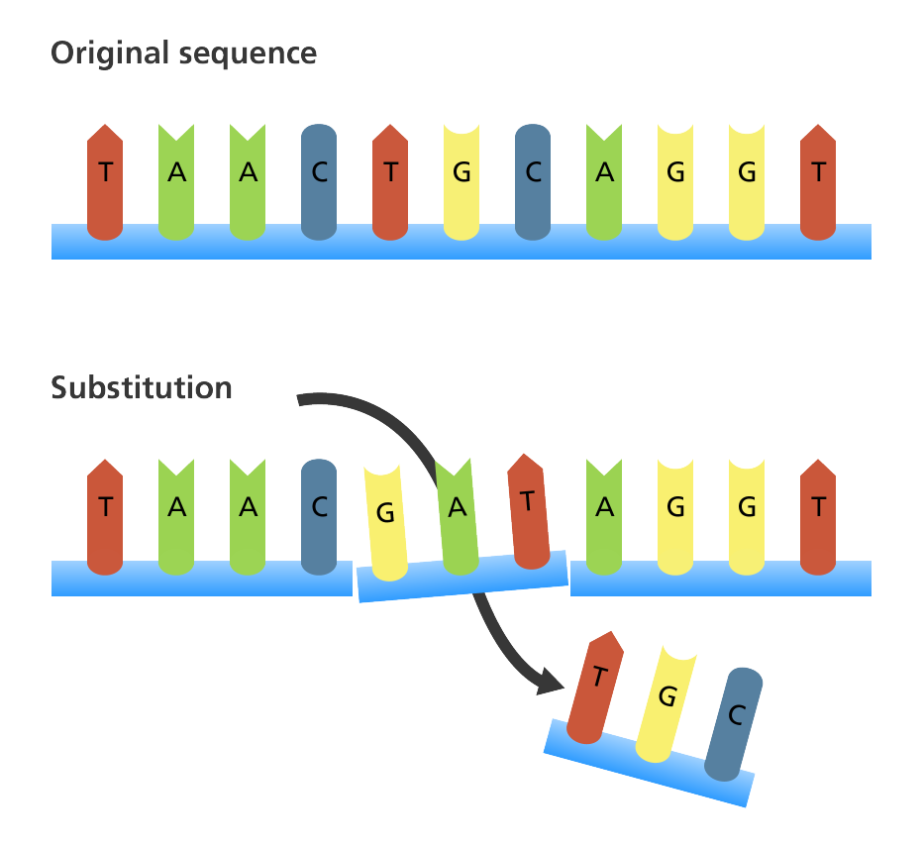
MUTATIONS
Substitution
One nitrogen base is replaced by a different nitrogen base

Slide 27
EFFECTS OF MUTATIONS
Depends on where in the DNA sequence it occurs
Can cause genetic disorders
Some don’t affect traits at all
Some changes might benefit an organism

