Slide 1
Chemical Changes

Slide 2
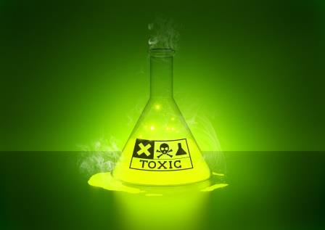
Chemical Property
Characteristic of matter that can be observed as it changes to a different type of matter

Slide 3
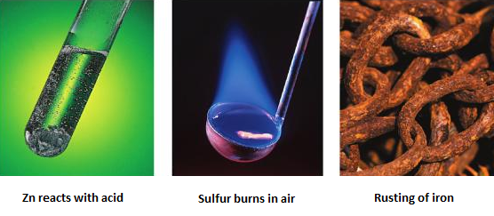
Chemical Reaction
Process in which the atoms of one or more of substances that make up matter rearrange to form new substances
Have new chemical and physical properties

Slide 4
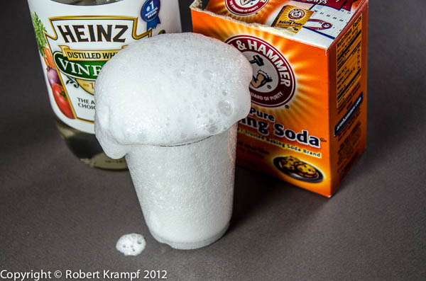
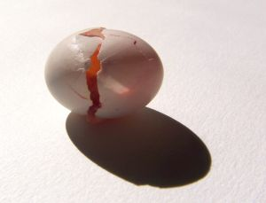
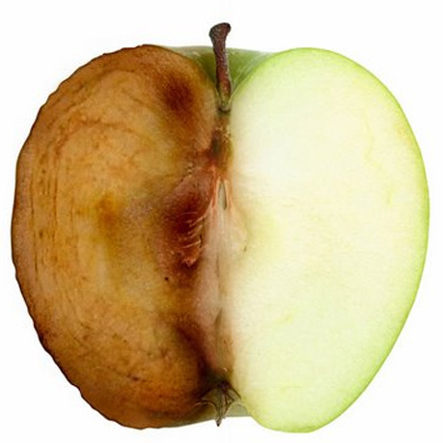
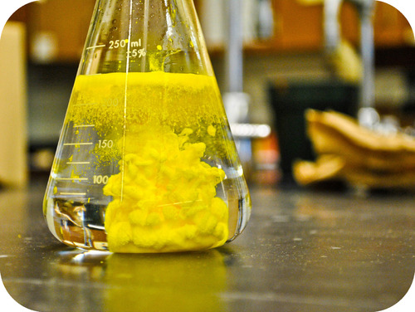
Signs of a Chemical Reaction
Change in Properties
Formation of bubbles
Change in color
Change in odor
Formation of a precipitate
Solid formed when two liquids react

Slide 5
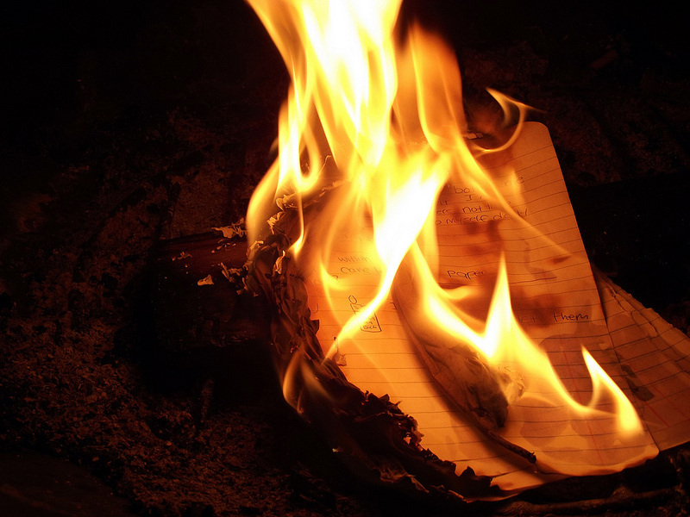
Signs of a Chemical Reaction
Change in Energy
Warming or cooling
Release of light

Slide 6
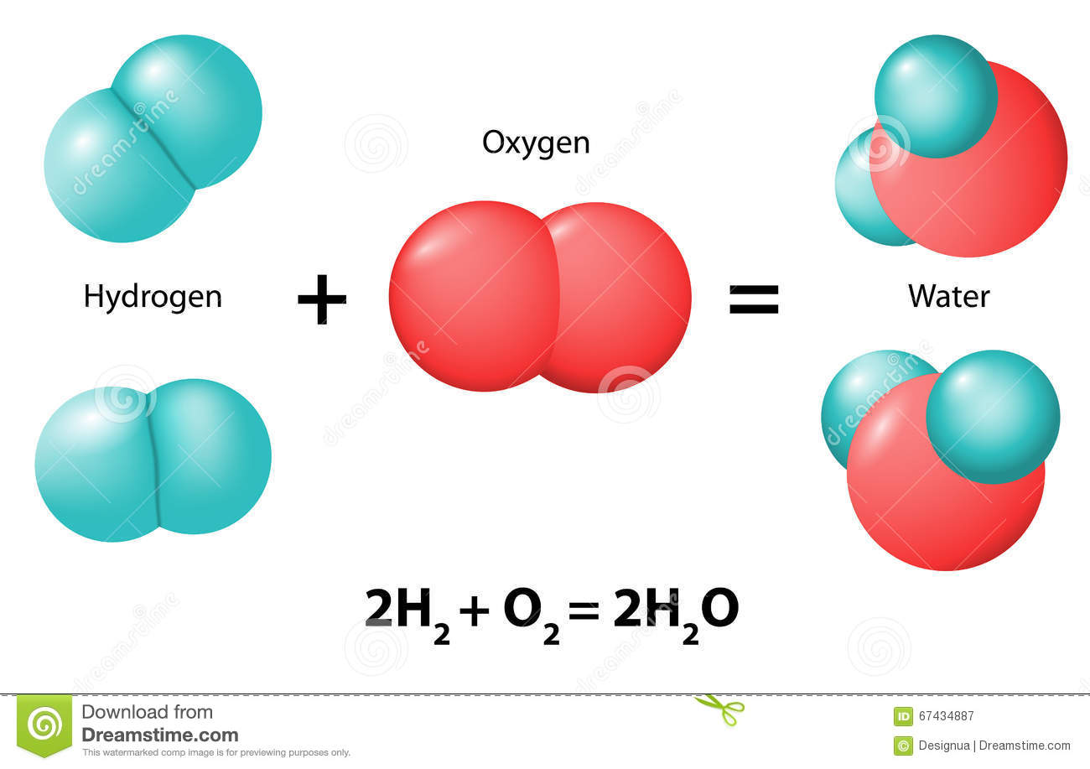
What Happens in a Chemical Reaction?
Atoms rearrange and form new substances (different elements or compounds)
Bonds break
Atoms separate and rearrange
New bonds form

Slide 7
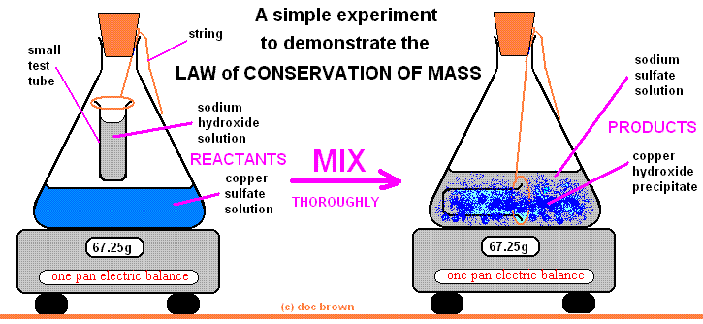
Conservation of Mass
Mass is the same before and after a change

Slide 8
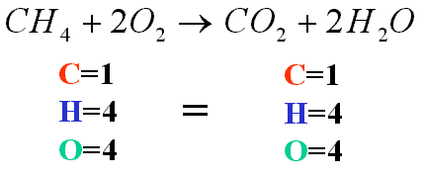
Chemical Equation
Balanced Chemical Equation
Number of atoms before a reaction must equal the number of atoms after the reaction

Slide 9
Chemical Equation
Includes chemical formulas of each substance in the reaction
Example:
Reactants | Yields | Products
H + H + O | → | H₂O
Fe + S | → | FeS

Slide 10
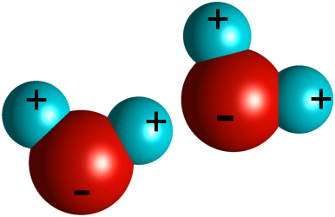
Chemical Equation
Coefficient
Number placed in front of an element symbol or chemical formula in an equation
Example:
2 H₂O = 2 waters

Slide 11
Types of Chemical Reactions
Synthesis
A type of chemical reaction in which two or more substances combine and form one compound
Example:
2Na + Cl₂ → 2NaCl
Sodium + Chlorine → Sodium chloride

Slide 12
Types of Chemical Reactions
Decomposition
A type of chemical reaction in which a compound breaks down and forms two or more substances
Example:
H₂O₂ → 2H₂O + O₂
Hydrogen Peroxide → Water + Oxygen

Slide 13
Types of Chemical Reactions
Replacement
Single Replacement
One element replaces another element
Double Replacement
Negative ions in two compounds switch places, forming two new compounds

Slide 14
Types of Chemical Reactions
Combustion
A type of chemical reaction in which a substance combines with oxygen and releases energy

Slide 15
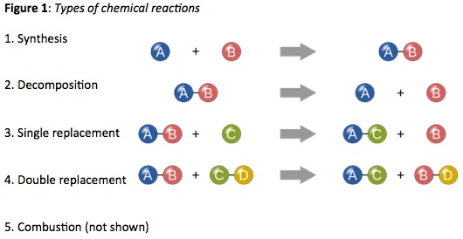
Types of Chemical Reactions

Slide 16
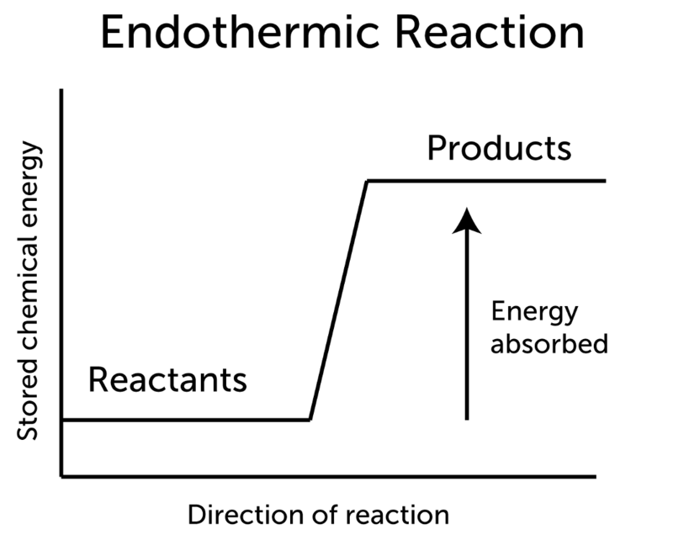
Endothermic Reactions
Energy absorbed
Reactants + thermal energy → products
More energy needed to break bonds

Slide 17
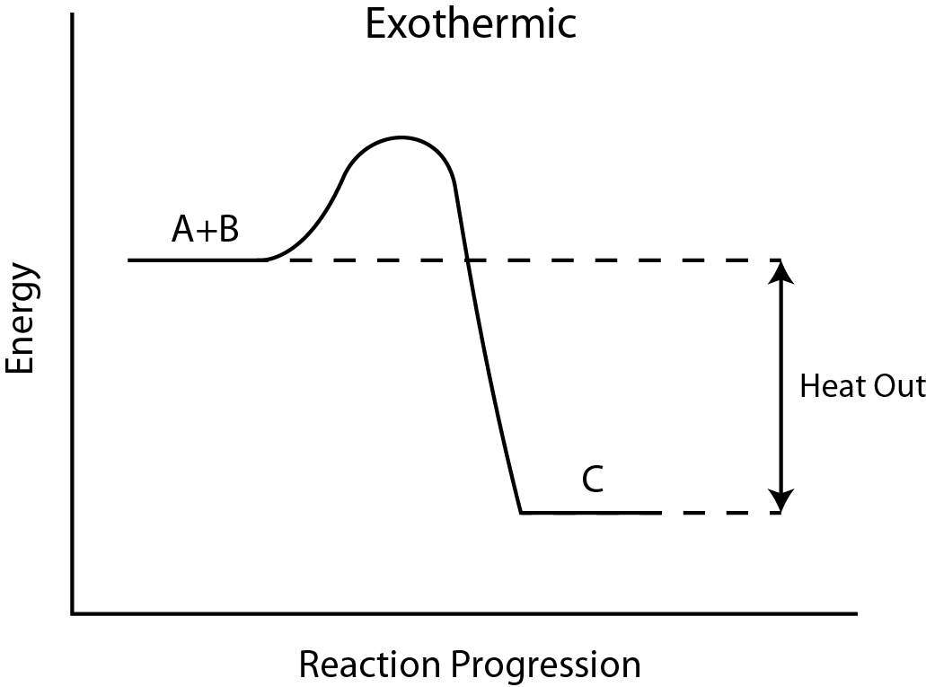
Exothermic Reactions
Energy released
Reactants → products + thermal energy

Slide 18
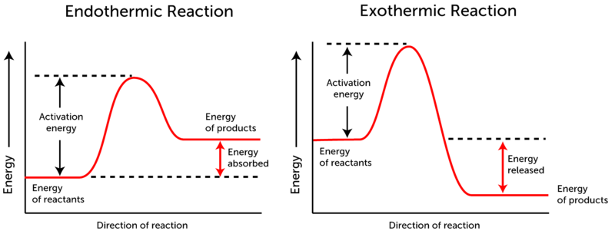
Activation Energy
Minimum amount of energy needed to start a chemical reaction

Slide 19
Factors affecting the Rates of Chemical Reactions
Temperature
Higher temperature increases rate of reaction
Higher temperature → greater particle speed → particles collide more → collisions break more bonds

Slide 20
Factors affecting the Rates of Chemical Reactions
Concentration
Amount of substance at a certain volume
Concentration increases → particles collide more → reaction occurs faster

Slide 21
Factors affecting the Rates of Chemical Reactions
Surface Area
Amount of exposed outer area of a solid
Smaller pieces have more surface area so reaction occurs faster
Example: whole piece of chalk vs. ground pieces

Slide 22
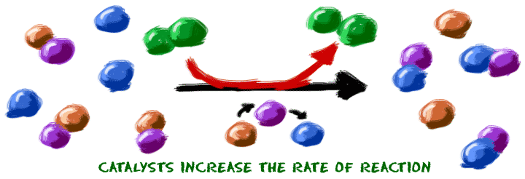
Catalysts
Substance that increases reaction rate by lowering activation energy
Not a reactant
Makes reaction happen faster
Example: Enzymes are catalysts that make reactions speed up in living cells

Slide 23
Inhibitors
A substance that slows or stops a chemical reaction
Example: Preservatives in food are inhibitors that slow down food spoilage

