Slide 1
Chemical Compounds and Bonds

Slide 2
Electron Arrangement
Atomic Model-Bohr Diagram
Electrons arranged in energy levels
1st energy level = up to 2 electrons
2nd energy level = up to 8 electrons
3rd energy level = up to 18 electrons
Valence Electrons
The electrons in the outermost energy level

Slide 3
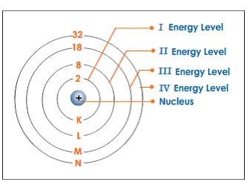
Electron Arrangement
Areas of space in which electrons move are called energy levels

Slide 4
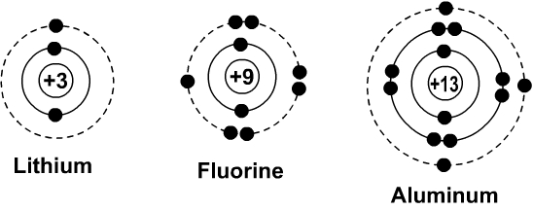
Electron Arrangement
Atomic Model—Bohr Diagram

Slide 5
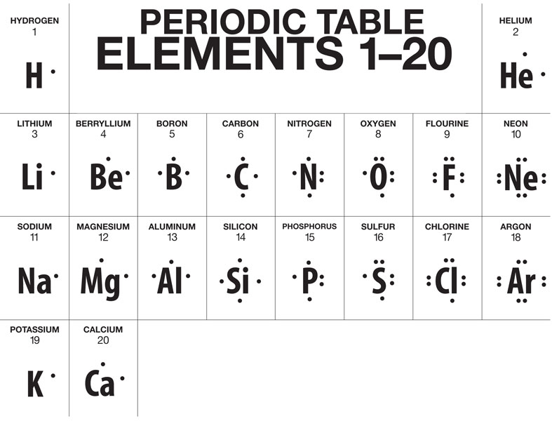
Electron Arrangement
Electron (Lewis) Dot Diagram
Represents valence electrons as dots around the element’s chemical symbol
Number of unpaired dots is the number of bonds atoms can form
Cannot exceed 8 dots

Slide 6
Electron Arrangement
Electrons closest to nucleus
Lowest energy level
Have least amount of energy
Are most closely attracted to nucleus

Slide 7
Electron Arrangement
Electrons farthest from the nucleus
Called valence electrons
Highest energy level
Have greatest amount of energy
Weak attraction to nucleus
Can be attracted to nucleus of other atoms
Most likely involved in chemical bonds

Slide 8
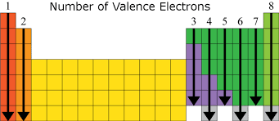
Electron Arrangement
Valence Electrons
Elements in a certain group have the same number of valence electrons

Slide 9
Compounds
Chemically Stable Elements
Eight valence electrons
No unpaired dots
Do not easily react
Stable elements
All electrons in pairs

Slide 10
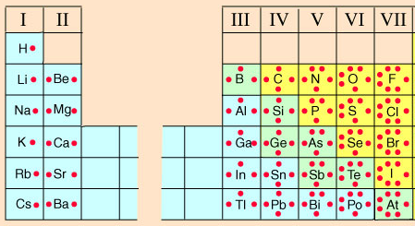
Compounds
Chemically Unstable Elements
Between one and seven valence electrons
Easily bond with other elements
Form chemical bonds
Unstable elements
Unmatched electrons

Slide 11
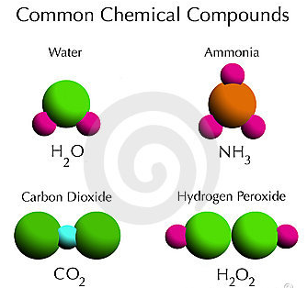
Compounds
Formed when atoms of different elements chemically combine
Held together by chemical bonds
Chemical bonds
A force that holds two or more atoms together

Slide 12
Covalent Bonds
A chemical bond formed when two atoms SHARE one or more pairs of valence electrons

Slide 13
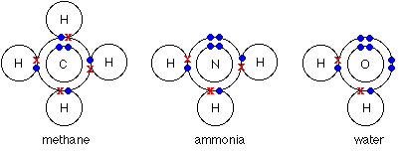
Covalent Bonds
Octet Rule
Tendency of atoms to form bonds to try to equal eight valence electrons
Sometimes multiple bonds are formed to satisfy this rule

Slide 14
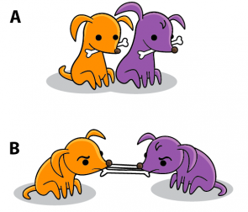
Covalent Bonds

Slide 15
Covalent Bonds
Oxidation Number
Total number of electrons that an atom either gains or loses to form a chemical bond

Slide 16
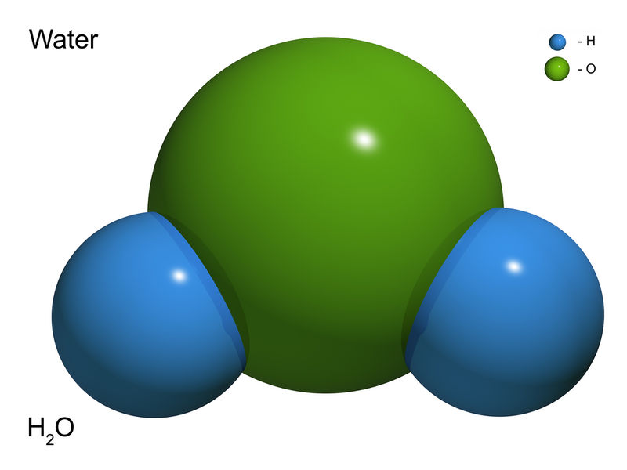
Covalent Bonds
H₂O
Forms two covalent bonds
Each bond forms a stable compound

Slide 17
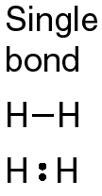
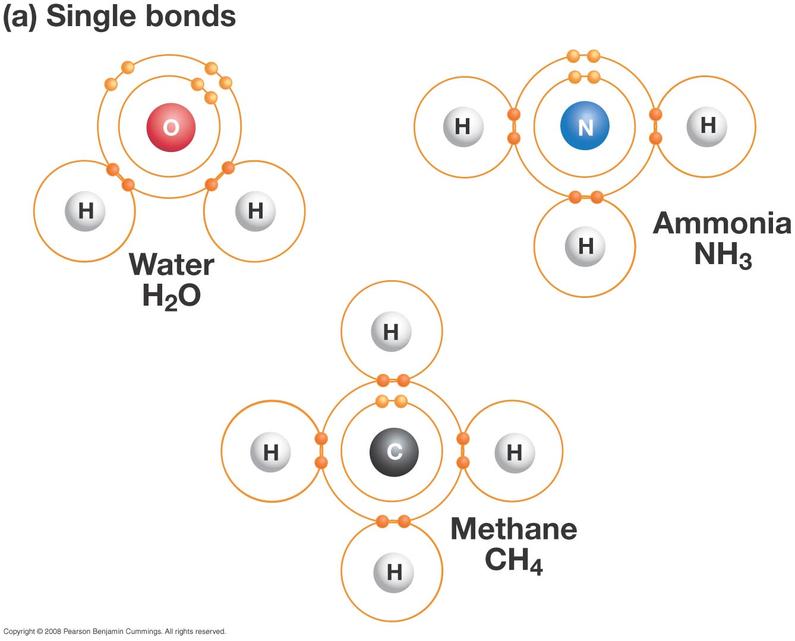
Covalent Bonds
Single covalent bond
Two atoms share one pair of valence electrons

Slide 18
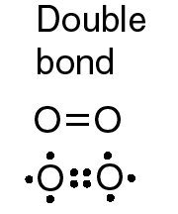
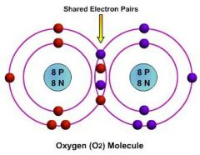
Covalent Bonds
Double covalent bond
Two atoms share two pairs of valence electrons
Stronger bond

Slide 19
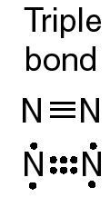
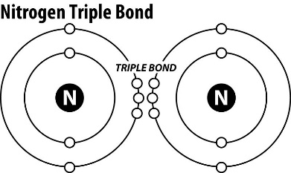
Covalent Bonds
Triple covalent bond
Two atoms share three pairs of valence electrons
Strongest

Slide 20
Covalent Bonds
Covalent Compounds
Formed when two or more atoms share valence electrons
Share similar properties
Low melting and boiling point
Usually gases or liquids at room temperature
Poor conductors

Slide 21
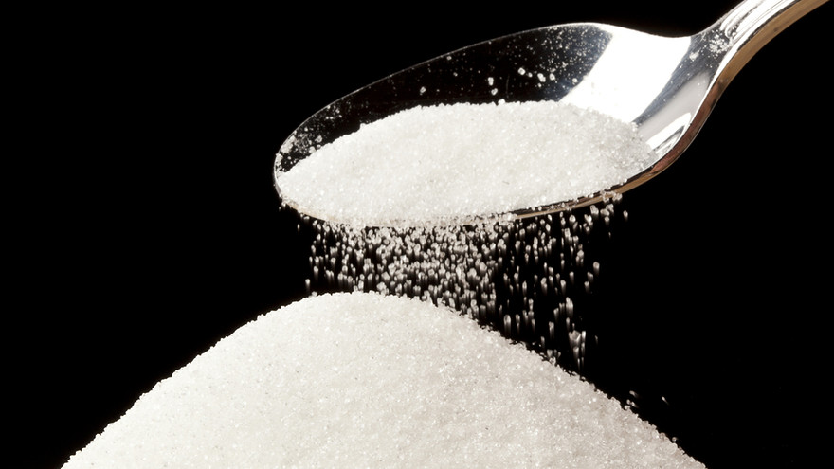
Covalent Bonds
Molecule
A group of atoms held together by covalent bonding that acts as an independent unit
Example:
Table sugar C₁₂H₂₂O₁₁
12 carbons, 22 hydrogens, 11 oxygens
All covalently bonded

Slide 22
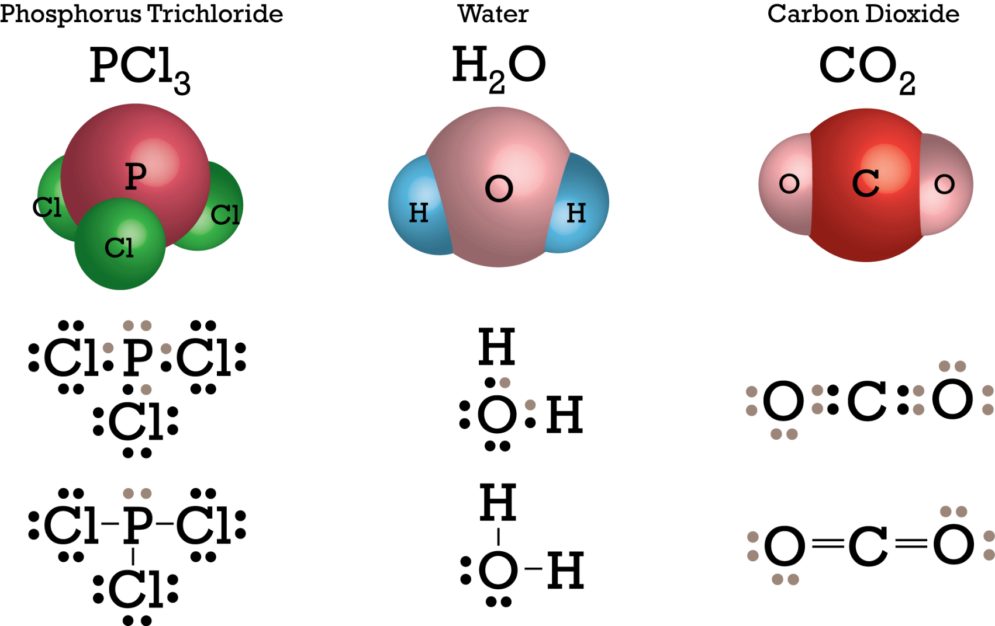
Covalent Bonds

Slide 23
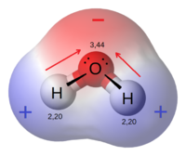
Covalent Bonds
Polar Molecule
A molecule that has a partial positive and a partial negative end because of unequal sharing of electrons
Example:
Water
Shared electrons are pulled closer to oxygen than to hydrogen
Sugar dissolves in water because both are polar

Slide 24
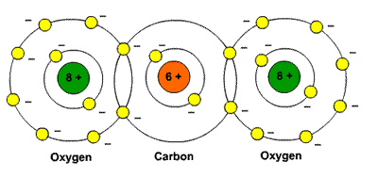
Covalent Bonds
Nonpolar Molecule
Attraction to shared electrons is equal
Will not dissolve in polar molecules, only nonpolar
Example:
Carbon dioxide

Slide 25
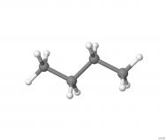
Molecular Models of Butane (C₄H₁₀)
Lewis Dot
Ball and Stick

Slide 26
Molecular Models
Research and draw a Lewis dot structure and ball and stick model for each of the following molecules.
Water (H2O)
Carbon dioxide (CO2)
Methane (CH4)
Hydrogen Peroxide (H2O2)
In general, why are models important when studying elements and compounds?

Slide 27
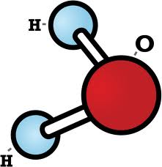
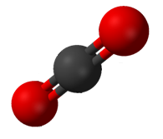
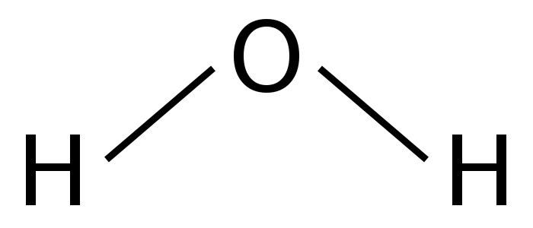
Molecular Models
WATER
CARBON DIOXIDE

Slide 28
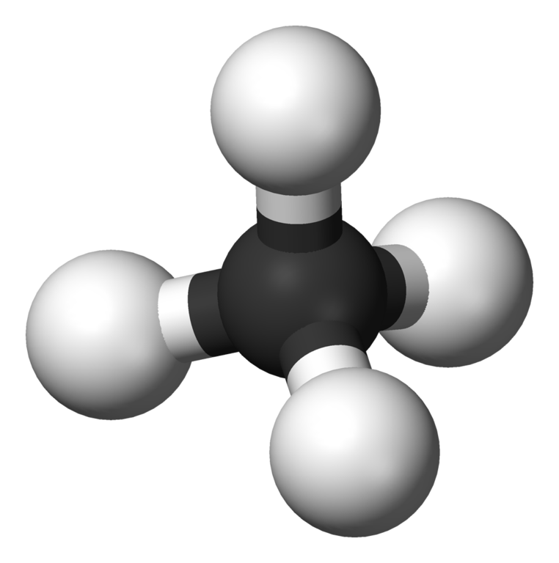
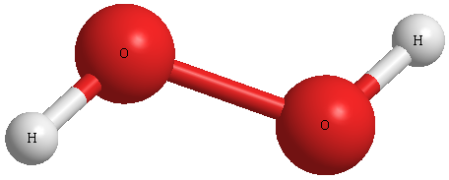
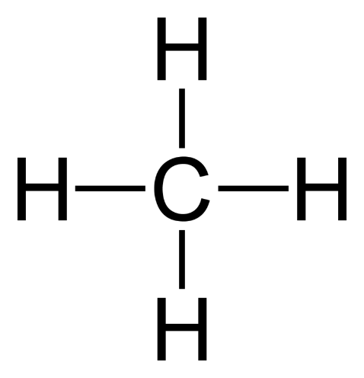
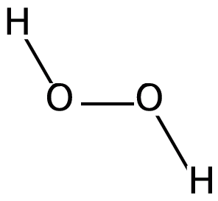
Molecular Models
METHANE
HYDROGEN PEROXIDE

Slide 29
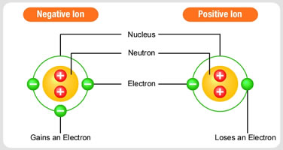
Ions
An atom that is no longer neutral because it has gained or lost electrons

Slide 30
Ions
Positive Ions
An atom with a positive charge
Has lost one or more electron
Represented by element’s symbol and plus sign (Na+)

Slide 31
Ions
Negative Ions
An atom with a negative charge
Has gained one or more electron
Represented by element’s symbol and negative sign (Cl-)

Slide 32
Ions
Metal atoms typically lose electrons
Nonmetal atoms typically gain electrons

Slide 33
Ionic Bonds
Ionic Bonds
The attraction between positively and negatively charged ions in an ionic compound

Slide 34
Ionic Bonds
Ionic Bonds
An valence electron from one atom is TRANSFERRED to the valence shell of another atom
The atom that lost an ion becomes positive.
The atom that gains an electron becomes negative

Slide 35
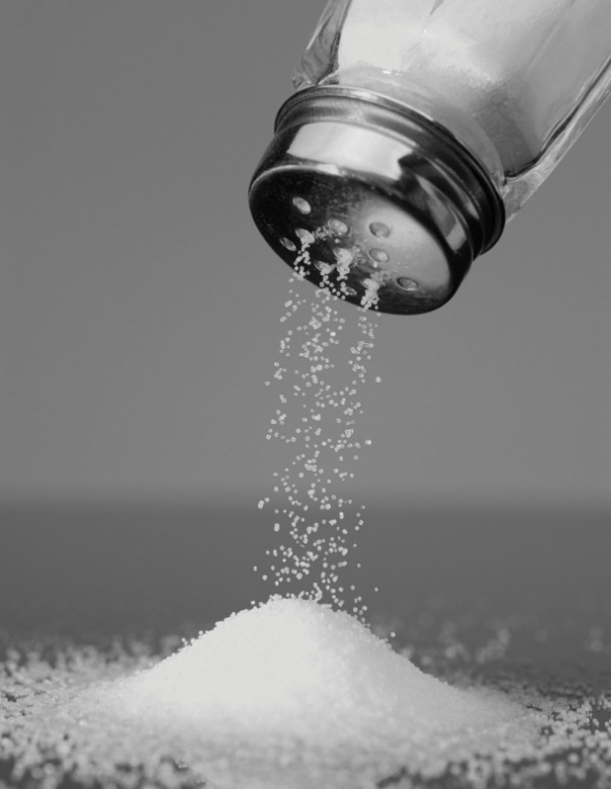
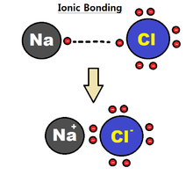
Ionic Bonds
Ionic Compounds
Solid and brittle at room temperature
High melting and boiling points
Many dissolve in water
Example
NaCl
Sodium and chlorine = table salt

Slide 36
Covalent vs Ionic
Covalent
Between nonmetal atoms
Form molecules
Sharing of electrons
Ionic
Between nonmetal and metal atoms
No molecules
Attraction between positive and negative ions
Transfer of electrons

Slide 37
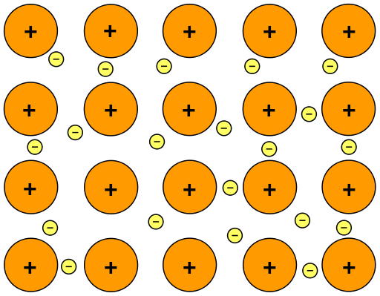
Metallic Bonds
A bond formed when many metal atoms share their pooled valence electrons and brittle at room temperature
Valence electrons not bonded to one atom
“Sea of electrons” surrounds positive ions
Compounds formed have properties of metals
Example
Aluminum

