Slide 1
Organization

Slide 2
How do you think the system used to organize where people live is similar to how your body is organized?
Continent
Country
State
County
City
Cells
Tissue
Organ
Organ System
Organism

Slide 3
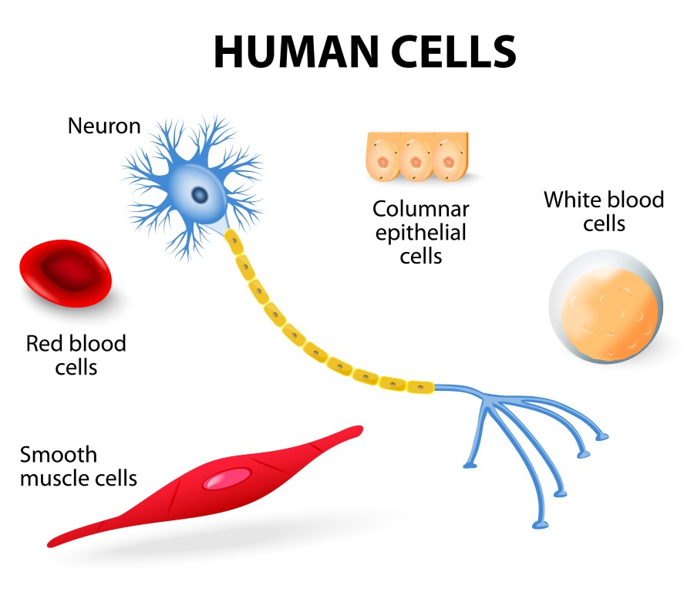
Levels of Organization
Cell
Work together to perform jobs in an organism
Cell Differentiation
Process by which cells become different types of cells

Slide 4
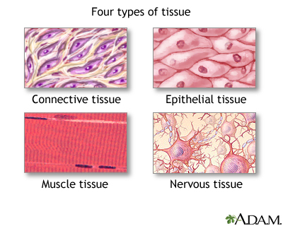
Levels of Organization
Tissue
Groups of similar cells that work together to carry out a specific task
EX: muscle tissue

Slide 5
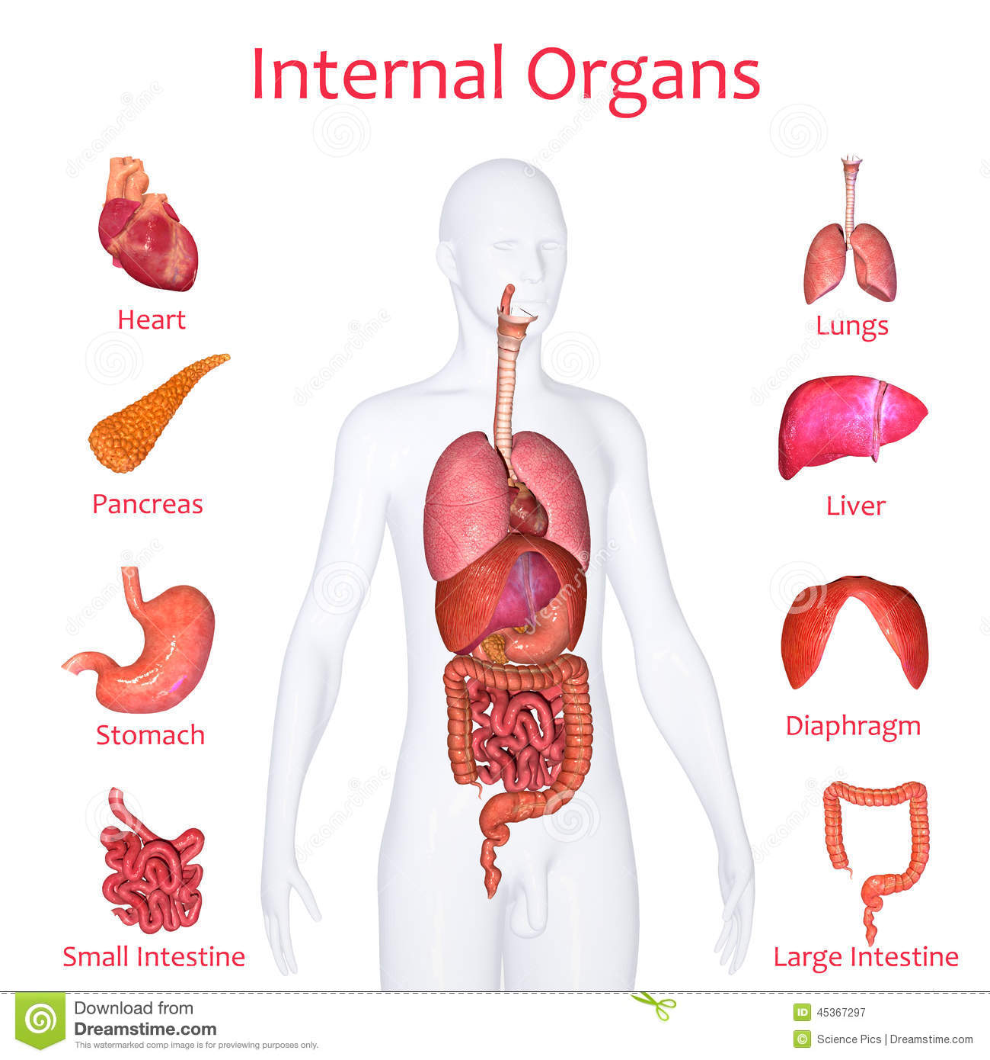
Levels of Organization
Organs
Groups of different tissues that work together to complete a series of tasks
EX: heart, lungs

Slide 6
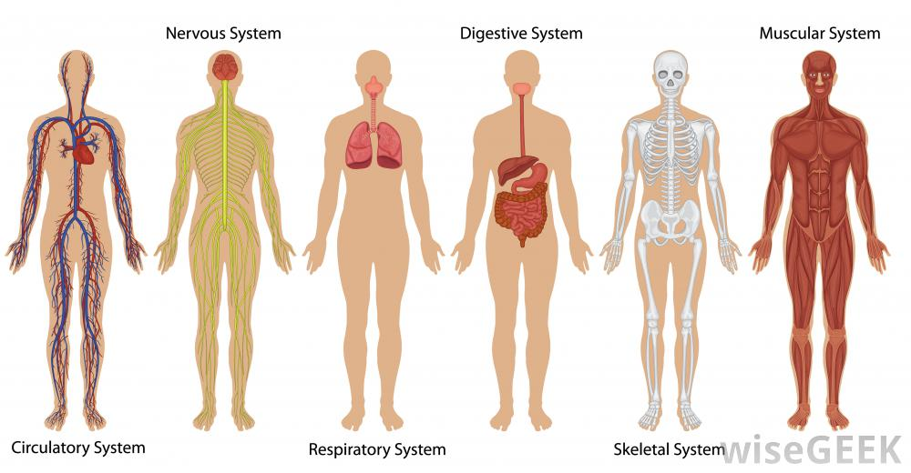
Levels of Organization
Organ System
Groups of different organs working together to complete a series of tasks

Slide 7
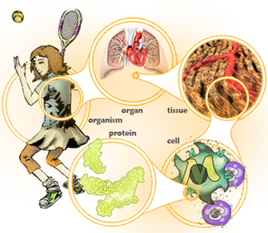
Levels of Organization
Organism
Organ systems work together to complete jobs needed for survival

Slide 8
Cell Cycle

Slide 9
Cell Cycle
Cycle of growth, development, and division of cells
As a result of the cell cycle, you end up with two daughter cells that are identical to the original cell.

Slide 10
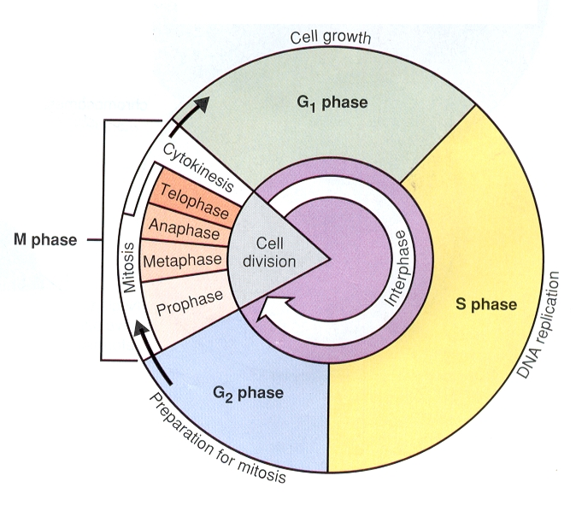
Phases of the Cell Cycle
Interphase
Period during the cell’s cycle of a cell’s growth and development
Three phases:
G₁--Rapid growth and replication
of the organelles
S--Copying of DNA
G₂--Preparation for cell division

Slide 11
Phases of the Cell Cycle
Interphase
G₁
Cell gets bigger
Cell continues normal jobs
Cell makes extra proteins

Slide 12
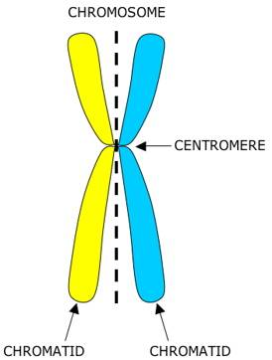
Phases of the Cell Cycle
Interphase
S
Create identical strands of DNA
Strands form chromosomes which are arranged as identical pairs called sister chromatids (duplicated chromosomes)
Held together by centromeres

Slide 13
Phases of the Cell Cycle
Interphase
G₂
Cell grows
Cell prepares for mitosis
Cell stores energy

Slide 14
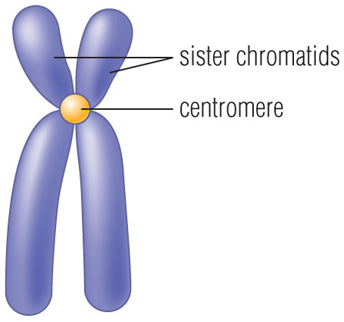
Phases of the Cell Cycle
Mitotic phase
Mitosis
Nucleus and its contents divide
Form two identical nuclei
Sister chromatids separate and become chromosomes

Slide 16
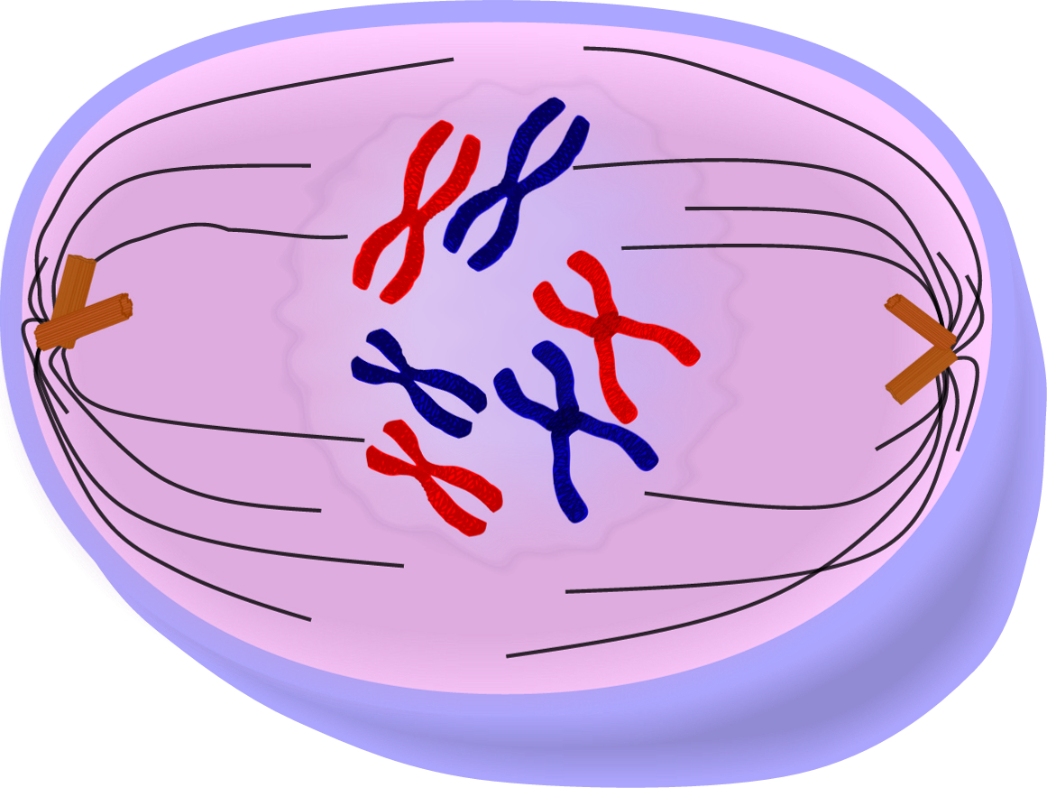
Phases of the Cell Cycle
Mitotic phase
Phases of Mitosis
Prophase
Copied DNA condenses into chromosomes
The nucleolus disappears
The nuclear membrane breaks down
Spindle fibers begin to form

Slide 17
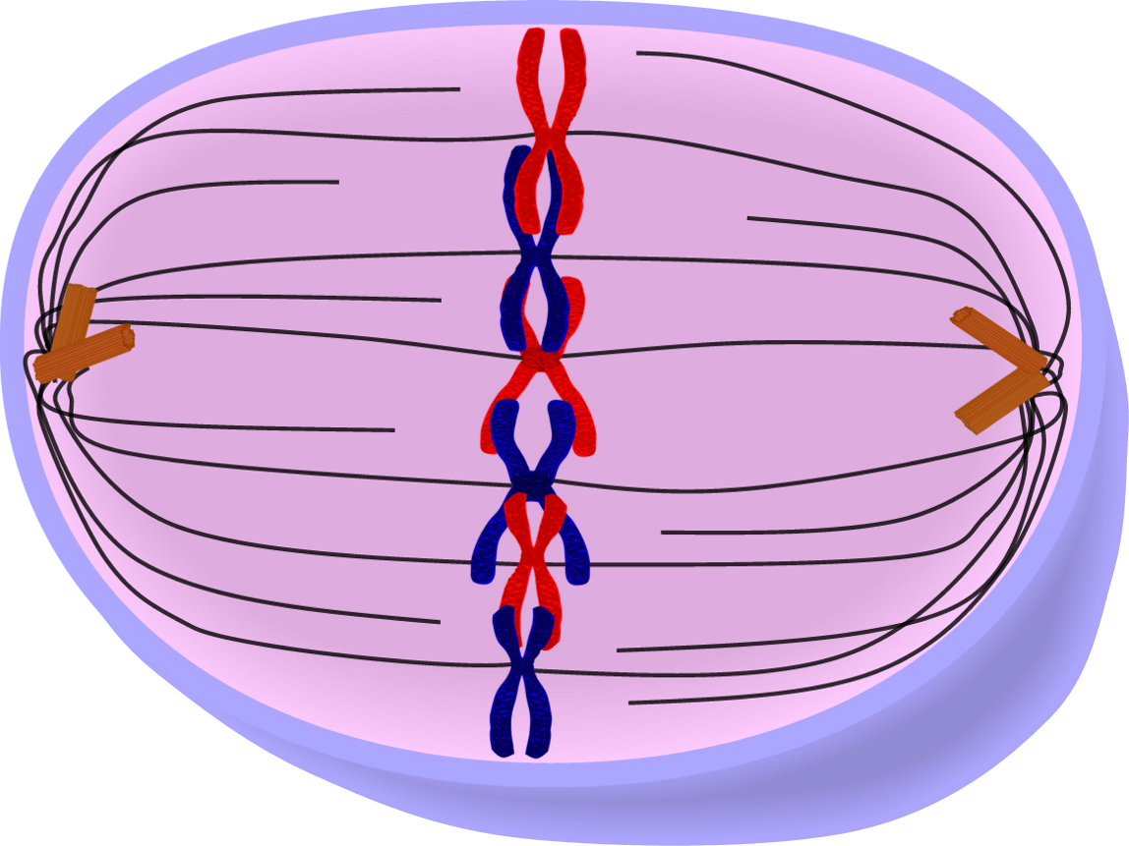
Phases of the Cell Cycle
Mitotic phase
Phases of Mitosis
Metaphase
Chromosomes line up in single file at the middle of the cell

Slide 18
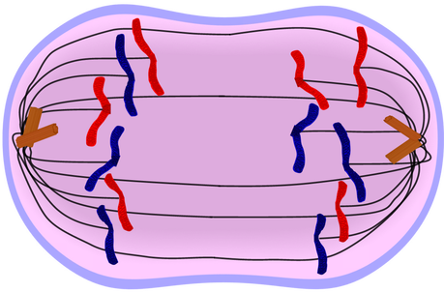
Phases of the Cell Cycle
Mitotic phase
Phases of Mitosis
Anaphase
Sister chromatids separate
Spindle fibers begin to shorten
Chromatids pulled toward the opposite sides of the cell
The cell begins to lengthen

Slide 19
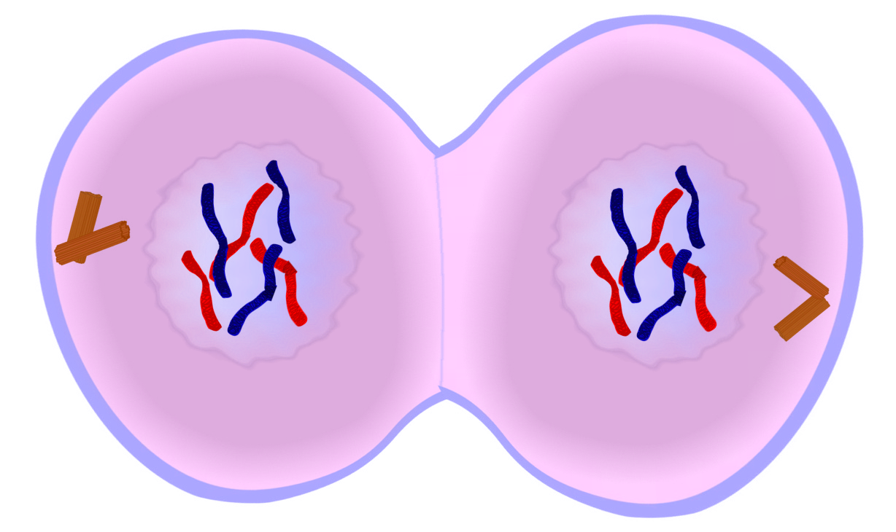
Phases of the Cell Cycle
Mitotic phase
Phases of Mitosis
Telophase
A nuclear membrane forms around the chromatin
Chromosomes begin to unwind
Spindle fibers begin to break down
Two identical nuclei form

Slide 20
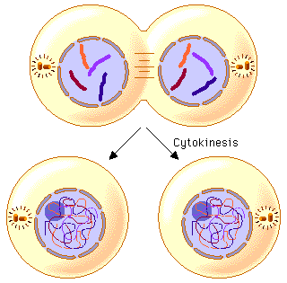
Phases of the Cell Cycle
Mitotic phase
Cytokinesis
Cytoplasm and its contents separate
Forms two daughter cells

Slide 22
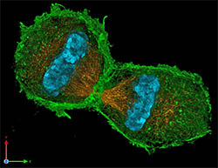
Importance of Cell Division
Growth
Multicellular organisms need to grow and develop
Replacement
Replace worn out or damaged cells
Repair
Repair damage to cells
Reproduction
Unicellular organisms only

