Slide 1
Absolute
Age
Dating

Slide 2
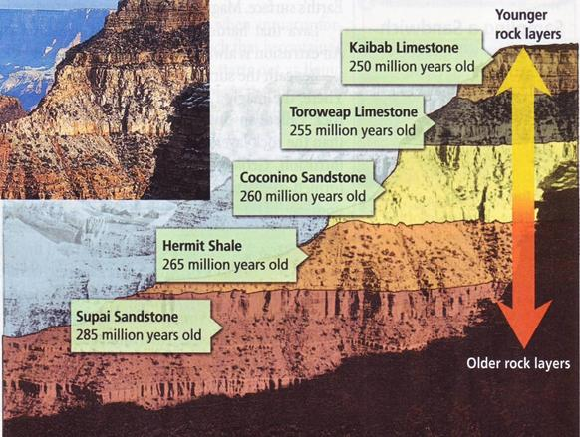
Absolute age
The numerical age in years of a rock or object

Slide 3
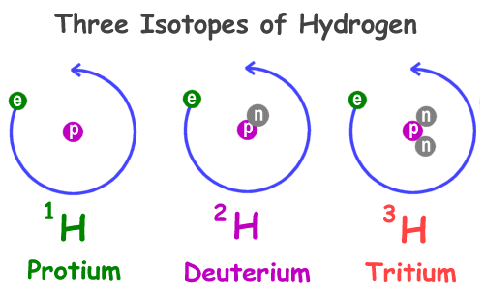
Absolute age
Isotope
Atoms of the same element that have different numbers of neutrons
Hydrogen | Hydrogen-2 | Hydrogen-3

Slide 4
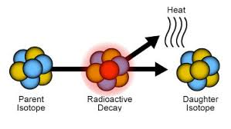
Absolute age
Radioactive Isotopes
Radioactive Decay
Process by which an unstable element naturally changes into another element that is stable
Radioactive isotopes decay at a constant rate

Slide 5
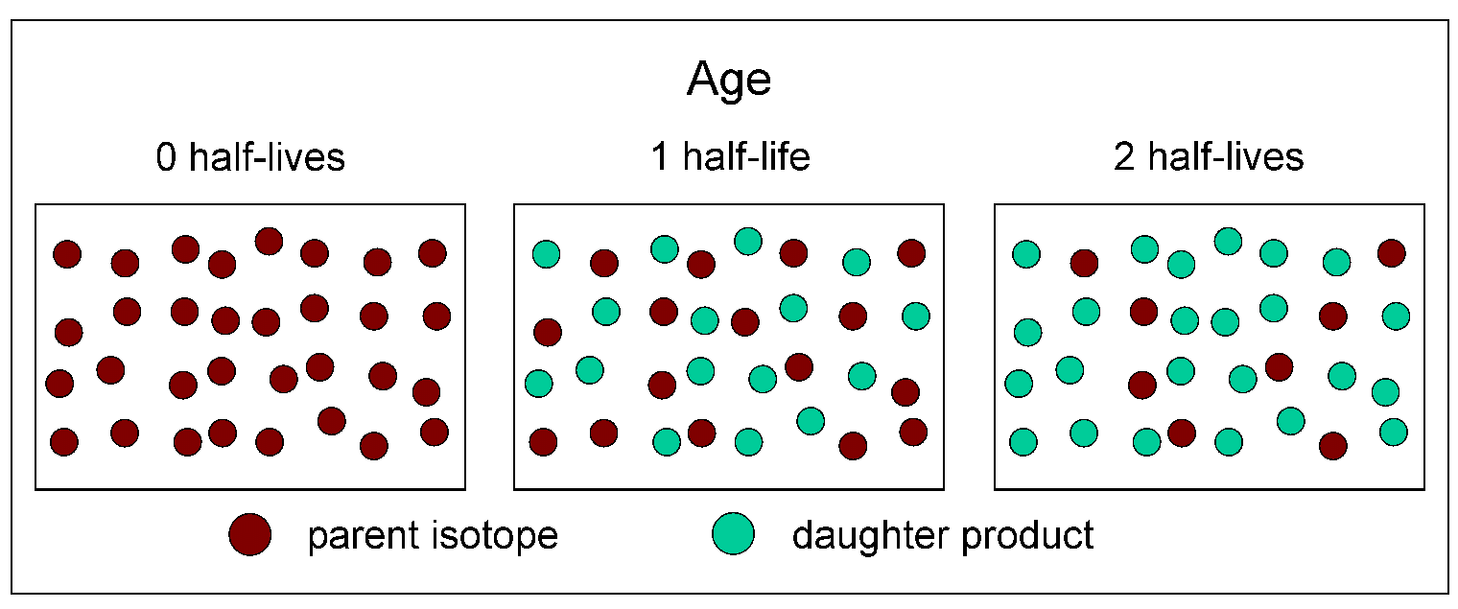
Absolute age
Radioactive Isotopes
Half-Life
Time required for half the parent isotope to decay into daughter isotopes

Slide 6
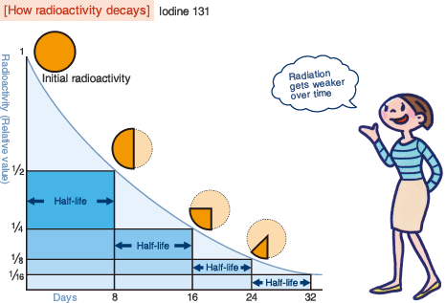

Slide 7
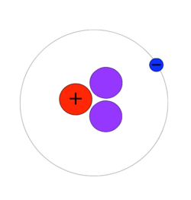
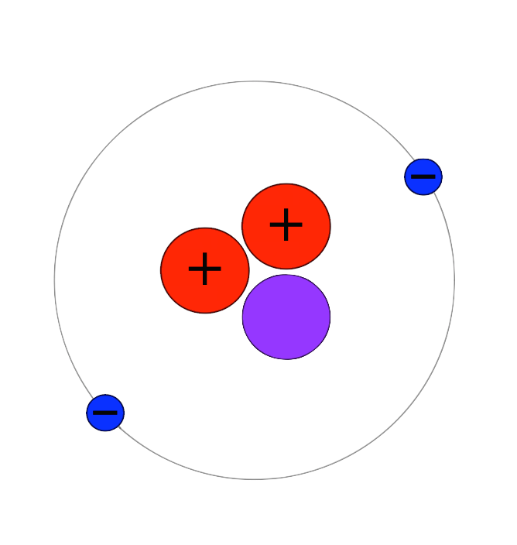
Absolute age
Released Energy
Radioactive Isotopes
Process of Radioactive Decay
Radioactive isotopes=unstable
Decay (change) over time
As they decay, they release energy
Form new, stable isotopes
Hydrogen-3 | Helium-3
Unstable due to an extra neutron | Extra neutron decays into a proton
Parent | Daughter

Slide 8
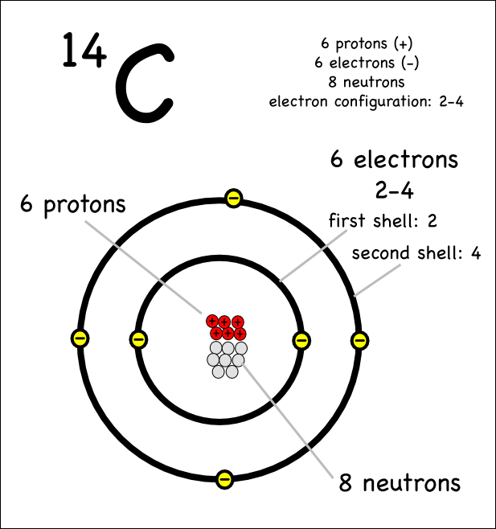
Absolute age
Carbon-14 (C-14))
6 protons, 8 neutrons

Slide 9
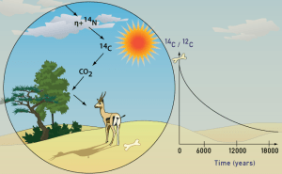
Absolute age
Radiocarbon Dating
For organic materials only
In a live organism, C-14 (unstable) decays to C-12 (stable)

Slide 10
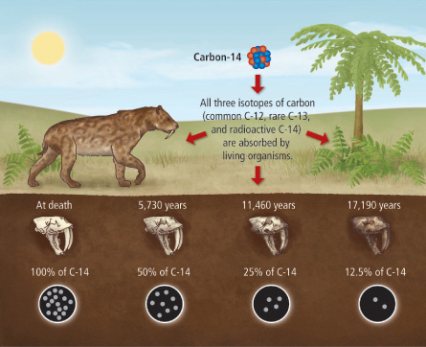
Absolute age
Radiocarbon Dating
In dead organisms, C-14 decays to N-14
Measure ratio of C-14 to N-14
For remains under 60,000 years old
In remains older, not enough C-14 is left to measure accurately

Slide 11
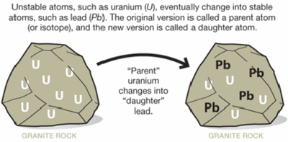
Absolute age
Radiocarbon Dating
Uranium-235 (U-235)
Igneous Rock
U-235 trapped in minerals
Decays to Pb-207 (lead)
Measure ratio of U-235 to PB-207

Slide 12
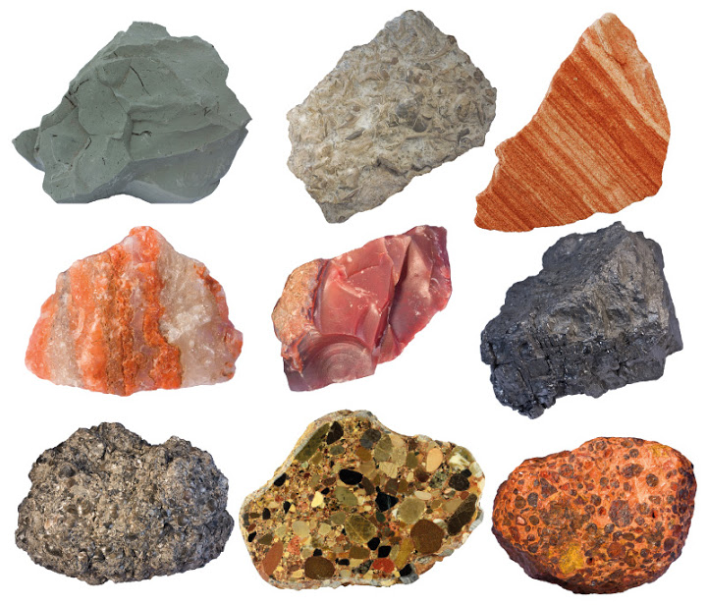
Absolute age
Radiocarbon Dating
Uranium-235 (U-235)
Sedimentary Rock
Harder to date with U-235
Grains come from various areas and were formed at different times
Age would be for one grain, not whole rock

Slide 13
Absolute age
Radiocarbon Dating
Earth’s Age
4.54 billion years old
Based on radiometric dating of moon and meteorites

